Slide 1
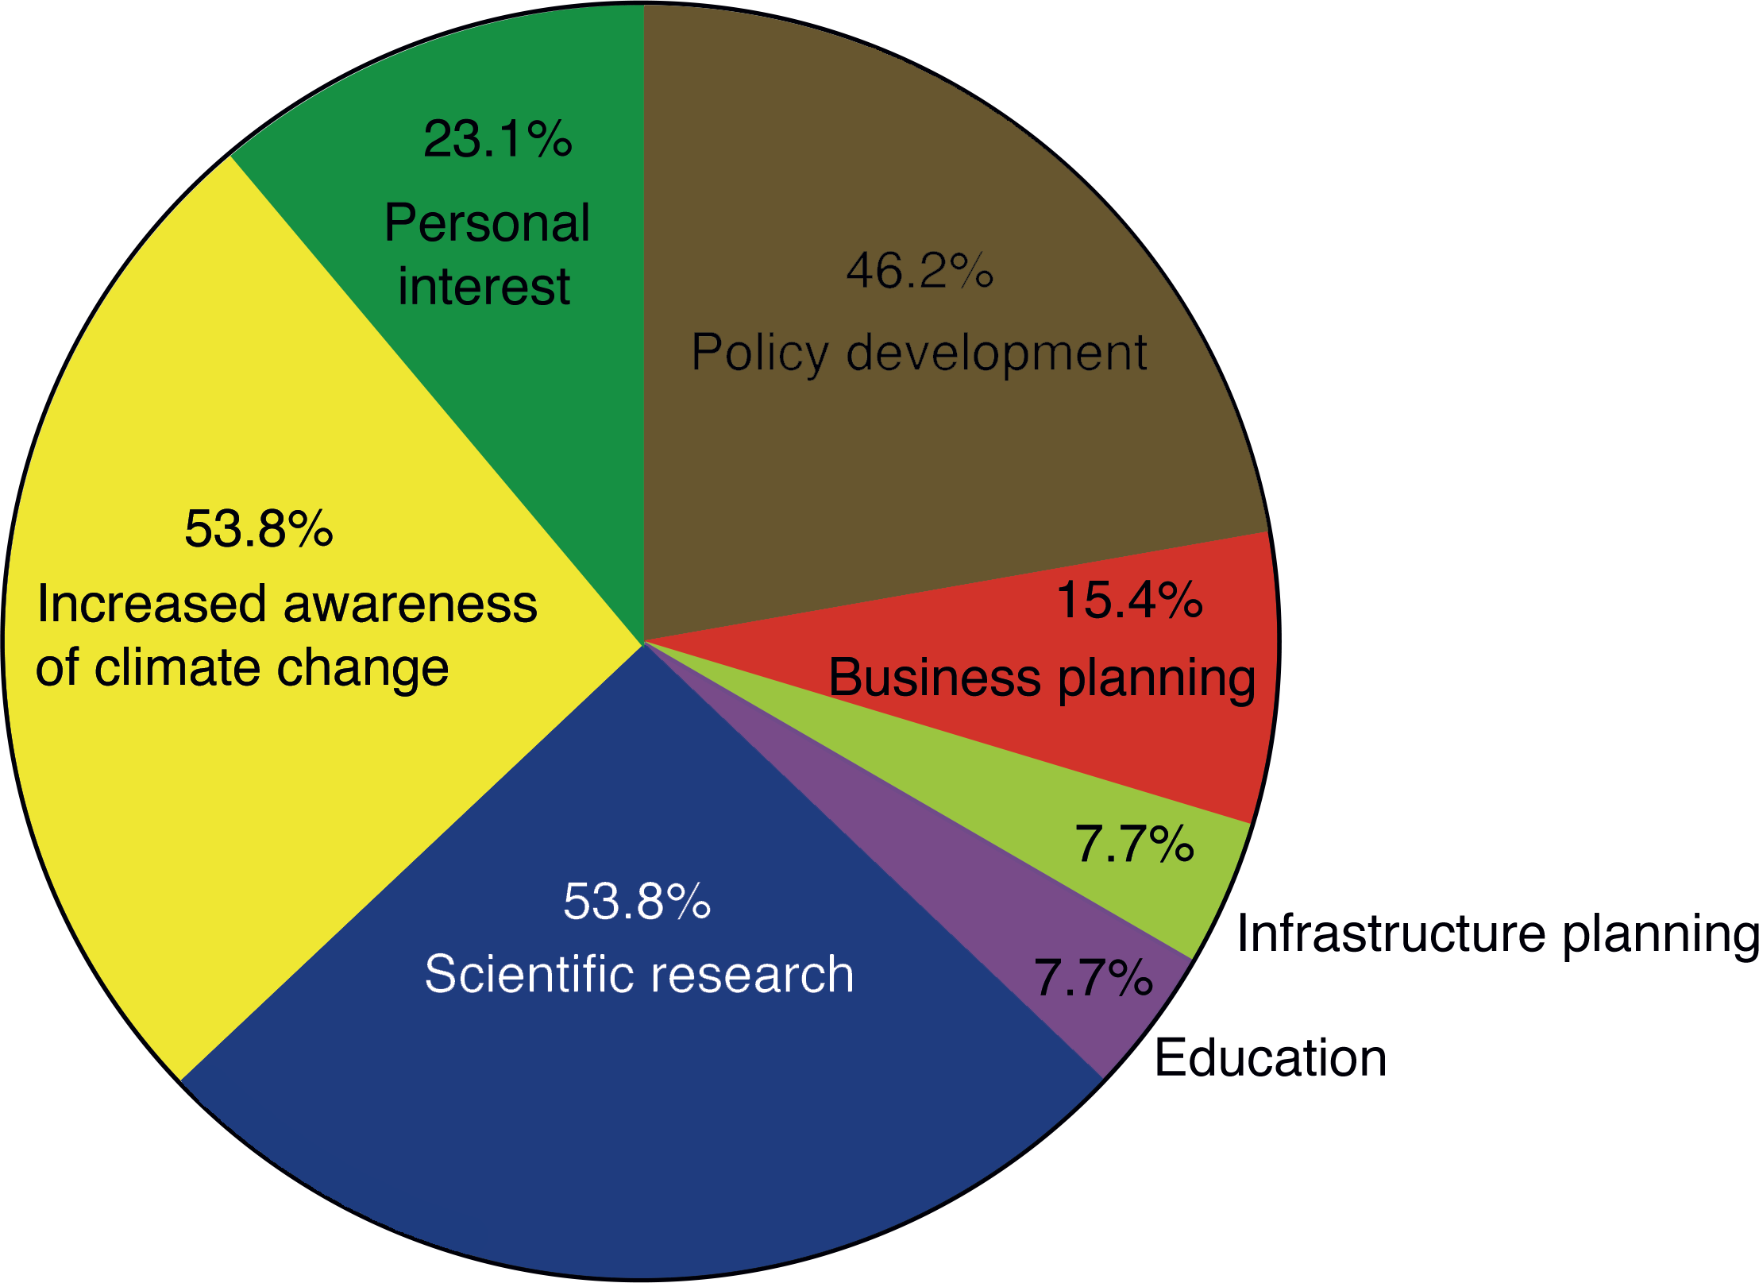
Thing H (2012) PAGES news 20(3): 112
Figure 1
Notes:
Past4Future stakeholder survey
Henning Thing
Centre for Ice and Climate, Niels Bohr Institute, University of Copenhagen; thing@gfy.ku.dk

Slide 2
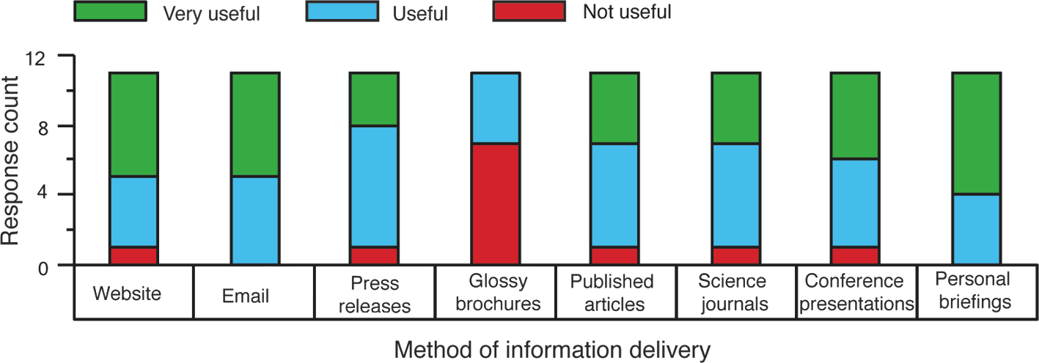
Thing H (2012) PAGES news 20(3): 112
Figure 2
Notes:
Past4Future stakeholder survey
Henning Thing
Centre for Ice and Climate, Niels Bohr Institute, University of Copenhagen; thing@gfy.ku.dk

Slide 3
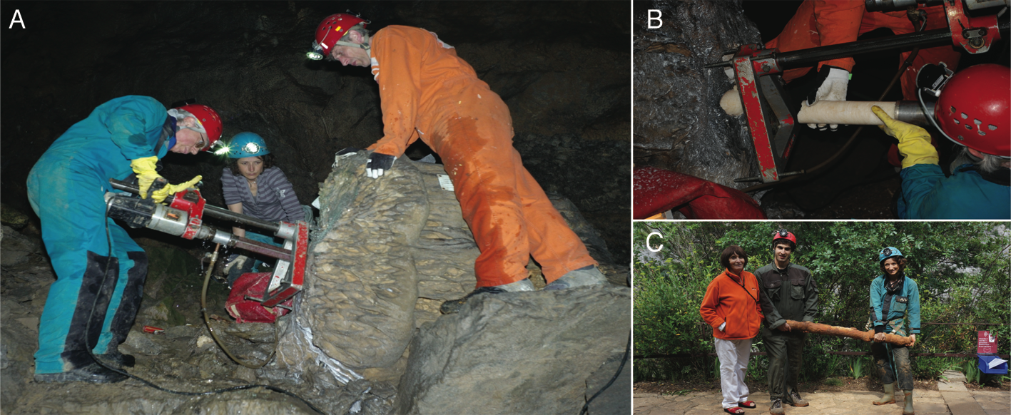
Verheyden S, Genty D (2012) PAGES news 20(3): 113
Figure 1
Notes:
Lifting the veil on speleothem sampling
Sophie Verheyden¹ and Dominique Genty²
¹Geological Survey, Royal Belgian Institute of Natural Sciences, Belgium; sophie.verheyden@naturalsciences.be
²Laboratoire des Sciences du Climat et de l’Environnement, CEA Saclay, Gif-sur-Yvette, France

Slide 4
Steffensen JP (2012) PAGES news 20(3): 114-115
Figure 1: A) Photo: J.P. Steffensen, B) Photo: T. Burton
Notes:
Drilling a deep ice core at the NEEM site (Greenland)
Jørgen P. Steffensen
Centre for Ice and Climate, Niels Bohr Institute, University of Copenhagen; jps@gfy.ku.dk

Slide 5
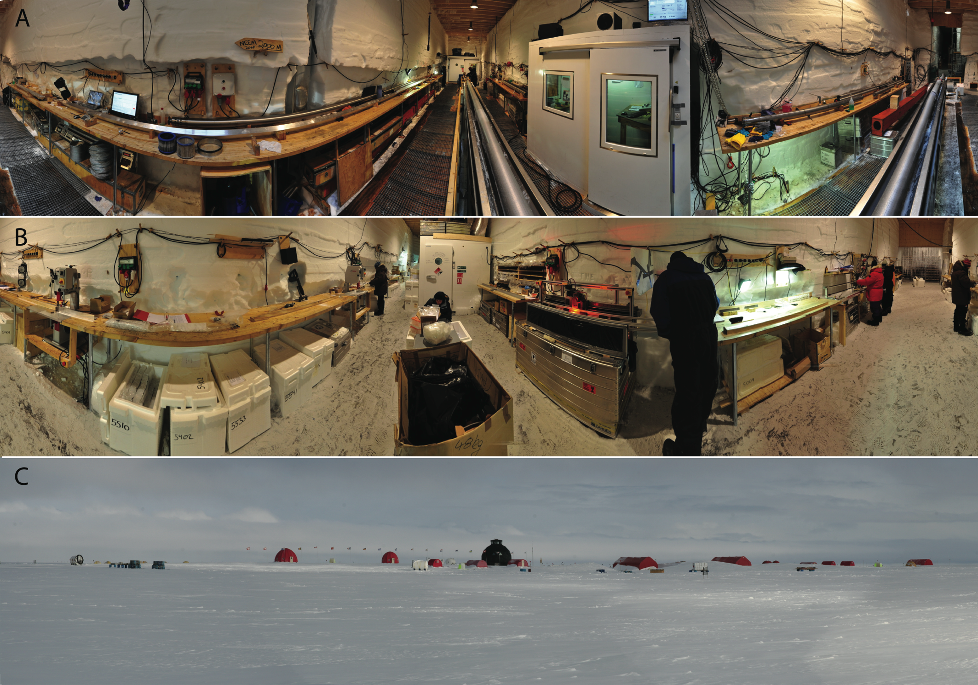
Steffensen JP (2012) PAGES news 20(3): 114-115
Figure 2: A) Photo: M. Leonhardt and J.P. Steffensen.
B) Photo: M. Leonhardt and J.P. Steffensen. C) Photo: J.P. Steffensen
Notes:
Drilling a deep ice core at the NEEM site (Greenland)
Jørgen P. Steffensen
Centre for Ice and Climate, Niels Bohr Institute, University of Copenhagen; jps@gfy.ku.dk

Slide 6
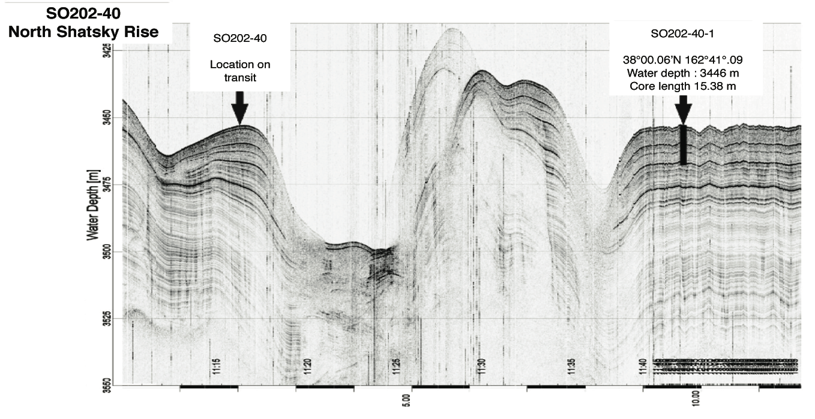
Gersonde R, Seidenkrantz M-S (2012) PAGES news 20(3): 116-117
Figure 1 from Gersonde R (2012) Reports on Polar and
Marine Research 643, doi: 10013/epic.38996
Notes:
Sampling marine sediment
Rainer Gersonde¹ and Marit-Solveig Seidenkrantz²
¹Alfred-Wegener-Institute for Polar and Marine Research, Bremerhaven, Germany; Rainer.Gersonde@awi.de
²Centre for Past Climate Studies, Department of Geoscience, Aarhus University, Denmark

Slide 7
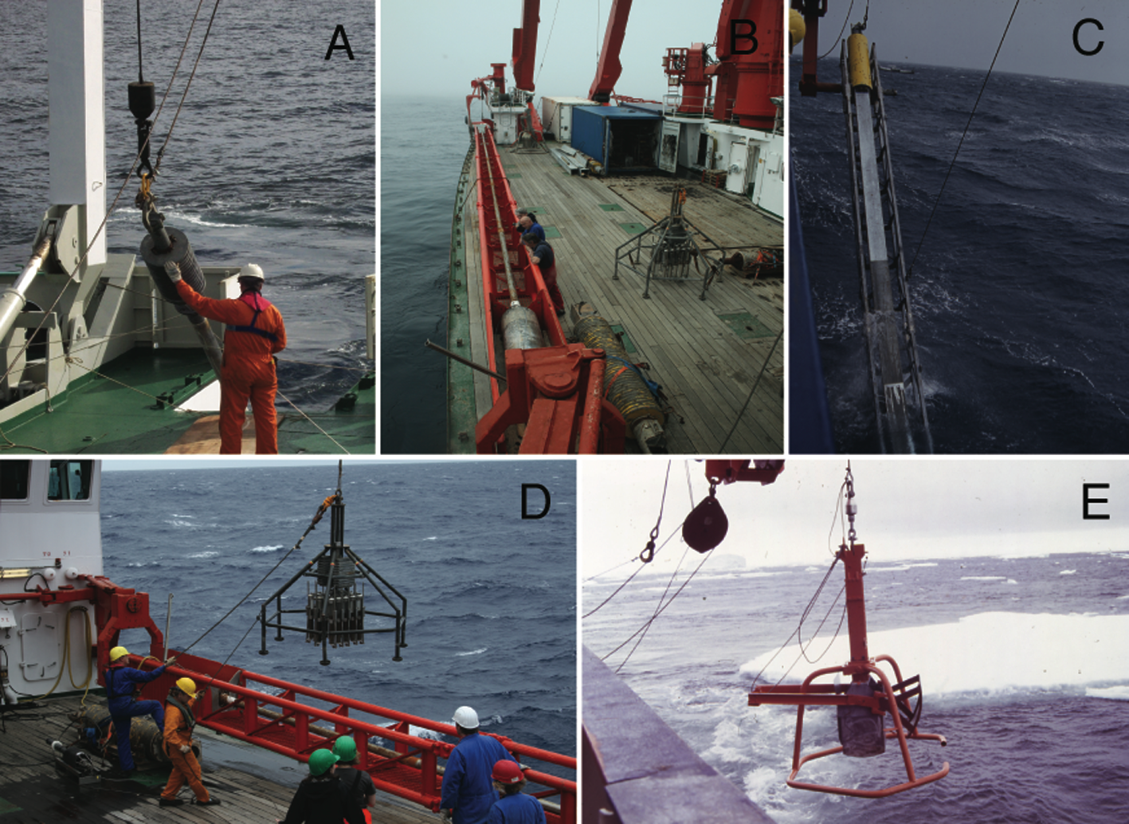
Gersonde R, Seidenkrantz M-S (2012) PAGES news 20(3): 116-117
Figure 2: A) Photo: A.K. Gunvald. B) Photo: B. Diekmann.
C) Photo: B. Diekmann. D) Photo: M. Winterfeld.
E) Photo: R. Gersonde
Notes:
Sampling marine sediment
Rainer Gersonde¹ and Marit-Solveig Seidenkrantz²
¹Alfred-Wegener-Institute for Polar and Marine Research, Bremerhaven, Germany; Rainer.Gersonde@awi.de
²Centre for Past Climate Studies, Department of Geoscience, Aarhus University, Denmark

Slide 8
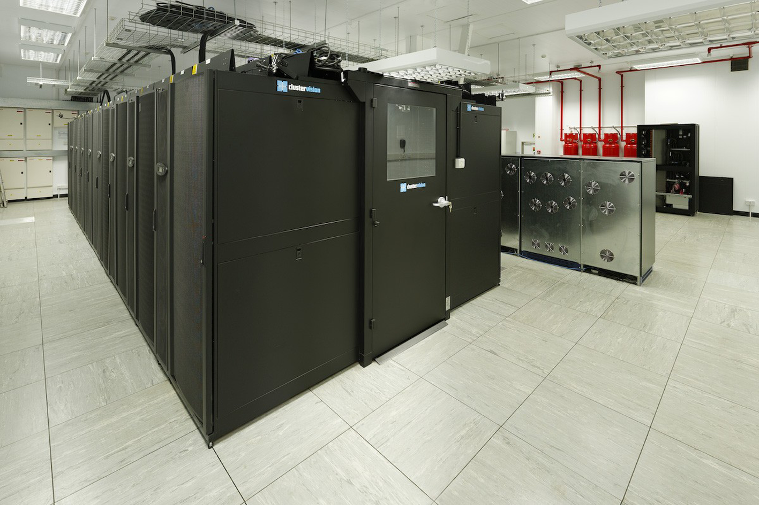
Stone EJ et al. (2012) PAGES news 20(3): 118-119
Figure 1: Photo: Timo Kunkel
Notes:
Insights into paleoclimate modeling
Emma J. Stone¹, P. Bakker², S. Charbit³, S.P. Ritz⁴ and V. Varma⁵
¹School of Geographical Sciences, University of Bristol, UK; emma.j.stone@bristol.ac.uk
²Earth & Climate Cluster, Department of Earth Sciences, Vrije Universiteit Amsterdam, The Netherlands; ³Laboratoire des Sciences du Climat et de l'Environnement, CEA Saclay, Gif-sur-Yvette, France; ⁴Climate and Environmental Physics, Physics Institute and Oeschger Centre for Climate Change Research, University of Bern, Switzerland; ⁵Center for Marine Environmental Sciences and Faculty of Geosciences, University of Bremen, Germany

Slide 9
Andresen CS et al. (2012) PAGES news 20(3): 120-121
Figure 1: A) from: Straneo F et al. (2012), Annals of Glaciology 53: 202-210.
B) and (C) from:
Andresen CS et al. (2012) Nature Geoscience 5: 37-41.
Notes:
Using marine sediment archives to reconstruct past outlet glacier variability
Camilla S. Andresen¹, F. Straneo², M.H. Ribergaard³, A.A. Bjørk⁴, A. Kuijpers¹ and K.H. Kjær⁴
¹Geological Survey of Denmark and Greenland, Department of Marine Geology and Glaciology, Denmark; csa@geus.dk
²Department of Physical Oceanography, Woods Hole Oceanographic Institution, USA; ³Danish Meteorological Institute, Centre for Ocean and Ice, Denmark; ⁴Centre for GeoGenetics, Natural History Museum, Denmark

Slide 10
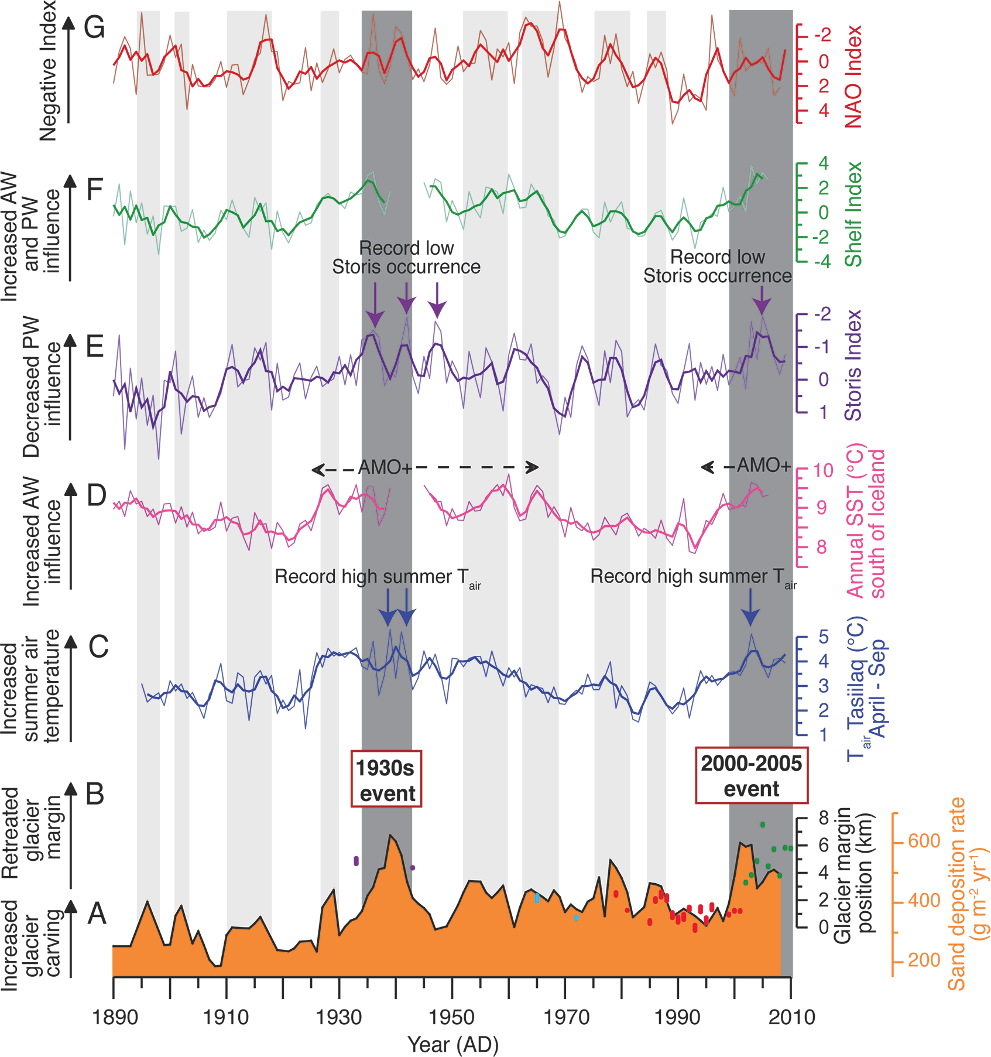
Andresen CS et al. (2012) PAGES news 20(3): 120-121
Figure 2: modified from Andresen CS et al. (2012) Nature Geoscience 5: 37-41.
Notes:
Using marine sediment archives to reconstruct past outlet glacier variability
Camilla S. Andresen¹, F. Straneo², M.H. Ribergaard³, A.A. Bjørk⁴, A. Kuijpers¹ and K.H. Kjær⁴
¹Geological Survey of Denmark and Greenland, Department of Marine Geology and Glaciology, Denmark; csa@geus.dk
²Department of Physical Oceanography, Woods Hole Oceanographic Institution, USA; ³Danish Meteorological Institute, Centre for Ocean and Ice, Denmark; ⁴Centre for GeoGenetics, Natural History Museum, Denmark

Slide 11
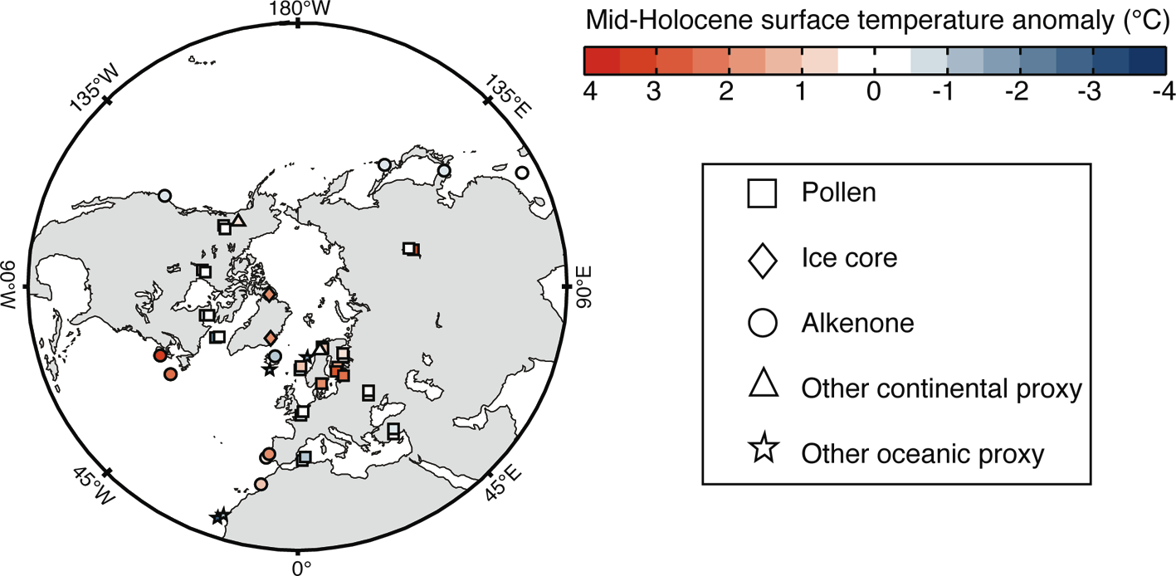
Mairesse A, Goosse H (2012) PAGES news 20(3): 122-123
Figure 1
Notes:
Using data assimilation to estimate the consistency between different climate proxies and a climate model results
Aurélien Mairesse and Hugues Goosse
Georges Lemaître Centre for Earth and Climate Research, Earth and Life Institute, Université catholique de Louvain, Belgium; aurelien.mairesse@uclouvain.be

Slide 12
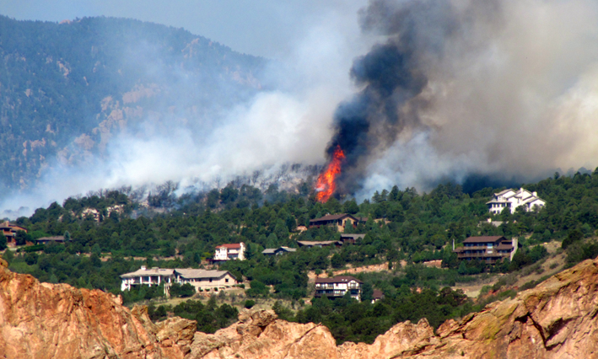
Kehrwald N, Zennaro P, Barbante C (2012) PAGES news 20(3): 124-125
Figure 1: Photo: Erica Rewey
Notes:
Increasing fire activity in a warming climate? Ice core record insights from the present and the last interglacials
Natalie Kehrwald¹, P. Zennaro^{1,2} and C. Barbante^{1,2}
¹Department of Environmental Sciences, Informatics and Statistics, University of Venice, Italy; kehrwald@unive.it
²Institute for the Dynamics of Environmental Processes, Consiglio Nazionale delle Ricerche, Venice, Italy

Slide 13
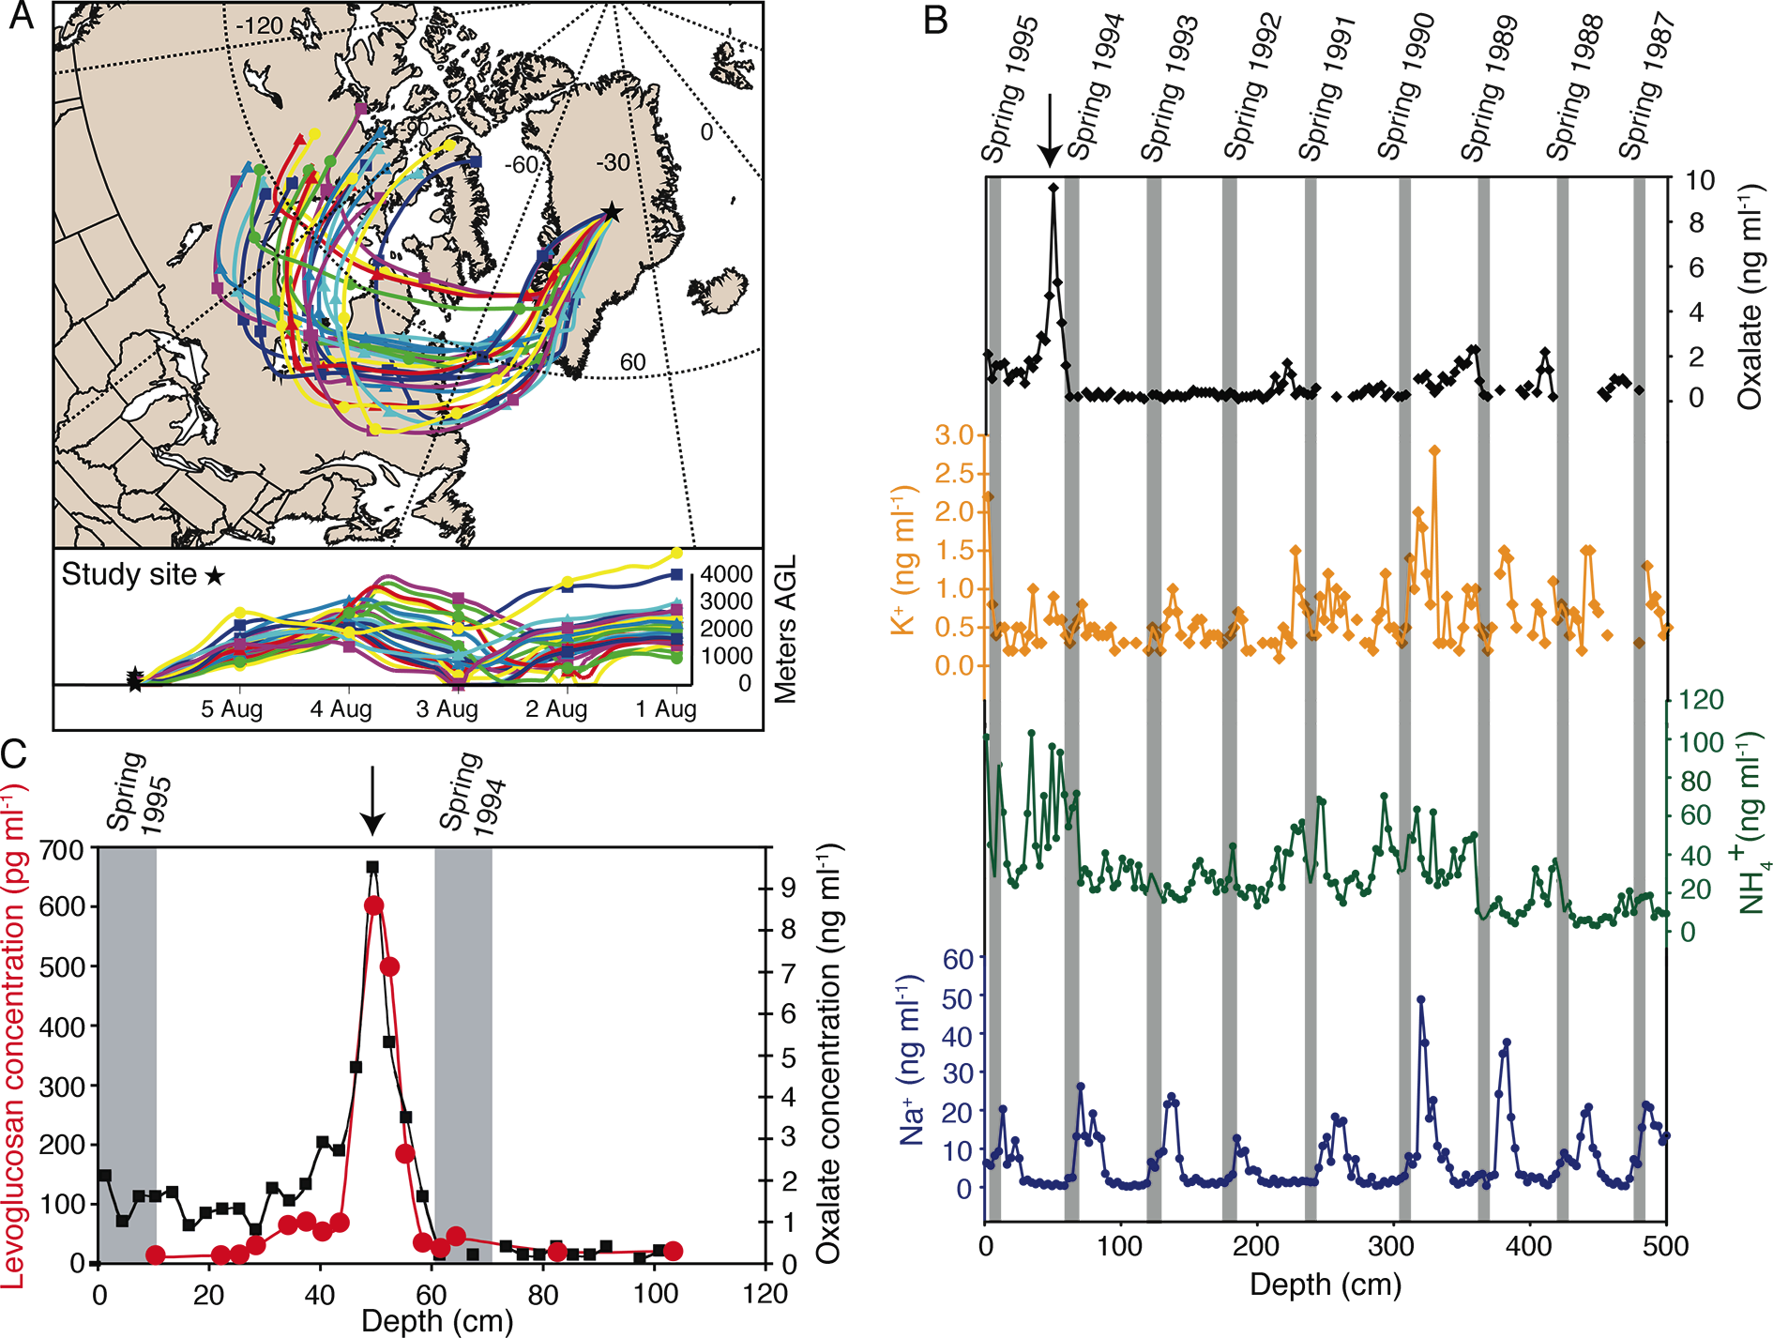
Kehrwald N, Zennaro P, Barbante C (2012) PAGES news 20(3): 124-125
Figure 1: Modified from Kehrwald N et al. (2012) Tellus B 64,
doi: http://dx.doi.org/10.3402/tellusb.v64i0.18196
Notes:
Increasing fire activity in a warming climate? Ice core record insights from the present and the last interglacials
Natalie Kehrwald¹, P. Zennaro^{1,2} and C. Barbante^{1,2}
¹Department of Environmental Sciences, Informatics and Statistics, University of Venice, Italy; kehrwald@unive.it
²Institute for the Dynamics of Environmental Processes, Consiglio Nazionale delle Ricerche, Venice, Italy

Slide 14
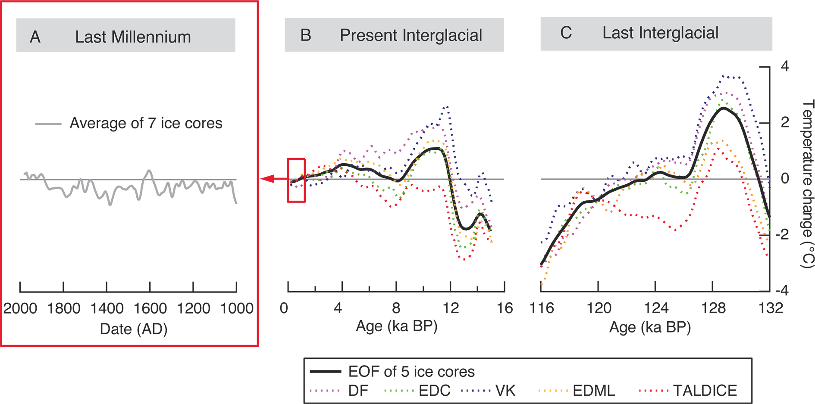
Masson-Delmotte et al. (2012) PAGES news 20(3): 126-127
Figure 1
Notes:
Antarctic interglacial climate variability and implications for changes in ice sheet topography
Valérie Masson-Delmotte¹, E. Capron², H. Goosse³, K. Pol², M. Siddall⁴, L. Sime², S. Bradley⁴ and B. Stenni⁵
¹Laboratoire des Sciences du Climat et de l’Environnement, CEA Saclay, Gif-sur-Yvette, France; valerie.masson@lsce.ipsl.fr
²British Antarctic Survey, Cambridge, UK; ³Georges Lemaître Centre for Earth and Climate Research, Earth and Life Institute, Université catholique de Louvain, Belgium; ⁴Department of Earth Sciences, University of Bristol, UK; ⁵Department of Geological, Environmental and Marine Sciences, University of Trieste, Trieste, Italy

Slide 15
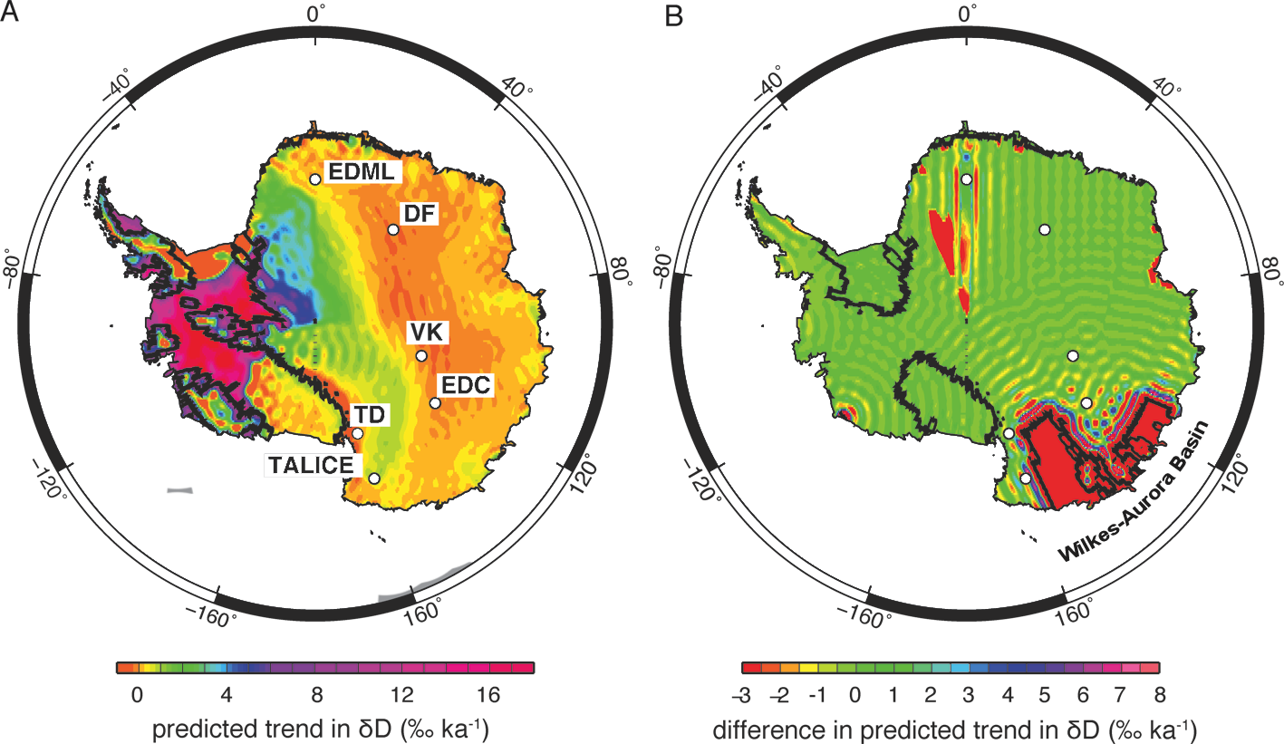
Masson-Delmotte et al. (2012) PAGES news 20(3): 126-127
Figure 2: A) Modified from Bradley SL et al. (2012) Global and Planetary Change 88-89: 64-75, B) Modified from:
Bradley SL et al. (2013) Global and Planetary Change 100: 278-290
Notes:
Antarctic interglacial climate variability and implications for changes in ice sheet topography
Valérie Masson-Delmotte¹, E. Capron², H. Goosse³, K. Pol², M. Siddall⁴, L. Sime², S. Bradley⁴ and B. Stenni⁵
¹Laboratoire des Sciences du Climat et de l’Environnement, CEA Saclay, Gif-sur-Yvette, France; valerie.masson@lsce.ipsl.fr
²British Antarctic Survey, Cambridge, UK; ³Georges Lemaître Centre for Earth and Climate Research, Earth and Life Institute, Université catholique de Louvain, Belgium; ⁴Department of Earth Sciences, University of Bristol, UK; ⁵Department of Geological, Environmental and Marine Sciences, University of Trieste, Trieste, Italy

Slide 16
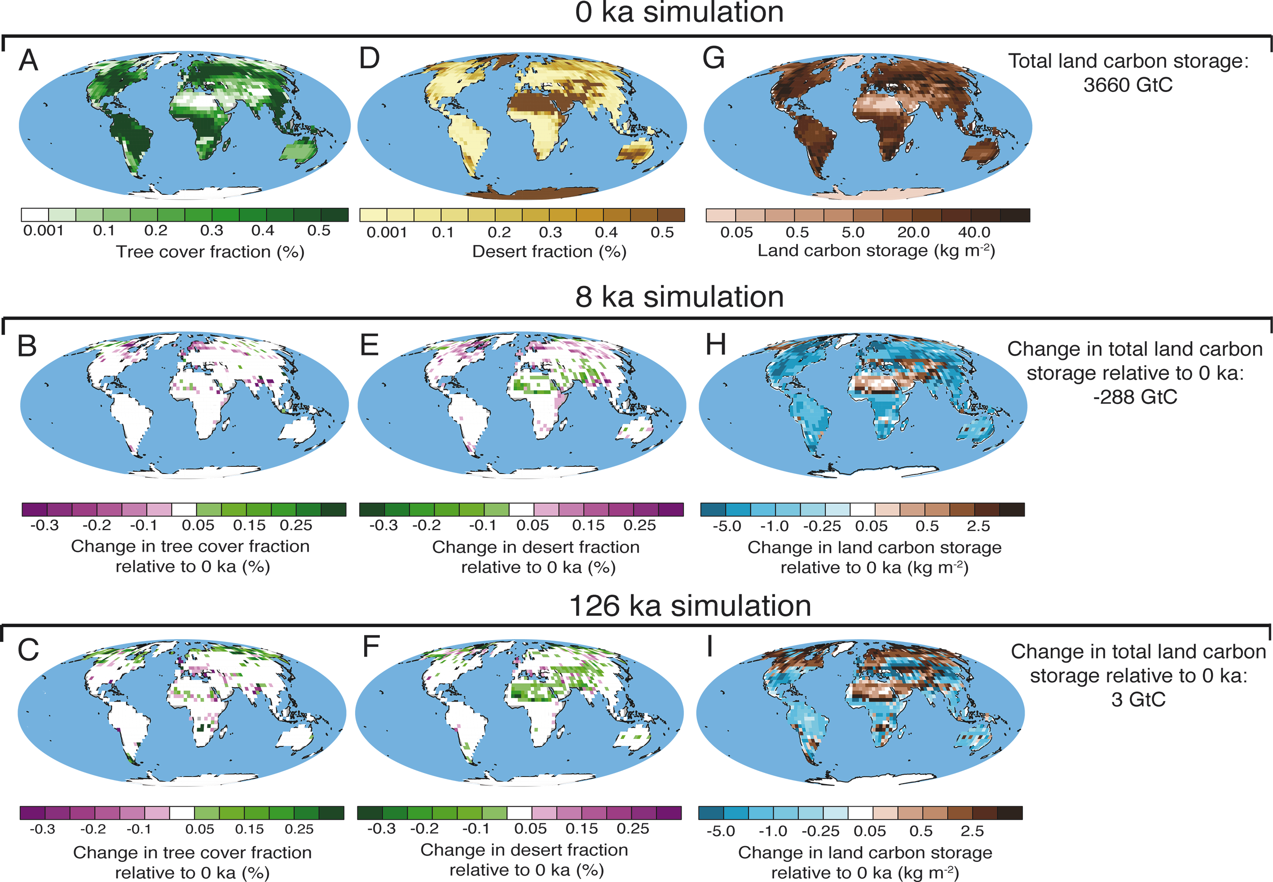
Brücher T, Brovkin V (2012) PAGES news 20(3): 128-129
Figure 1
Notes:
Land biosphere dynamics during the present and the last interglacials
Tim Brücher and Victor Brovkin
Max Planck Institute for Meteorology, Hamburg, Germany; tim.bruecher@zmaw.de

Slide 17
Brücher T, Brovkin V (2012) PAGES news 20(3): 128-129
Figure 2
Notes:
Land biosphere dynamics during the present and the last interglacials
Tim Brücher and Victor Brovkin
Max Planck Institute for Meteorology, Hamburg, Germany; tim.bruecher@zmaw.de

Slide 18
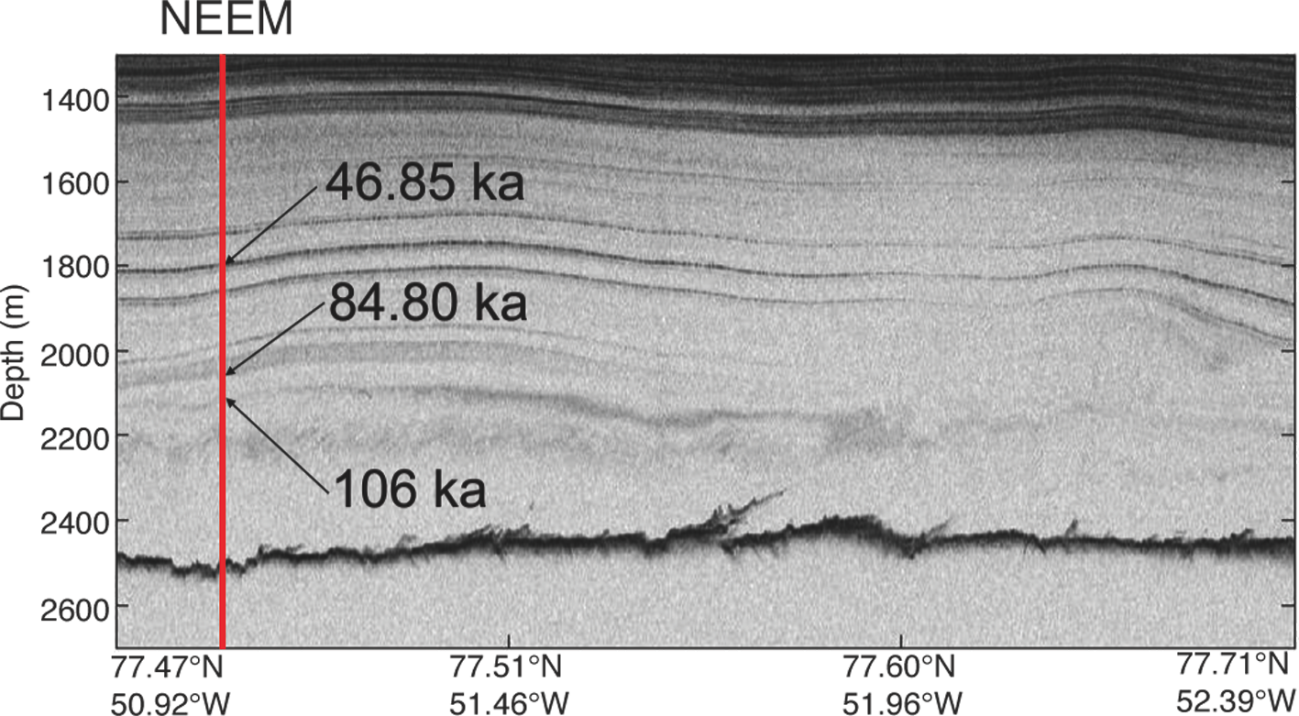
Dahl-Jensen D, Gogineni P, White JWC (2012) PAGES news 20(3): 130-131
Figure 1: from NEEM community members (2013)
Nature 493: 489-494
Notes:
Reconstruction of the last interglacial period from the NEEM ice core
Dorthe Dahl-Jensen¹, P. Gogineni² and J.W.C. White³
¹Centre for Ice and Climate, Niels Bohr Institute, University of Copenhagen, Denmark; ddj@gfy.ku.dk
²Centre for Remote Sensing Ice Sheets, University of Kansas, USA; 3INSTAAR, University of Colorado, USA

Slide 19
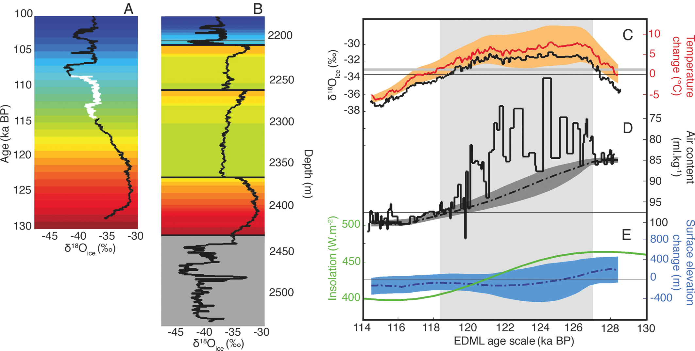
Dahl-Jensen D, Gogineni P, White JWC (2012) PAGES news 20(3): 130-131
Figure 1: from NEEM community members (2013)
Nature 493: 489-494
Notes:
Reconstruction of the last interglacial period from the NEEM ice core
Dorthe Dahl-Jensen¹, P. Gogineni² and J.W.C. White³
¹Centre for Ice and Climate, Niels Bohr Institute, University of Copenhagen, Denmark; ddj@gfy.ku.dk
²Centre for Remote Sensing Ice Sheets, University of Kansas, USA; 3INSTAAR, University of Colorado, USA

Slide 20
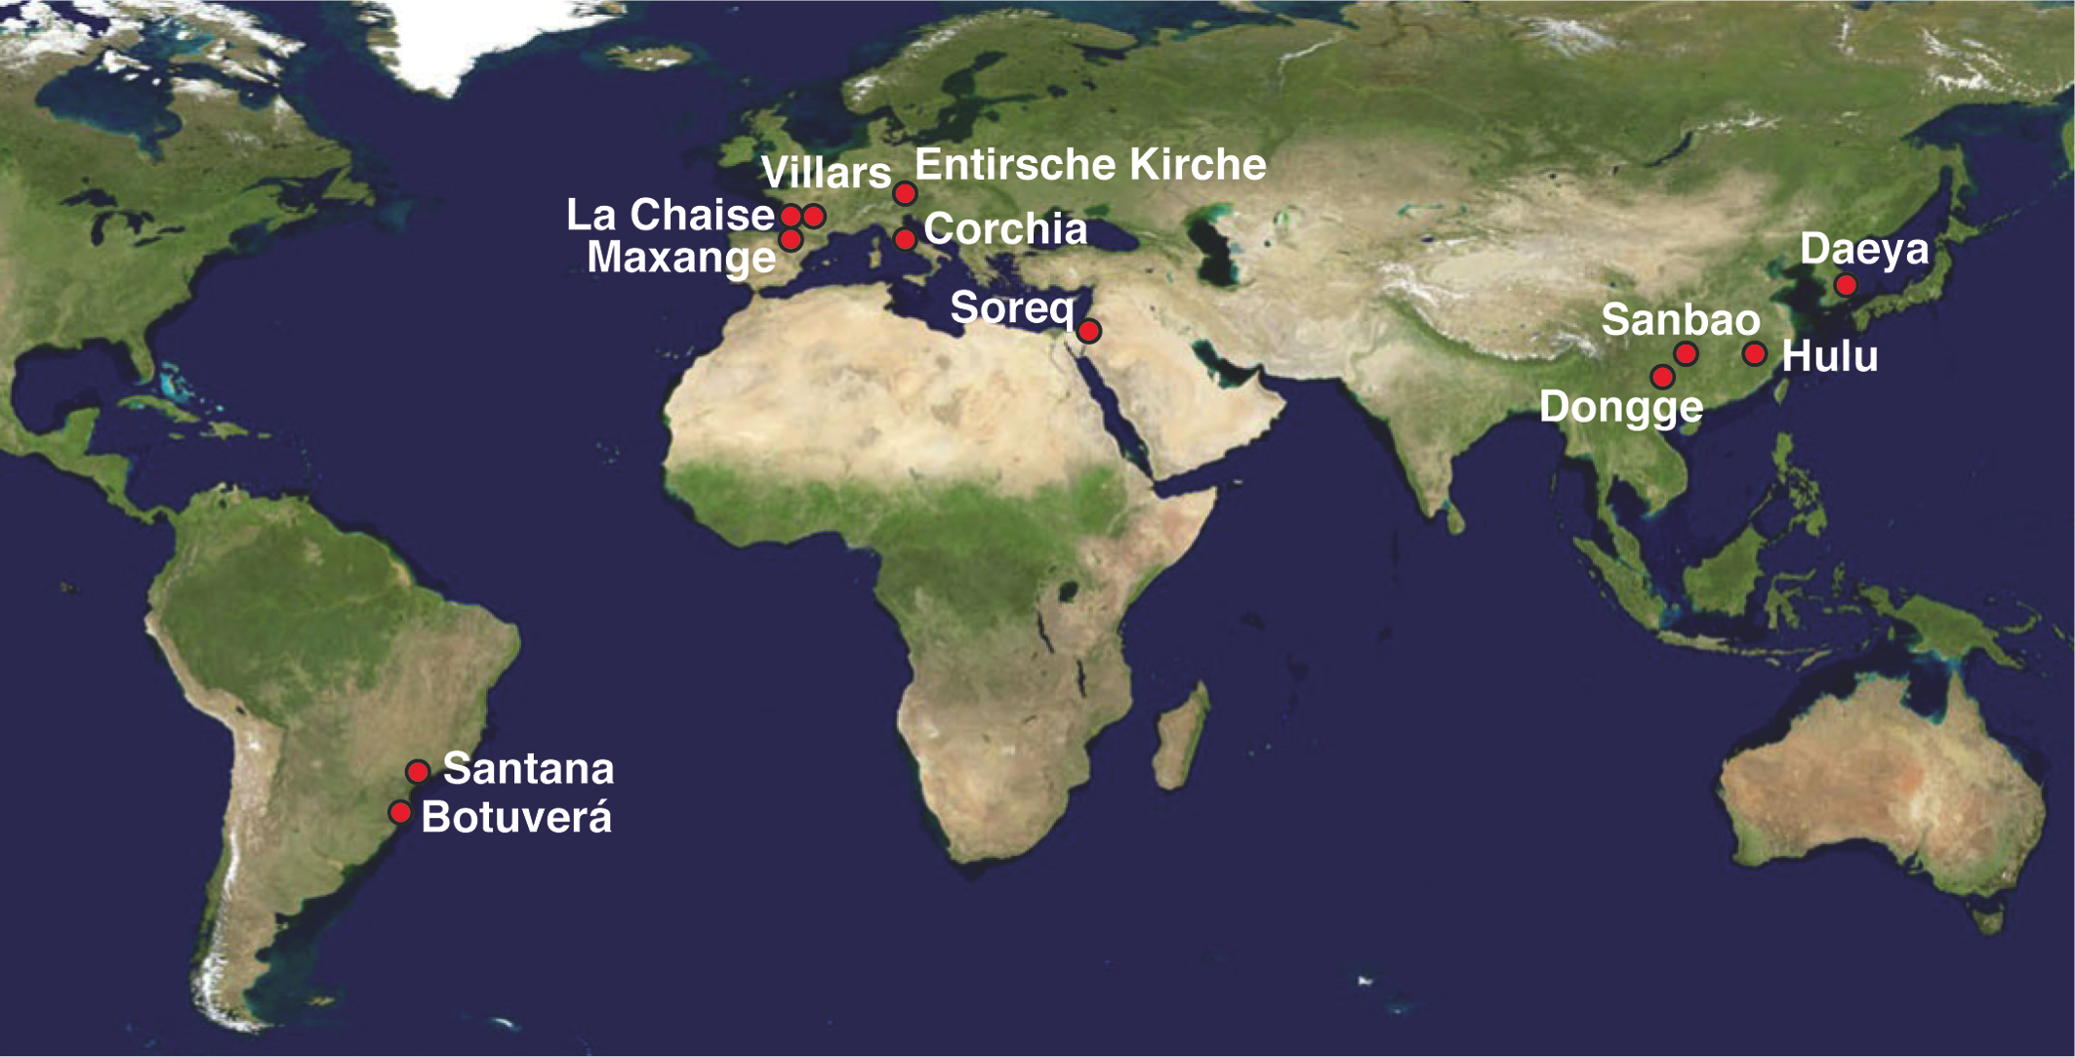
Genty D, Verheyden S, Wainer K (2012) PAGES news 20(3): 132-133
Figure 1
Notes:
Speleothem records over the Last Interglacial
Dominique Genty¹, S. Verheyden² and K. Wainer³
¹Laboratoire des Sciences du Climat et de l’Environnement, CEA Saclay, Gif-sur-Yvette, France; dominique.genty@lsce.ipsl.fr
²Geological Survey, Royal Belgian Institute of Natural Sciences, Belgium; ³Department of Earth Sciences, University of Oxford, UK

Slide 21
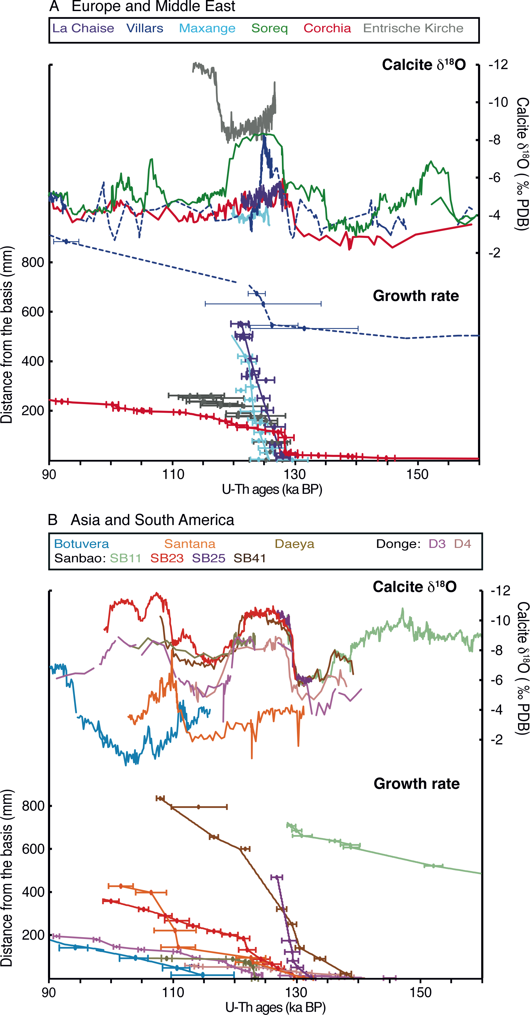
Genty D, Verheyden S, Wainer K (2012) PAGES news 20(3): 132-133
Figure 2
Notes:
Speleothem records over the Last Interglacial
Dominique Genty¹, S. Verheyden² and K. Wainer³
¹Laboratoire des Sciences du Climat et de l’Environnement, CEA Saclay, Gif-sur-Yvette, France; dominique.genty@lsce.ipsl.fr
²Geological Survey, Royal Belgian Institute of Natural Sciences, Belgium; ³Department of Earth Sciences, University of Oxford, UK

Slide 22
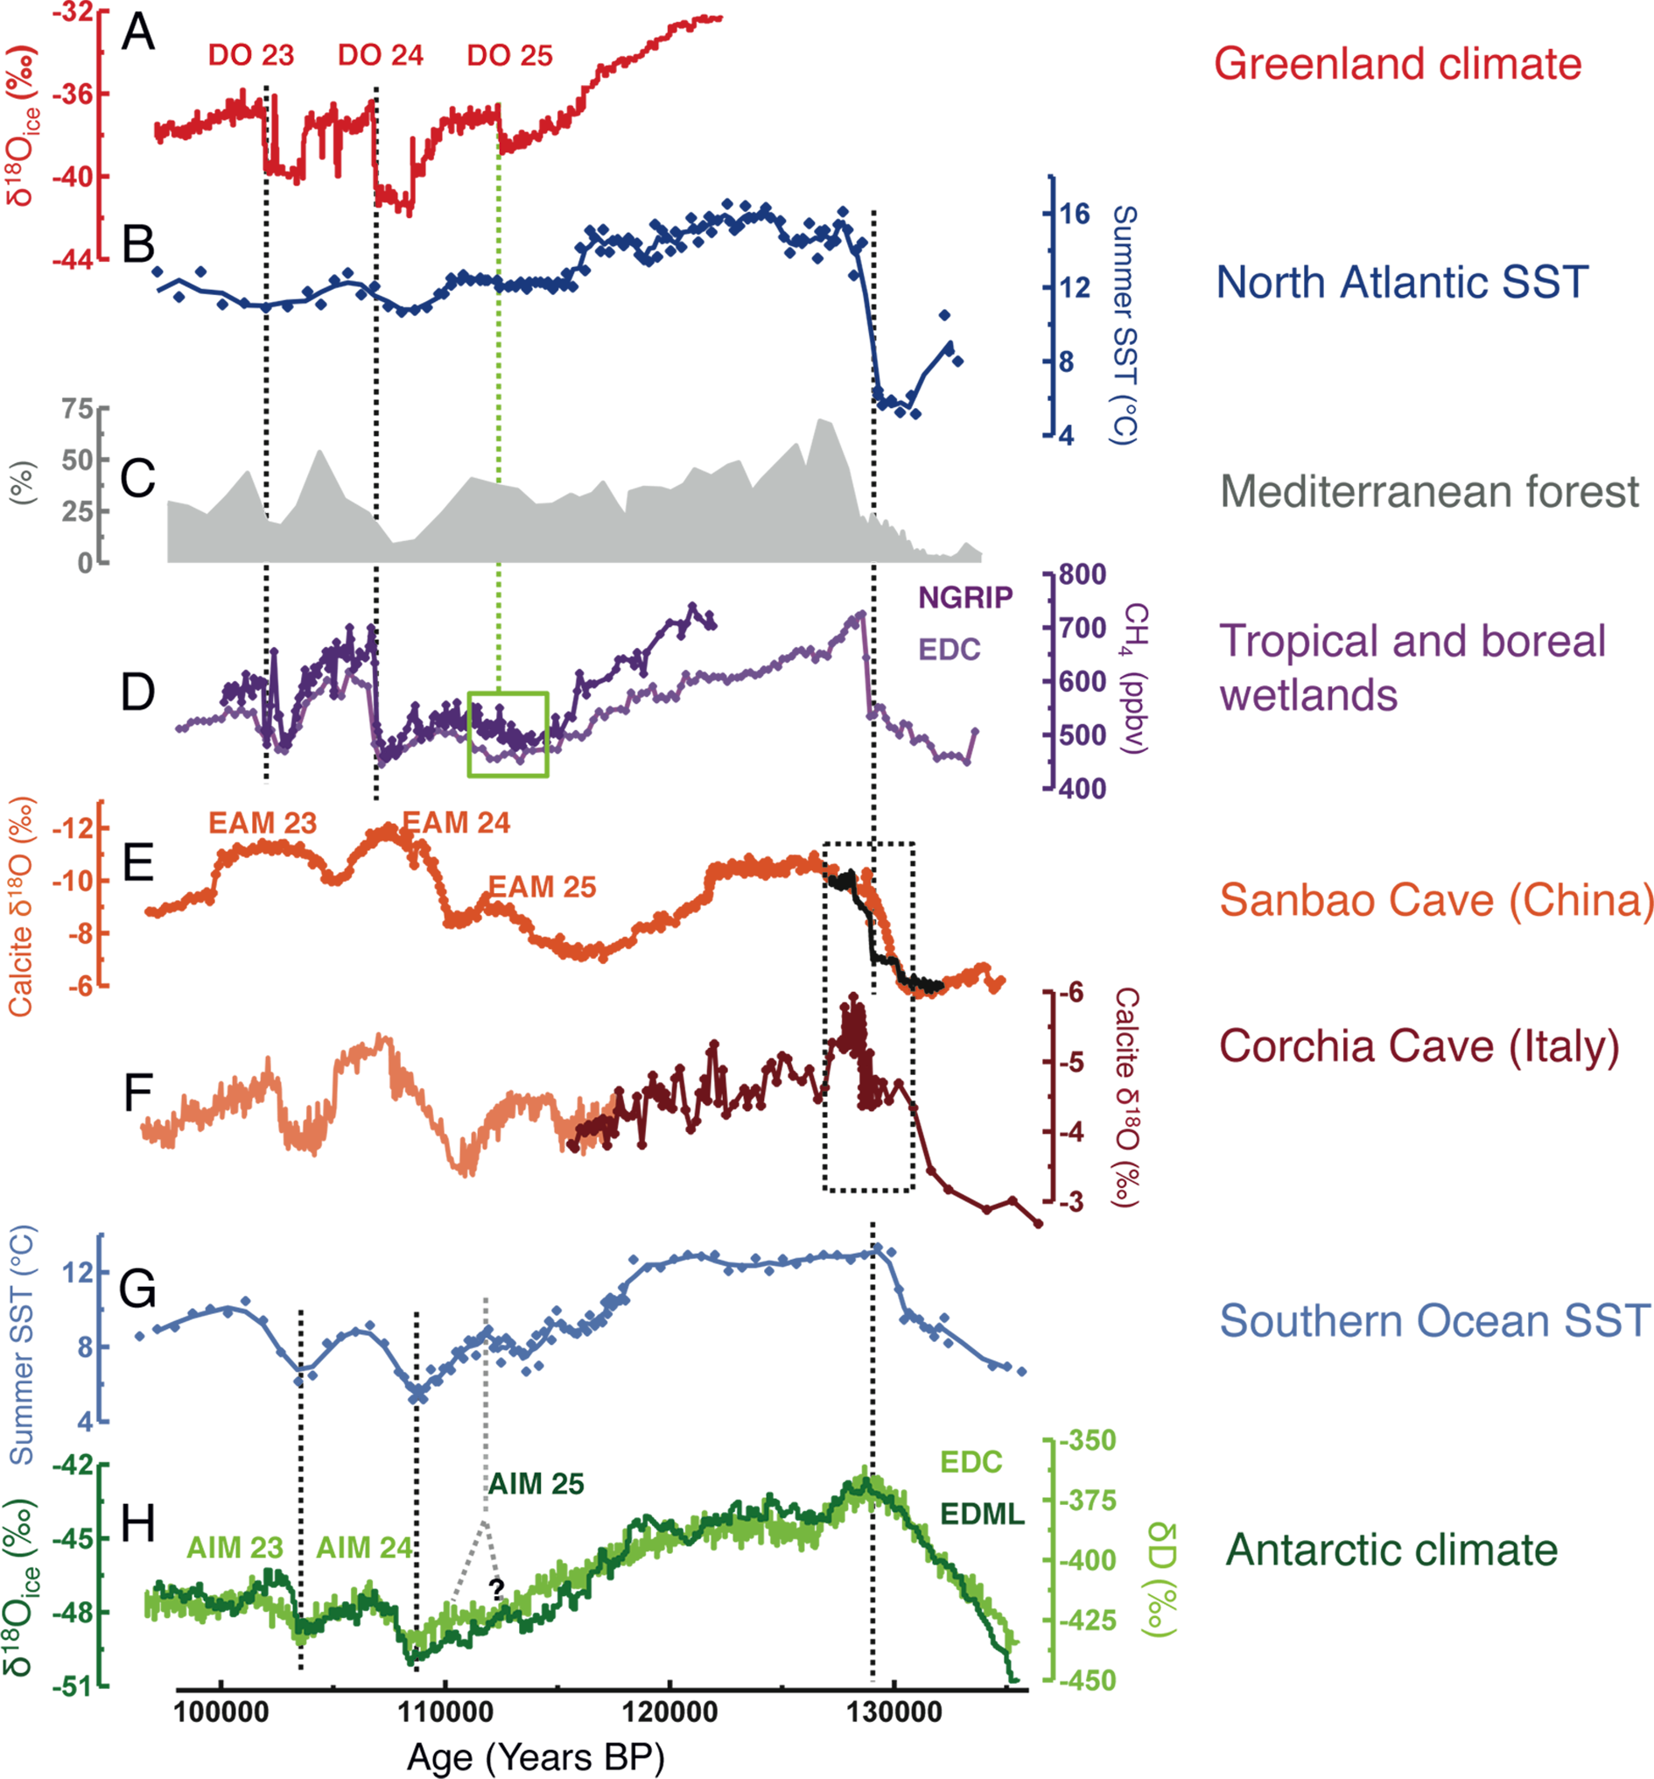
Capron E et al. (2012) PAGES news 20(3): 134-135
Figure 1
Notes:
Dating and synchronizing paleoclimatic records over the Last Interglacial
Emilie Capron¹, A. Landais², P.C. Tzedakis³, E. Bard⁴, T. Blunier⁵, D. Dahl-Jensen⁵, T. Dokken⁶, R. Gersonde⁷, F. Parrenin⁸, M. Schulz⁹, B. Vinther² and C. Waelbroeck²
¹British Antarctic Survey, Cambridge, UK; ecap@bas.ac.uk
²Laboratoire des Sciences du Climat et de l’Environnement, CEA Saclay, Gif-sur-Yvette, France; ³UCL Department of Geography, University College London, London, UK; ⁴Centre de Recherche et d’Enseignement de Géosciences de l’Environnement, Aix en Provence, France; ⁵Department of Geophysics, University of Copenhagen, Denmark; ⁶Bjerknes Center Centre for Climate Research, Bergen, Norway; ⁷Alfred Wegener Institute, Bremerhaven, Germany; ⁸Laboratoire de Glaciologie et Géophysique de l’Environnement, Grenoble, France;⁹MARUM, Center for Marine Environmental Sciences, and Faculty of Geosciences, University of Bremen, Germany

Slide 23
Sime LC, Masson-Delmotte V, Risi C, Sjolte J (2012) PAGES news 20(3): 136-137
Figure 1: from Sime LC et al. (2013) Quaternary Science
Reviews 67: 59-80
Notes:
Sea surface temperature controls on warm climate water isotopes in Greenland ice cores
Louise C. Sime¹, V. Masson-Delmotte², C. Risi³ and J. Sjolte⁴
¹British Antarctic Survey, Cambridge, UK; lsim@bas.ac.uk
²Laboratoire des Sciences du Climat et de l'Environnement, Gif-sur-Yvette, France; ³Laboratoire de Météorologie Dynamique, Paris, France; ⁴Lund University, Sweden

Slide 24
Sime LC, Masson-Delmotte V, Risi C, Sjolte J (2012) PAGES news 20(3): 136-137
Figure 2
Notes:
Sea surface temperature controls on warm climate water isotopes in Greenland ice cores
Louise C. Sime¹, V. Masson-Delmotte², C. Risi³ and J. Sjolte⁴
¹British Antarctic Survey, Cambridge, UK; lsim@bas.ac.uk
²Laboratoire des Sciences du Climat et de l'Environnement, Gif-sur-Yvette, France; ³Laboratoire de Météorologie Dynamique, Paris, France; ⁴Lund University, Sweden

Slide 25
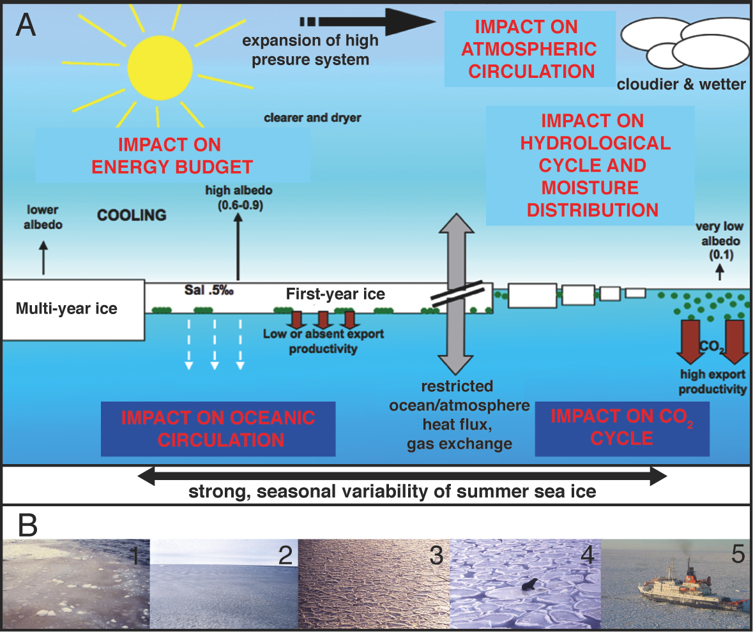
Gersonde R, de Vernal A (2012) PAGES news 20(3): 138-139
Figure 1: A) Modified from Gersonde R, Zielinski U (2000)
Palaeogeography, Palaeoclimatology, Palaeoecology 162: 263-286.
B) Photos: R. Gersonde.
Notes:
Reconstruction of past sea ice
Rainer Gersonde¹ and Anne de Vernal²
¹Alfred-Wegener-Institute for Polar and Marine Research, Bremerhaven, Germany; Rainer.Gersonde@awi.de
²GEOTOP, Université du Québec à Montréal, Montréal, Canada

Slide 26
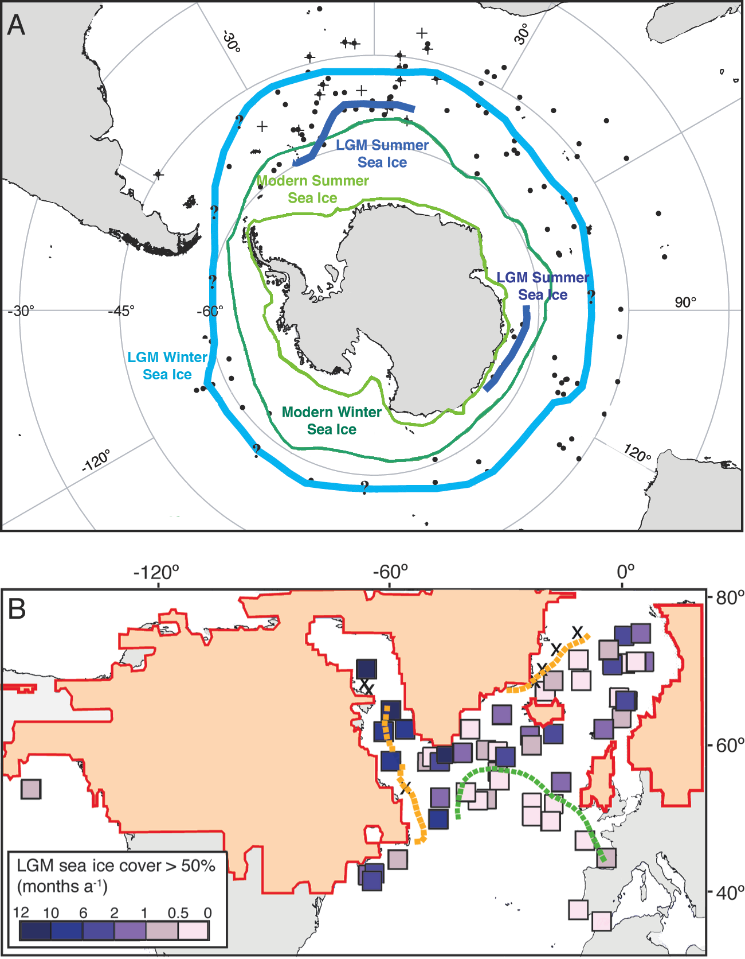
Gersonde R, de Vernal A (2012) PAGES news 20(3): 138-139
Figure 1: A) Modified from Gersonde R, Crosta X, Abelmann A, Armand L (2005) Quaternary Science Reviews 24: 869-896
B) Modified from
de Vernal A et al. (2005) Quaternary Science Reviews 24: 897-924
Notes:
Reconstruction of past sea ice
Rainer Gersonde¹ and Anne de Vernal²
¹Alfred-Wegener-Institute for Polar and Marine Research, Bremerhaven, Germany; Rainer.Gersonde@awi.de
²GEOTOP, Université du Québec à Montréal, Montréal, Canada

Slide 27
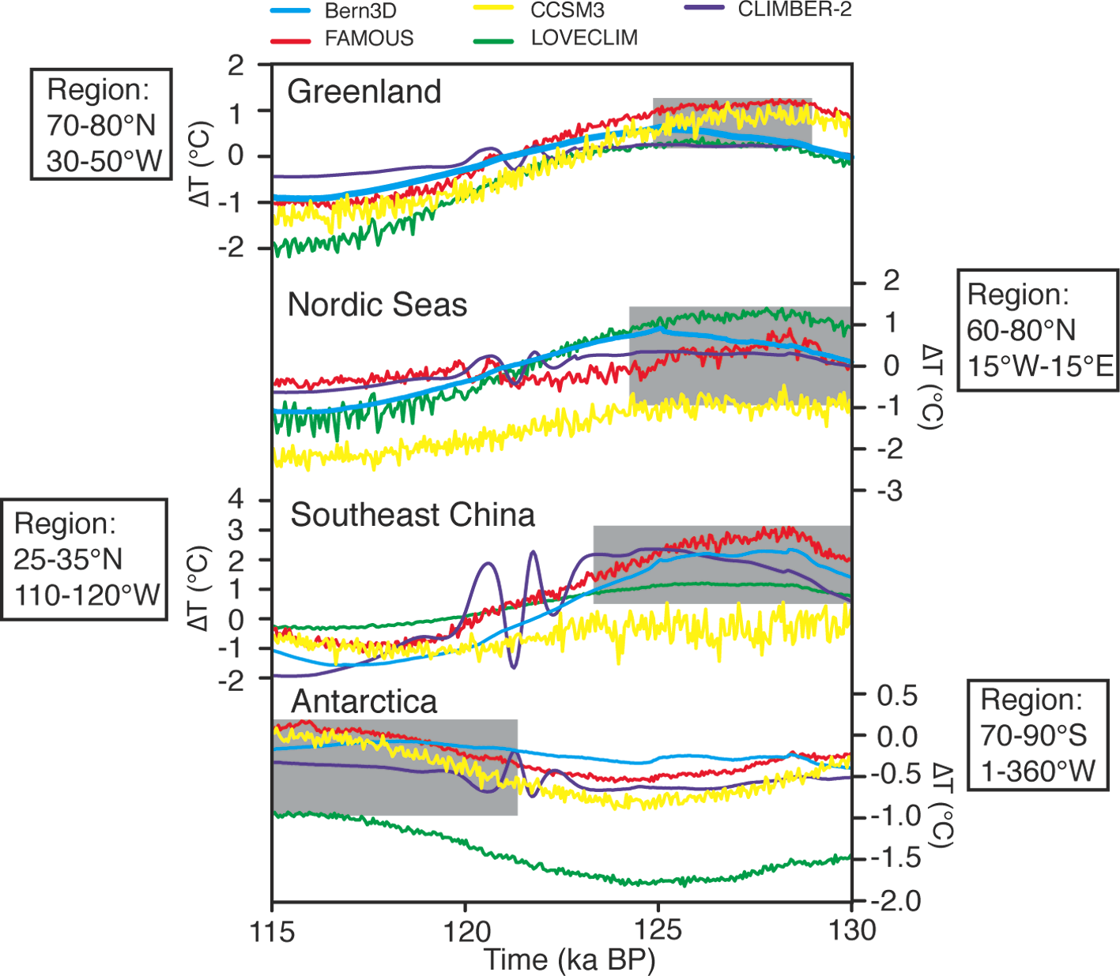
Stone EJ et al. (2012) PAGES news 20(3): 140-141
Figure 1
Notes:
A climate model inter-comparison of Last Interglacial peak warmth
Emma J. Stone¹, P. Bakker², S. Charbit³, S.P. Ritz⁴ and V. Varma⁵
¹School of Geographical Sciences, University of Bristol, UK; emma.j.stone@bristol.ac.uk
²Earth & Climate Cluster, Department of Earth Sciences, Vrije Universiteit Amsterdam, The Netherlands; ³Laboratoire des Sciences du Climat et de l'Environnement, CEA Saclay, Gif-sur-Yvette, France; ⁴Climate and Environmental Physics, Physics Institute and Oeschger Centre for Climate Change Research, University of Bern, Switzerland; ⁵Center for Marine Environmental Sciences and Faculty of Geosciences, University of Bremen, Germany

Slide 28
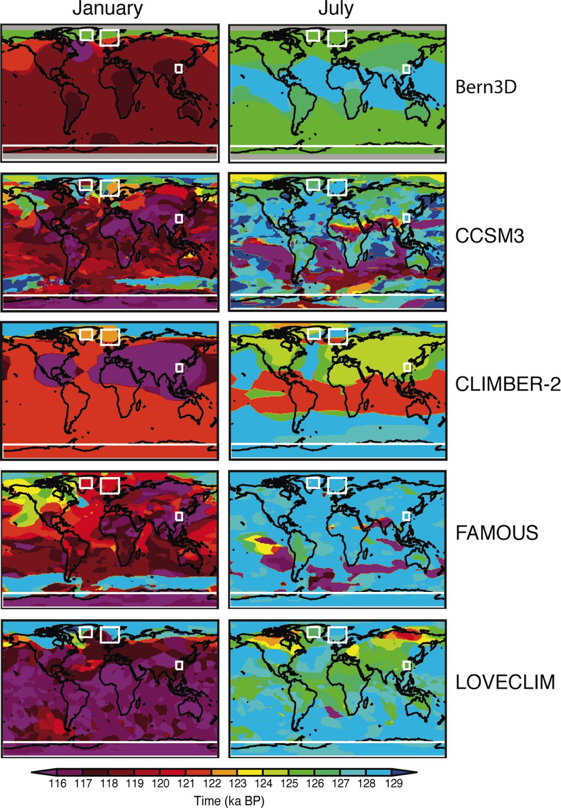
Stone EJ et al. (2012) PAGES news 20(3): 140-141
Figure 2: Modified from Bakker P et al. (2013) Climate of the Past 9: 605-619
Notes:
A climate model inter-comparison of Last Interglacial peak warmth
Emma J. Stone¹, P. Bakker², S. Charbit³, S.P. Ritz⁴ and V. Varma⁵
¹School of Geographical Sciences, University of Bristol, UK; emma.j.stone@bristol.ac.uk
²Earth & Climate Cluster, Department of Earth Sciences, Vrije Universiteit Amsterdam, The Netherlands; ³Laboratoire des Sciences du Climat et de l'Environnement, CEA Saclay, Gif-sur-Yvette, France; ⁴Climate and Environmental Physics, Physics Institute and Oeschger Centre for Climate Change Research, University of Bern, Switzerland; ⁵Center for Marine Environmental Sciences and Faculty of Geosciences, University of Bremen, Germany

Slide 29
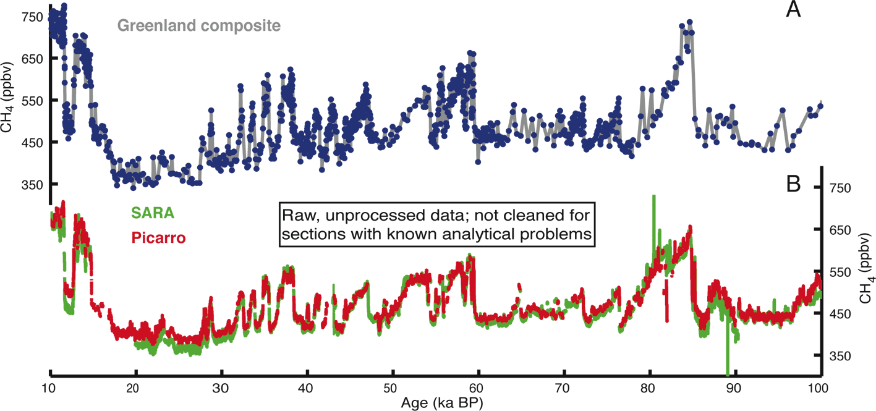
Blunier T, Chappellaz J, Brook E (2012) PAGES news 20(3): 142-143
Figure 1
Notes:
Continuous in-field measurements of gas concentration from ice cores
Thomas Blunier¹, J. Chappellaz² and E. Brook³
¹Centre for Ice and Climate, Niels Bohr Institute, University of Copenhagen, Denmark; blunier@gfy.ku.dk
²Laboratoire de Glaciologie et Géophysique de l’Environnement, CNRS, Université Joseph Fourier-Grenoble, France; ³Department of Geosciences, Oregon State University, Corvallis, USA

Slide 30
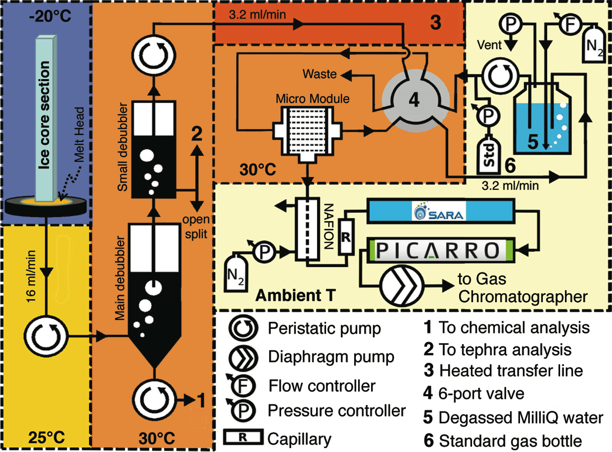
Blunier T, Chappellaz J, Brook E (2012) PAGES news 20(3): 142-143
Figure 2
Notes:
Continuous in-field measurements of gas concentration from ice cores
Thomas Blunier¹, J. Chappellaz² and E. Brook³
¹Centre for Ice and Climate, Niels Bohr Institute, University of Copenhagen, Denmark; blunier@gfy.ku.dk
²Laboratoire de Glaciologie et Géophysique de l’Environnement, CNRS, Université Joseph Fourier-Grenoble, France; ³Department of Geosciences, Oregon State University, Corvallis, USA

Slide 31
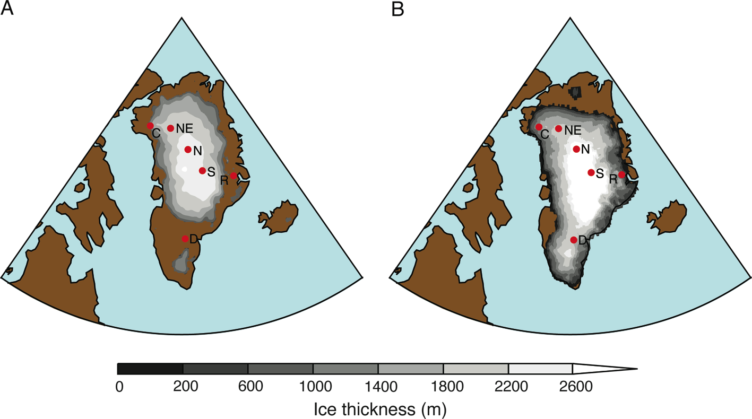
Siddall M et al. (2012) PAGES news 20(3): 144-145
Figure 1: A) Modified from Otto-Bliesner BL et al. (2006) Science 311: 1751-1753.
B) Modified from Stone EJ, DJ Lunt, Annan JD, Hargreaves JC (2012) Climate of the Past Discussions 8: 2731-2776
Notes:
Sea level variations during the Last Interglacial
Mark Siddall¹, R.C.A. Hindmarsh², W.G. Thompson³, A. Dutton⁴, R.E. Kopp⁵ and E.J. Stone⁶
¹Department of Earth Sciences, University of Bristol, UK; mark.siddall@bristol.ac.uk
²Science Programmes, British Antarctic Survey, Cambridge, UK; ³Department of Geology and Geophysics, Woods Hole Oceanographic Institution, Woods Hole, USA; ⁴Department of Geological Sciences, University of Florida, Gainesville, USA; ⁵Department of Earth & Planetary Sciences and Rutgers Energy Institute, Rutgers University, New Brunswick, USA; ⁶School of Geographical Sciences, University of Bristol, UK

Slide 32
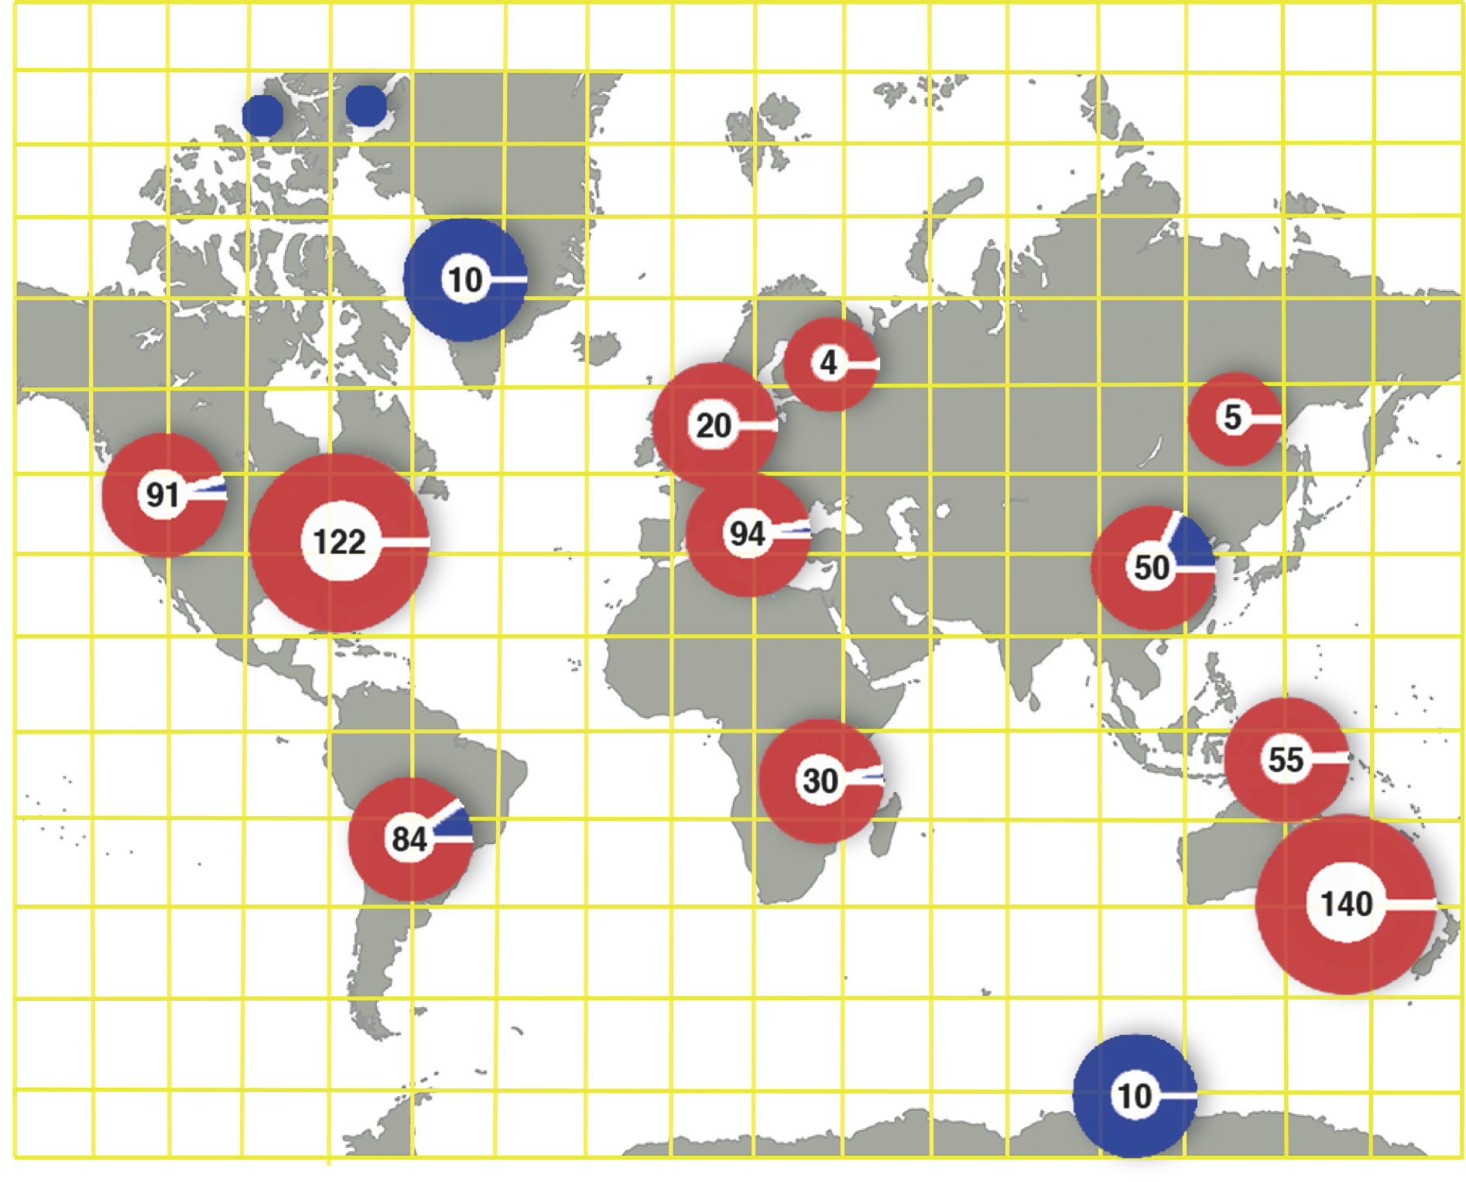
Kehrwald K, Barbante C, Whitlock C, Brovkin V (2012) PAGES news 20(3): 146
Figure 1
Notes:
Paleofire workshop
Natalie Kehrwald¹, C. Barbante^{1,2}, C. Whitlock³ and V. Brovkin⁴
¹Department of Environmental Science, Informatics and Statistics, University of Venice, Italy; kehrwald@unive.it
²Institute for the Dynamics of Environmental Processes, Consiglio Nazionale delle Ricerche, Venice, Italy; ³Department of Earth Sciences, Montana State University, Montana, USA; ⁴Max Planck Institute for Meteorology, Hamburg, Germany

Slide 33
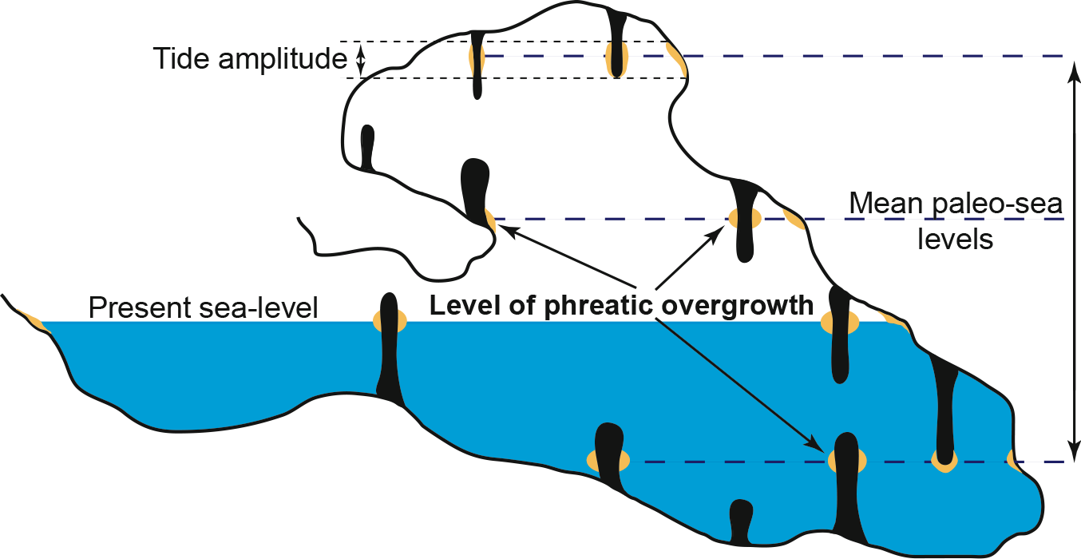
Onac BP, Dorale, JA, Fornós JJ (2012) PAGES news 20(3): 147
Figure 1: Modified from Tuccimei P et al. (2012) Quaternary International 262: 56-64
Notes:
Sea level changes into MIS 5: From observations to predictions
Bogdan P. Onac¹, J.A. Dorale² and J.J. Fornós³
¹Department of Geology, University of South Florida, Tampa, USA; bonac@usf.edu
²Department of Geoscience, University of Iowa, USA; ³Departament de Ciències de la Terra, Universitat de les Illes Balears, Palma, Spain

Slide 34
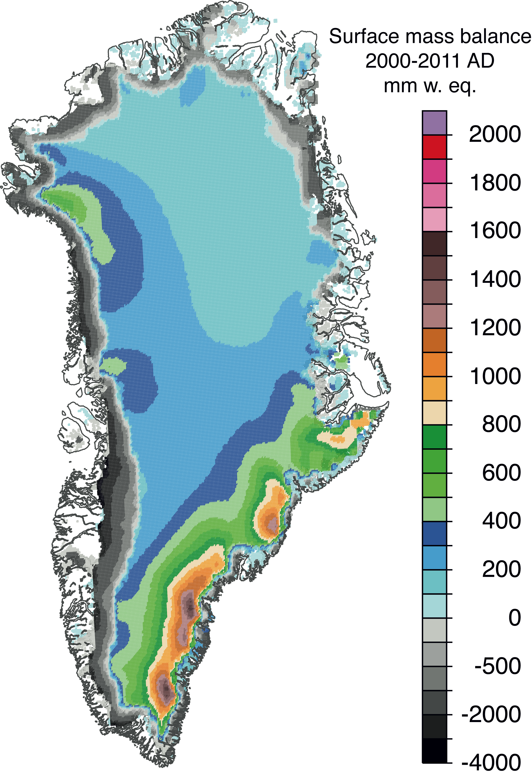
Dutton A, Stone EJ, Carlson A (2012) PAGES news 20(3): 148
Figure 1 from Box JE et al. (2012) The Cryosphere 6: 821-839
Notes:
Ice sheet climate interactions: Implications for coastal engineering
Andrea Dutton¹, E.J. Stone² and A. Carlson³
¹Department of Geological Sciences, University of Florida, Gainesville, USA; adutton@ufl.edu
²School of Geographical Sciences, University of Bristol, UK; ³Department of Geoscience, University of Wisconsin, Madison, USA

Slide 35
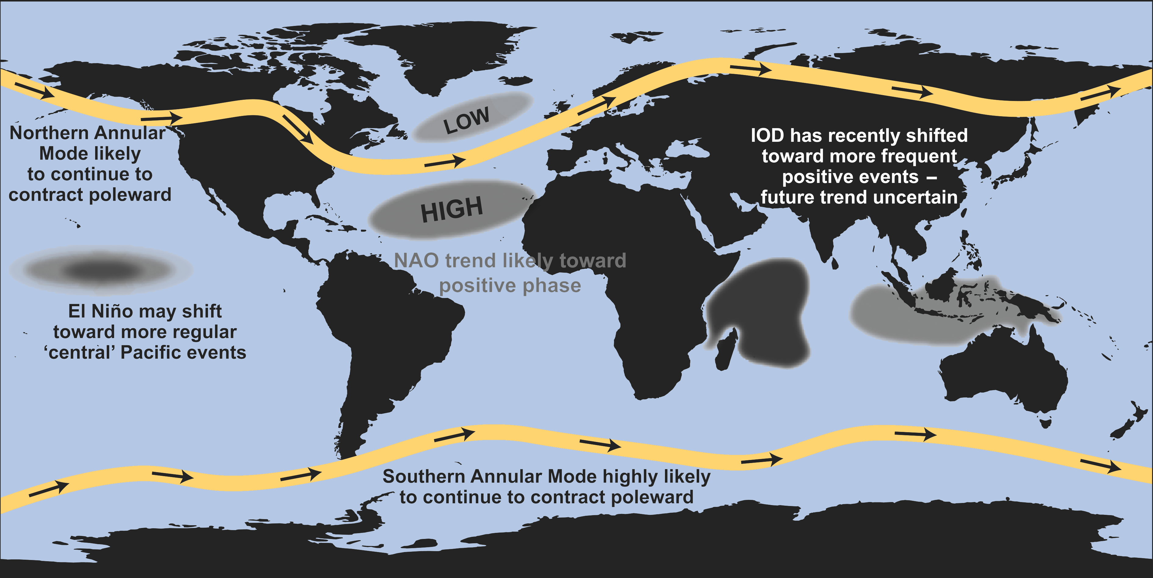
Fischer H, Wolff EW (2012) PAGES news 20(3): 149
Figure 1 from England MH (2011) In: Richardson K, Steffen W, Liverman D (Eds) Climate Change: Global Risks, Challenges and Decisions, Cambridge University Press, 33-35
Notes:
Modes of variability in the climate system: Past-Present-Future
Hubertus Fischer¹ and Eric W. Wolff²
¹Climate and Environmental Physics and Oeschger Centre for Climate Change Research, University of Bern, Switzerland; hubertus.fischer@climate.unibe.ch
²British Antarctic Survey, Cambridge, UK

Slide 36
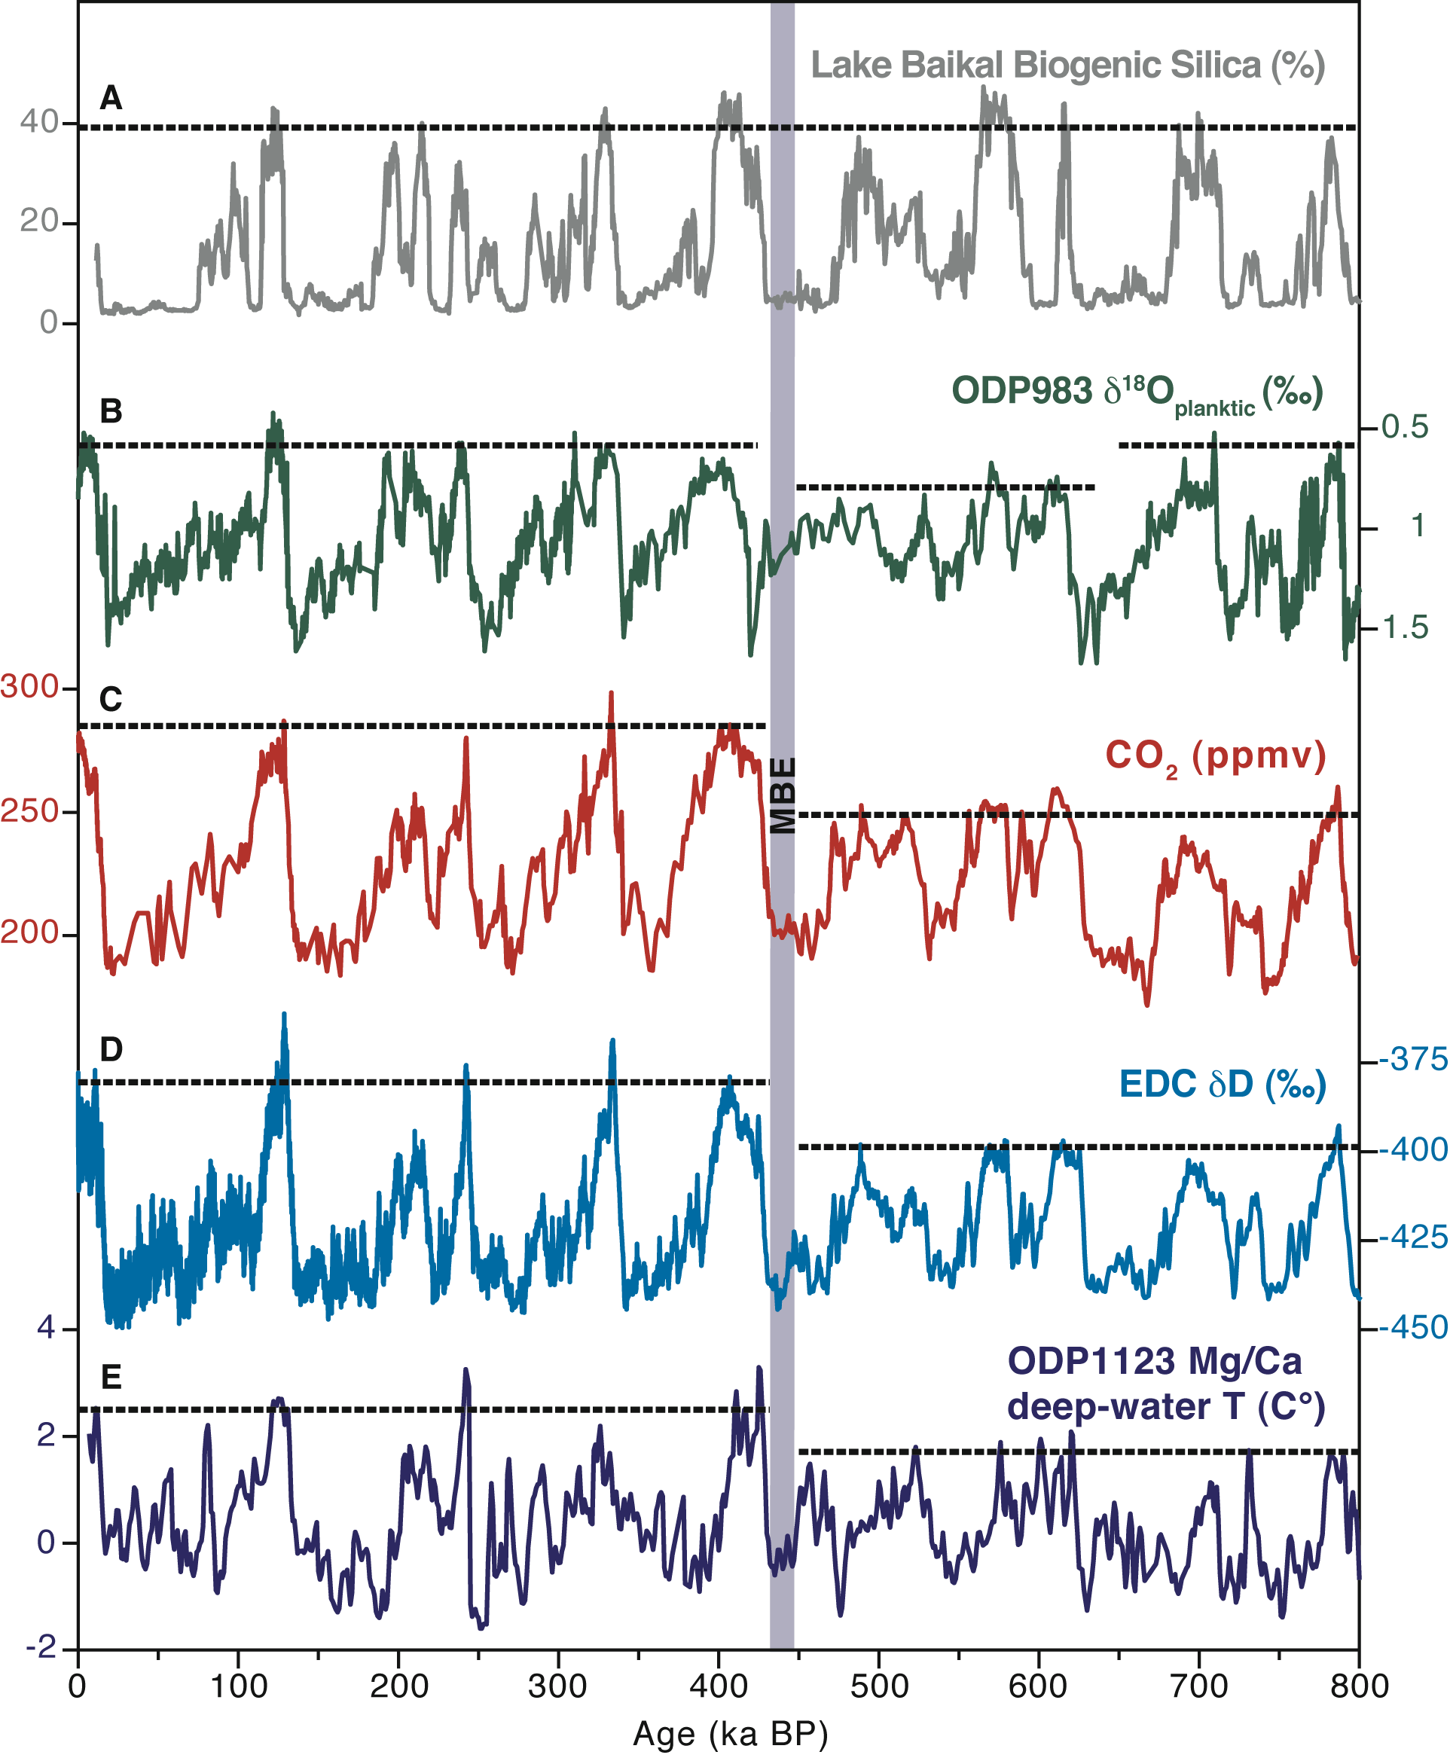
Tzedakis PC et al. (2012) PAGES news 20(3): 150
Figure 1
Notes:
The 4th PAGES past interglacials workshop
Polychronis C. Tzedakis¹, J.F. McManus², D. Raynaud³, D.A. Hodell⁴, L.C. Skinner⁴ and E.W. Wolff⁵
¹Department of Geography, University College London, UK; p.c.tzedakis@ucl.ac.uk
²Lamont-Doherty Earth Observatory of Columbia University, New York, USA; ³Laboratoire de Glaciologie et Géophysique de l’Environnement, Grenoble, France; ⁴Department of Earth Sciences, University of Cambridge, UK; ⁵British Antarctic Survey, Cambridge, UK

Slide 37
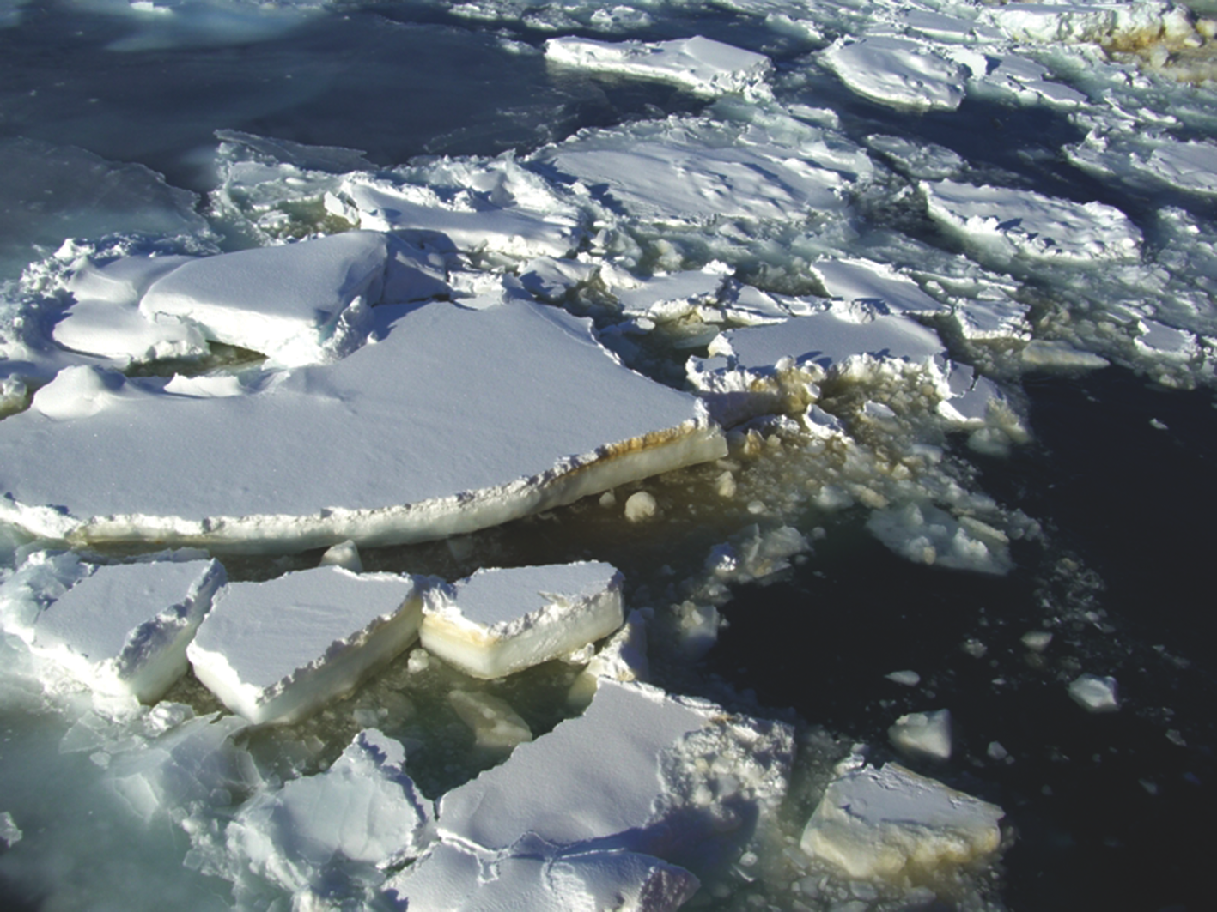
de Vernal A, Wolff EW, Gersonde R (2012) PAGES news 20(3): 151
Figure 1: Photo: Claire Allen
Notes:
Sea ice in the paleoclimate system
Anne de Vernal¹, E.W. Wolff² and R. Gersonde³
¹GEOTOP, Université du Québec à Montréal, Canada; devernal.anne@uqam.ca
²British Antarctic Survey, Cambridge, UK; ³Alfred-Wegener-Institute for Polar and Marine Research, Bremerhaven, Germany

