Slide 1
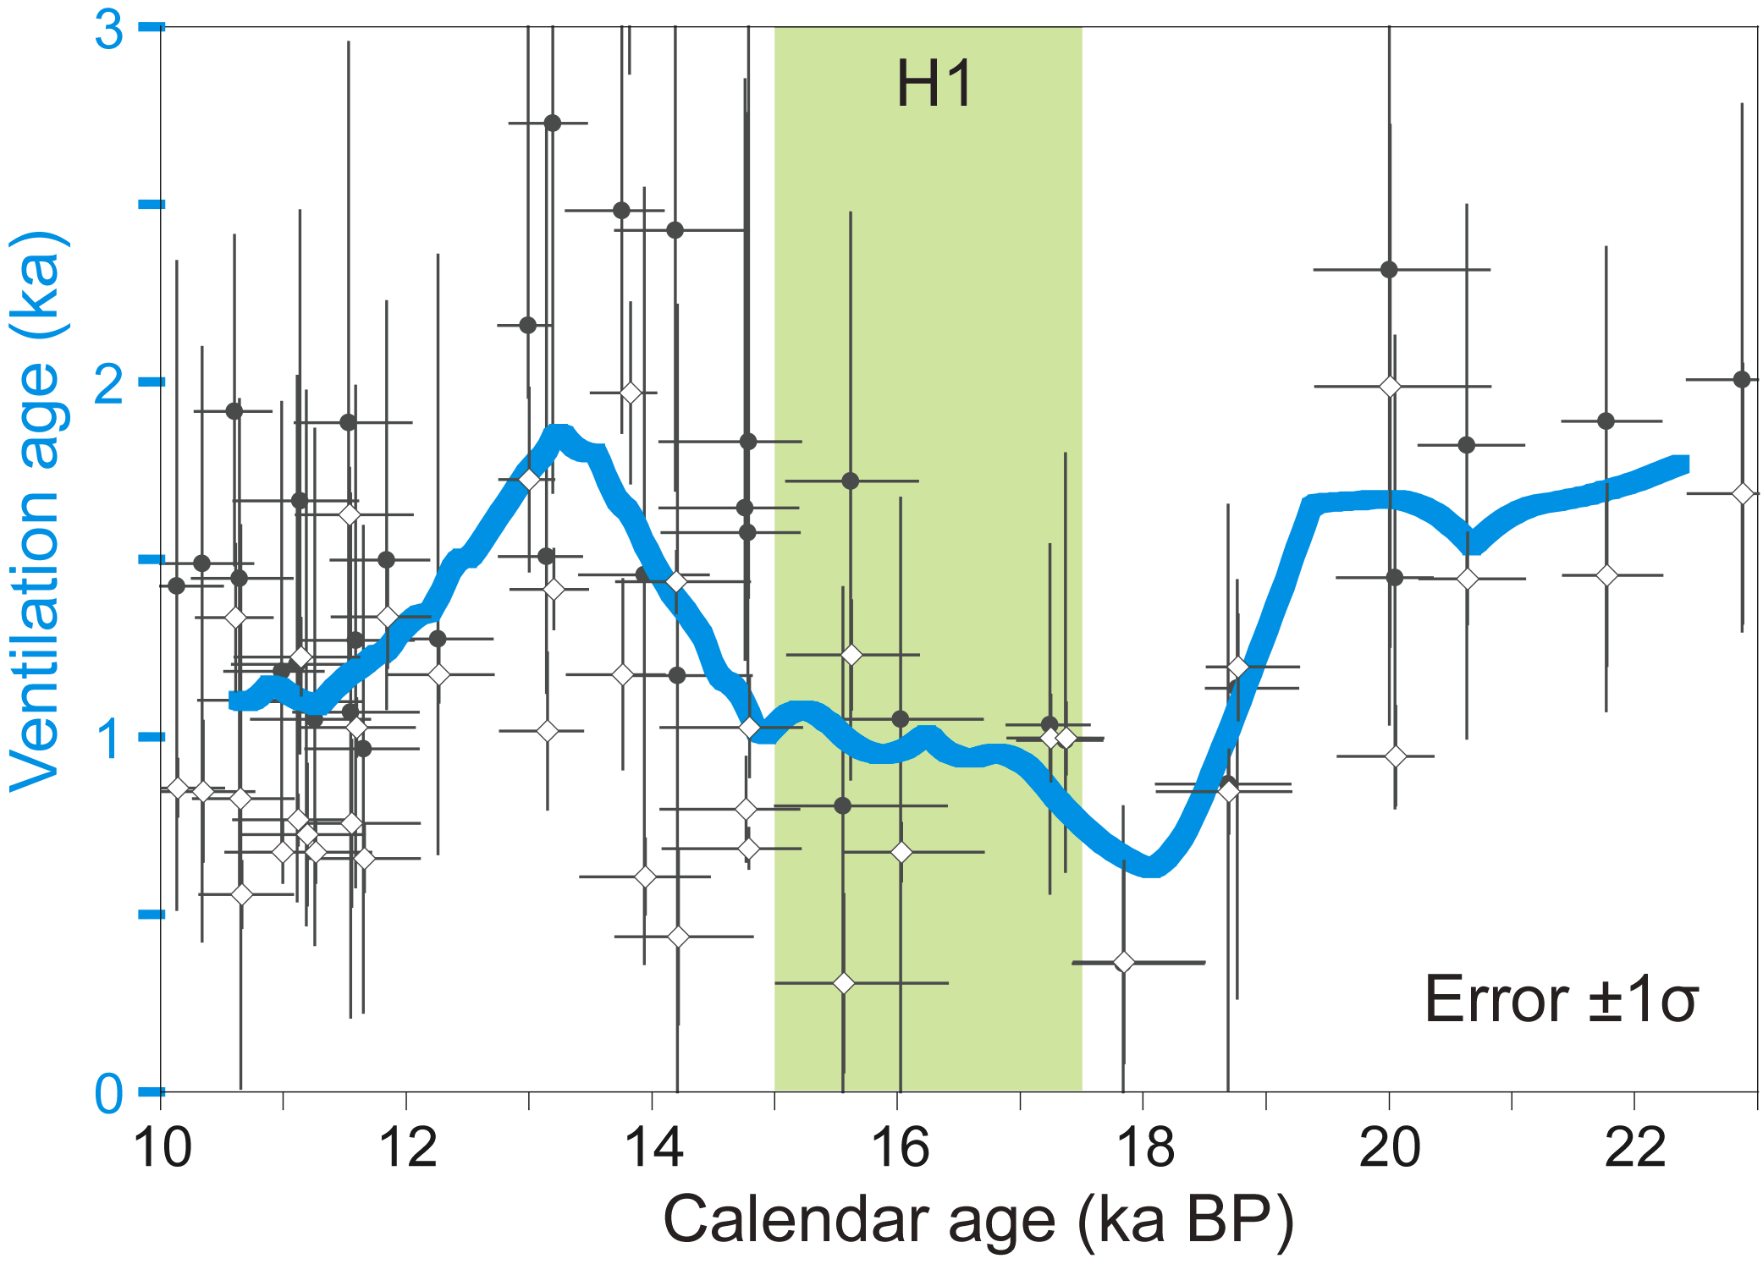
Okazakai et al. (2012) PAGES news 20(2): 60
Modified from Okazaki et al. (2010) Science 329: 200-204
Notes:
Ocean circulation in the North Pacific during the last glacial termination
Yusuke Okazaki1,2, A. Timmermann3, L. Menviel4, M.O. Chikamoto 3, N. Harada2 and A. Abe-Ouchi2,5
1Department of Earth and Planetary Sciences, Kyushu University, Fukuoka, Japan; yokazaki@geo.kyushu-u.ac.jp
2Research Institute for Global Change, Japan Agency for Marine-Earth Science and Technology, Yokosuka, Japan; 3International Pacific Research
Center, School of Ocean and Earth Science and Technology, University of Hawaii, Honolulu, USA; 4Climate Change Research Centre, University of
New South Wales, Sydney, Australia; 5Atmosphere and Ocean Research Institute, University of Tokyo, Kashiwa, Japan
Figure 1: Ventilation age changes based on published radiocarbon data in the western North Pacific between
900 and 2800 m water depths (Okazaki et al. 2010). Reconstructed ventilation change based on the 14C age offset
between co-existing benthic (BF) and planktic foraminifers (PF; open diamonds), projection ages (considering
atmospheric 14C change; gray circles), and smoothed spline interpolation of averaged BF-PF age offsets and projection
ages (blue line). H1: Heinrich event 1.

Slide 2
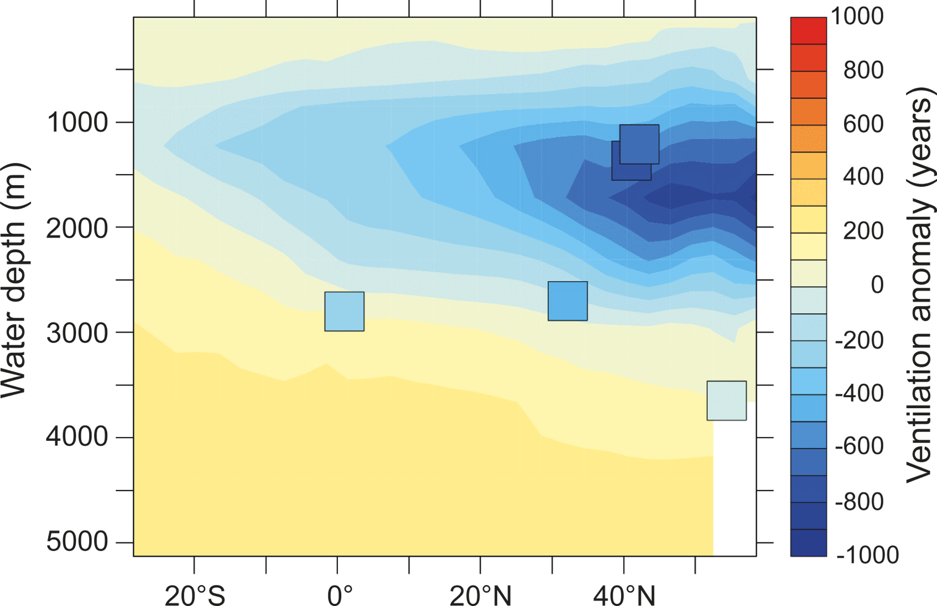
Okazakai et al. (2012) PAGES news 20(2): 61
Modified from Okazaki et al. (2010) Science 329: 200-204
Notes:
Ocean circulation in the North Pacific during the last glacial termination
Yusuke Okazaki1,2, A. Timmermann3, L. Menviel4, M.O. Chikamoto 3, N. Harada2 and A. Abe-Ouchi2,5
1Department of Earth and Planetary Sciences, Kyushu University, Fukuoka, Japan; yokazaki@geo.kyushu-u.ac.jp
2Research Institute for Global Change, Japan Agency for Marine-Earth Science and Technology, Yokosuka, Japan; 3International Pacific Research
Center, School of Ocean and Earth Science and Technology, University of Hawaii, Honolulu, USA; 4Climate Change Research Centre, University of
New South Wales, Sydney, Australia; 5Atmosphere and Ocean Research Institute, University of Tokyo, Kashiwa, Japan
Figure 2: Zonally averaged simulated radiocarbon age anomalies in the North Pacific between a collapsed Atlantic
MOC state and the preindustrial control simulation. Squares indicate projection age anomalies for the deglacial
H1 period reconstructed from western North Pacific sediment cores (Okazaki et al. 2010).

Slide 3
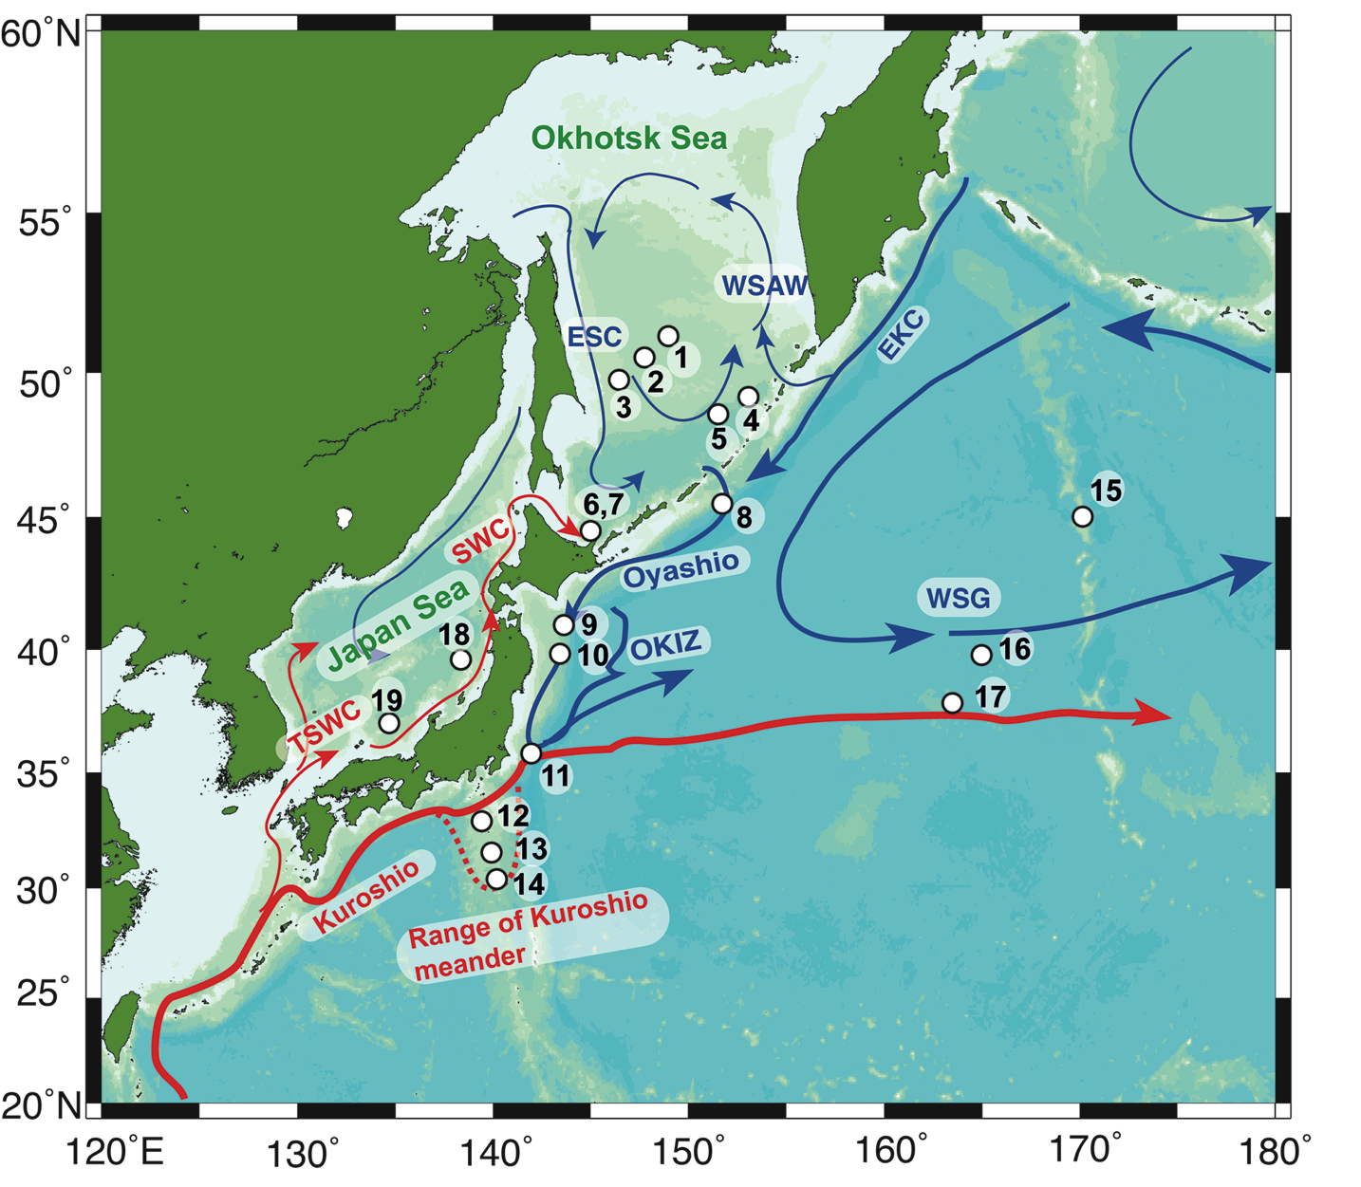
Harada et al. (2012) PAGES news 20(2): 62
Notes:
North Pacific - North Atlantic linkages during the Last Glacial Termination
Naomi Harada1, A. Timmermann2, M. Sato 1, O. Seki3, Y. Nakamura1, K. Kimoto 1, Y. Okazaki4, K. Nagashima1, S.A. Gorbarenko5, L. Menviel6,
M.O. Chikamoto 2 and A. Abe-Ouchi1,7
1Research Institute for Global Change, Japan Agency for Marine-Earth Science and Technology, Japan; haradan@jamstec.go.jp
2International Pacific Research Center (IPRC), University of Hawaii, USA; 3Institute of Low Temperature Science, Hokkaido University, Japan; 4Institute
for Advanced Study, Kyushu University, Japan; 5V.I.II'ichev Pacific Oceanological Institute, Far East Branch of Russian Academy of Science,
Russia; 6Climate Change Research Centre, University of New South Wales, Australia; 7Atmosphere and Ocean Research Institute, The University of
Tokyo, Japan
Figure 1: Sediment core locations in the western–central North Pacific and the Okhotsk and Japan Seas. Numbers
indicate the coring sites as in Harada et al. (2012). Arrows show the average direction of flow of surface waters,
with red and blue arrows indicating warm and cold currents, respectively. EKC, East Kamchatka Current; WSAW,
Western Subarctic Water; ESC, East Sakhalin Current; SWC, Soya Warm Current; TSWC, Tsushima Warm Current;
OKIZ, Oyashio–Kuroshio interfrontal zone; WSG, Western subarctic gyre.

Slide 4
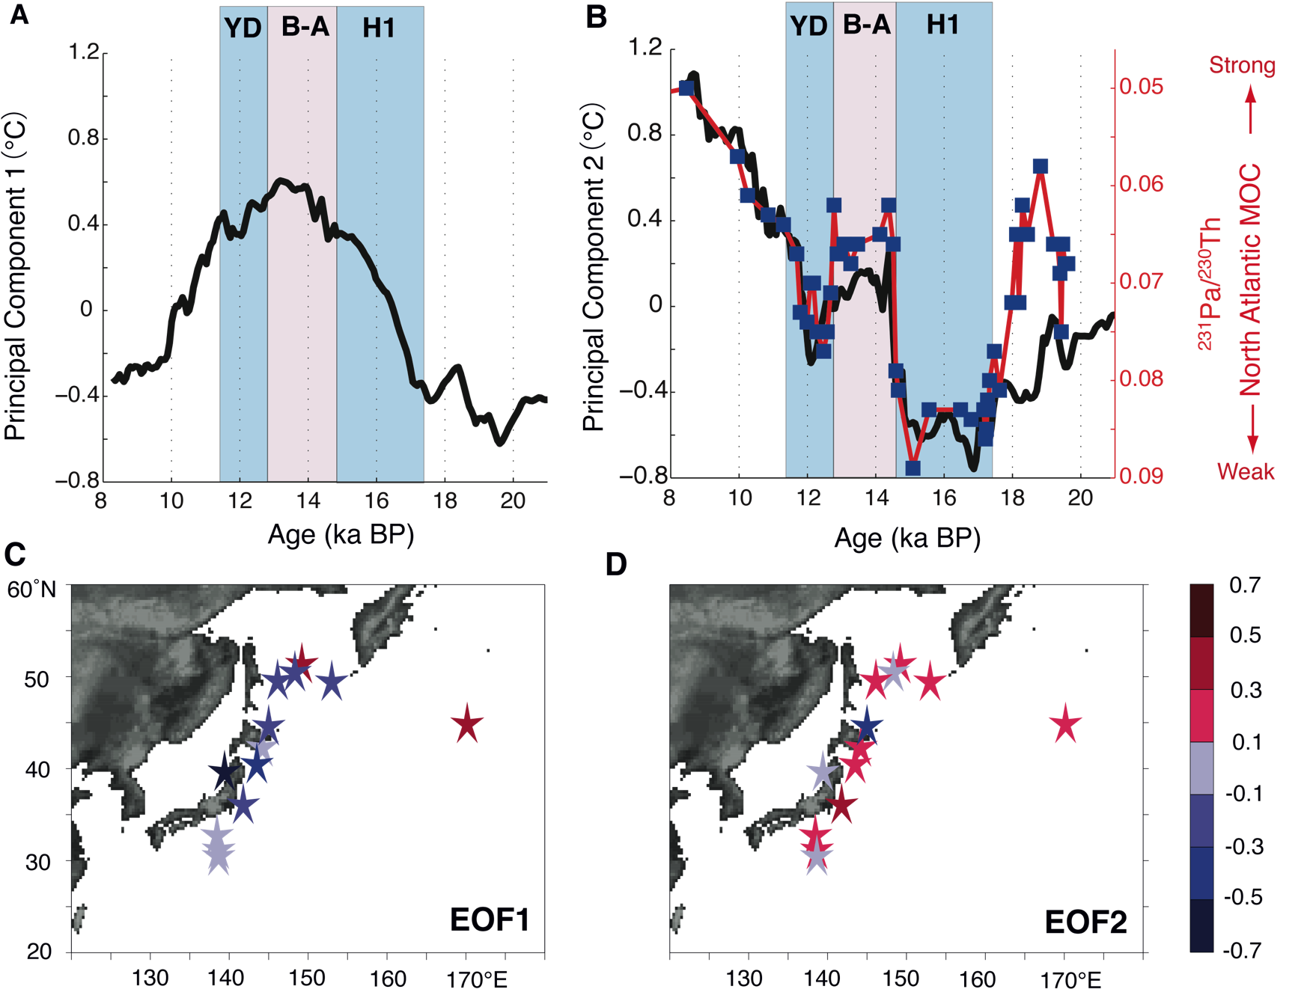
Harada et al. (2012) PAGES news 20(2): 63
Modified from Harada et al. (2012) Deep-See Res. II 61-64: 93-105
Notes:
North Pacific - North Atlantic linkages during the Last Glacial Termination
Naomi Harada1, A. Timmermann2, M. Sato 1, O. Seki3, Y. Nakamura1, K. Kimoto 1, Y. Okazaki4, K. Nagashima1, S.A. Gorbarenko5, L. Menviel6,
M.O. Chikamoto 2 and A. Abe-Ouchi1,7
1Research Institute for Global Change, Japan Agency for Marine-Earth Science and Technology, Japan; haradan@jamstec.go.jp
2International Pacific Research Center (IPRC), University of Hawaii, USA; 3Institute of Low Temperature Science, Hokkaido University, Japan; 4Institute
for Advanced Study, Kyushu University, Japan; 5V.I.II'ichev Pacific Oceanological Institute, Far East Branch of Russian Academy of Science,
Russia; 6Climate Change Research Centre, University of New South Wales, Australia; 7Atmosphere and Ocean Research Institute, The University of
Tokyo, Japan
Figure 2: Empirical orthogonal function (EOF) analysis of alkenone-derived temperatures throughout 22-8 ka BP. A) First principal component [°∆C] corresponding to EOF1
pattern. B) Second principal component [°∆C] corresponding to the EOF2 pattern, along with estimates of North Atlantic meridional overturning circulation (McManus et al.
2004). C) EOF1 and (D) EOF2 spatial patterns [unitless]. The color scale indicates the loading of the EOF pattern.

Slide 5
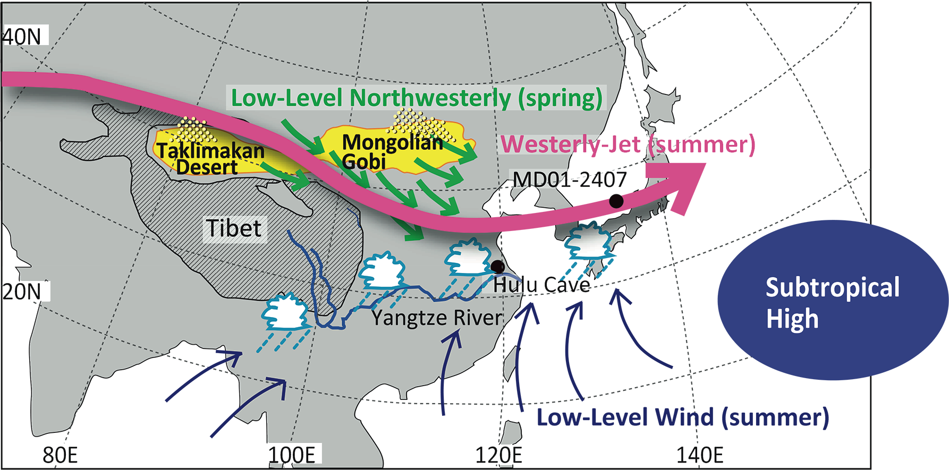
Nagashima and Tada (2012) PAGES news 20(2): 64
Notes:
Teleconnection mechanism between millennial-scale Asian Monsoon dynamics and North Atlantic climate
Kana Nagashima1 and Ryuji Tada2
1Research Institute for Global Change, Japan Agency for Marine-Earth Science and Technology, Yokosuka, Japan; nagashimak@jamstec.go.jp
2Department of Earth and Planetary Sciences, Graduate School of Science, University of Tokyo, Japan
Figure 1: Spring and summer atmospheric circulation patterns and the East Asian Summer Monsoon rainband over
East Asia (shown by clouds). The locations of the marine sediment core MD01-2407, the Hulu Cave speleothem,
and important geographical features are also shown.

Slide 6
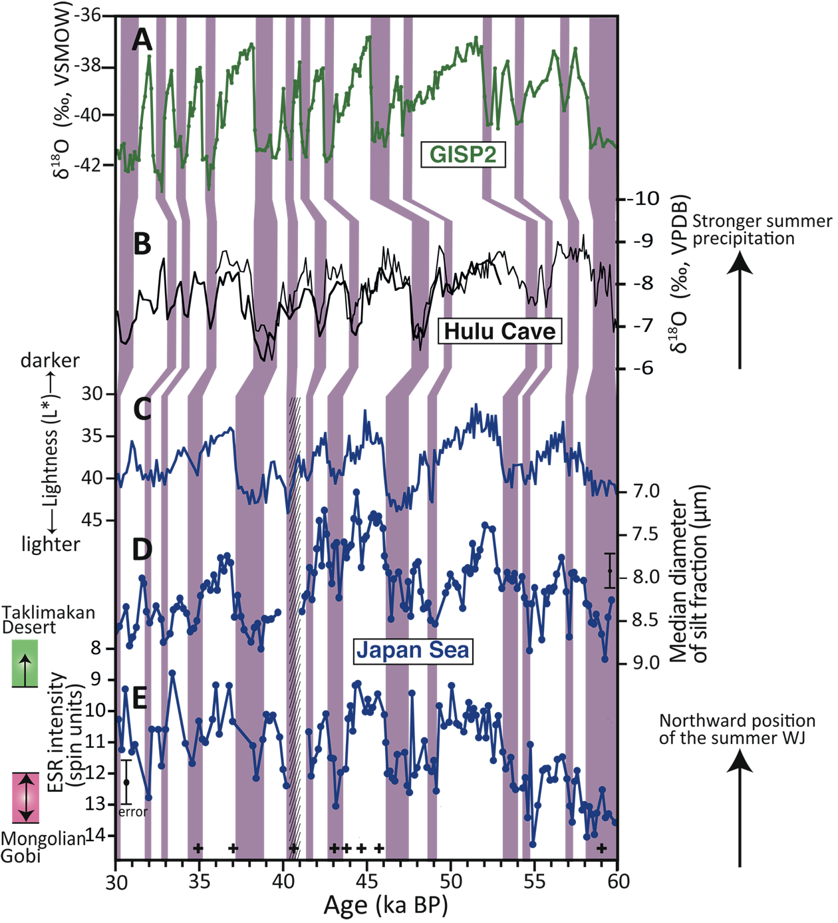
Nagashima and Tada (2012) PAGES news 20(2): 65
Notes:
Teleconnection mechanism between millennial-scale Asian Monsoon dynamics and North Atlantic climate
Kana Nagashima1 and Ryuji Tada2
1Research Institute for Global Change, Japan Agency for Marine-Earth Science and Technology, Yokosuka, Japan; nagashimak@jamstec.go.jp
2Department of Earth and Planetary Sciences, Graduate School of Science, University of Tokyo, Japan
Figure 1: Spring and summer atmospheric circulation patterns and the East Asian Summer Monsoon rainband over
East Asia (shown by clouds). The locations of the marine sediment core MD01-2407, the Hulu Cave speleothem,
and important geographical features are also shown.
Figure 2: Dust provenance records from the Japan Sea compared with paleoclimate records from Greenland and
southeastern China. A) GISP2 δ18O record (Grootes and Stuiver 1997); (B) Hulu Cave stalagmite δ18O record (Wang
et al. 2001); (C) lightness (L*; Watanabe et al. 2007), (D) median grain size of the silt fraction, and (E) ESR intensity
of silt-sized quartz (Nagashima et al. 2011) in core MD01-2407 from the Japan Sea. Plus signs (+) mark age-control
points in core MD01-2407 (Yokoyama et al. 2007). Vertical purple bars indicate stadials in GISP2, heavier oxygen
isotope (weak Asian monsoon) events in Hulu Cave, and light-colored layers in core MD01-2407. The vertical
hatched bar indicates an interval in the core containing volcanic ash.

Slide 7
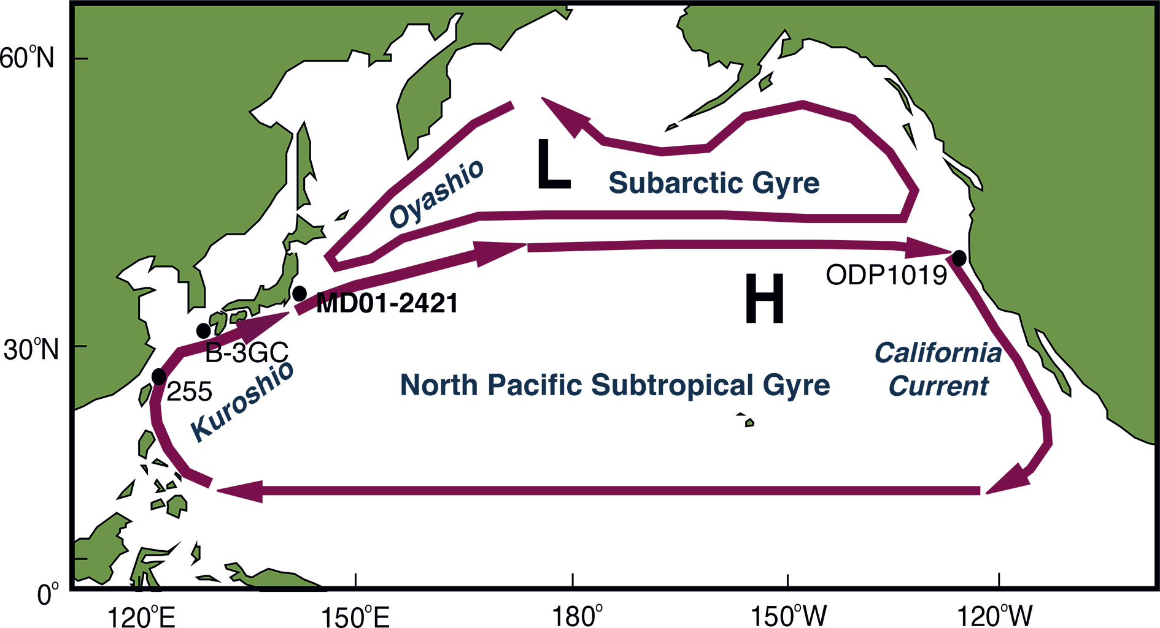
Yamamoto (2012) PAGES news 20(2): 66
Modified from Isono et al. (2009) Geology 37: 591-594
Notes:
Latent 1500-year climate oscillation in the Holocene
Masanobu Yamamoto
Faculty of Environmental Earth Science, Hokkaido University, Sapporo, Japan; myama@ees.hokudai.ac.jp
Figure 2: Holocene variations in (A) detrended UK’37-derived SST at the study site (Isono et al. 2009), (B) its 400-year
running mean omitting the cooling event at 8.5 ka, (C) hematite-stained grain content in a North Atlantic core
(Bond et al. 1997), (D) mixed layer density in the North Atlantic (Thornalley et al. 2009), (E) lateral SST differences
in the Okinawa Trough (Jian et al. 2000), (F) detrended UK'37-derived SST at ODP Site 1019 at the California margin
(Barron et al. 2003), and (G) tree-ring Δ14C-based sunspot numbers (Solanki et al. 2004). Gray shading indicates
cold periods at the Japan margin. (H) Time deviations from a regular 1470-year template for the mid-point of
warmings at site MD01-2421 during the Holocene and at Greenland site GISP2 during the last glacial period
(Rahmstorf 2003). Numbers in panel H indicate Dansgaard-Oeschger interstadials; “A” = Alleröd. Figure modified
from Isono et al. (2009).

Slide 8
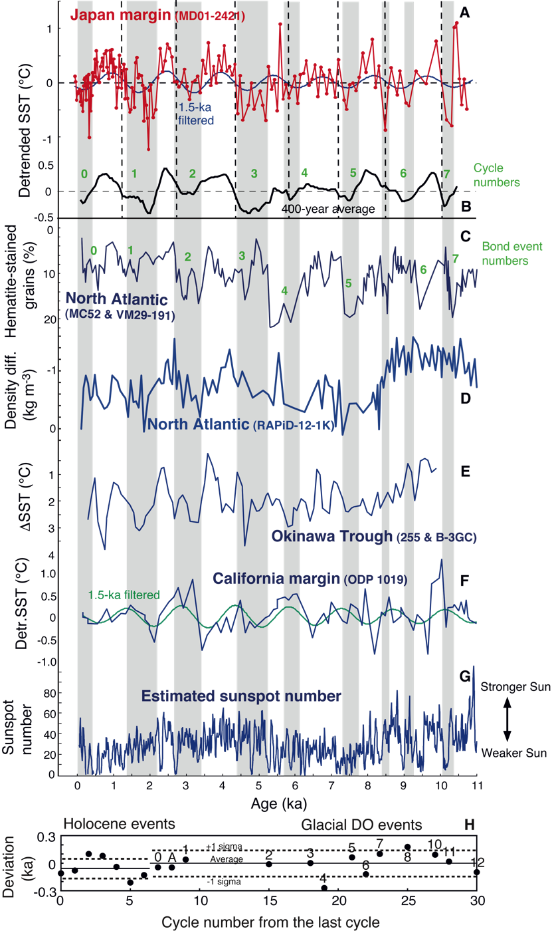
Yamamoto (2012) PAGES news 20(2): 67
Modified from Isono et al. (2009) Geology 37: 591-594
Notes:
Latent 1500-year climate oscillation in the Holocene
Masanobu Yamamoto
Faculty of Environmental Earth Science, Hokkaido University, Sapporo, Japan; myama@ees.hokudai.ac.jp
Figure 1: Locations of the study site MD01-2421, and other mentioned reference sites in the North Pacific. The subarctic
and subtropical gyre circulations are driven by westerly and trade winds that are regulated by the summer
North Pacific High (H) and the winter Aleutian Low (L). Figure modified from Isono et al. (2009).

Slide 9
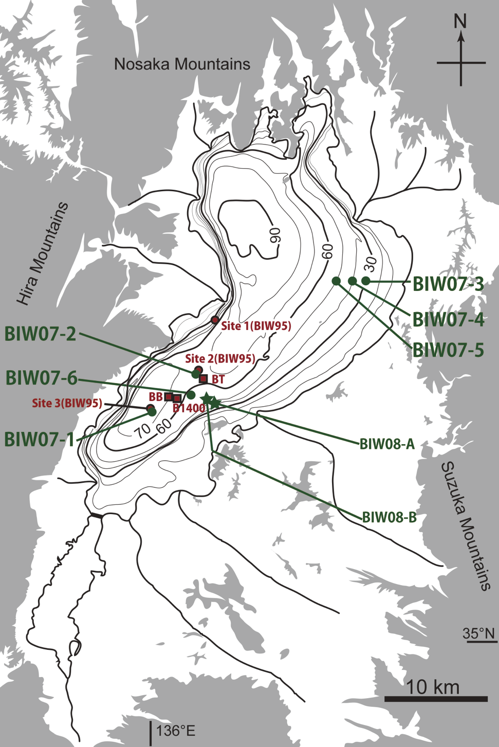
Takemura (2012) PAGES news 20(2): 68
Modified from Takemura et al. (2010) Quat Res Japan 49: 147-160
Notes:
The history of Lake Biwa drilling
Keiji Takemura
Institute for Geothermal Sciences, Kyoto University, Beppu, Japan; takemura@bep.vgs.kyoto-u.ac.jp
Figure 1: Map showing locations of principal coring sites in Lake Biwa (from Takemura et al. 2010). BB (200 m drilling
in 1971; Horie 1984), B1400 (1400 m drilling in 1982-1983; Takemura 1990; Horie 1991), BT (141 m drilling in 1986;
Yoshikawa and Inouchi 1991), Site 1, 2, 3 (BIW95; Piston cores in 1995; Takemura et al. 2000), BIW07-1 to BIW07-6
(Piston cores in 2007; Takemura et al. 2010), BIW08-A and BIW08-B (Drilled cores in 2008; Takemura et al. 2010).

Slide 10
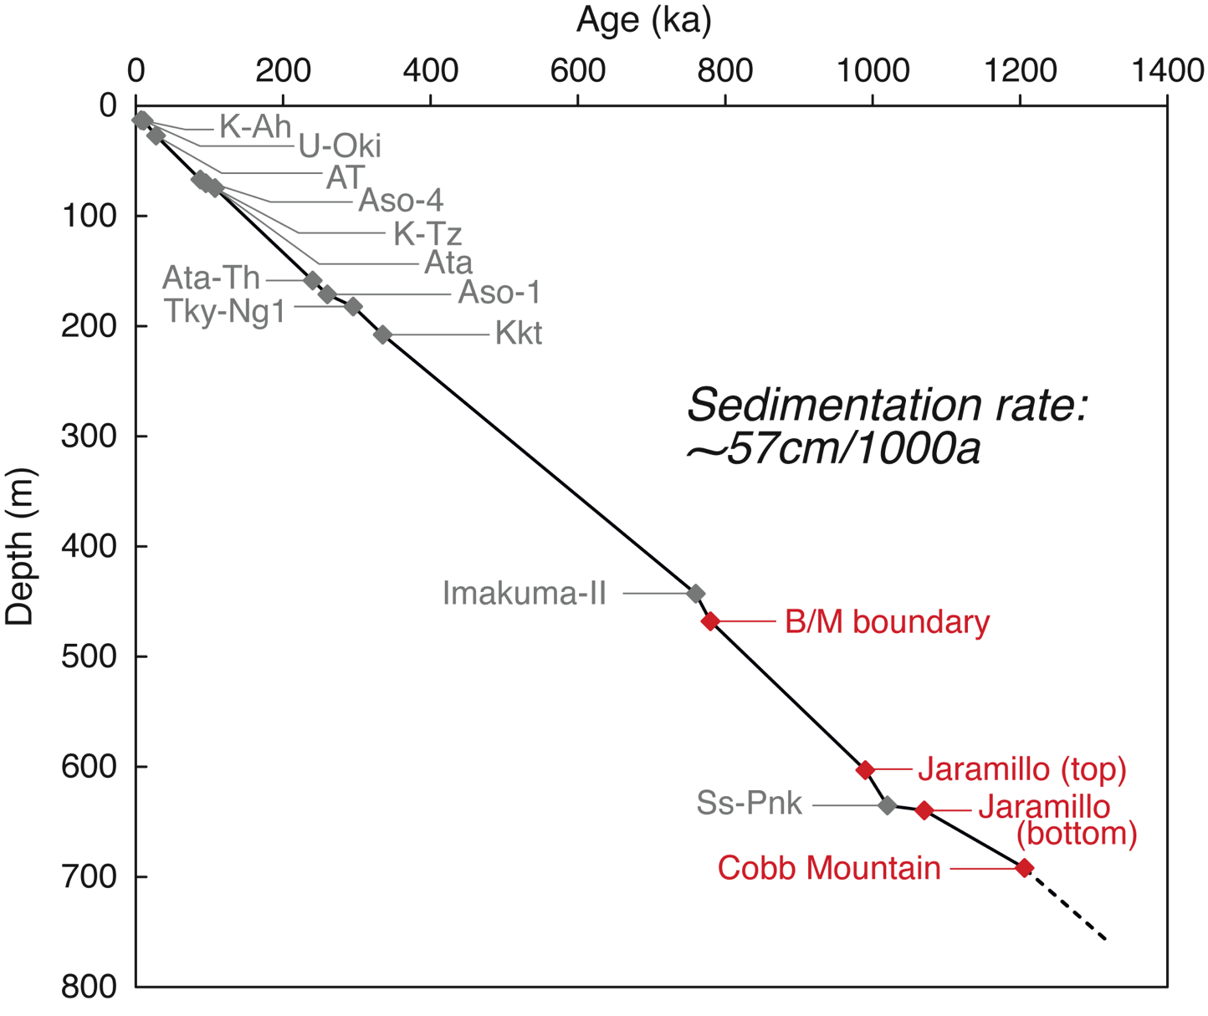
Takemura (2012) PAGES news 20(2): 69
From Takemura et al. (2010) Quat Res Japan 49: 101-109
Notes:
The history of Lake Biwa drilling
Keiji Takemura
Institute for Geothermal Sciences, Kyoto University, Beppu, Japan; takemura@bep.vgs.kyoto-u.ac.jp
Figure 2: Summary of chronology of core B1400 based on the re-investigation of fission track ages, tephra identification
and magnetostratigraphy (Danhara et al. 2010). Tephra horizons (gray): K-Ah, U-Oki, AT, Aso-4, K-Tz,Ata, At-Th,
Aso-1, Tky-Ng1, Kkt, Imakuma II, Ss-Pink; Paleomagnetic information (red): B/M (Brunhes/Matuyama) boundary,
top of Jaramillo event, bottom of Jaramillo event, Cobb mountain event.

Slide 11
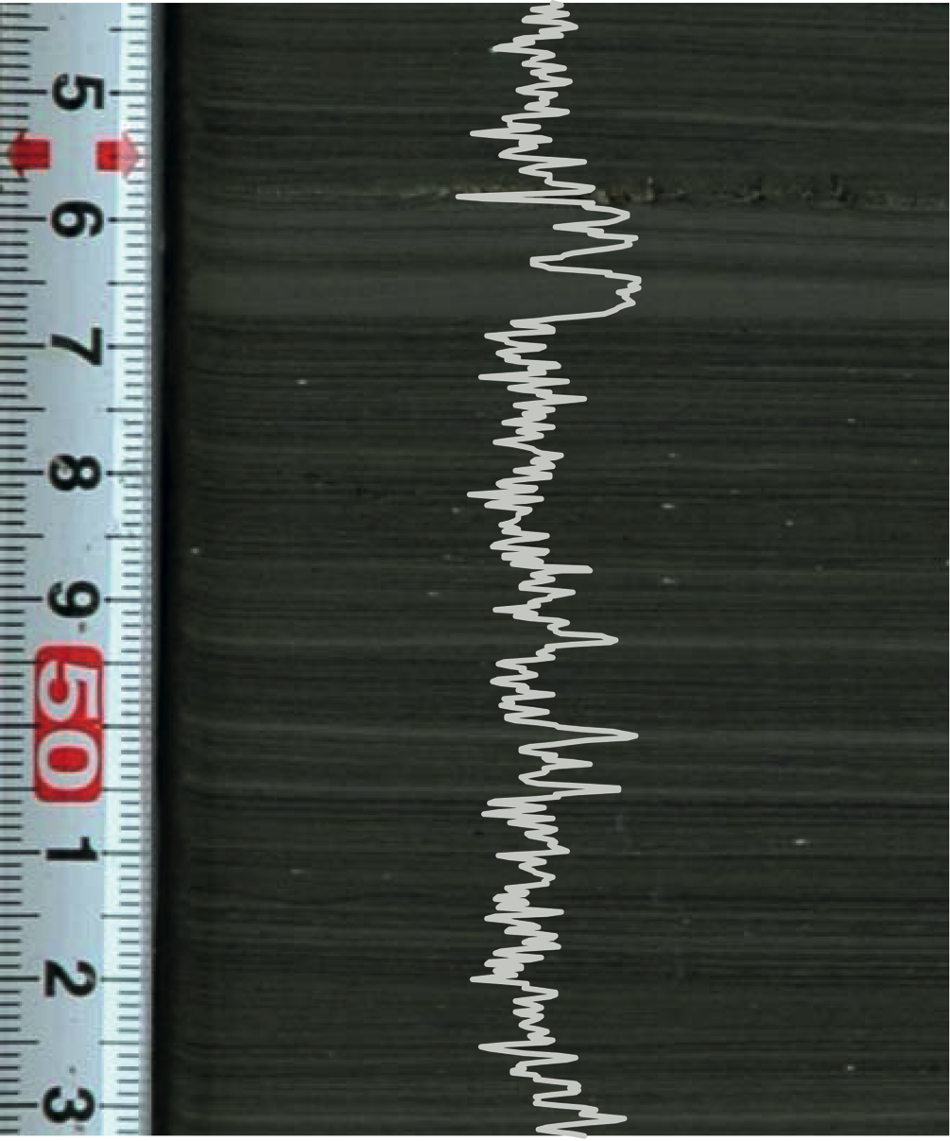
Nakagawa et al. (2012) PAGES news 20(2): 70
Notes:
Lake Suigetsu 2006 Varved Sediment Core Project
Takeshi Nakagawa1 and Suigetsu 2006 Project Members2
1School of Geography, Politics and Sociology, Newcastle University, Newcastle upon Tyne, UK; takeshi.nakagawa@newcastle.ac.uk
2www.suigetsu.org
Figure 1: Varved sediments of Lake Suigetsu, Honshu Island, Japan. The curve shows relative gray scale values as
measured on the displayed image.

Slide 12
Nakagawa et al. (2012) PAGES news 20(2): 71
Notes:
Lake Suigetsu 2006 Varved Sediment Core Project
Takeshi Nakagawa1 and Suigetsu 2006 Project Members2
1School of Geography, Politics and Sociology, Newcastle University, Newcastle upon Tyne, UK; takeshi.nakagawa@newcastle.ac.uk
2www.suigetsu.org
Figure 2: Photographic litho-stratigraphy of the SG06
core (modified after Nakagawa et al. 2012). Red shades
show disturbed sediment sections. The coring team
consisted of people from Newcastle University (UK),
University of Tokyo, Osaka City University, Chiba University
of Commerce, Naruto University of Education,
Kyoto University (Japan), GeoForschungsZentrum
Potsdam (Germany), and Royal Holloway University
of London (UK).

Slide 13
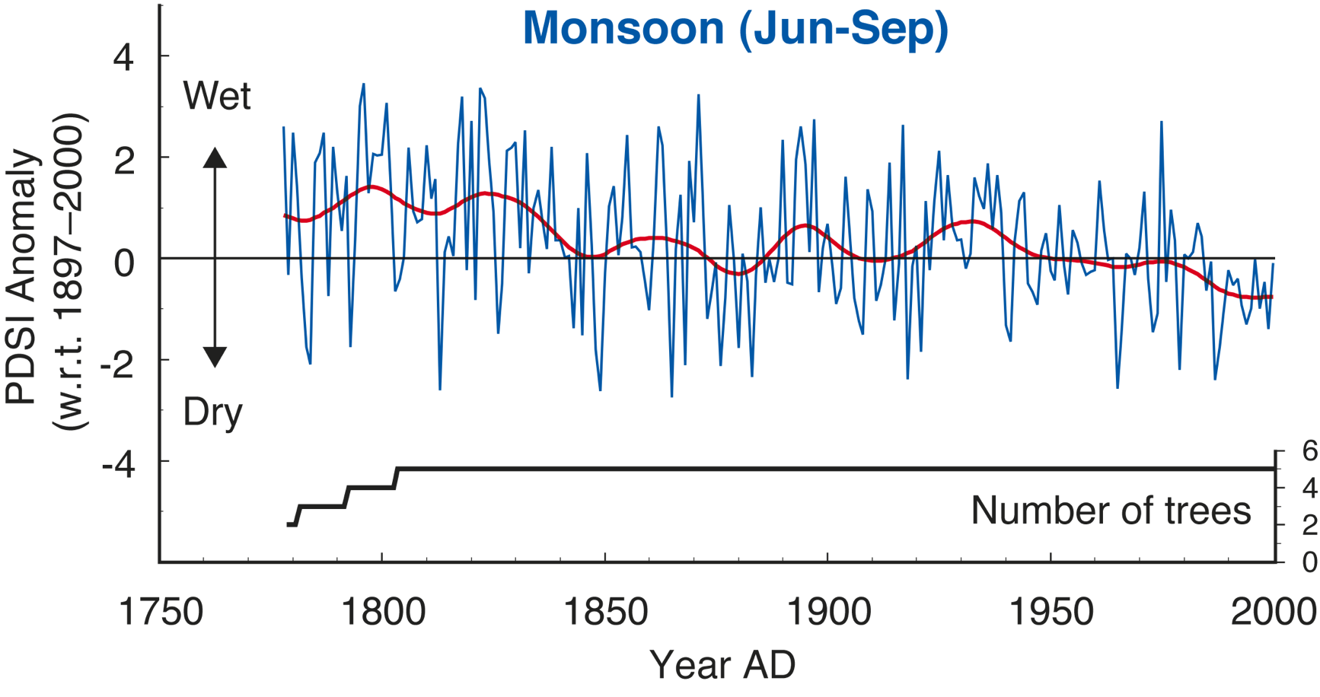
Sano et al. (2012) PAGES news 20(2): 72
Modified from Sano et al. (2012) The Holocene 22: 809-817
Notes:
Monsoon reconstruction in subtropical Asia from oxygen isotope ratios of tree-ring cellulose
Masaki Sano, C. Xu and T. Nakatsuka
Graduate school of Environmental Studies, Nagoya University, Japan; sano.masaki@b.mbox.nagoya-u.ac.jp
Figure 1: Reconstructed June-September PDSI from tree-ring δ18O in the Nepal Himalayas. The thick curve represents a 30-year cubic spline. Figure modified from Sano et
al. (2012a).

Slide 14
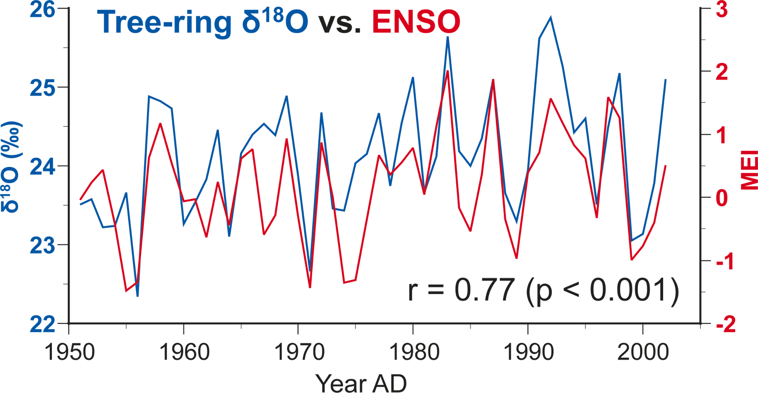
Sano et al. (2012) PAGES news 20(2): 73
Modified from Xu et al. (2011) J Geophys Res 116: D24109
Notes:
Monsoon reconstruction in subtropical Asia from oxygen isotope ratios of tree-ring cellulose
Masaki Sano, C. Xu and T. Nakatsuka
Graduate school of Environmental Studies, Nagoya University, Japan; sano.masaki@b.mbox.nagoya-u.ac.jp
Figure 2: Comparison of inter-annual variations in tree-ring δ18O from Laos and the Multivariate ENSO index (MEI) for the period of 1951-2002. Figure modified from Xu et
al. (2011).

Slide 15
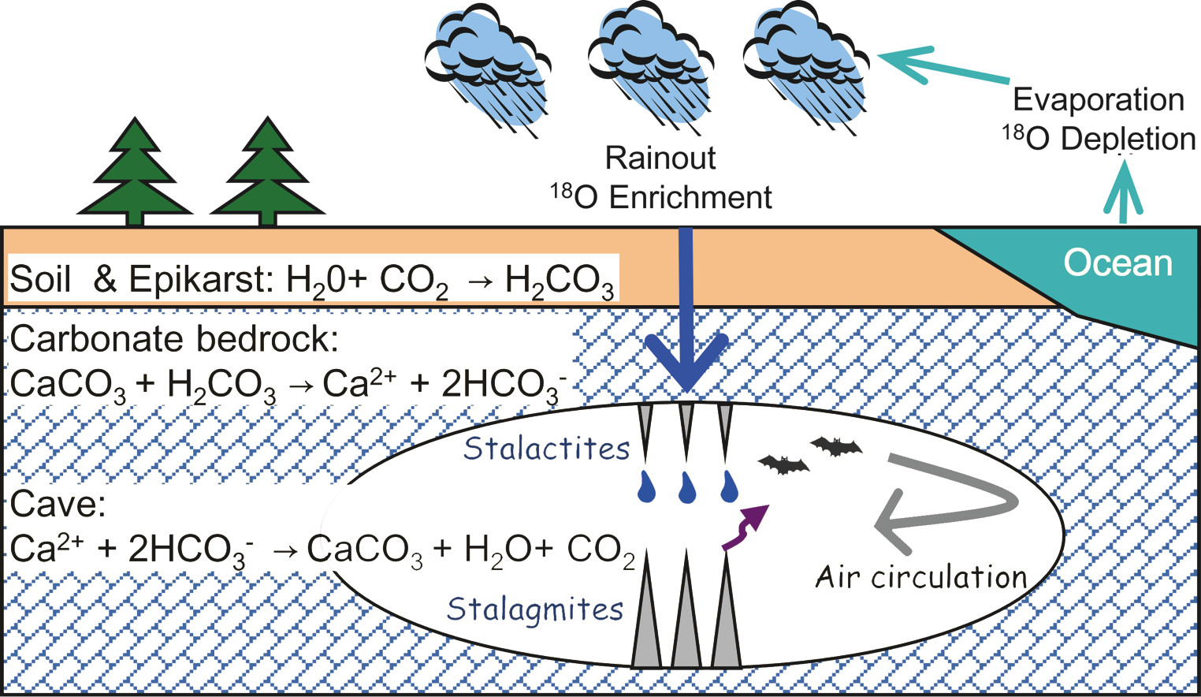
Watanabe et al. (2012) PAGES news 20(2): 74
Notes:
Hydroclimate reconstruction in Indonesia over the last centuries by stalagmite isotopic analyses
Yumiko Watanabe1, T. Tagami1, S. Ohsawa2, K. Takemura2 and S. Yoden1
1Division of Earth and Planetary Sciences, Graduate School of Science, Kyoto University, Japan; yumiko@kueps.kyoto-u.ac.jp
2Institute for Geothermal Sciences, Graduate School of Science, Kyoto University, Japan
Figure 1:The formation process of stalagmites.

Slide 16
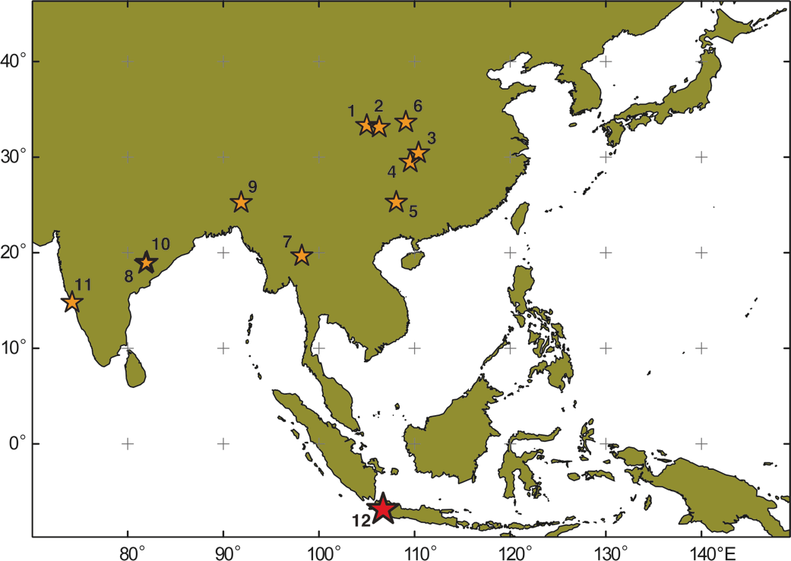
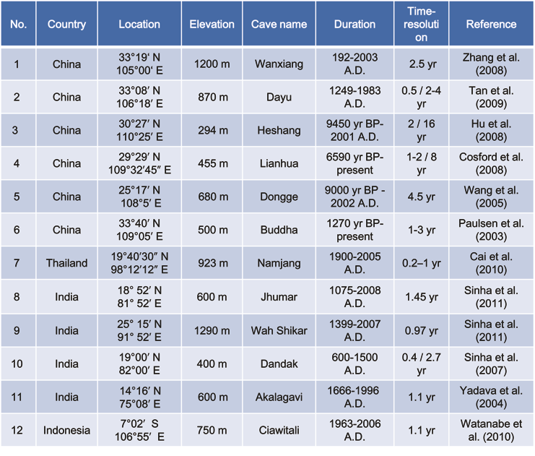
Watanabe et al. (2012) PAGES news 20(2): 75
Notes:
Hydroclimate reconstruction in Indonesia over the last centuries by stalagmite isotopic analyses
Yumiko Watanabe1, T. Tagami1, S. Ohsawa2, K. Takemura2 and S. Yoden1
1Division of Earth and Planetary Sciences, Graduate School of Science, Kyoto University, Japan; yumiko@kueps.kyoto-u.ac.jp
2Institute for Geothermal Sciences, Graduate School of Science, Kyoto University, Japan
Figure 2: Study sites of Asian stalagmites used to reconstruct rainfall variations over the last 2000 years. The red
star shows the location of the Ciawitali Cave on West Java, Indonesia.

Slide 17
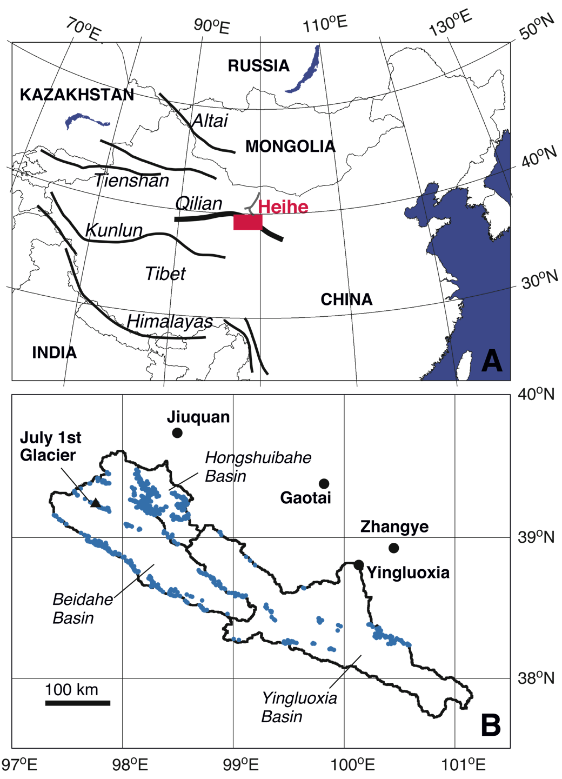
Fujita and Satai (2012) PAGES news 20(2): 76
Notes:
River runoff over 2000 years in the arid Heihe River Basin, northwestern China
Koji Fujita and Akiko Sakai
Graduate School of Environmental Studies, Nagoya University, Nagoya, Japan; cozy@nagoya-u.jp
Figure 1: A) Location of the Heihe River, northwest China. Red rectangle indicates the area shown in panel B. B) The
catchments of upper stream basins. Stations where several decades worth of hydrological and meteorological data
are available are indicated (black circles), as is the July 1st Glacier, where glaciological observations were conducted
for the period 2002-2005. Blue dots denote glaciers in the basin delineated from satellite images. Each grid square
is equivalent to the grid of the used APHRODITE precipitation dataset (0.5°∆; Yatagai et al. 2009).

Slide 18
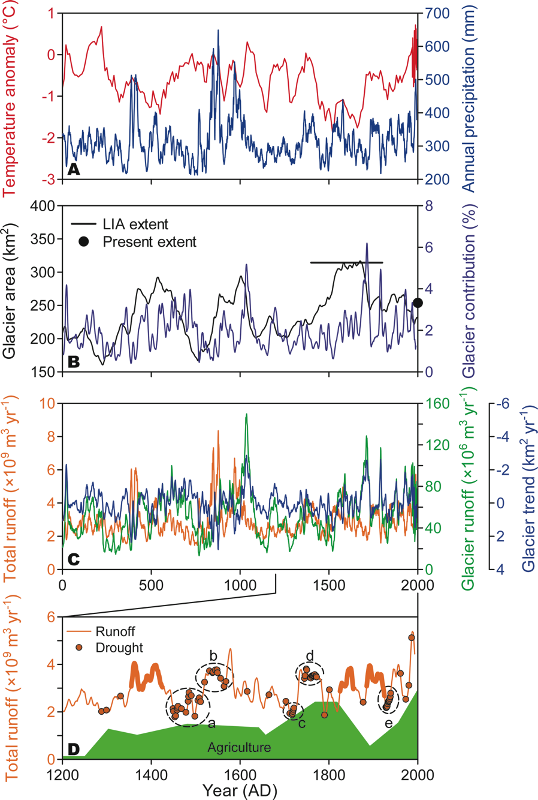
Fujita and Satai (2012) PAGES news 20(2): 77
Notes:
River runoff over 2000 years in the arid Heihe River Basin, northwestern China
Koji Fujita and Akiko Sakai
Graduate School of Environmental Studies, Nagoya University, Nagoya, Japan; cozy@nagoya-u.jp
Figure 2: Climate and runoff records for the Heihe Basin covering the past two millennia. A) Annual mean temperature
anomaly rel. to AD 1966-1995 (Yang et al. 2002), and annual precipitation (Zhang et al. 2003). B) Glacier
area and contribution of glacier runoff to total runoff (Sakai et al. 2012). The present and LIA extents are shown
by the black dot and line, respectively. C) Total annual catchment runoff, annual glacier runoff (Sakai et al. 2012),
and trend of glacier extent (see equation in the main text). D) Five-year moving average of river runoff and drought
events recorded in historical documents. Five prolonged drought periods (a-e) are highlighted (Sakai et al. 2012).
Thick lines denote drought-free periods, which are discussed in the main text. Green shading denotes trends of
agricultural activity in the region as retrieved from historical documents (Inoue et al. 2007; Nakawo 2011).

Slide 19
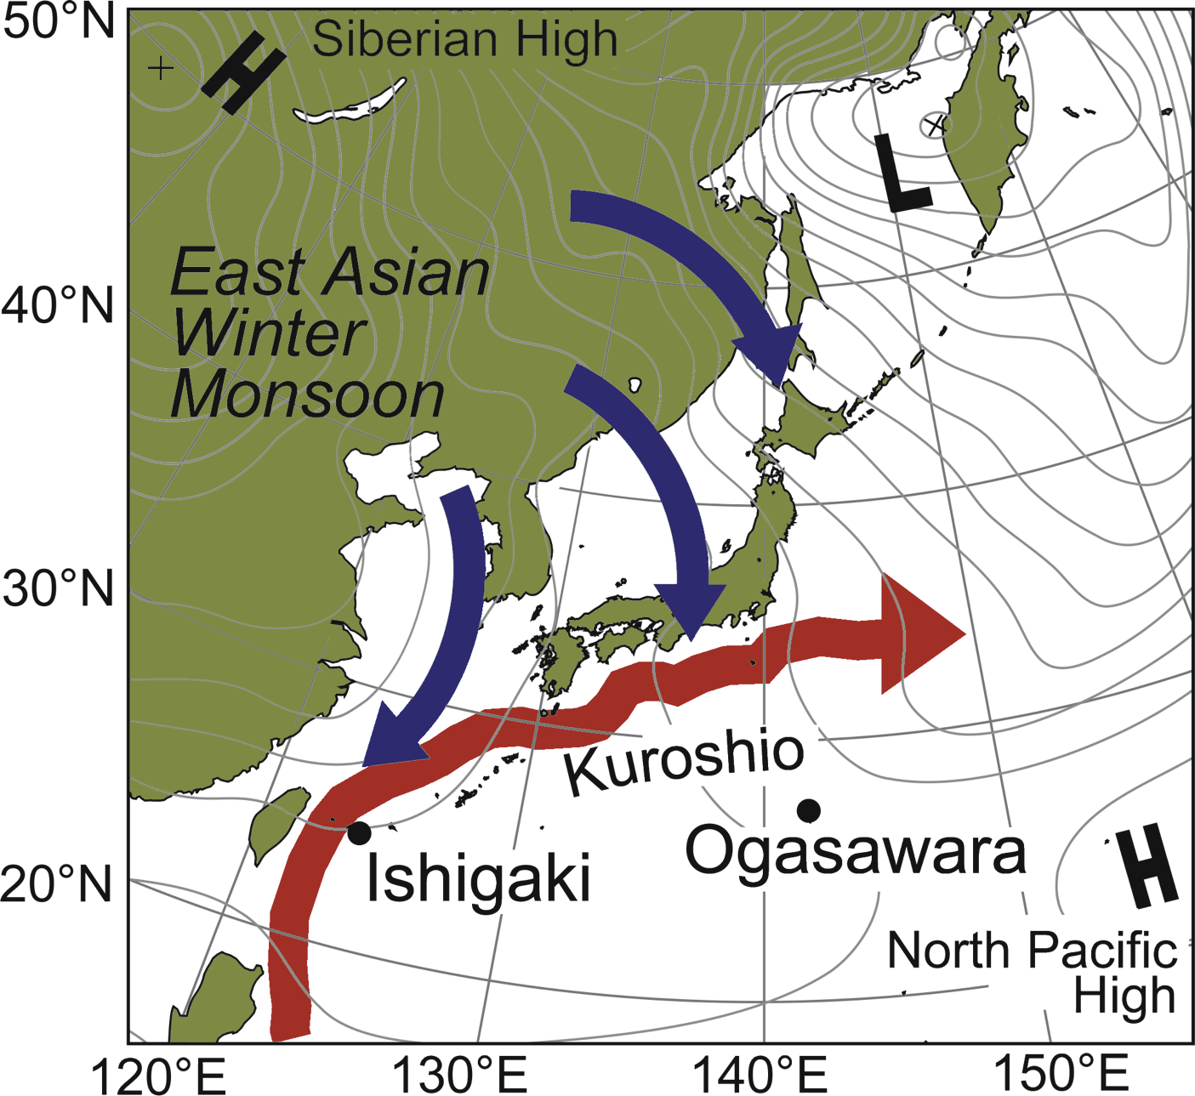
Suzuki (2012) PAGES news 20(2): 78
Modified from Mishima et al. (2010) Geophys res letters 37: L15609
Notes:
Two centuries of climate events detected in coral records from Ishigaki and Ogasawara Islands, Japan
Atsushi Suzuki
Geological Survey of Japan, National Institute of Advanced Industrial Science and Technology (AIST), Japan; a.suzuki@aist.go.jp
Figure 1: Map of the northwestern Pacific showing the locations of the Ishigaki and Ogasawara Islands. The typical
winter East Asian sea-level atmospheric pressure distribution (isolines) and the path of the Kuroshio current (red
arrow) are also shown. Northerly winds (East Asian winter monsoon) blowing from the Siberian High influence
the climate around Japan in winter (blue arrows). Modified from Mishima et al. (2010).

Slide 20
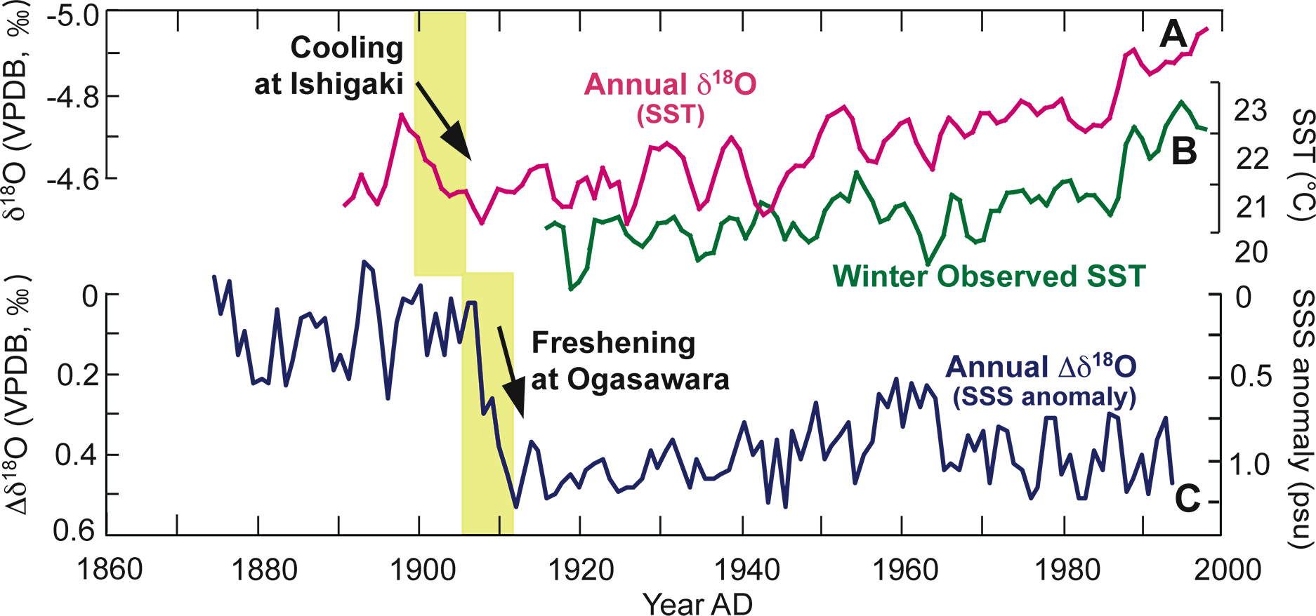
Suzuki (2012) PAGES news 20(2): 79
Notes:
Two centuries of climate events detected in coral records from Ishigaki and Ogasawara Islands, Japan
Atsushi Suzuki
Geological Survey of Japan, National Institute of Advanced Industrial Science and Technology (AIST), Japan; a.suzuki@aist.go.jp
Figure 2: Time series of (A) annual coral δ18O (SST) data, (B) observed winter (December–February average) SST at Ishigaki Island, and (C) residual coral δ18O records (Δδ18O)
in the Ogasawara Islands, based on both δ18O and Sr/Ca. VPDB refers to the Vienna PeeDee Belemnite standard. The coral-based sea surface salinity (SSS) anomaly was
calculated from the regional δ18O seawater–salinity relationship (0.42‰ per 1 psu; Felis et al. 2009). The yellow bars correspond to the abrupt cooling (1900-1905) inferred
at Ishigaki Island and the abrupt freshening (1905-1910) in the Ogasawara Islands.

Slide 21
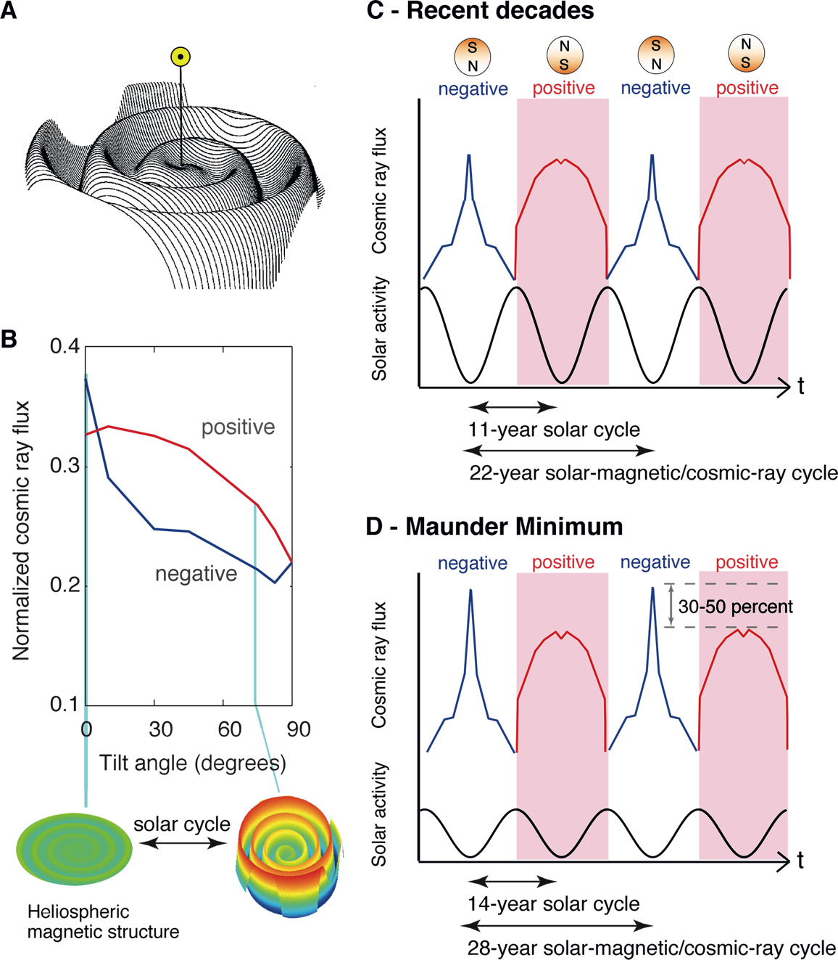
Miyahara et al. (2012) PAGES news 20(2): 80
Notes:
Tracing the response of climate to galactic cosmic rays
Hiroko Miyahara1,2, Y. Yokoyama2,3, Y.T. Yamaguchi2,3 and T. Nakatsuka4
1Institute for Cosmic Ray Research, The University of Tokyo, Kashiwa, Japan; hmiya@icrr.u-tokyo.ac.jp
2Japan Agency for Marine-Earth Science and Technology, Yokosuka, Japan; 3Atmosphere and Ocean Research Institute, The University of Tokyo,
Kashiwa, Japan; 4Graduate School of Environmental Studies, Nagoya University, Nagoya, Japan
Figure 1: A) Schematic of the heliospheric magnetic field with the Sun located at the center (modified after Jokipii
and Thomas 1981). B) Relation between the numerically calculated intensity of galactic cosmic rays at the Earth and
the waviness of the heliospheric magnetic field (as illustrated by the schematics below the graph), for both positive
and negative polarities of the solar dipole magnetic field (based on Kota and Jokipii 2001). C) Cosmic-ray time
profile at the Earth in the case of a tilt angle of 5°∆ at solar cycle minima and 75°∆ at maxima, as is observed during
the recent decades. D) As for (C), but for tilt angles of 0°∆ at cycle minima, which reproduces the cosmic ray variation
at the Maunder Minimum. Note that the polarity reverses at every maximum of the solar cycle, and that the length
of the solar cycle tends to be longer (e.g. 14 years during the Maunder Minimum) when solar activity is suppressed.

Slide 22
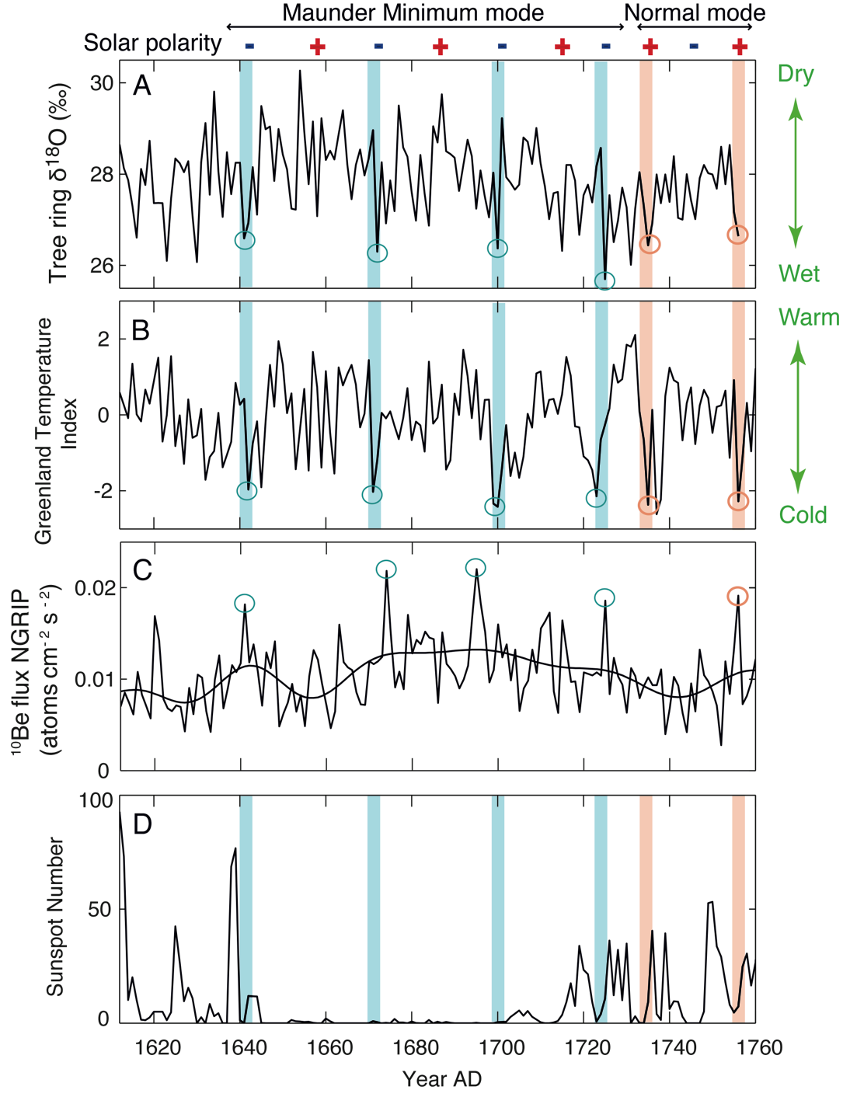
Miyahara et al. (2012) PAGES news 20(2): 81
Modified from Yamaguchi et al. (2010) PNAS 107: 20697-20702
Notes:
Tracing the response of climate to galactic cosmic rays
Hiroko Miyahara1,2, Y. Yokoyama2,3, Y.T. Yamaguchi2,3 and T. Nakatsuka4
1Institute for Cosmic Ray Research, The University of Tokyo, Kashiwa, Japan; hmiya@icrr.u-tokyo.ac.jp
2Japan Agency for Marine-Earth Science and Technology, Yokosuka, Japan; 3Atmosphere and Ocean Research Institute, The University of Tokyo,
Kashiwa, Japan; 4Graduate School of Environmental Studies, Nagoya University, Nagoya, Japan
Figure 2: Temporal trends in (A) relative humidity in Japan reconstructed based on 18O in tree-ring cellulose (Yamaguchi
et al. 2010), (B) reconstructed temperature in Greenland based on 18O in ice cores (Vinther et al. 2003), (C)
cosmic-ray-induced nuclides (Berggren et al. 2009), and (D) sunspot numbers (Hoyt and Schatten 1998). Open
circles denote annual-scale 30%-50% enhancements in cosmic rays (C), and the corresponding climate response
(A, B). Blue and red shadings periods of negative and positive solar polarity, respectively. Figure modified from
Yamaguchi et al. 2010.

Slide 23
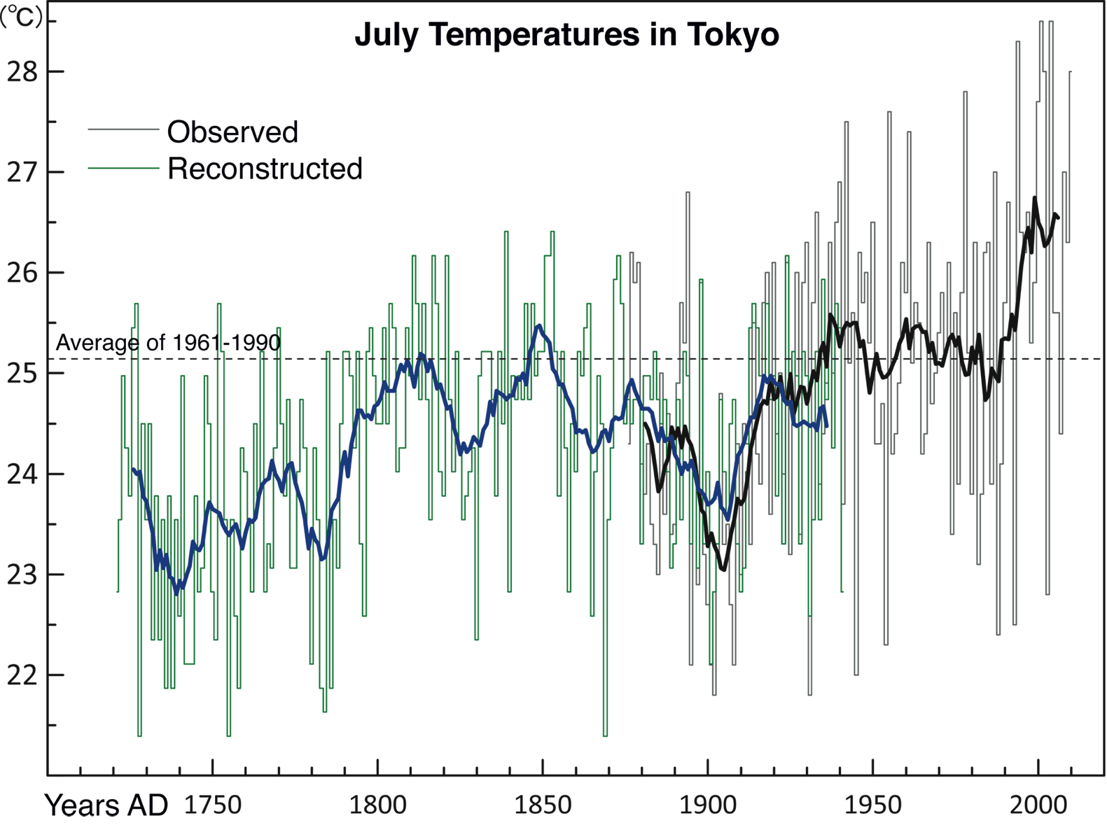
Zaiki et al. (2012) PAGES news 20(2): 82
Updated from Mikami (1996) Geographical Reports of Tokyo
Metropolitan University 31: 157-165
Notes:
Document-based reconstruction of past climate in Japan
Masumi Zaiki1, M.J. Grossman2 and T. Mikami3
1Department of Economics, Seikei University, Tokyo, Japan; mzaiki@econ.seikei.ac.jp
2Department of Geography, Southern Illinois University Edwardsville, USA; 3Department of History, Teikyo University, Tokyo, Japan
Figure 1: Time series of reconstructed (green lines) and observed (black/gray lines) July temperatures in Tokyo
for 1721-2000. Thin lines indicate year-to-year variations and thick lines indicate 11-year running mean. Figure
modified and updated from Mikami (1996).

Slide 24
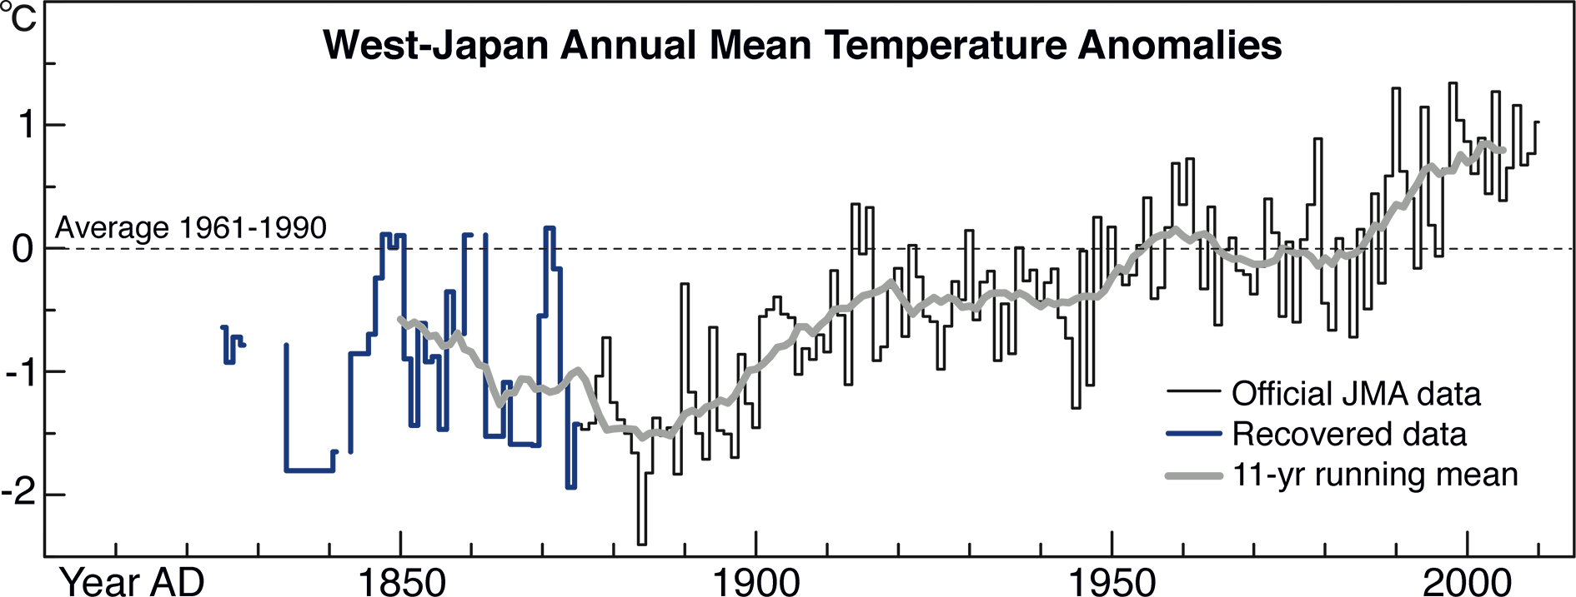
Zaiki et al. (2012) PAGES news 20(2): 83
Updated from Zaiki et al. (2006) Int J Clim 26: 399-423
Notes:
Document-based reconstruction of past climate in Japan
Masumi Zaiki1, M.J. Grossman2 and T. Mikami3
1Department of Economics, Seikei University, Tokyo, Japan; mzaiki@econ.seikei.ac.jp
2Department of Geography, Southern Illinois University Edwardsville, USA; 3Department of History, Teikyo University, Tokyo, Japan
Figure 2: Time series of West-Japan Temperature (WJT) anomaly for the period 1820-2010. Blue line is derived from newly recovered meteorological data, black line is from
official JMA data, and the gray thick line is a smoothed 11-year running mean. Figure modified and updated from Zaiki et al. (2006).

Slide 25
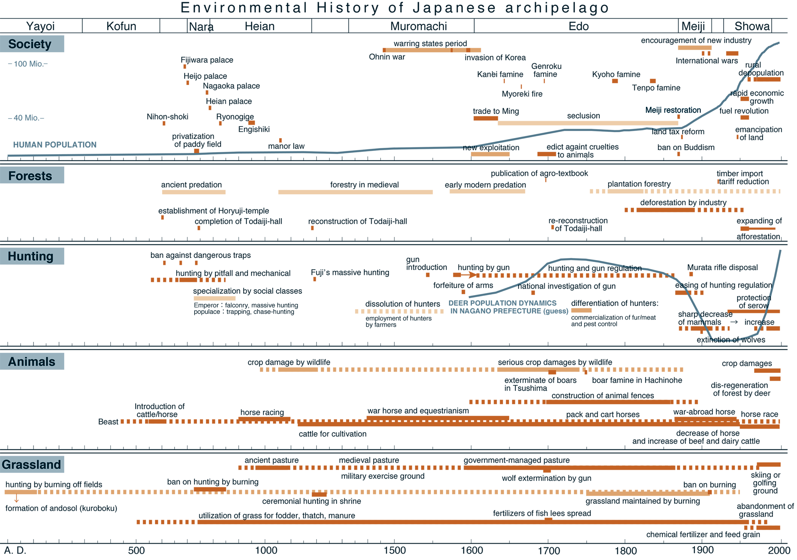
Yumoto (2012) PAGES news 20(2): 84
Notes:
Human-environment interaction and climate in the Japanese Archipelago
Takakazu Yumoto
Research Institute of Humanity and Nature, Kyoto, Japan; yumoto@chikyu.ac.jp
Figure 1: Chronological chart of the Japanese Archipelago during 0-2000 AD. The periods of governance and their names are given at the top of the figure.

Slide 26
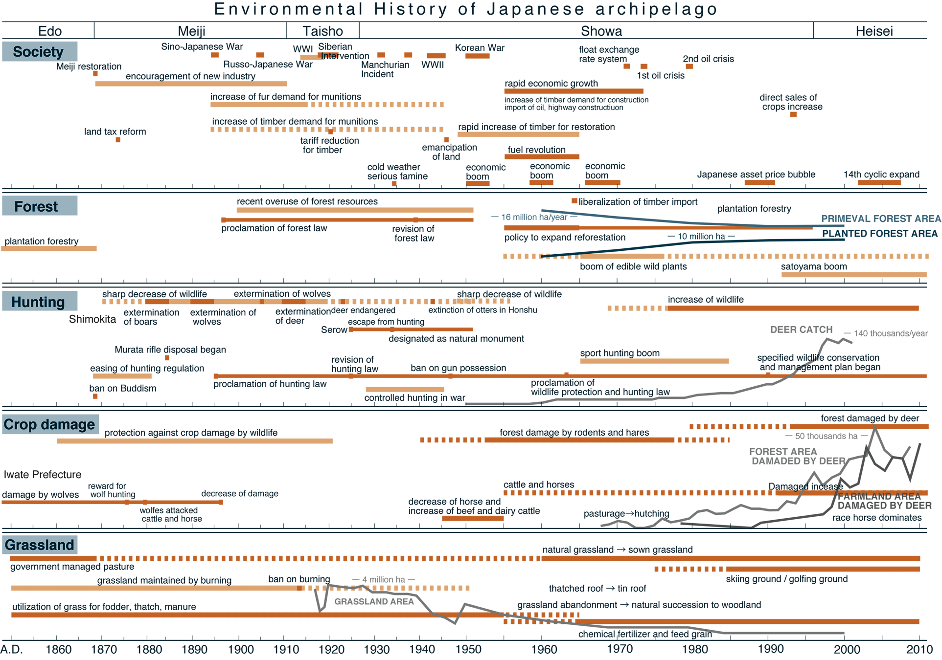
Yumoto (2012) PAGES news 20(2): 85
Notes:
Human-environment interaction and climate in the Japanese Archipelago
Takakazu Yumoto
Research Institute of Humanity and Nature, Kyoto, Japan; yumoto@chikyu.ac.jp
Figure 2: Chronological chart of the Japanese Archipelago during 1850-2010 AD. The periods of governance and their names are given at the top of the figure.

Slide 27
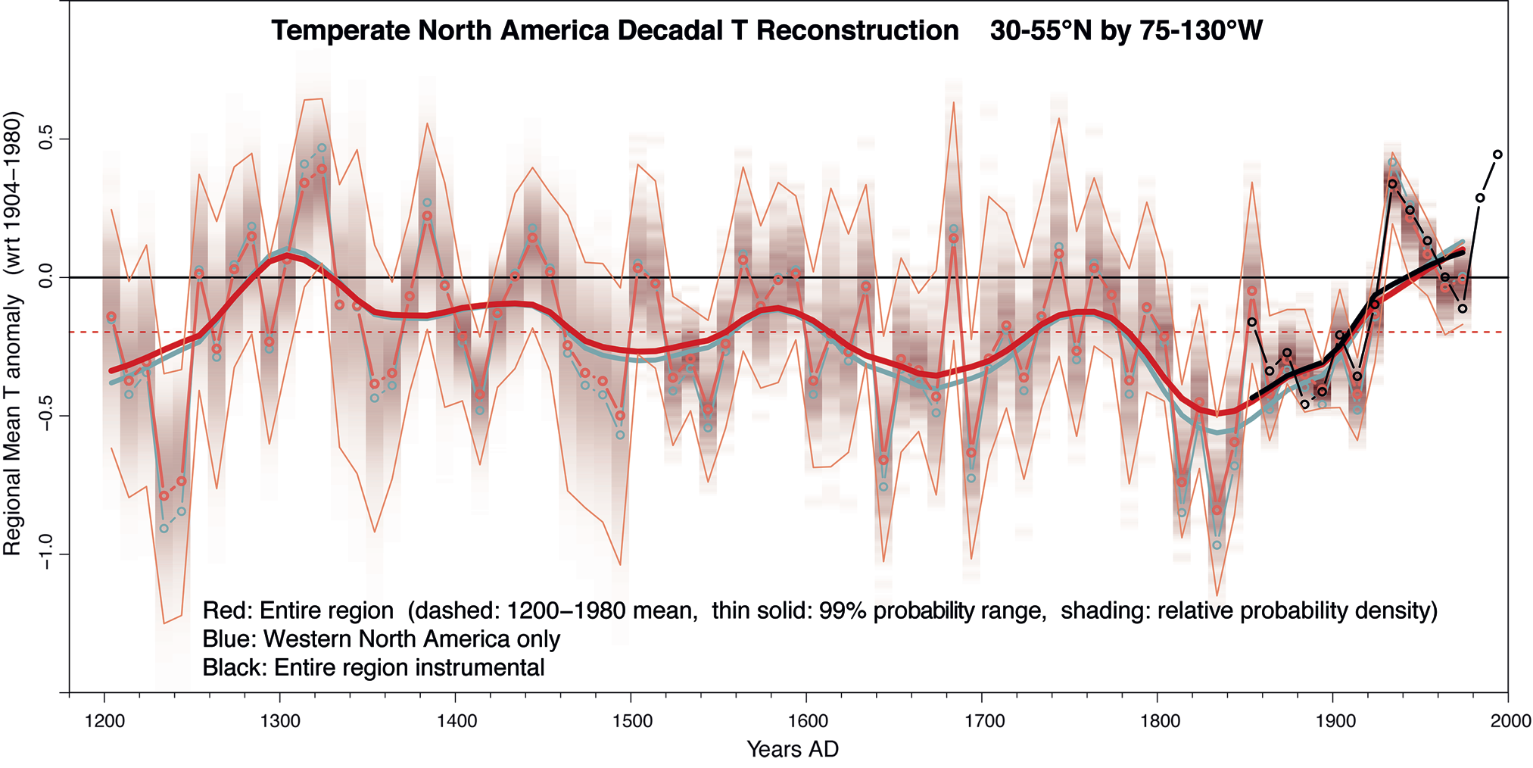
Wahl et al. (2012) PAGES news 20(2): 86
Notes:
An 800-year decadal-scale reconstruction of annual mean temperature for temperate North America
Eugene R. Wahl1, H.F. Diaz2, V. Trouet3 and E.R. Cook4
1National Climactic Data Center, National Oceanic and Atmospheric Administration, Boulder, USA; Eugene.R.Wahl@noaa.gov
2Cooperative Institute for Research in Environmental Science, University of Colorado, Boulder, USA; 3Laboratory of Tree-Ring Research, University
of Arizona, Tucson, USA; 4Tree-Ring Lab, Lamont-Doherty Earth Observatory, Palisades, USA
Figure 1: Reconstruction of annual mean temperature deviations from a 1904-1980 AD average (thin black line) for North America (30°∆-55°∆N, 75°∆-130°∆W). Values shown are
decadal means and a lowess filter to highlight low frequency fluctuations. The average for the full period of record (1200-1980 AD) for the entire region is shown as a dotted red
line, variable shading gives relative probability density for each decadal value, thin red envelope lines denote 99% probability range associated with each decadal mean value

Slide 28
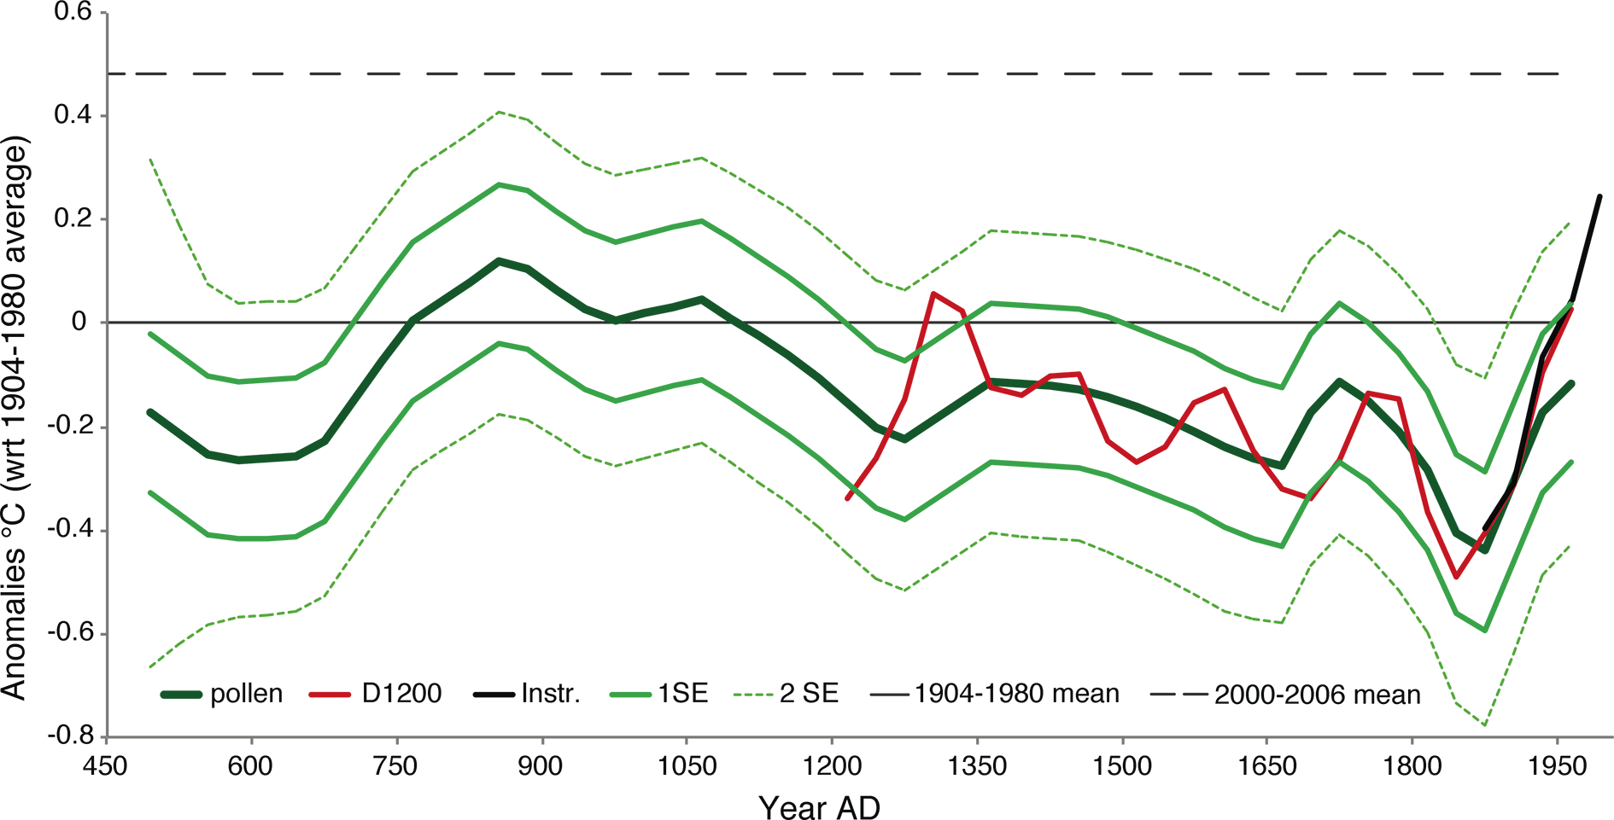
Trouet et al. (2012) PAGES news 20(2): 88
Notes:
A pollen-based extension of the 800-year decadalscale reconstruction of annual mean temperature for temperate North America dating back to 480 AD
Valerie Trouet1, H.F. Diaz2, A.E. Viau3, E.R. Wahl4
1Laboratory of Tree-Ring Research, University of Arizona, Tucson, USA; trouet@email.arizona.edu
2Cooperative Institute for Research in Environmental Sciences, University of Colorado, Boulder, USA; 3Department of Geography, University of
Ottawa, Canada; 4National Climatic Data Center, National Oceanic and Atmospheric Administration, Boulder, USA
Figure 1: Reconstruction (dark green curve) of 30-year averages of annual mean temperature deviations from a 1904-1980 AD average for North America (30˚-55˚N, 75˚-
130˚W). Values shown correspond to the combination of three pollen-reconstruction PCs resulting from a stepwise multiple linear regression with the 30-year-subsampled RC
temperature series (red curve), and thus reflects low frequency variations. Dashed (full) light green lines give 2SE (1SE) uncertainty estimations associated with each 30-year
value. Full black curve shows comparably smoothed instrumental temperature values. Dotted black line represents the average deviation for the period 2000-2006 AD, also
from comparably smoothed instrumental data.

Slide 29
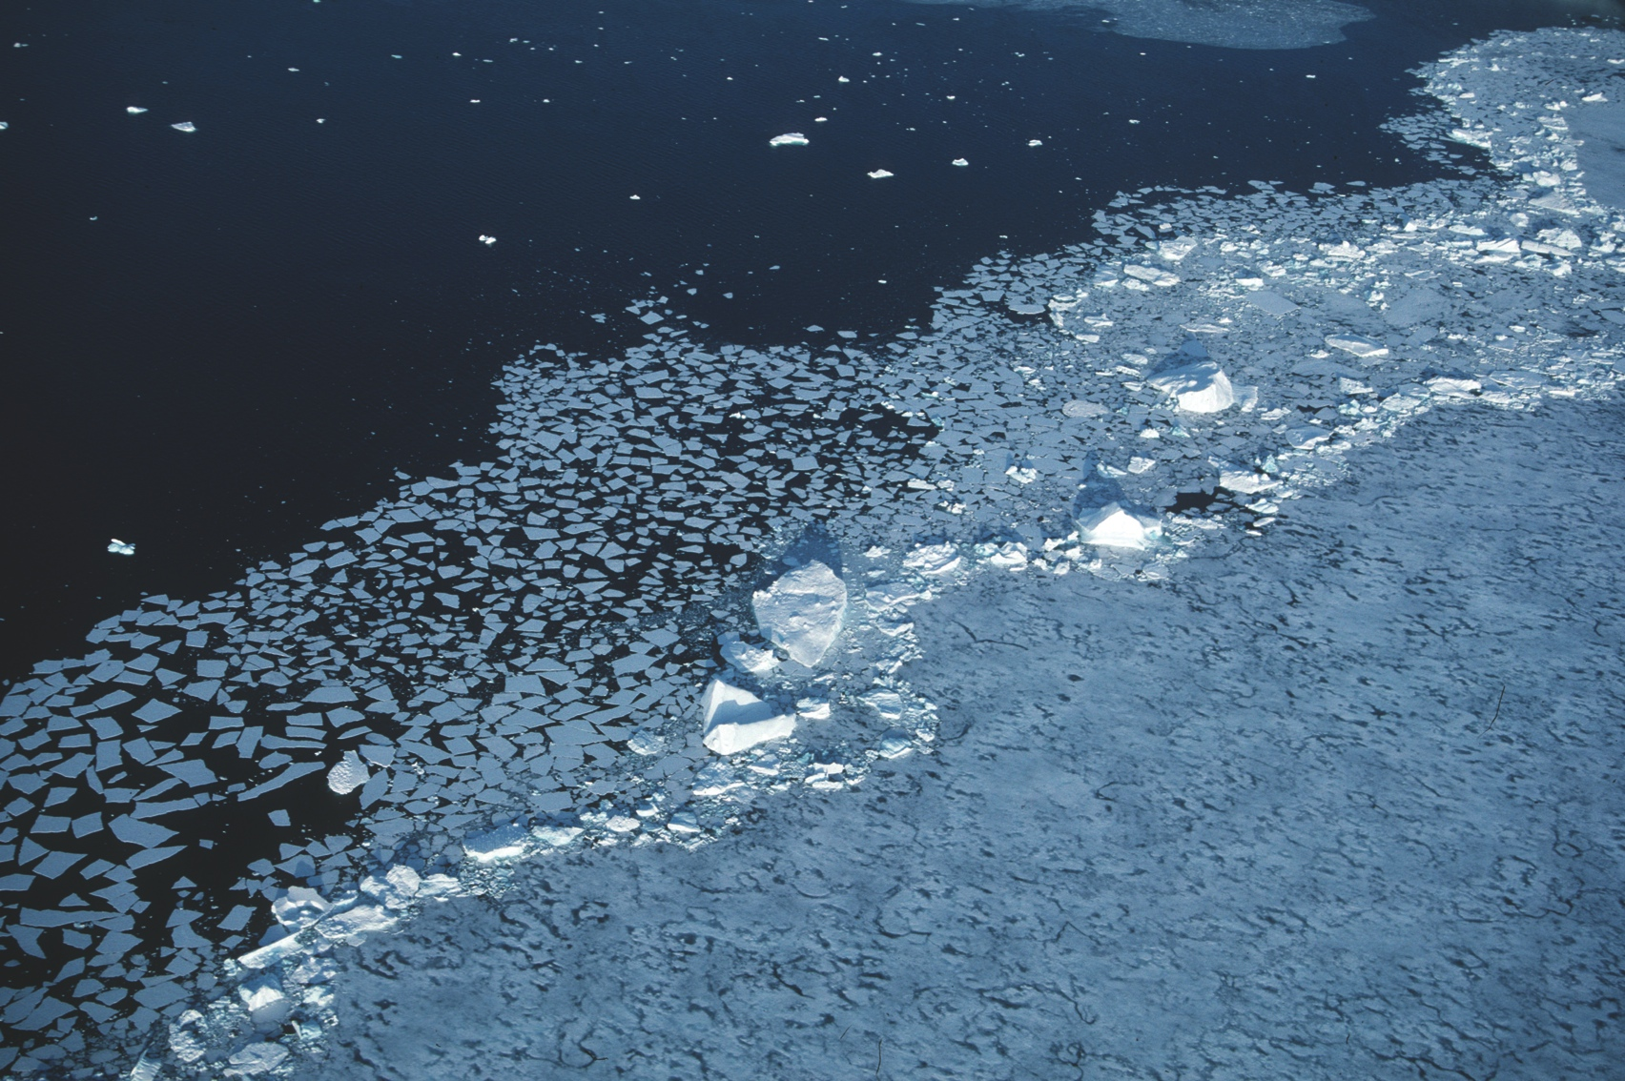
Wolff et al. (2012) PAGES news 20(2): 90
Photo by P. Bucktrout (British Antarctic Survey, UK)
Notes:
Sea Ice Proxy Working Group (SIP)
Eric Wolff1, A. de Vernal2 and R. Gersonde3 (co -chairs of the SIP WG )
1British Antarctic Survey, Cambridge, UK; ewwo@bas.ac.uk
2GEOTOP, Universit. de Qu.bec . Montr.al, Canada; 3Geosciences, Alfred-Wegener-Institute for Polar & Marine Research, Bremerhaven, Germany
Figure 1: The edge of the pack ice in the Weddell Sea. Photo by P. Bucktrout (British Antarctic Survey, UK).

Slide 30
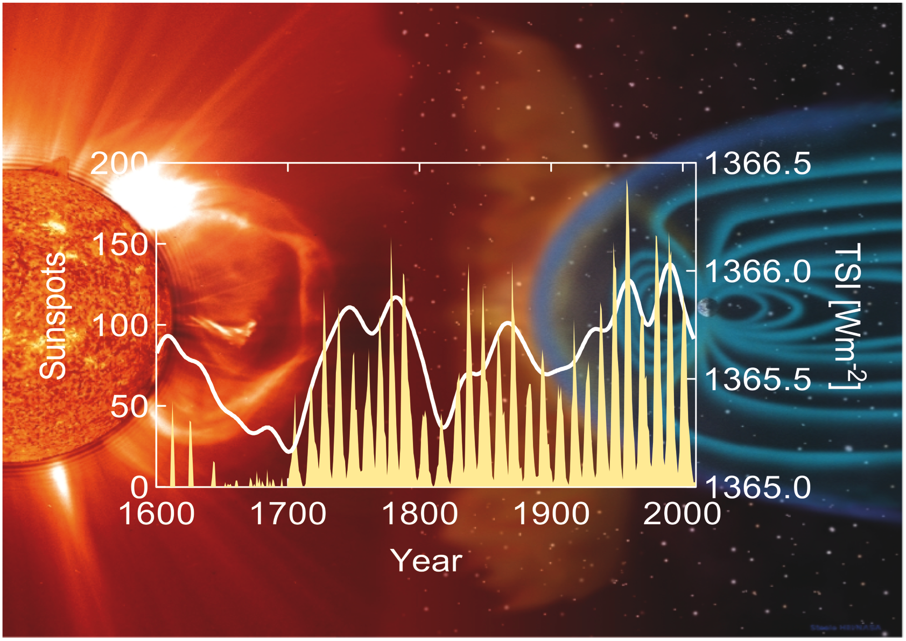
Beer. (2012) PAGES news 20(2): 91
Notes:
Solar Forcing – a new PAGES Working Group
Jürg Beer
Swiss Federal Institute of Aquatic Science and Technology, Dübendorf, Switzerland; juerg.beer@eawag.ch
Figure 1: Background picture - The Sun emitting electromagnetic radiation and hot plasma (solar wind) carrying
magnetic fields. While the radiation reaches the Earth directly solar particles are partly shielded by the geomagnetic
field. Graph - Sunspot numbers reflect the solar magnetic activity which is dominated by the 11-year Schwabe
cycle. The reconstructed smoothed total solar irradiance (TSI) follows the envelope of the sunspot record with
minima at 1645-1715 AD (Maunder Minimum) and at 1790-1830 AD (Dalton Minimum) and a maximum in the
second half of the 20th century.

Slide 31
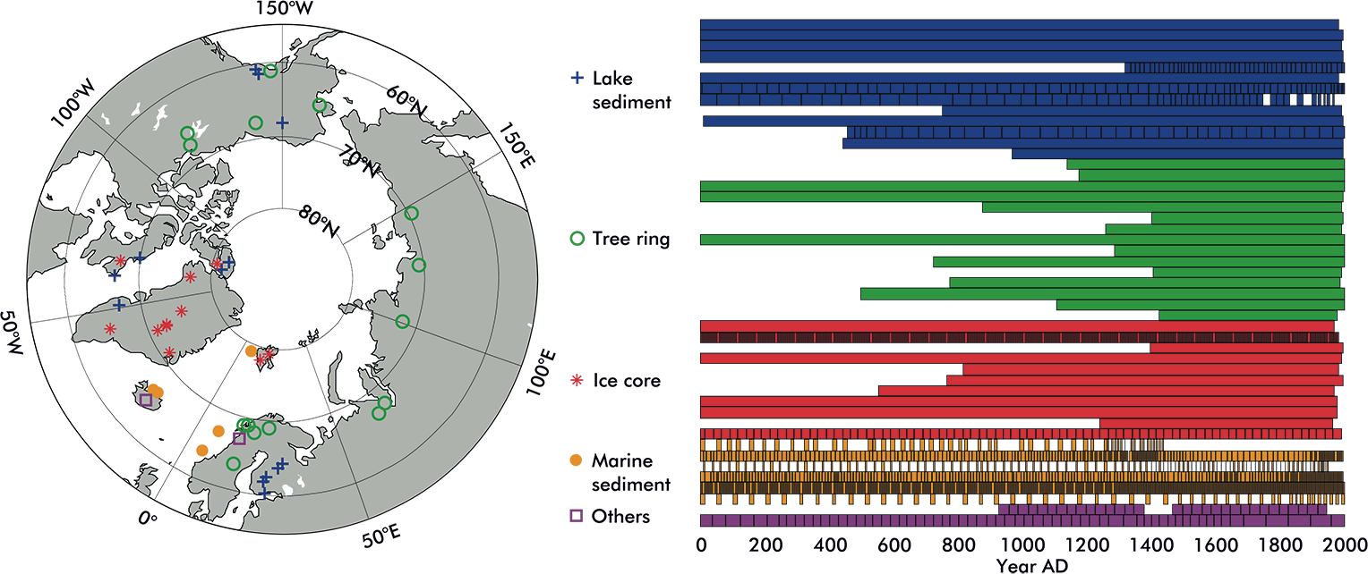
Hanhijärvi (2012) PAGES news 20(2): 92
Notes:
Arctic2k: Spatiotemporal Temperature Reconstruction
Sami Hanhijärvi
Department of Environmental Sciences, University of Helsinki, Finland; sami.hanhijarvi@helsinki.fi
Figure 1: Spatial and temporal distribution of the Arctic2k proxy records. Single solid box in temporal extent signifies annual resolution. Otherwise, each box represents the
time frame of a single value of a single proxy record. Records have been truncated prior to 1 BC. All proxy series in this figure are or will be archived on the NOAA paleoclimatology
database.

Slide 32
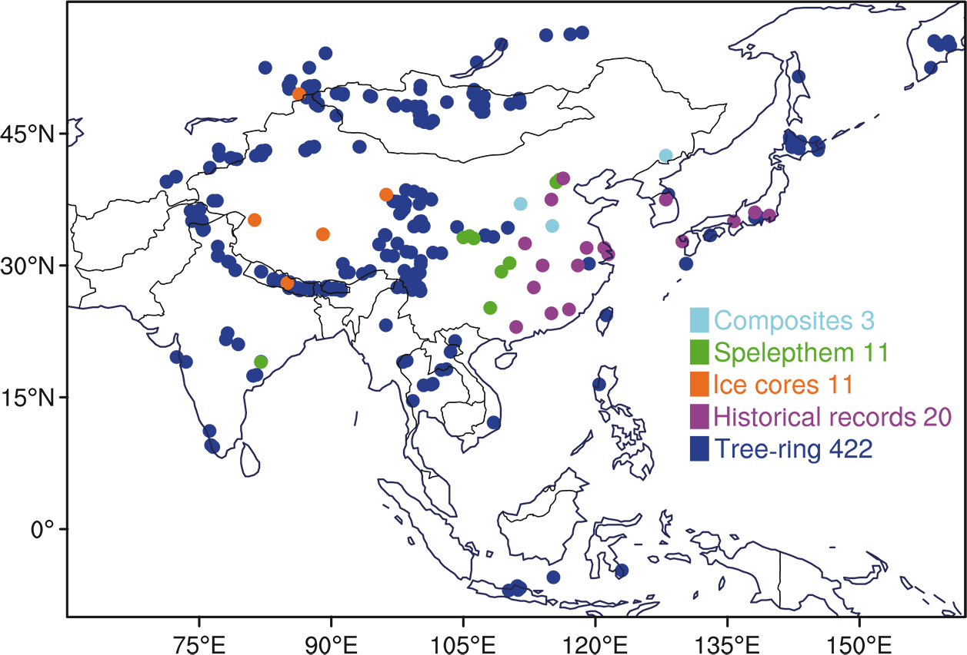
Sano et al. (2012) PAGES news 20(2): 93
Notes:
2nd Workshop of the PAGES Asia2k Working Group
Masaki Sano1, Shi Feng2, Takeshi Nakatsuka1 and Asia2k members
1Graduate School of Environmental Studies, Nagoya University, Japan; sano.masaki@b.mbox.nagoya-u.ac.jp
2Cold and Arid Regions Environmental and Engineering Research Institute, Chinese Academy of Sciences, China
Figure 1: The locations, types and numbers of available proxy records considered by the Asia2k group.

Slide 33
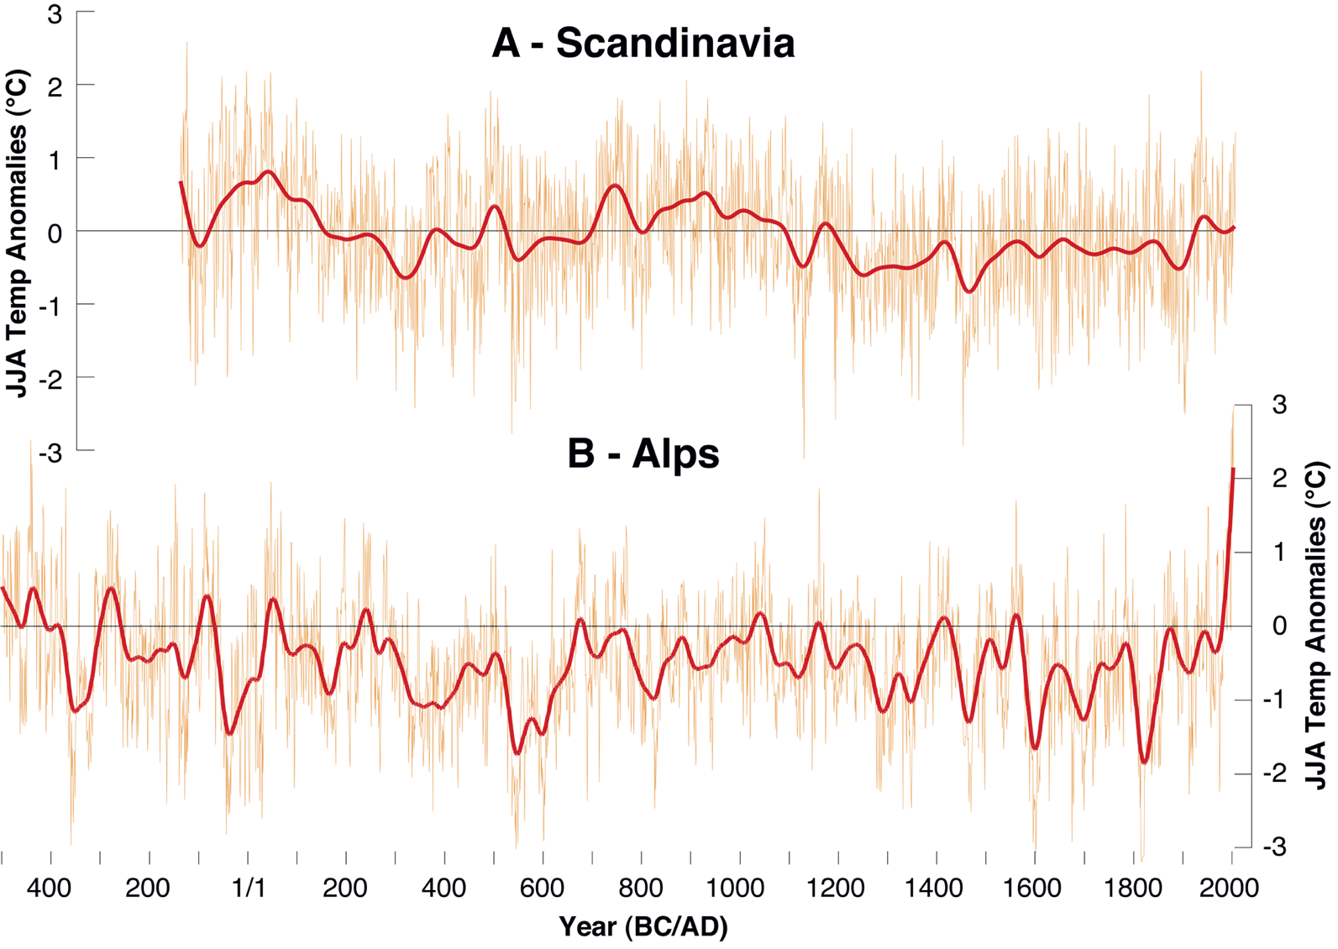
Luterbacher et al. (2012) PAGES news 20(2): 94
Notes:
Synthesizing paleoclimatic data to reconstruct 2000 years of European/Mediterranean temperature change
Jürg Luterbacher1, F.J. Gonzalez-Rouco 2, D. McCarroll3, S. Wagner4 and E. Zorita4
1Department of Geography, University of Giessen, Germany; Juerg.luterbacher@geogr.uni-giessen.de
2Department of Astrophysics and Atmospheric Sciences and Instituto de Geociencias UCM-CSIC (IGEO), Complutense University, Madrid, Spain;
3Department of Geography, Swansea University, UK; 4Helmholtz Center for Materials and Coastal Research, Geesthacht, Germany
Figure 1: Reconstructed 2000 years of Northern Scandinavian (A) and Alpine (B) summer temperatures based on
tree-ring data (Büntgen et al. 2011; Esper et al. 2012)

Slide 34
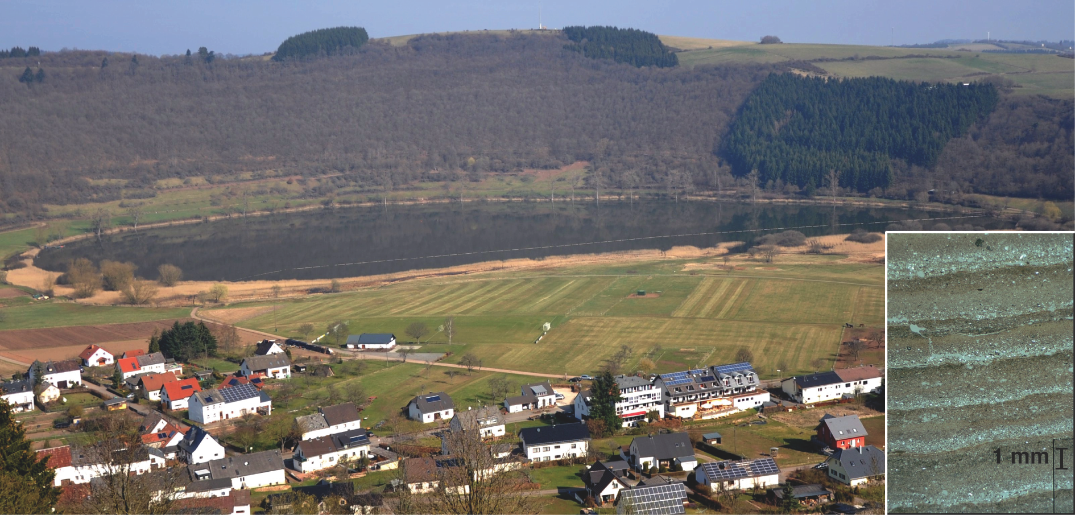
Zolitschka et al. (2012) PAGES news 20(2): 95
Notes:
Deciphering climatic and environmental signals from varved sediments by applying process-related studies
Bernd Zolitschka1, P. Francus2, A.E.K. Ojala3 and A. Schimmelmann4
1Institute of Geography, University of Bremen, Germany; zoli@uni-bremen.de
2National Institute of Scientific Research, Qu.bec, Canada; 3Geological Survey of Finland, Espoo, Finland; 4Department of Geological Sciences,
Indiana University, Bloomington, USA
Figure 1: Lakes like Meerfelder Maar are important archives for climatic and environmental reconstructions since
the Late-Glacial. The record of this site extends back into the Weichselian and provides a potential target for a
future integrated lake deep drilling project. Most of the Holocene and Late Glacial sediments are annually laminated
(varved). As an example the microphotography (inset) shows minerogenic varves of Younger Dryas age
(courtesy A. Brauer).

Slide 35
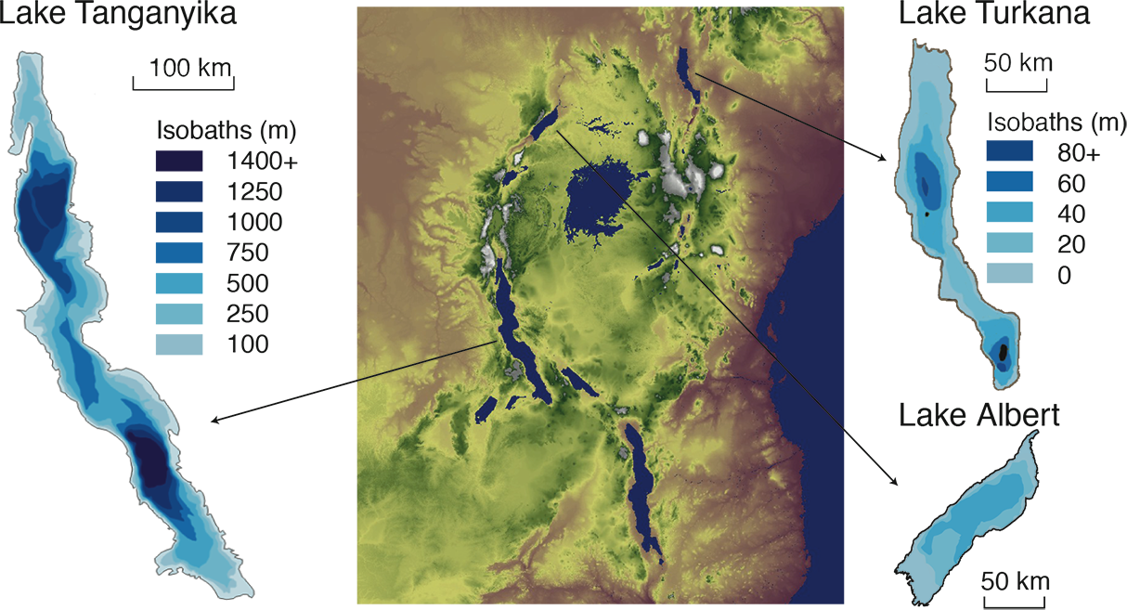
Russell et al. (2012) PAGES news 20(2): 96
Notes:
A strategic plan for scientific drilling in the East African rift lakes
James M. Russell1, A.S. Cohen2, T.C. Johnson3 and C.A. Scholz4
1Department of Geological Sciences, Brown University, Providence, USA; James_Russell@Brown.edu
2Department of Geosciences, University of Arizona, Tucson, USA; 3Large Lakes Observatory, University of Minnesota Duluth, USA; 4Department of
Earth Sciences, Syracuse University, USA
Figure 1: Map of East Africa with bathymetric maps of Lakes Tanganyika, Turkana, and Albert. Note the different
scale for Tanganyika.

Slide 36
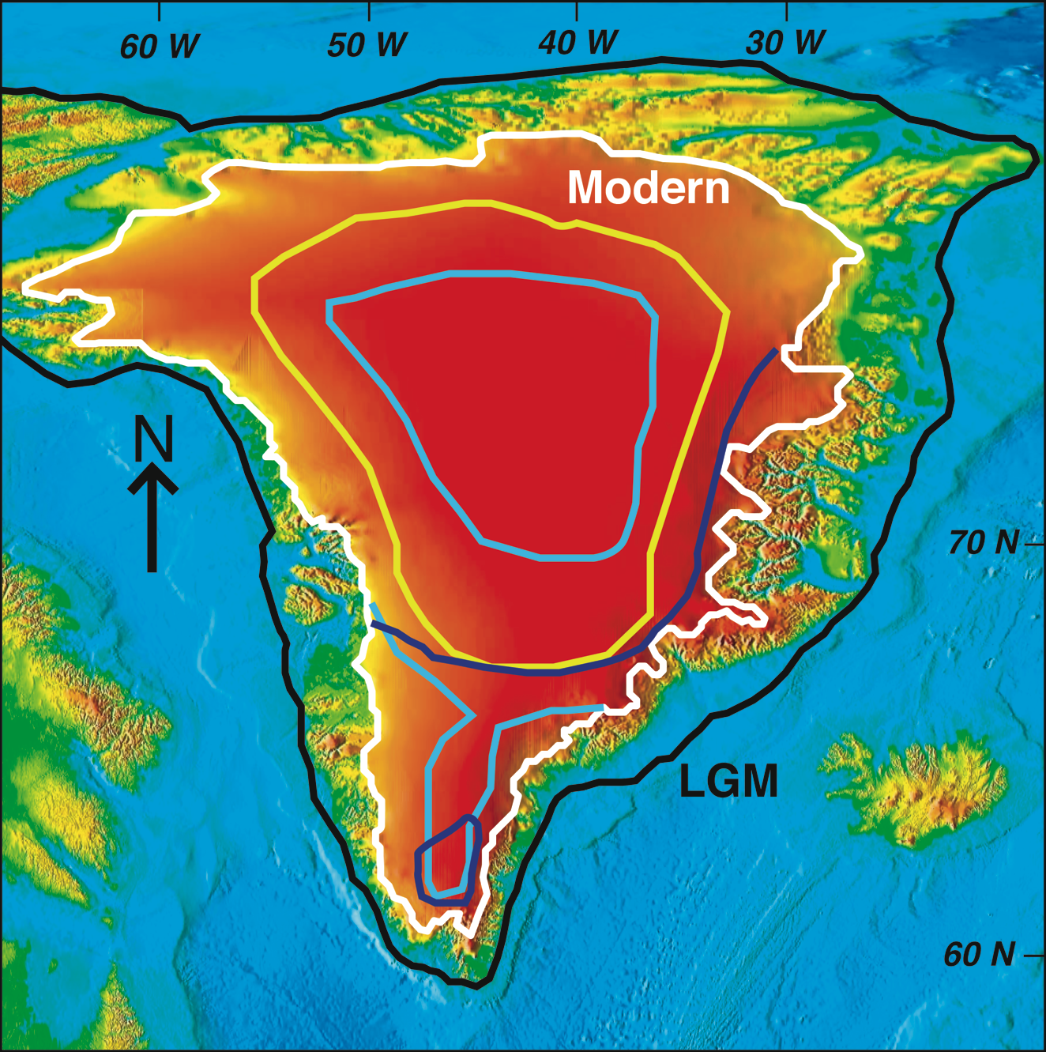
Carlson and Stoner (2012) PAGES news 20(2): 97
Notes:
Assessing the history of the Greenland Ice Sheet through ocean drilling
Anders Carlson1,2 and Joseph Stoner2
1Department of Geoscience, Center for Climatic Research, University of Wisconsin-Madison, USA; acarlson@coas.oregonstate.edu
2College of Earth, Ocean and Atmospheric Sciences, Oregon State University, Corvallis, USA
Figure 1: Last interglaciation (~125 ka) modeled GIS extents using the same ice-sheet model but different climate
forcing schemes. Light blue lines are two extents of Cuffey and Marshall (2000) with only a remnant ice dome in
central Greenland or significant ice persisting in south Greenland. The dark blue line shows the maximum retreat
modeled by Otto-Bliesner et al. (2006) with only a small ice dome persisting in south Greenland; a second simulation
of their model had an extent similar to the minimum retreat of Cuffey and Marshall (2000). The yellow line denotes
the minimum retreat predicted by Lhomme et al. (2005), with south Greenland completely deglaciated. The black
line shows the estimated extent of the GIS at the last glacial maximum (LGM) on the continental shelf by Funder
et al. (2011). This wide range in modeled last interglaciation GIS extents predicts a sea-level rise contribution of 2
to 5.5 m, highlighting the need for geologic records of past GIS behavior.

Slide 37
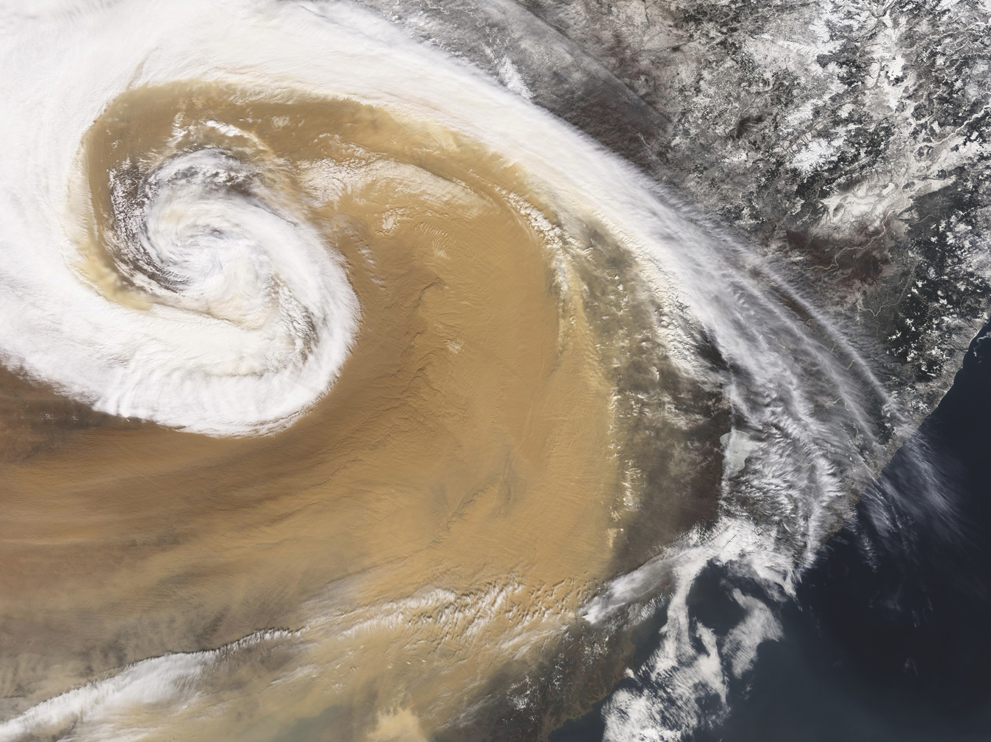
Stuut et al. (2012) PAGES news 20(2): 98
Image: NASA
Notes:
Processes and Quaternary history of dust dynamics: low-latitude records and global implications
Jan-Berend Stuut1,2, U. Merkel2 and D.-D. Rousseau3
1NIOZ - Netherlands Institute for Sea Research, Den Burg, The Netherlands; jbstuut@nioz.nl
2MARUM - Center for Marine Environmental Sciences, University of Bremen, Germany; 3Ecole Normale Sup.rieure, Laboratoire de M.t.orologie
Dynamique & CERES-ERTI, Paris, France
Figure 1: Dust storm over China in April 2001. Dust from this event crossed the Pacific Ocean and was deposited
as far as the Great Lakes region in the USA. Image credit: NASA.

Slide 38
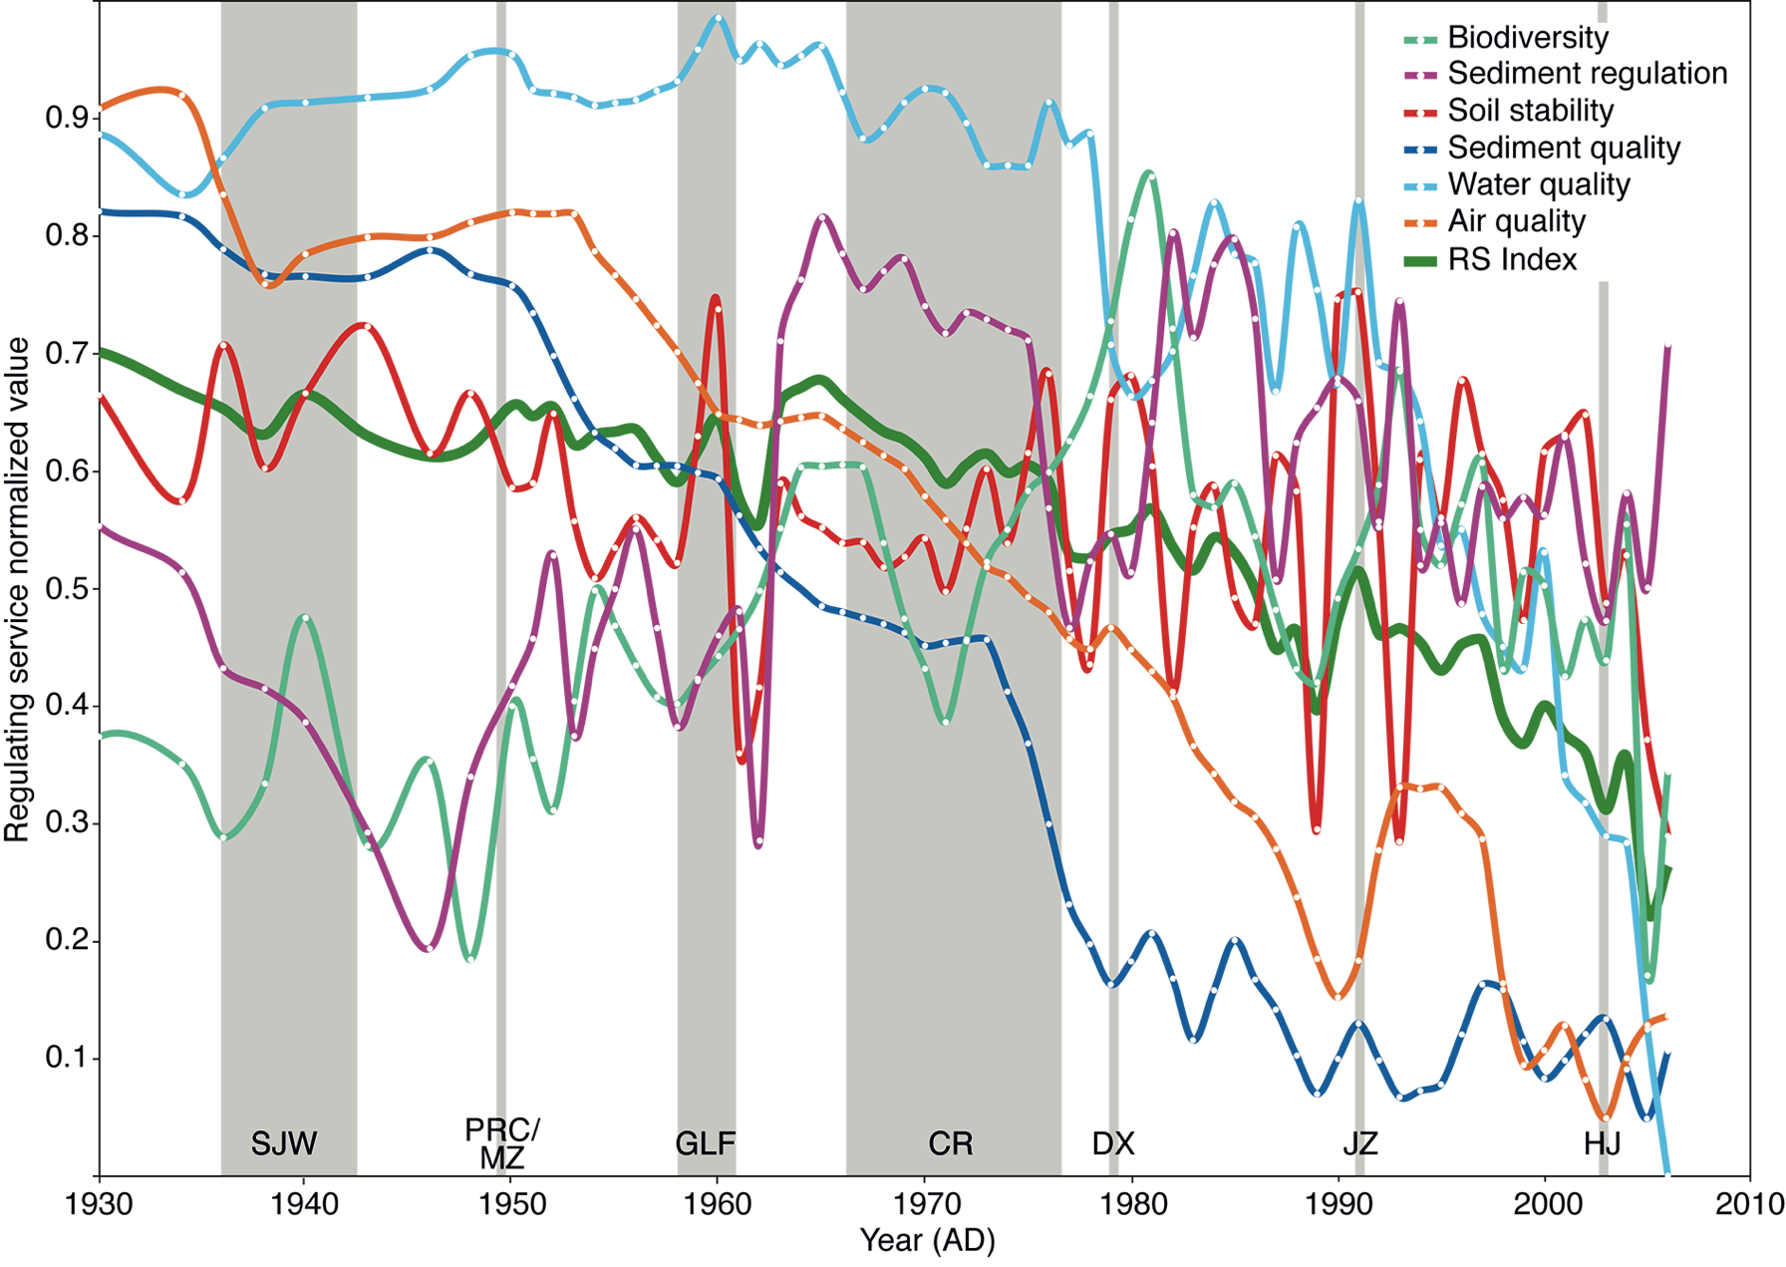
Dearing and Langdon (2012) PAGES news 20(2): 99
After Dearing et al. (2012) PNAS 109
Notes:
Human-climate-ecosystem interactions: learning from the past
John Dearing and Peter Langdon
Geography and Environment, University of Southampton, UK; J.Dearing@soton.ac.uk
Figure 1: Lower Yangtze basin 1930-2006: normalized regulating service proxy records for biodiversity, sediment regulation, soil stability, sediment quality, water quality, air
quality and regulating service (RS) Index based on lake sediment analyses, showing downward trends (losses of services) towards the present. Vertical bars show major 20th-21st
century political events (from left to right): Sino-Japanese War 1937-1945 (SJW); People's Republic of China founded by Mao Zedong 1949 (PRC); Great Leap Forward 1958-
1961 (GLF); Cultural Revolution 1966-1976 (CR); Deng Xiaoping's economic reforms from late 1970s-early 1980s (DX); leadership of Jiang Zemin from 1989 (JZ); leadership of
Hu Jintao from 2003 (HJ). After Dearing et al. (2012).

Slide 39
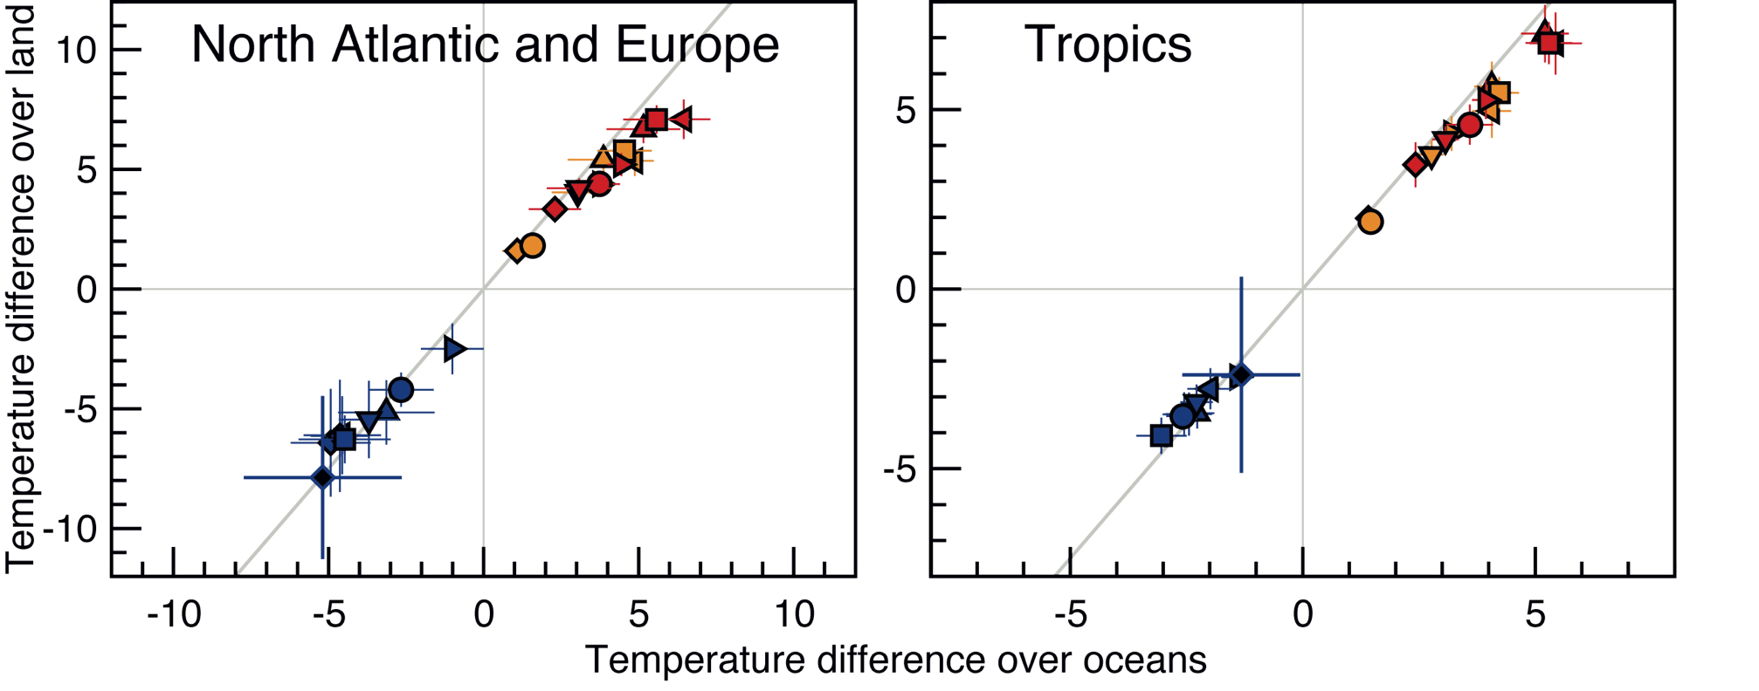
Schmidt (2012) PAGES news 20(2): 101
Figure by Masa Kageyama
Notes:
Using paleo-climate model/data comparisons to constrain future projections
Gavin A. Schmidt1, E. Guilyardi2,3, M. Kageyama4, M.E. Mann5, V. Masson-Delmott e4 and A. Timmermann6
1NASA Goddard Institute for Space Studies, New York, USA; Gavin.A.Schmidt@nasa.gov
2Laboratoire d’Oc.anographie et du Climat, Institut Pierre Simon Laplace, Paris, France; 3Department of Meteorology, University of Reading, UK;
4Laboratoire des Sciences du Climat et de l’Environnement, Institut Pierre Simon Laplace, Gif-sur-Yvette, France; 5Department of Meteorology,
Pennsylvania State University, USA; 6Department of Oceanography, University of Hawaii, Honolulu, USA
Figure 1: Preliminary results from the CMIP5 archive showing the multi-model ensemble for temperature differences
at the LGM and in idealized increased CO2 experiments. Left-hand panel shows the robust relationship between
the North Atlantic and European ocean and land temperatures in both cold and warm climates (using an average
of the simulation data over points only where there are observations). Right hand panel shows equivalent results
for the Tropics. The blue crosses indicate the results (with uncertainties) from the observational data syntheses from
the LGM. Red and yellow symbols show the CMIP5 model results. Figure courtesy of Masa Kageyama.

Slide 40
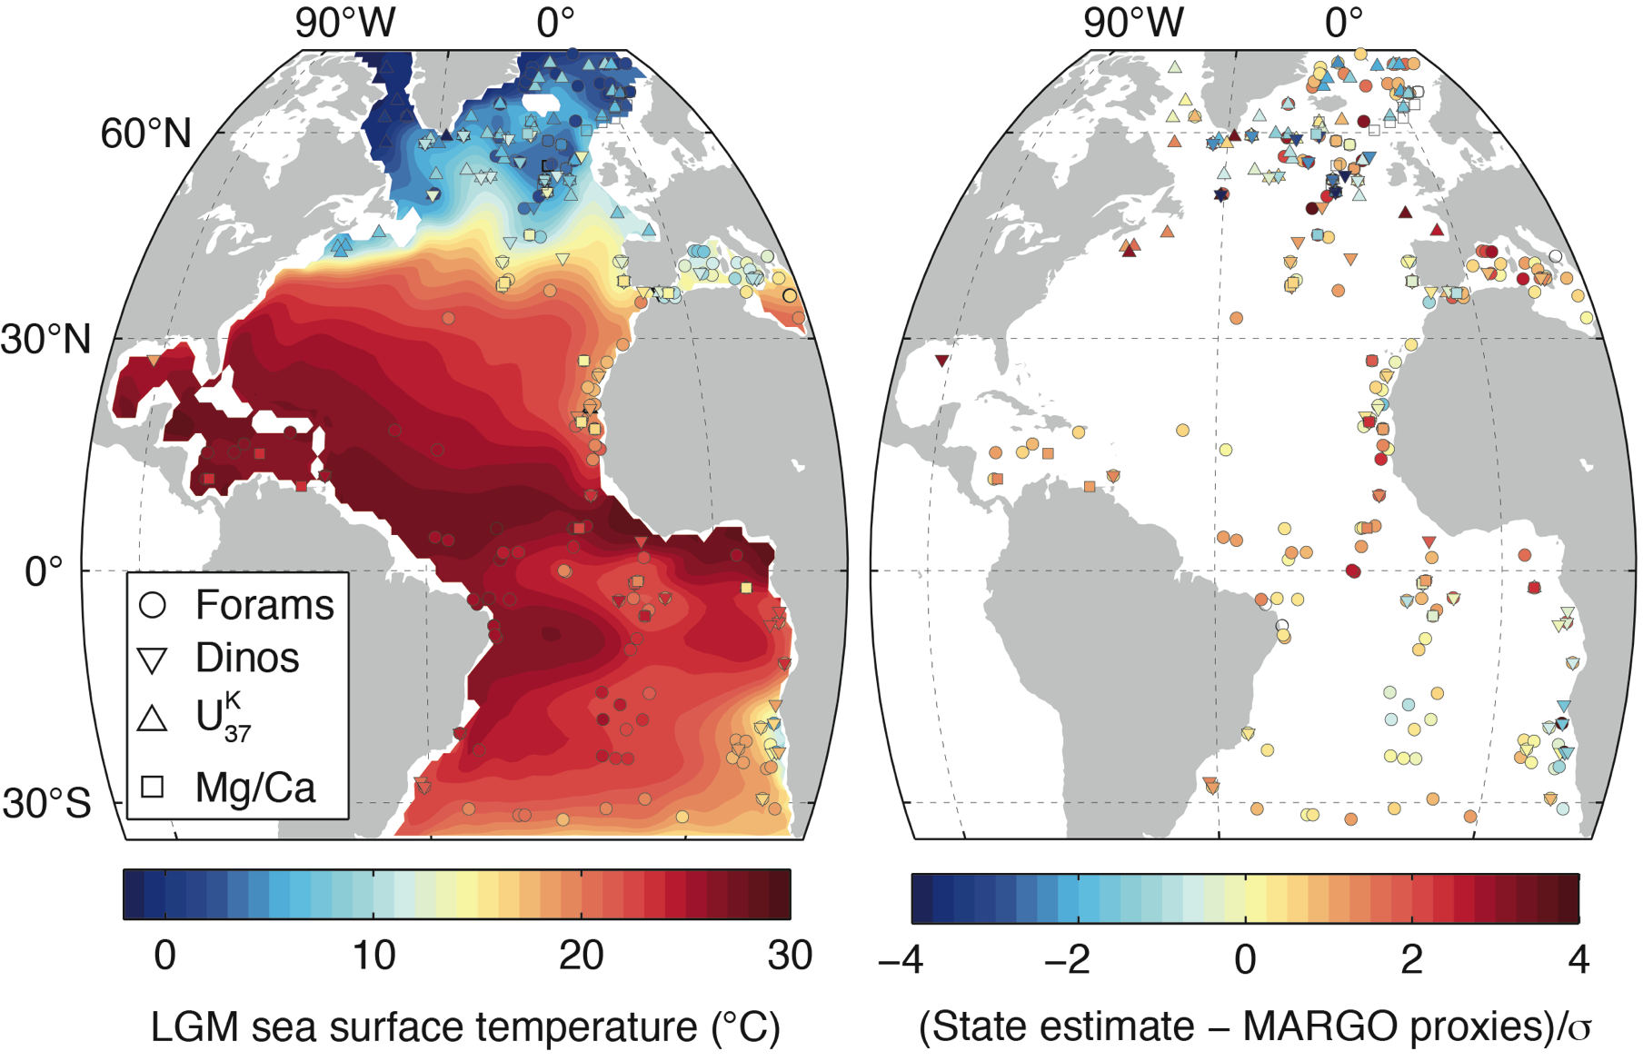
Kucera et al. (2012) PAGES news 20(2): 102
Figure by Holly Dail
Notes:
The Paleo-ocean challenge: data meet models
Michal Kucera, A. Paul and S. Mulitza
MARUM - Center for Marine Environmental Sciences, University of Bremen, Germany; mkucera@marum.de
Figure 1: An example of the application of an inverse approach to LGM ocean data (MARGO 2009). The left panel
shows annual mean sea surface temperature (SST) in an LGM Atlantic ocean state estimate (contours) with MARGO
LGM SST proxy records overlaid (symbols; Forams and Dinos refers to SST estimates from transfer functions based
on assemblages of planktonic foraminifera and dinoflagellate cysts). The state estimate is created by application
of the “adjoint method” to identify an ocean state that is consistent with both oceanic physics and with the proxy
records, given their uncertainties. The right panel shows normalized misfits, computed as [(state estimate – MARGO
proxies)/σ] where σ is the uncertainty in the data. Symbol colors show where the state estimate is consistent with
the data, given their uncertainties. Values near zero indicate consistency. In this map, a satisfactory fit is obtained
for most low latitude data. In the high latitudes, large values indicate that a satisfactory fit to all of the MARGO
data simultaneously is not possible. Analysis and graphics: unpublished data courtesy of Holly Dail, Massachusetts
Institute of Technology, USA

Slide 41
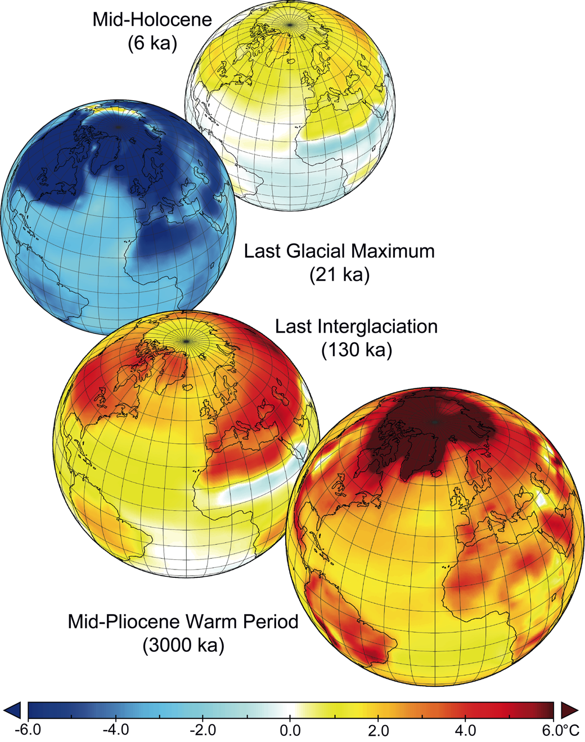
Hill et al. (2012) PAGES news 20(2): 103
Notes:
Paleoclimate modeling: an integrated component of climate change science
Daniel J. Hill1,2, A.M. Haywood1, D.J. Lunt3, B.L. Otto -Bliesner4, S.P. Harrison5 and P. Braconnot 6
1School of Earth and Environment, University of Leeds, UK; d.j.hill@leeds.ac.uk
2Climate Change Group, British Geological Survey, Nottingham, UK; 3School of Geographical Sciences, University of Bristol, UK; 4Climate and
Global Dynamics Division, National Center for Atmospheric Research, Boulder, USA; 5Department of Biological Sciences, Macquarie University,
Sydney, Australia; 6Laboratory for Climate and Environmental Sciences, Pierre Simon Laplace Institute, Gif-sur-Yvette, France
Figure 1: Multi-model mean summer (JJA) warming in the main Paleoclimate Model Intercomparison Project
(PMIP3) equilibrium time periods, mid-Holocene, Last Glacial Maximum (Braconnot et al. 2012), Last Interglacial
(Lunt et al. 2012) and the mid-Pliocene Warm period (Haywood et al. 2012).

Slide 42
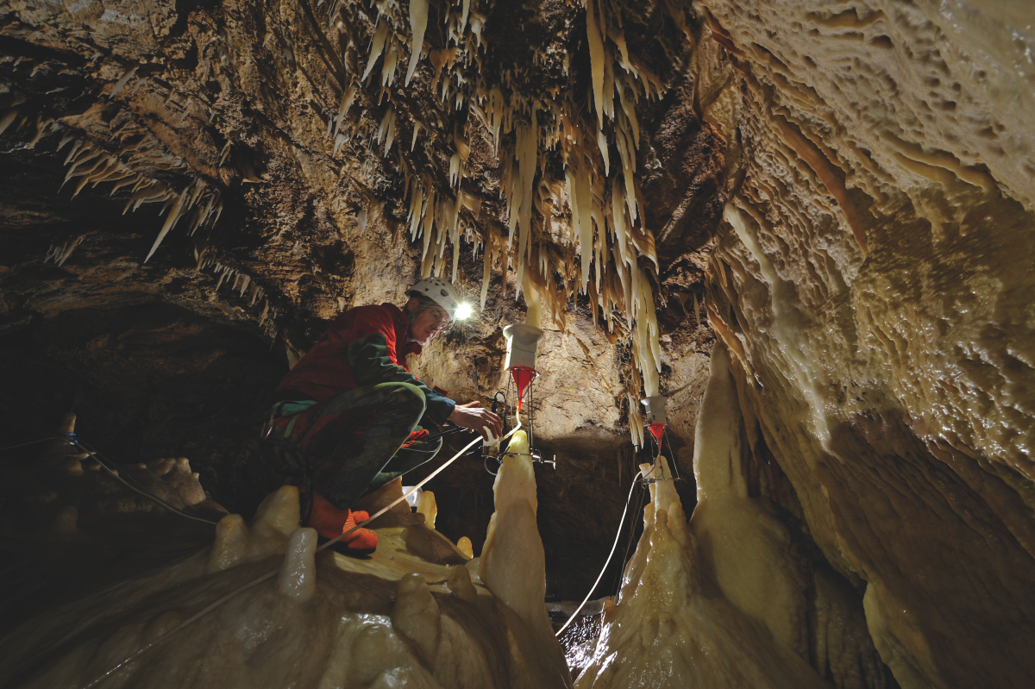
Mattey et al. (2012) PAGES news 20(2): 104
Photo: Robbie Shone
Notes:
Second International Cave Monitoring Workshop
David Mattey1, C. Spötl2 and M. Luetscher2
1Department of Earth Sciences, University of London, UK; mattey@es.rhul.ac.uk
2Institute of Geology and Palaeontology, University of Innsbruck, Austria
Figure 1: Dripwater collection in Obir Cave, Austria. Photo credit: Robbie Shone (shonephotography.com).

Slide 43
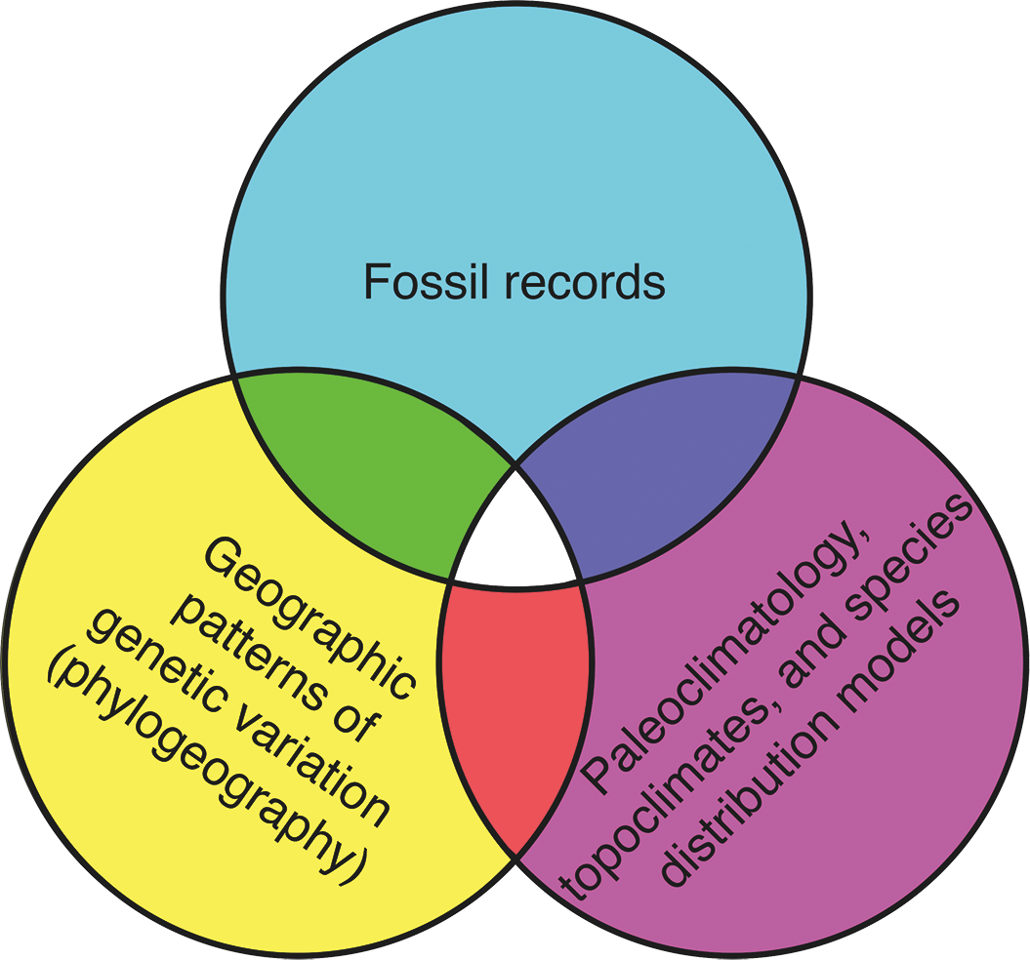
Gavin et al. (2012) PAGES news 20(2): 105
Photo: Robbie Shone
Notes:
Climate Refugia: Joint Inference from Fossils, Genetics and Models
Daniel G. Gavin1, S. Z. Dobrowski2, A. Hampe3, F. S. Hu4 and F. Rodriguez-Sanchez5
1Department of Geography, University of Oregon, Eugene, USA; dgavin@uoregon.edu
2Department of Forest Management, University of Montana, Missoula, USA; 3Biodiversit., G.nes et Communaut.s, INRA, Bordeaux, France; 4Department
of Plant Biology, University of Illinois, Urbana, USA; 5Department of Plant Sciences, University of Cambridge, UK
Figure 1: Three broad approaches to studying past species responses to climate change may be used jointly to exploit
the complementary strengths of each approach to obtain the most complete reconstruction of historical refugia.

Slide 44
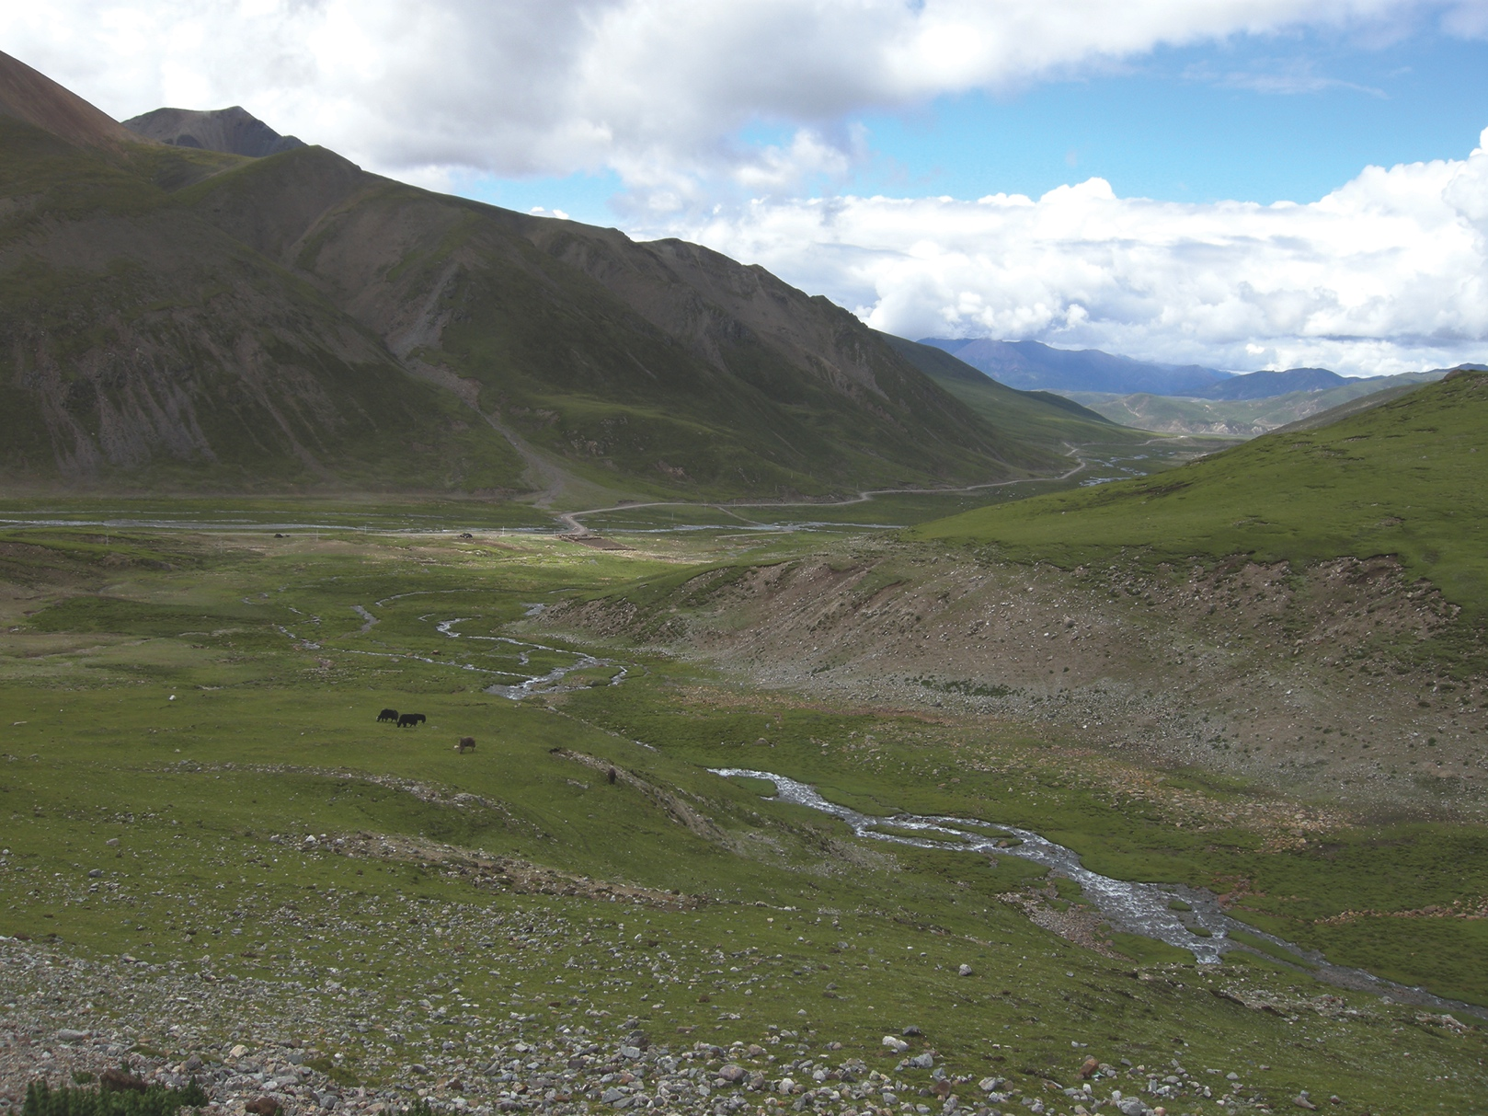
Willis et al. (2012) PAGES news 20(2): 106
Photo: Shonil A. Bhagwat
Notes:
Landscape Planning for the Future: Using fossil records to map potential threats, opportunities and likely future developments for biodiversity and ecosystem services
Kathy J. Willis1, S. A. Bhagwat2 and E. S. Jeffers1
1Oxford Long-Term Ecology Laboratory, University of Oxford, UK; Kathy.willis@zoo.ox.ac.uk
2School of Geography and the Environment, University of Oxford, UK
Figure 1: Ecosystems, such as the Tibetan Plateau depicted here, provide a wide variety of ecosystem services such
as clean water, recreation space and fodder for grazing. Information on the response of these goods and services
to environmental change is recorded in natural archives and is essential for the sustainable management of these
resources. Photo: Shonil A. Bhagwat.

Slide 45
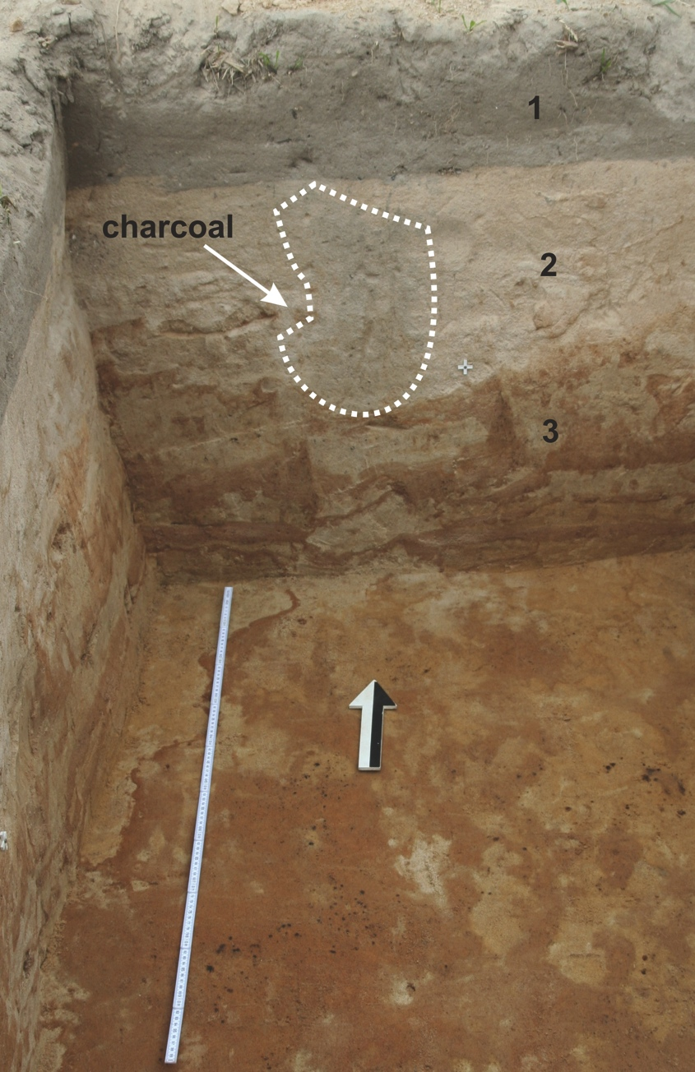
Lisa et al. (2012) PAGES news 20(2): 107
Photo: A. Wisniewski
Notes:
Geoarcheological Workshop – Actual stage of the environmental archeology investigations in southern Poland and northern Czech Republic
Lenka Lisa1, A. Wiśniewski2 and K. Issmer3
1Institute of Geology, Academy of Sciences of the Czech Republic, Prague, Czech Republic; lisa@gli.cas.cz
2Institute of Archaeology, University of Wrocław, Wrocław, Poland; 3Institute Geoecology and Geoinformatics, Adam Mickiewicz University,
Poznań, Poland
Figure 1: Excavation trench from the Late Pleistocene
archeological site Sowin in the Silesian region of
Southwestern Poland. The profile shows three main
stratigraphic units (recent soil, eolian sands, and sandclayish
sediments) and anthropogenic charcoal deposition.
Photo by A. Wisniewski.

