Slide 1
Figures – PAGES Magazine 23(2) 2015
Please cite the PAGES magazine article and, if available, the original reference when using a figure. See note section below the figures for details.

Slide 2
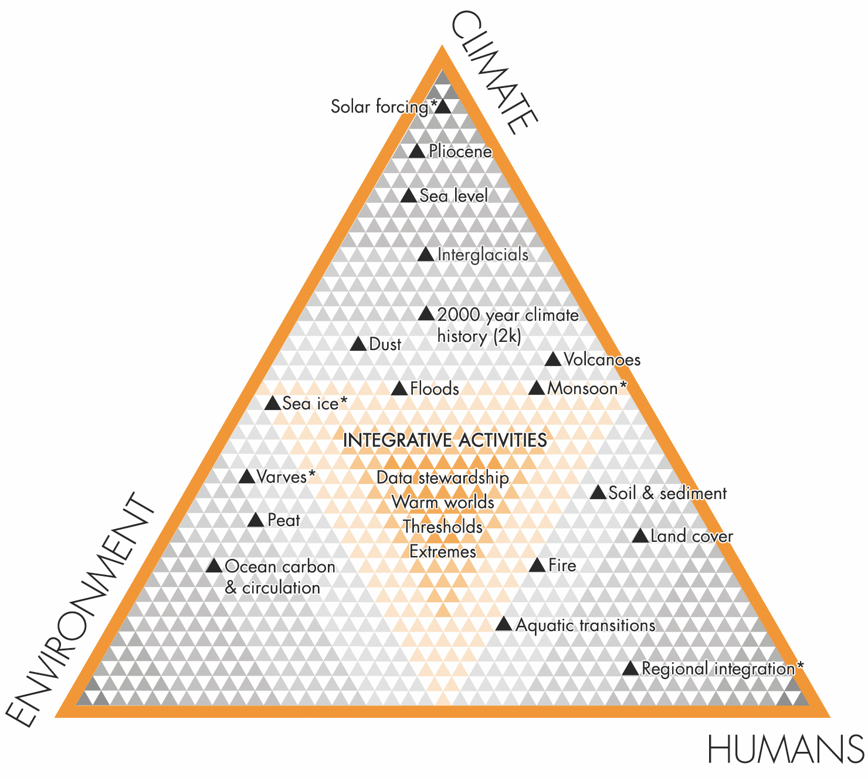
Notes:
Figure 1: PAGES’ science structure addresses the key components of the Earth system through the themes Climate, Environment, and Humans. The center of the triangle will hold cross-topical integrative activities, particularly suited to collaboration outside the PAGES community. Current working groups and the integrative activities are mapped on to the new science structure. The working groups marked with an asterisk are in their synthesis phase.
Transition accomplished New setting and new structure of PAGES
Thorsten Kiefer1, H. Fischer2, A. Mix3, S. Fritz4, L. von Gunten5 and L. Goodwin5
AFFILIATIONS
1PAGES International Project Office, Bern, Switzerland,
now at Future Earth Global Hub, Paris, France
2Climate and Environmental Physics, University of
Bern, Switzerland
3College of Earth, Ocean, and Atmospheric Sciences,
Oregon State University, Corvallis, USA
4Department of Earth and Atmospheric Sciences,
University of Nebraska, Lincoln, USA
5PAGES International Project Office, Bern, Switzerland
CONTACT
PAGES IPO: pages@pages.unibe.ch

Slide 3
Notes:
Figure 2: The PAGES science is embedded in a universe of opportunities for collaborations with the potential to enrich the diversity of research, impact of outreach, level of funding, and other aspects of the implementation of PAGES’ agenda.
Transition accomplished New setting and new structure of PAGES
Thorsten Kiefer1, H. Fischer2, A. Mix3, S. Fritz4, L. von Gunten5 and L. Goodwin5
AFFILIATIONS
1PAGES International Project Office, Bern, Switzerland,
now at Future Earth Global Hub, Paris, France
2Climate and Environmental Physics, University of
Bern, Switzerland
3College of Earth, Ocean, and Atmospheric Sciences,
Oregon State University, Corvallis, USA
4Department of Earth and Atmospheric Sciences,
University of Nebraska, Lincoln, USA
5PAGES International Project Office, Bern, Switzerland
CONTACT
PAGES IPO: pages@pages.unibe.ch

Slide 4
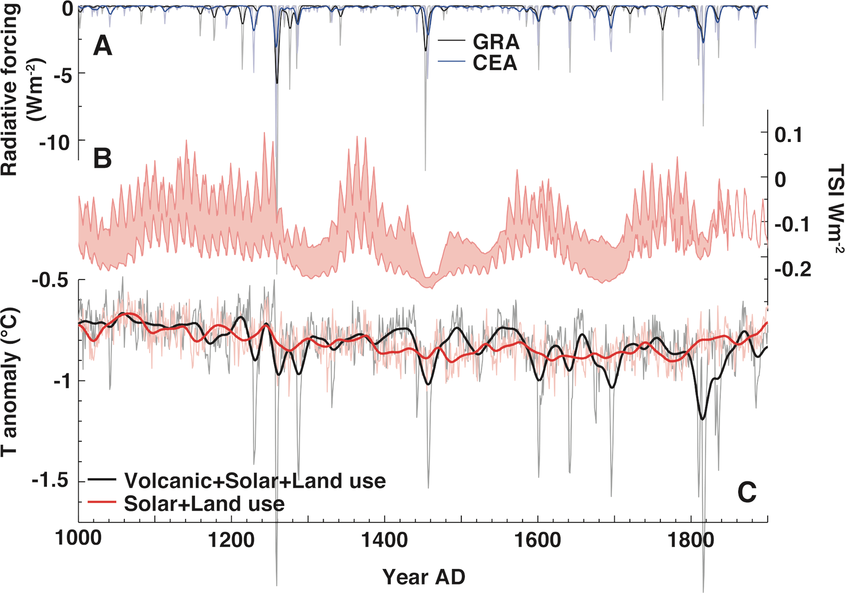
Notes:
Figure 1: Last millennium climate forcing and modeled global mean annual temperature response. (A) Two time series of global annual radiative forcing estimated by scaling
global sulfate loading (GRA: Gao et al. 2008 and CEA: Crowley et al. 2008 & Crowley and Untermann 2013) via aerosol optical depth (Schmidt et al. 2012, light lines) and a
10-year Gaussian smooth through these values (thick lines). (B) The full range of estimated PMIP3 annual total solar irradiance (TSI) anomalies (excluding those of Shapiro
et al. 2011) relative to a 1976-2006 baseline (Schmidt et al. 2012). (C) Global mean annual average surface air temperature response in the GISS-E2 last millennium (CMIP5)
experiment forced with given anthropogenic land use (Pongratz et al. 2008), solar variability (Steinhilber et al. 2009), and with (Crowley and Unterman 2013) or without (red)
volcanic forcing.
Volcanic eruptions and climate
Allegra N. LeGrande1 and Kevin J. Anchukaitis2
AFFILIATIONS
1NASA Goddard Institute for Space Studies, New
York, USA
2School of Geography and Development and
Laboratory of Tree-Ring Research, University of
Arizona, Tucson, USA
CONTACT
Allegra N. LeGrande: allegra.n.legrande@nasa.gov

Slide 5
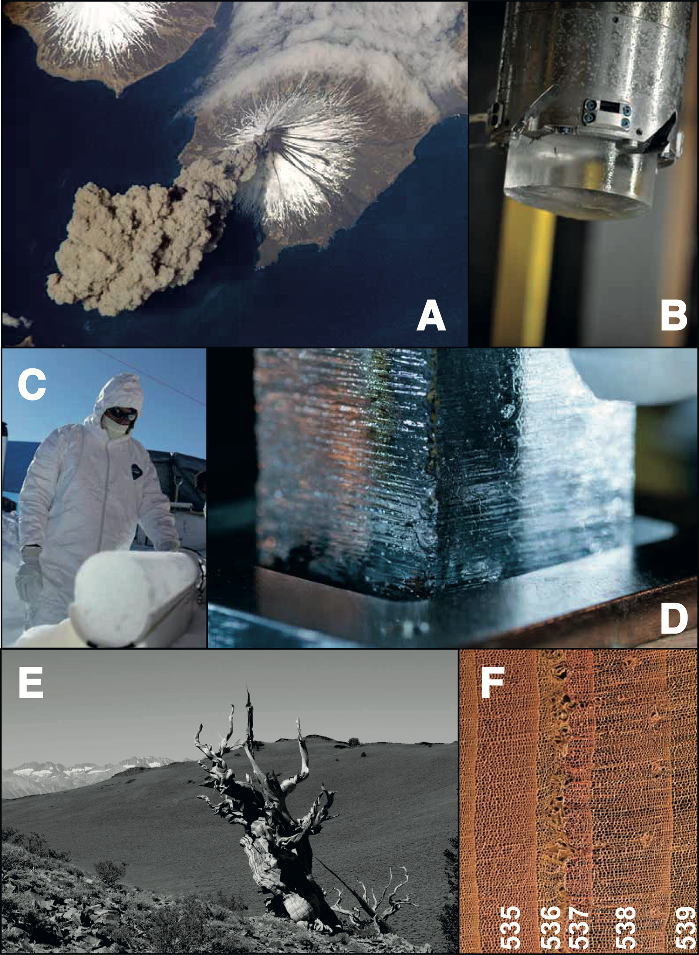
Notes:
Figure 1: (A) Injection of ash and aerosols into the atmosphere; (B) ice core section from WAIS Divide (Antarctica)
sticking out of the core barrel. High annual snowfall at this site enables individual annual layers to be identified and
counted; (C) ice core section from TUNU (Greenland) that contains a record of volcanic sulfate aerosols; (D) the ice
is slowly melted and a variety of elements and chemical species are simultaneously analyzed; (E) bristlecone pine
ring-width minima indicate that summer cooling often occurred when major volcanic eruptions dimmed the Earth’s
surface; (F) frost rings from a Siberian pine in Mongolia. The narrow, distorted rings for 536 and 537 CE indicate
a drastic cooling in the northern hemisphere which was caused by a large volcanic eruption. Image credits, A-F:
NASA, M. Twickler, M. Sigl, S. Masclin, M. Sigl, D. Breger (Micrographic Arts).
The history of volcanic eruptions since Roman times
Michael Sigl1,2, J.R. McConnell2, M. Toohey3, G. Plunkett4, F. Ludlow5, M. Winstrup6, S. Kipfstuhl7 and Y. Motizuki8
AFFILIATIONS
1Laboratory of Radio and Environmental Chemistry,
Paul-Scherrer-Institut, Villigen, Switzerland
2Desert Research Institute, Reno, USA
3GEOMAR Helmholtz-Zentrum für Ozeanforschung
Kiel, Germany
4School of Geography, Archaeology & Palaeoecology,
Queen’s University Belfast, UK
5Yale Climate & Energy Institute, and Department of
History, New Haven, USA
6Department of Earth and Space Sciences, University
of Washington, Seattle, USA
7Alfred-Wegener-Institut Helmholtz-Zentrum für Polarund
Meeresforschung, Bremerhaven, Germany
8RIKEN Nishina Center, Wako, Japan
CONTACT
Michael Sigl: michael.sigl@psi.ch

Slide 6
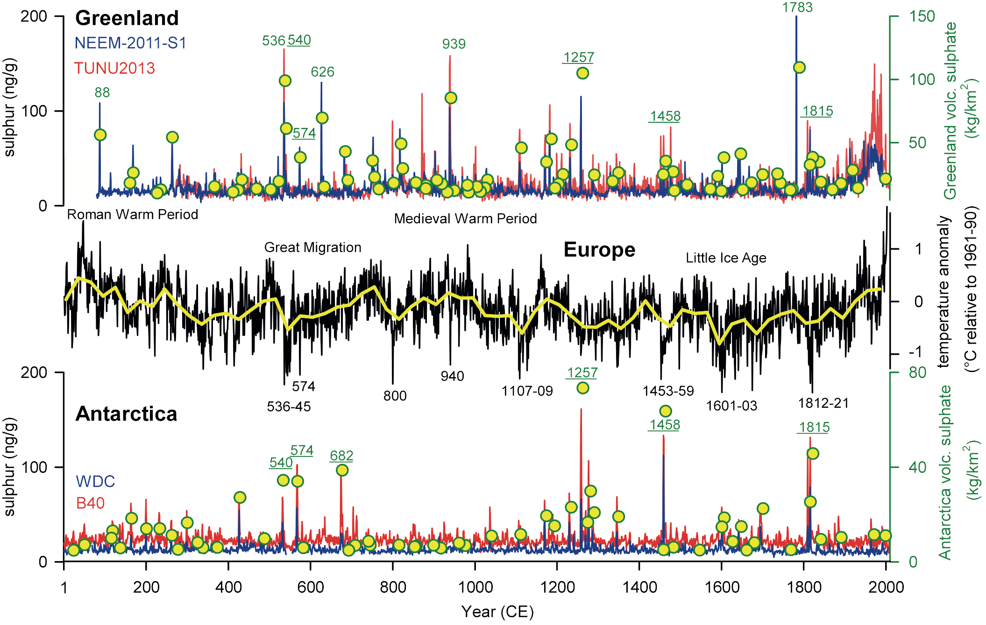
Notes:
Figure 2: Ice-core records of sulfur from two ice cores in Greenland and two ice cores in Antarctica (Sigl et al. 2013, 2014), used among others to infer atmospheric
deposition (yellow circles). More than 100 individual eruptions are reconstructed and attributed to either mid-to high latitude eruptions (e.g. Iceland, Alaska) and low-latitude
eruptions (underlined for selected events) based on the timing of sulfate deposition over the ice-sheets. Reconstructed dates are given for some large volcanic eruptions (Sigl
et al. 2015) as are time periods of strong summer cooling in Europe indicated by tree-ring reconstructions (black curve, PAGES-2k Consortium 2013).
The history of volcanic eruptions since Roman times
Michael Sigl1,2, J.R. McConnell2, M. Toohey3, G. Plunkett4, F. Ludlow5, M. Winstrup6, S. Kipfstuhl7 and Y. Motizuki8
AFFILIATIONS
1Laboratory of Radio and Environmental Chemistry,
Paul-Scherrer-Institut, Villigen, Switzerland
2Desert Research Institute, Reno, USA
3GEOMAR Helmholtz-Zentrum für Ozeanforschung
Kiel, Germany
4School of Geography, Archaeology & Palaeoecology,
Queen’s University Belfast, UK
5Yale Climate & Energy Institute, and Department of
History, New Haven, USA
6Department of Earth and Space Sciences, University
of Washington, Seattle, USA
7Alfred-Wegener-Institut Helmholtz-Zentrum für Polarund
Meeresforschung, Bremerhaven, Germany
8RIKEN Nishina Center, Wako, Japan
CONTACT
Michael Sigl: michael.sigl@psi.ch

Slide 7
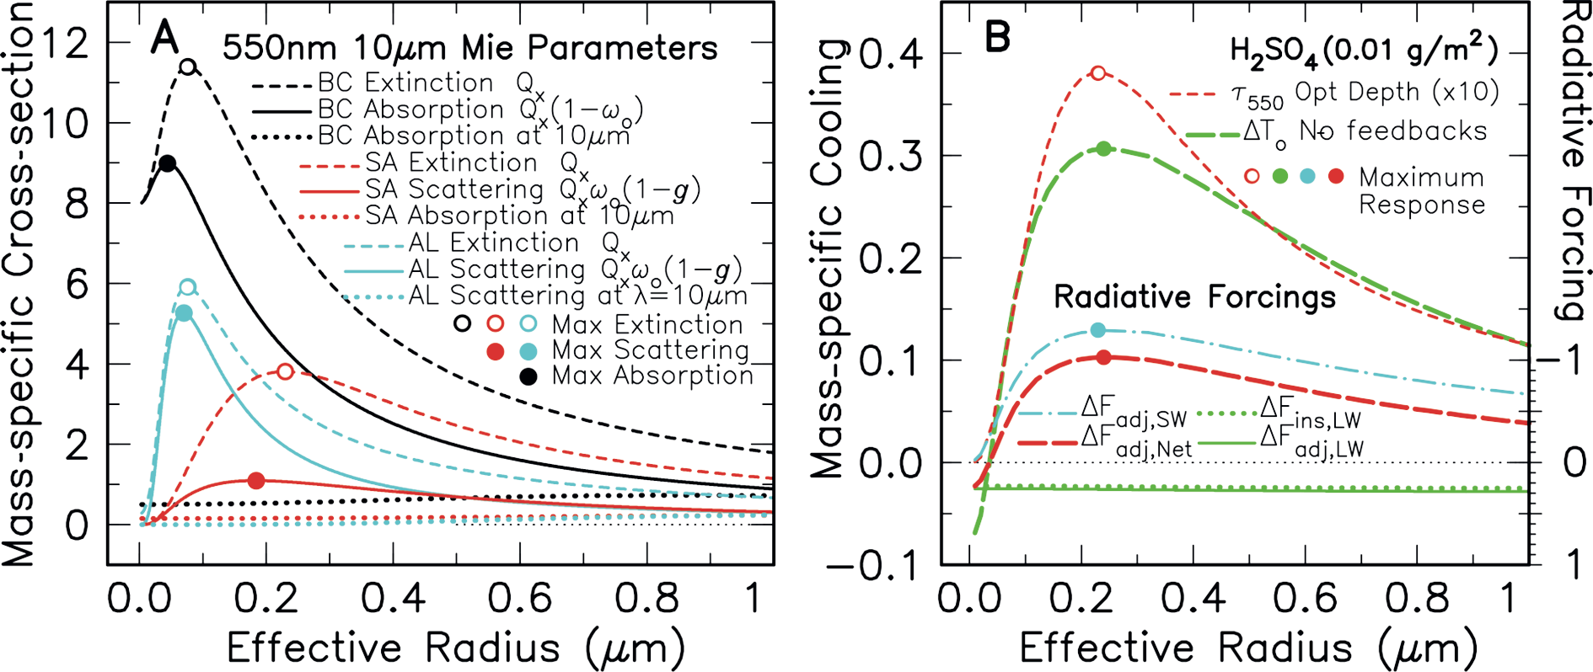
Notes:
Figure 1: (A) Mass-specific cross-sections (m2g-1) at 550 nm and 10 μm for black carbon (BC ), sulfuric acid (SA), aluminum (AL) aerosols as functions of aerosol size. Dashed
lines are Mie extinction efficiency factors Qx. BC absorption cross-section is solid black. Solid red and blue lines depict effective scattering cross-sections of SA and AL
aerosols. Black and red dotted lines are BC and SA absorption cross-sections at 10 μm. Blue dotted line is AL scattering at 10 μm. (B) Mass-specific cooling for SA aerosol
for mass density 0.01 gm-2 as functions of aerosol size. Dashed red line is SA optical depth (x10). Long-dash green line depicts no-feedback surface temperature (cooling)
change. Radiative forcings use right-hand scale. The long-dash red line depicts adjusted forcing with solar only (SW) component given by the dot-dash cyan line. The green
lines are LW instantaneous and adjusted forcings.
Volcanic aerosol radiative properties
Andrew Lacis
AFFILIATIONS
NASA Goddard Institute for Space Studies, New York,
USA
CONTACT
Andrew Lacis: andrew.a.lacis@nasa.gov

Slide 8
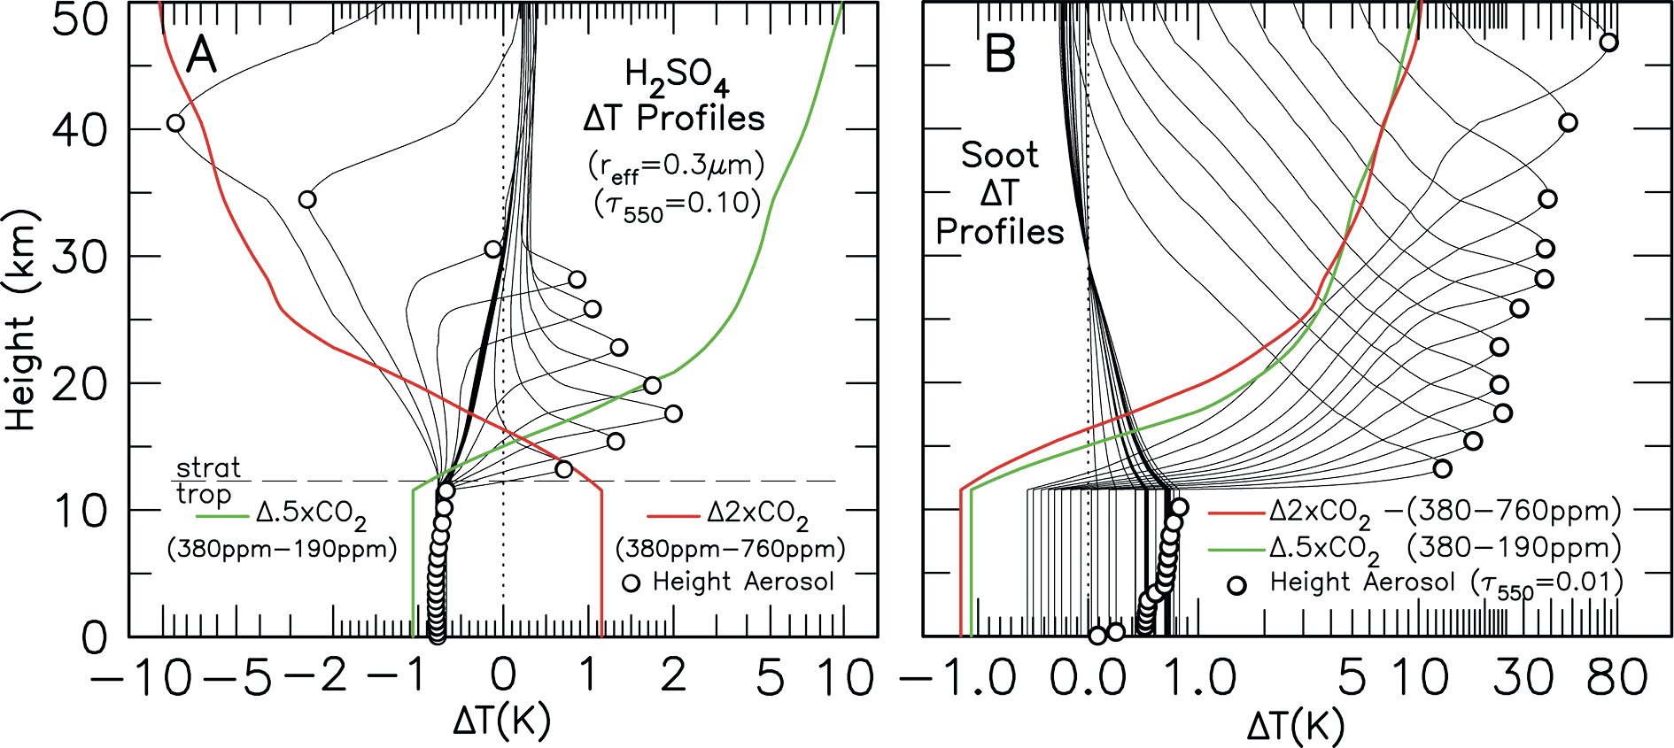
Notes:
Figure 2: (A) Atmospheric heating and cooling profiles for sulfuric acid (H2SO4) aerosol for optical depth τ550=0.10 as functions of aerosol height. Aerosol height is denoted
by the open circles. ΔT scale is linear from -2.0 to 2.0, logarithmic otherwise. Atmospheric temperature changes for 2xCO2 (red line) and 0.5xCO2 (green line), are included
for comparison. (B) Atmospheric heating and cooling profiles for black carbon (soot) aerosol for optical depth τ550=0.01 as functions of height (open circles). The ΔT scale is
linear from -1.0 to 1.0, otherwise logarithmic. For comparison, the temperature response for 2xCO2 and 0.5xCO2 are plotted as a negative temperature change.
Volcanic aerosol radiative properties
Andrew Lacis
AFFILIATIONS
NASA Goddard Institute for Space Studies, New York,
USA
CONTACT
Andrew Lacis: andrew.a.lacis@nasa.gov

Slide 9
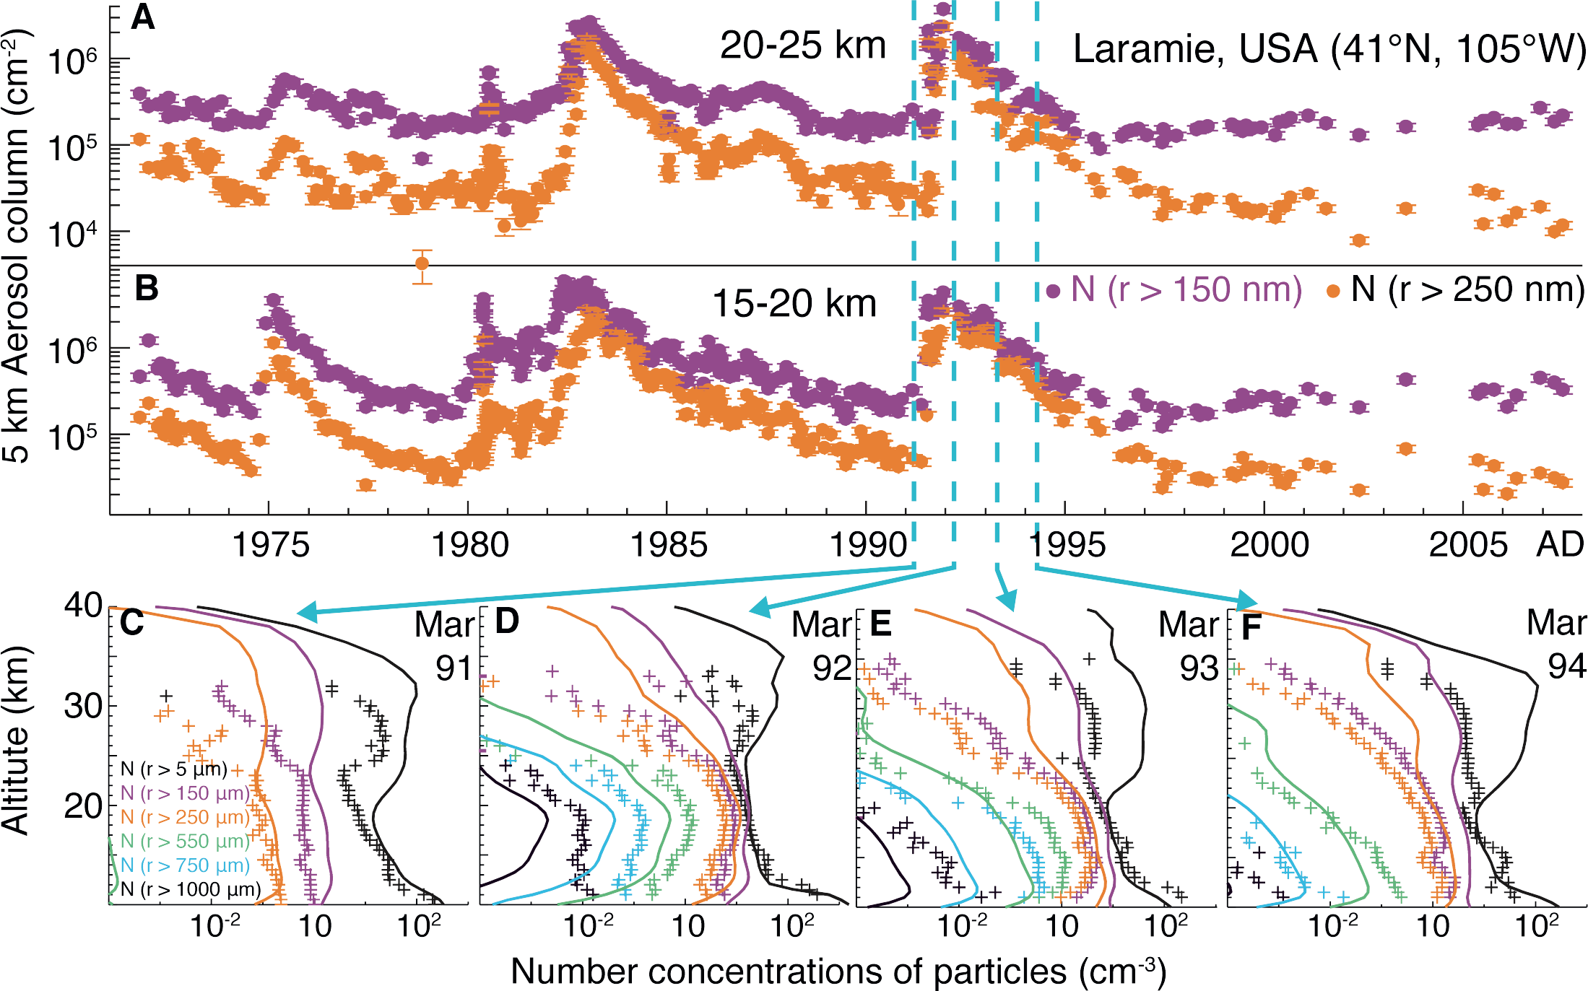
Notes:
Figure 1: The 30+ year record of column-integrated size-resolved stratospheric aerosol particle concentrations at altitudes of (A) 20-25 km and (B) 15-20 km from balloon
soundings at Laramie, USA (from Deshler 2008). (C-F) Example evaluation of the UM-UKCA model (Dhomse et al. 2014) simulated particle size distribution (dashed lines)
before (C) and after (D, E, F) the June 1991 Pinatubo eruption compared to measured particle concentrations (crosses) larger than different size thresholds (colors) and total
particle concentrations larger than 5 nm radius (black)..
Evolving particle size is the key to
improved volcanic forcings
Graham Mann1,2, S. Dhomse2, T. Deshler3, C. Timmreck4, A. Schmidt2, R. Neely1,2 and L. Thomason5
AFFILIATIONS
1National Centre for Atmospheric Science, University
of Leeds, UK
2School of Earth and Environment, University of Leeds,
UK
3Department of Atmospheric Science, University of
Wyoming, Laramie, USA
4Max Planck Institute for Meteorology, Hamburg,
Germany
5NASA Langley Research Center, Hampton, USA
CONTACT
Graham Mann: G.W.Mann@leeds.ac.uk

Slide 10
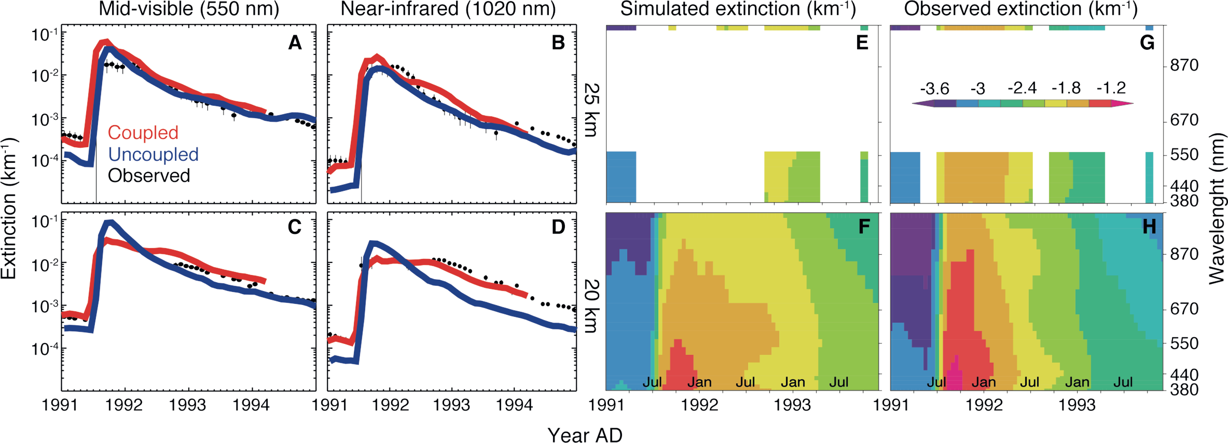
Notes:
Figure 2: The SAGE-II timeseries of tropical-mean (0-15°N) aerosol extinction in the mid-visible (550 nm) and near-infrared (1020 nm) at 25 km (A, B) and 20 km a.s.l. (C,
D) compared to radiatively coupled (red) and uncoupled (blue) Pinatubo simulations where 10 Tg of SO2 was injected. The evolution of the simulated extinction across the
shortwave spectrum at the two altitudes is shown in panels E and F, alongside that observed by SAGE-II v7.0 (G, H).
Evolving particle size is the key to improved volcanic forcings
Graham Mann1,2, S. Dhomse2, T. Deshler3, C. Timmreck4, A. Schmidt2, R. Neely1,2 and L. Thomason5
AFFILIATIONS
1National Centre for Atmospheric Science, University
of Leeds, UK
2School of Earth and Environment, University of Leeds,
UK
3Department of Atmospheric Science, University of
Wyoming, Laramie, USA
4Max Planck Institute for Meteorology, Hamburg,
Germany
5NASA Langley Research Center, Hampton, USA
CONTACT
Graham Mann: G.W.Mann@leeds.ac.uk

Slide 11
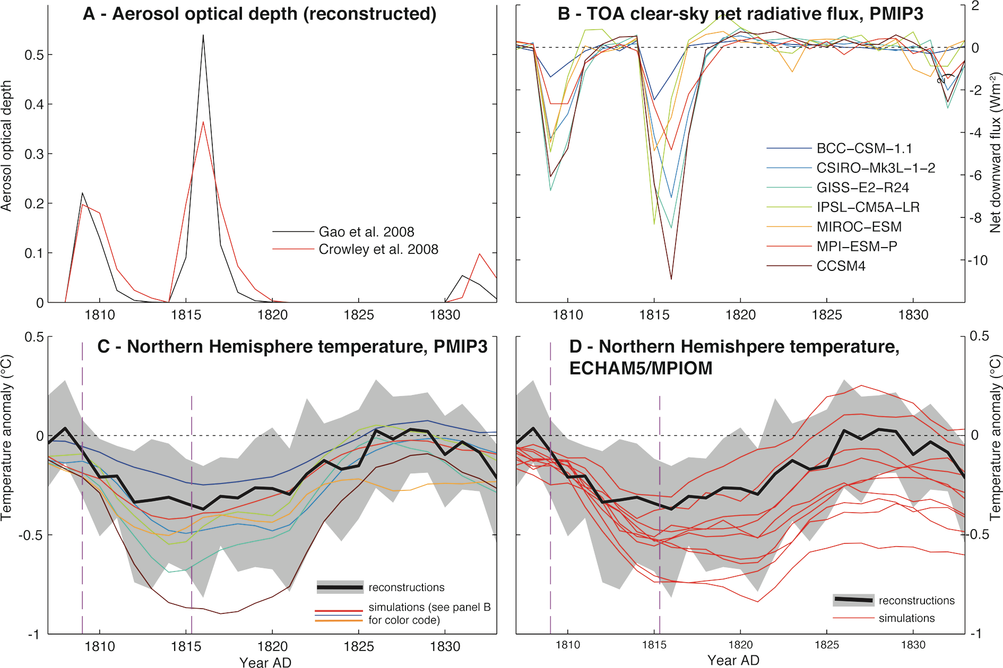
Notes:
Figure 1: Uncertainty in radiative forcing and climate response for the early-19th-century eruptions. (A) Two
estimates of annual-average global aerosol optical depth at 550 nm (AOD). (B) Top-of-atmosphere (TOA) annual average
net clear-sky radiative flux anomalies for a multi-model ensemble of last-millennium simulations (PMIP3;
Braconnot et al. 2012). (C) Comparison between simulated (PMIP3, 11-year smoothing, colors) and reconstructed
(black line: mean; shading: 5th-95th percentile range) Northern Hemisphere average summer temperature
anomalies (from 1799-1808). (D) Same as (C), but for a single-model ensemble (ECHAM5/MPIOM; Zanchettin
et al. 2013). The models tend to overestimate the reconstructed early-19th-century cooling, yet both simulation
ensembles are compatible with the reconstruction; different models and forcing inputs (C) and internal climate
variability (D) similarly contribute to simulation-ensemble spread.
A coordinated modeling assessment of the climate response to volcanic forcing
Davide Zanchettin1, C. Timmreck2, M. Khodri3, A. Robock4, A. Rubino1, A. Schmidt5 and M. Toohey2,6
AFFILIATIONS
1Department of Environmental Sciences, Informatics
and Statistics, University of Venice, Italy
2Max-Planck-Institute for Meteorology, Hamburg,
Germany
3IRD/IPSL/Laboratoire d'Océanographie et du Climat,
Paris, France
4Department of Environmental Sciences, Rutgers
University, New Brunswick, USA
5School of Earth and Environment, University of Leeds,
UK
6GEOMAR Helmholtz Centre for Ocean Research Kiel,
Germany
CONTACT
Davide Zanchettin: davide.zanchettin@unive.it

Slide 12
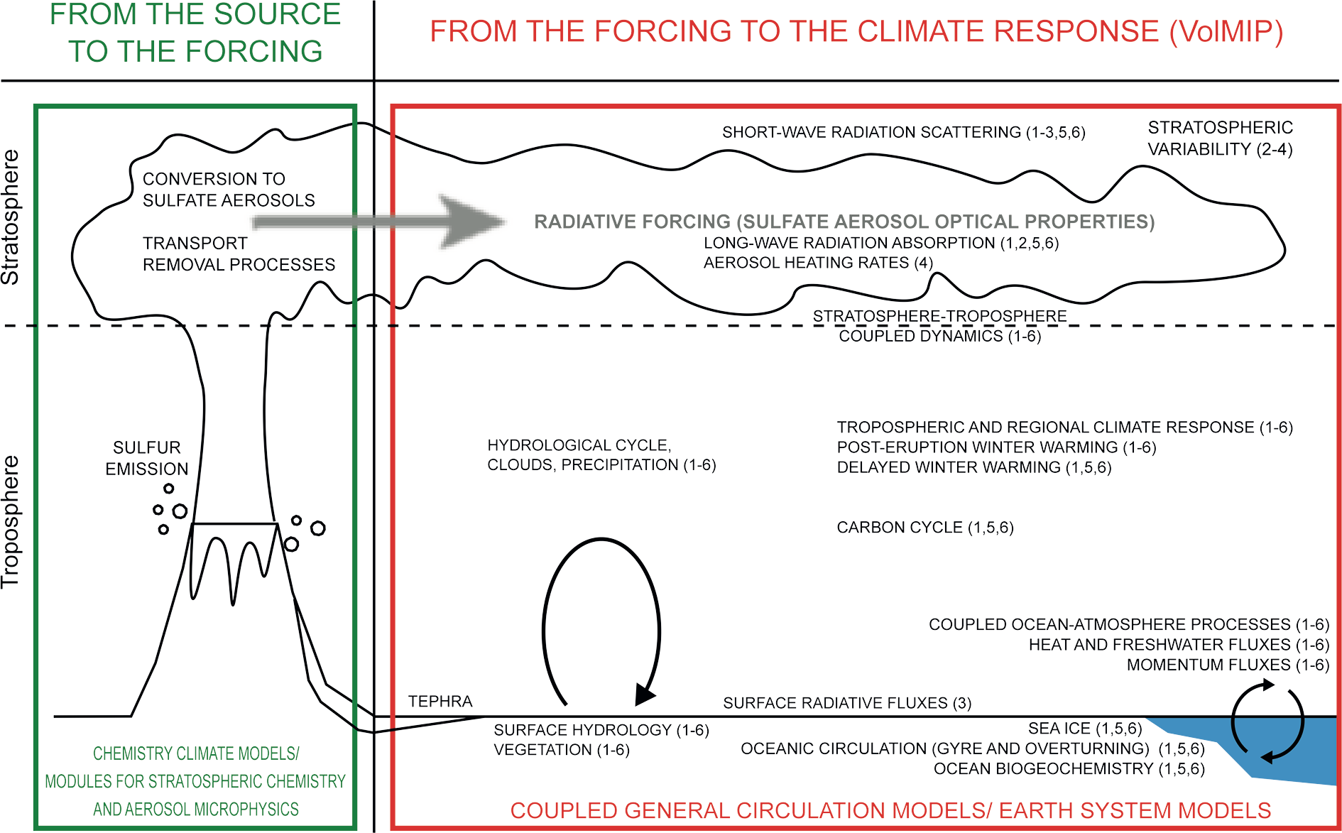
Notes:
Figure 2: Dominant processes illustrating the link between volcanic eruptions and climate response, with an
overview of VolMIP experiments as submitted to the World Climate Research Program for CMIP endorsement
(1-4: mandatory; 5,6: non-mandatory). VolMIP experiments: (1) Tambora-like tropical eruption [VolLongS60EQ];
(2) Pinatubo-like tropical eruption [VolShort20EQfull]; (3) Pinatubo-like eruption, prescribed perturbation to
shortwave radiative flux [VolShort20EQsurf]; (4) Pinatubo-like eruption, prescribed perturbation to aerosol
heating rates [VolShort20EQstrat]; (5) Laki-like high-latitude eruption [VolLongS100HL]; (6) 19th century-like
cluster of tropical eruptions [VolLongC19thC].
A coordinated modeling assessment of the climate response to volcanic forcing
Davide Zanchettin1, C. Timmreck2, M. Khodri3, A. Robock4, A. Rubino1, A. Schmidt5 and M. Toohey2,6
AFFILIATIONS
1Department of Environmental Sciences, Informatics
and Statistics, University of Venice, Italy
2Max-Planck-Institute for Meteorology, Hamburg,
Germany
3IRD/IPSL/Laboratoire d'Océanographie et du Climat,
Paris, France
4Department of Environmental Sciences, Rutgers
University, New Brunswick, USA
5School of Earth and Environment, University of Leeds,
UK
6GEOMAR Helmholtz Centre for Ocean Research Kiel,
Germany
CONTACT
Davide Zanchettin: davide.zanchettin@unive.it

Slide 13
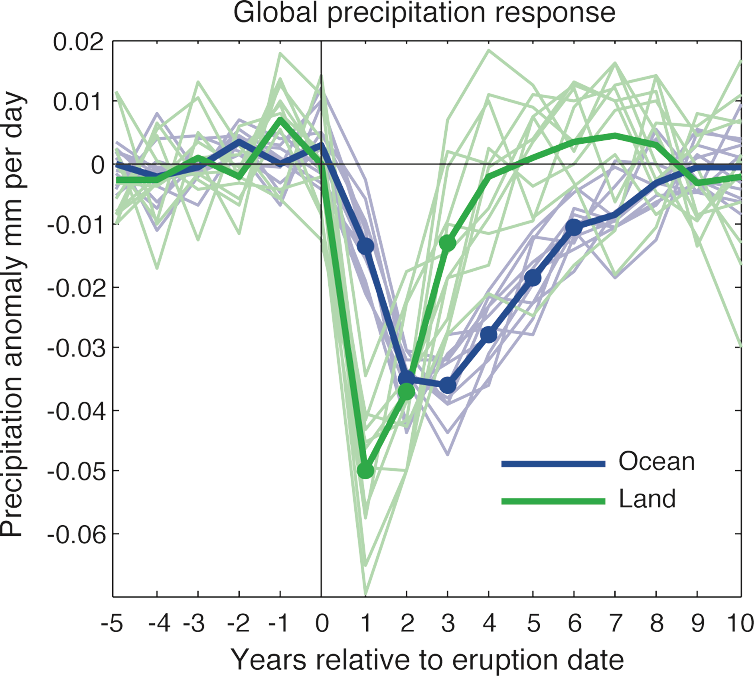
Notes:
Figure 1: Global land and ocean precipitation response averaged over 18 low latitude eruptions and 11
ensemble members of the climate model HadCM3. Thick lines are ensemble means and thin lines are individual
ensemble members. Dots indicate where the ensemble mean response is significant against internal variability at
the 5% level. Figure modified from Iles et al. 2013.
Volcanic eruptions and the global hydrological cycle
Carley E. Iles, G.C. Hegerl and A.P. Schurer
AFFILIATIONS
School of Geosciences, University of Edinburgh, UK
CONTACT
Carley E. Iles: carley.iles@ed.ac.uk

Slide 14
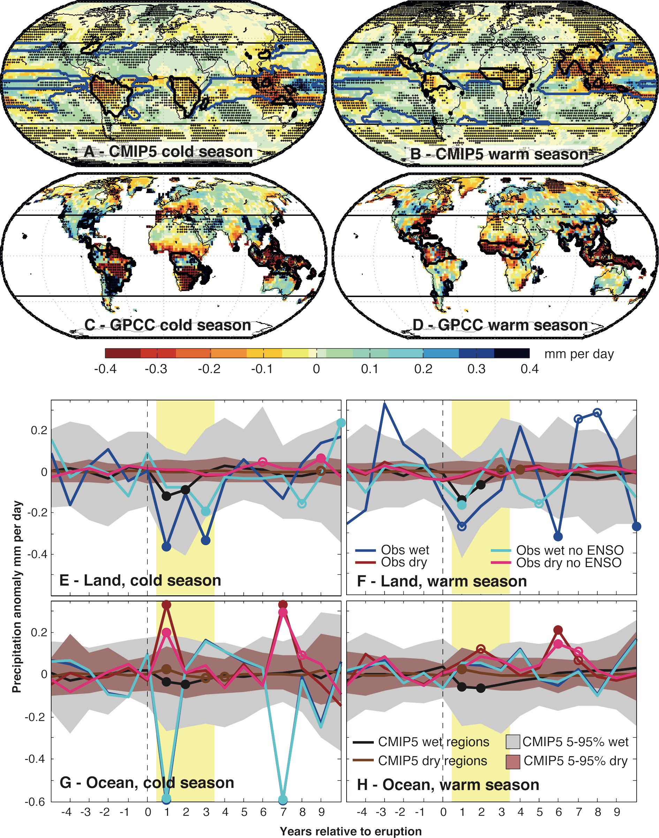
Notes:
Figure 2: Average precipitation response across the first two years following five volcanic eruptions for (A)
and (B) CMIP5 multi model mean, (C) and (D) observational data over land. Stippling indicates significance at
the 90% level. Contour line denotes tropical-subtropical wet regions, blue for ocean and black for land. (E-H)
Precipitation response averaged across wet and dry tropical-subtropical regions. Black line denotes the CMIP5
multi model mean over wet regions; brown for the dry regions. Shading denotes the 5-95% range of the results
for individual ensemble members. Blue and red lines are the observed response over the wet and dry regions,
respectively, with (darker line) and without (lighter line) the influence of ENSO. Circles indicate significance at
the 80% level (open) and 90% level (filled) for post-eruption years. Yellow shading indicates when a response is
expected. (A-F) are averaged over 5 eruptions and (G-H) over two (1982, 1991 eruptions). Figure modified from
Iles et al. 2014.
Volcanic eruptions and the global hydrological cycle
Carley E. Iles, G.C. Hegerl and A.P. Schurer
AFFILIATIONS
School of Geosciences, University of Edinburgh, UK
CONTACT
Carley E. Iles: carley.iles@ed.ac.uk

Slide 15
Notes:
Figure 1: “A Compendium of Chinese Meteorological Records of the Last 3,000 Years” compiles the most
comprehensive collection of Chinese official records including state annals, provincial annals, and county annals.
Volcanic monsoon influence revealed from multi-proxy evidence
Chaochao Gao
AFFILIATIONS
Department of Environmental Science, Zhejiang
University, Hangzhou, China
CONTACT
Chaochao Gao: gaocc@zju.edu.cn

Slide 16
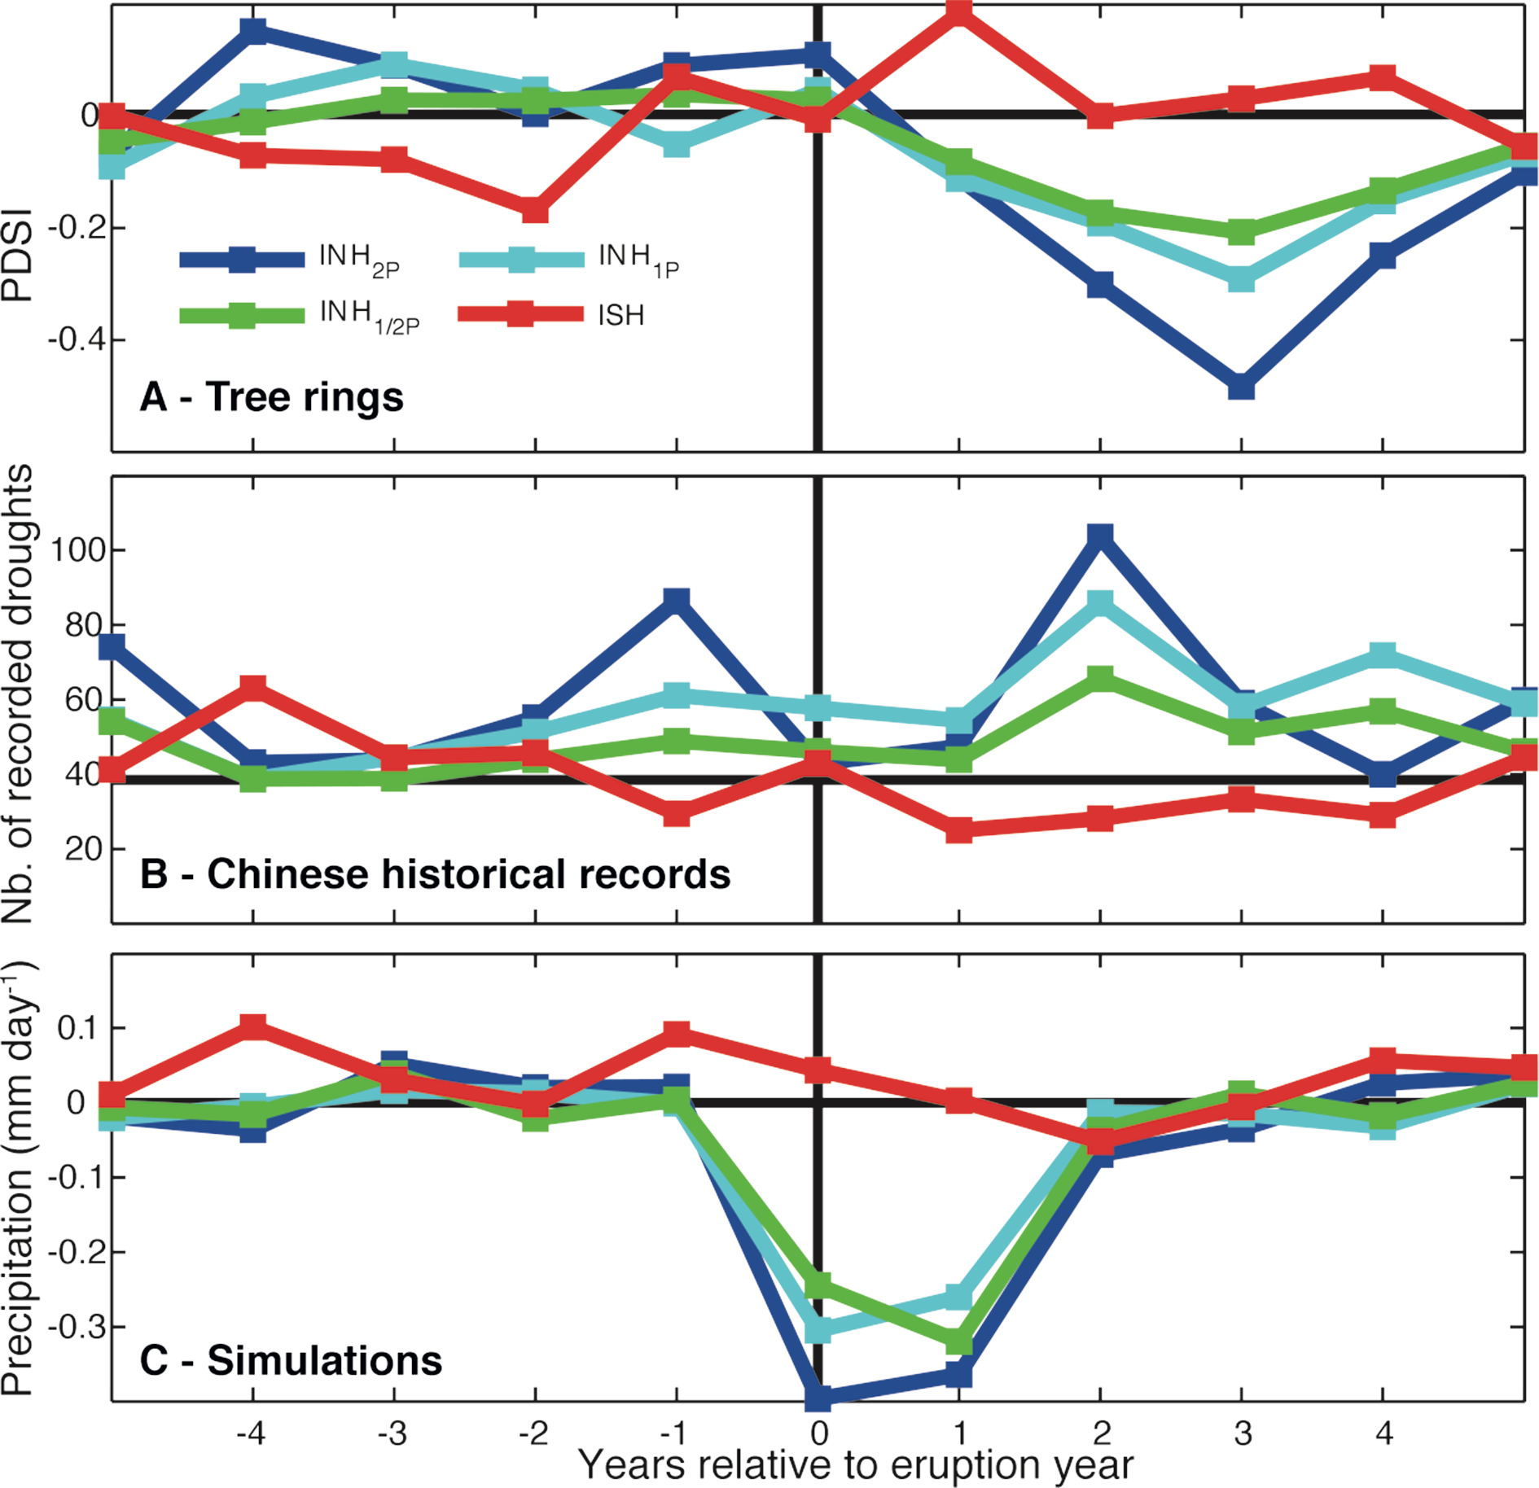
Notes:
Figure 2: Average summer rainfall response in China to volcanic perturbations, revealed from (A) tree rings
(Monsoon Asia Drought Atlas), (B) Chinese historical records (CHI), and (C) CESM and CC SM4 millennium
simulations. Plotted are the superposed epoch analysis results for eruptions with Northern Hemisphere sulfate
injection of more than half (INH1/2P), equal (INH1P), and double (INH2P) that of the 1991 Pinatubo eruption
and SH-only (ISH) injection during AD 1300-1850. (A) and (B) are adapted from Zhuo et al. (2014); (C) is the
precipitation anomaly with respect to the AD 1300-1850 mean.
Volcanic monsoon influence revealed from multi-proxy evidence
Chaochao Gao
AFFILIATIONS
Department of Environmental Science, Zhejiang
University, Hangzhou, China
CONTACT
Chaochao Gao: gaocc@zju.edu.cn

Slide 17
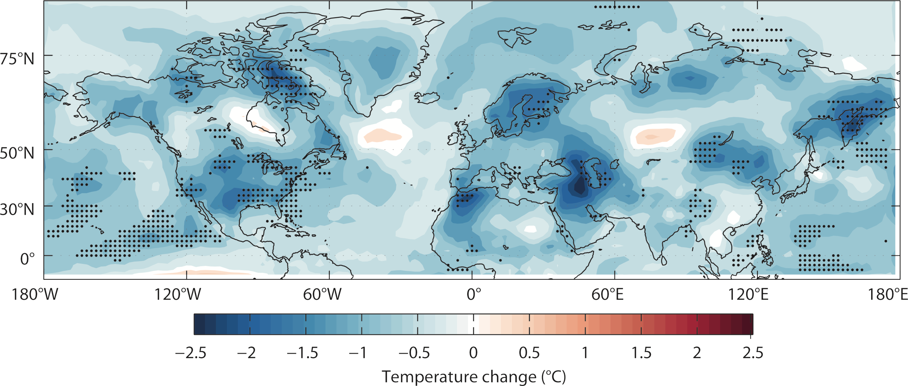
Notes:
Figure 1: Simulated cooling during the northern summer (JJA) of AD 1816, as estimated by the Coupled Model Intercomparison Project Phase 5 (Taylor et al. 2012). The
shading represents the multi-model mean temperature difference between the northern summer of 1816 and 1815, and stippling illustrates locations where at least seven of
eight model ensemble members agree on the sign of the temperature change.
On the AD 1815 Tambora eruption and the matter of misplaced tree rings
Scott St. George1 and Kevin J. Anchukaitis2
AFFILIATIONS
1Department of Geography, Environment and Society,
University of Minnesota, Minneapolis, USA
2School of Geography and Development & Laboratory
of Tree Ring Research, Tucson, USA
CONTACT
Scott St. George: stgeorge@umn.edu

Slide 18
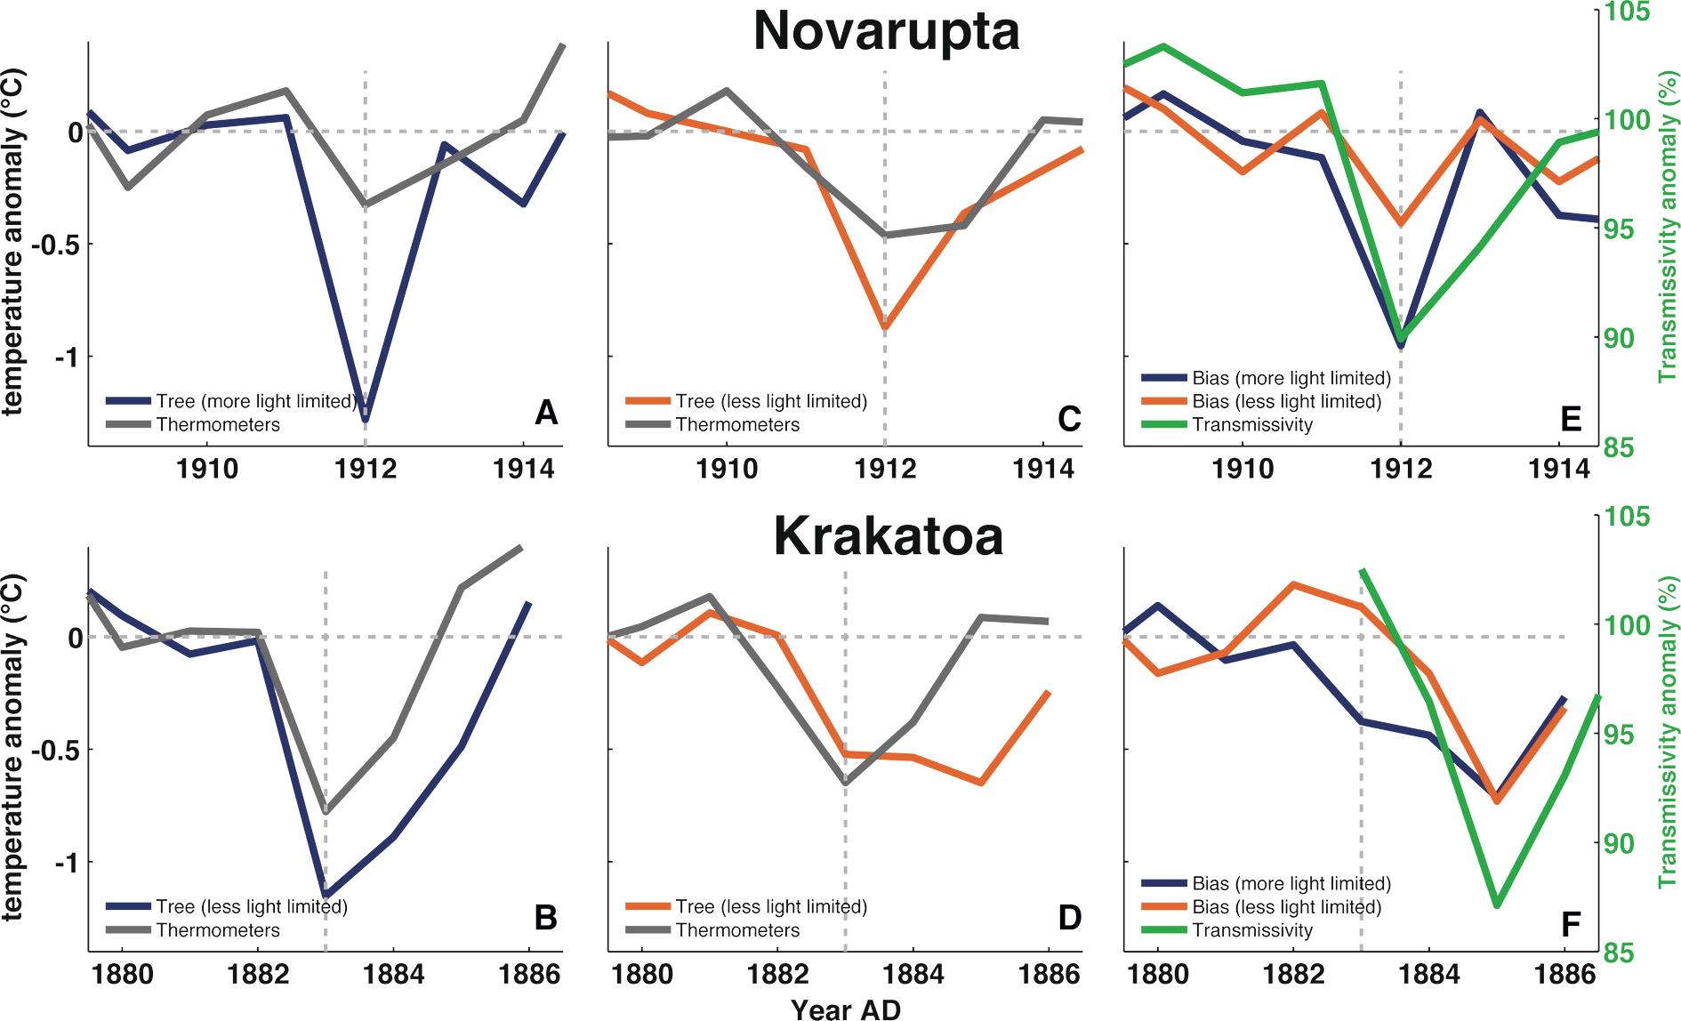
Notes:
Figure 1: Comparison of the volcanic cooling recorded by boreal tree rings with volcanic cooling recorded by
thermometers. Tree rings are calibrated into temperature units using a Bayesian approach (Tingley et al. 2014).
Top row shows response for 1912 Novarupta eruption and bottom row for 1883 Krakatoa eruption. (A and B)
Comparison for relatively strongly, and (C and D) for relatively weakly light-limited boreal regions. (E and F)
The bias in the tree-ring response from regions of relatively strong (blue) and weak (orange) light-limitation
compared with the anomaly in atmospheric transmissivity inferred from contemporary pyrheliometers (green;
Kimball 1918).
Illuminating the volcanic signal in tree rings
Alexander R. Stine1, M.P. Tingley2 and P. Huybers3
AFFILIATIONS
1Department of Earth & Climate Sciences, San
Francisco State University, USA
2Department of Statistics and Department of
Meteorology, Penn State University, State College,
USA
3Department of Earth and Planetary Sciences, Harvard
University, Cambridge, USA
CONTACT
Alexander Stine: stine@sfsu.edu

Slide 19
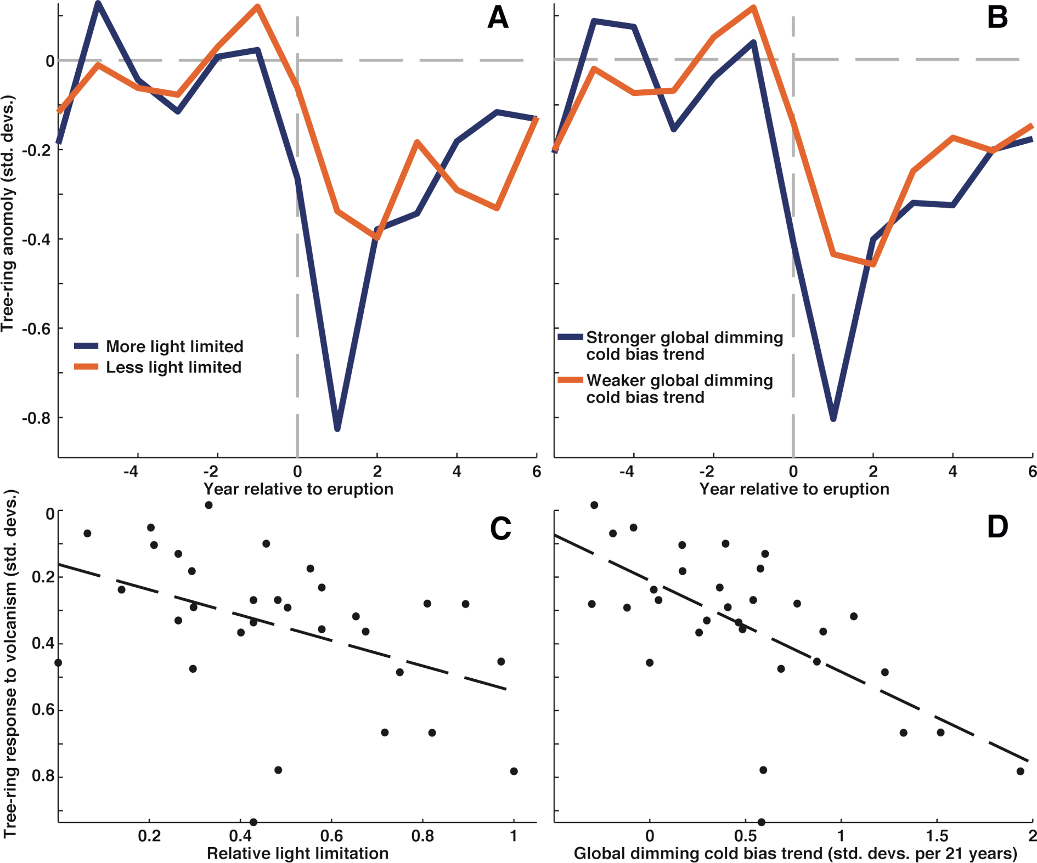
Notes:
Figure 2: Comparison of the tree-ring density response to volcanic eruptions of the last 700 years with local
estimates of light limitation and spatial variability in the response to global dimming (Stine and Huybers 2014).
(A) Volcanic response in strongly (blue) and weakly (orange) light-limited regions. (B) Volcanic response in
regions with strong (blue) and weak (orange) decline in density relative to temperature during period of global
dimming. Comparison of volcanic tree-ring response to (C) light limitation and to (D) global dimming across the
boreal region.
Illuminating the volcanic signal in tree rings
Alexander R. Stine1, M.P. Tingley2 and P. Huybers3
AFFILIATIONS
1Department of Earth & Climate Sciences, San
Francisco State University, USA
2Department of Statistics and Department of
Meteorology, Penn State University, State College,
USA
3Department of Earth and Planetary Sciences, Harvard
University, Cambridge, USA
CONTACT
Alexander Stine: stine@sfsu.edu

Slide 20
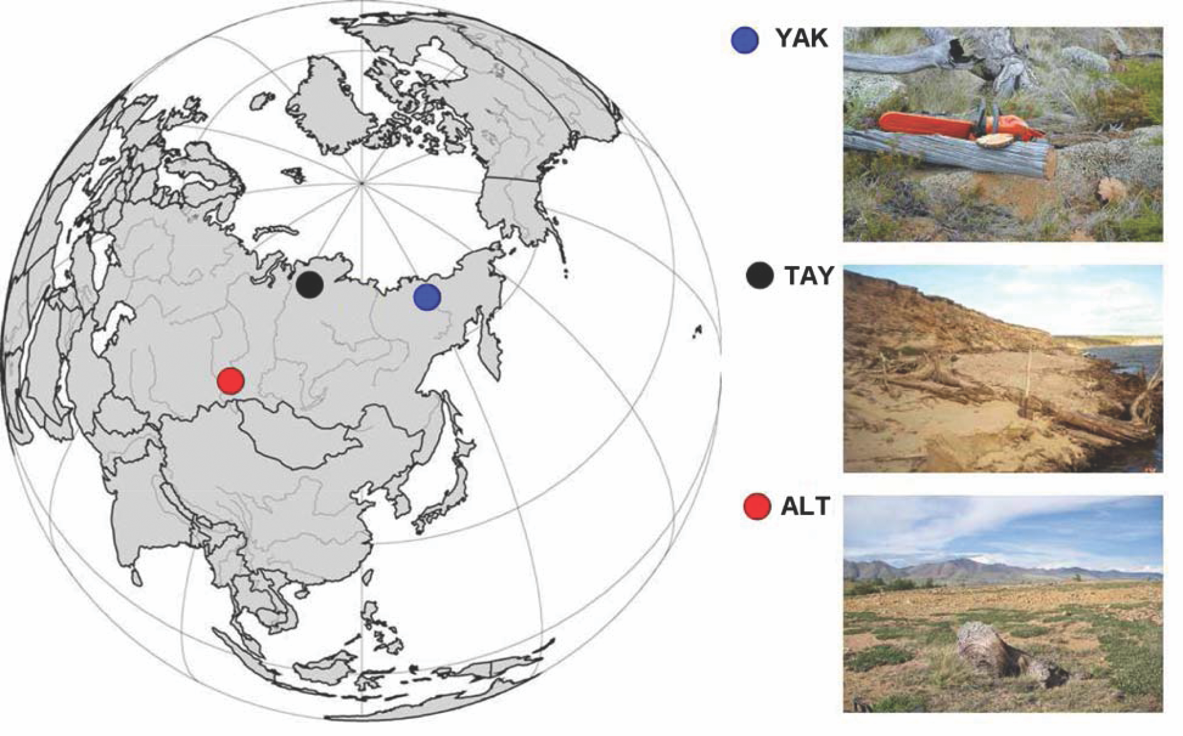
Notes:
Figure 1: Map with locations and photos of the study regions in the high-latitude sites in northeastern Yakutia
(69°N, 148°E; YAK), Taymir Penninsula (70°N, 103°E; TAY), and high-altitude site in the Russian Altai (50°N, 89°E;
ALT).
Siberian trees: Eyewitnesses to the volcanic event of AD 536
Olga V. Churakova (Sidorova)1,2,3,4, M. Saurer2, R.T.W. Siegwolf2, M.V. Bryukhanova4,6, T. Boettger5, M.M. Naurzbaev4,
V.S. Myglan6, O.V. Naumova4,6, D.V. Ovchinnikov4, M. Stoffel1,7, E.A. Vaganov4,6 and M.K. Hughes8
AFFILIATIONS
1Dendrolab.ch, University of Bern, Switzerland
2Paul Scherrer Institute, Villigen, Switzerland
3Institute of Terrestrial Ecosystem, ETH Zürich,
Switzerland
4V.N. Sukachev Institute of Forest SB RAS, Krasnoyarsk,
Russia
5Helmholz Zentrum, Halle/Saale, Germany
6Siberian Federal University, Krasnoyarsk, Russia
7Institute for Environmental Sciences, University of
Geneva, Switzerland
8Laboratory of Tree-Ring Research, University of
Arizona, Tucson, USA
CONTACT
Olga Churakova (Sidorova): olga.churakova@geo.unibe.ch

Slide 21
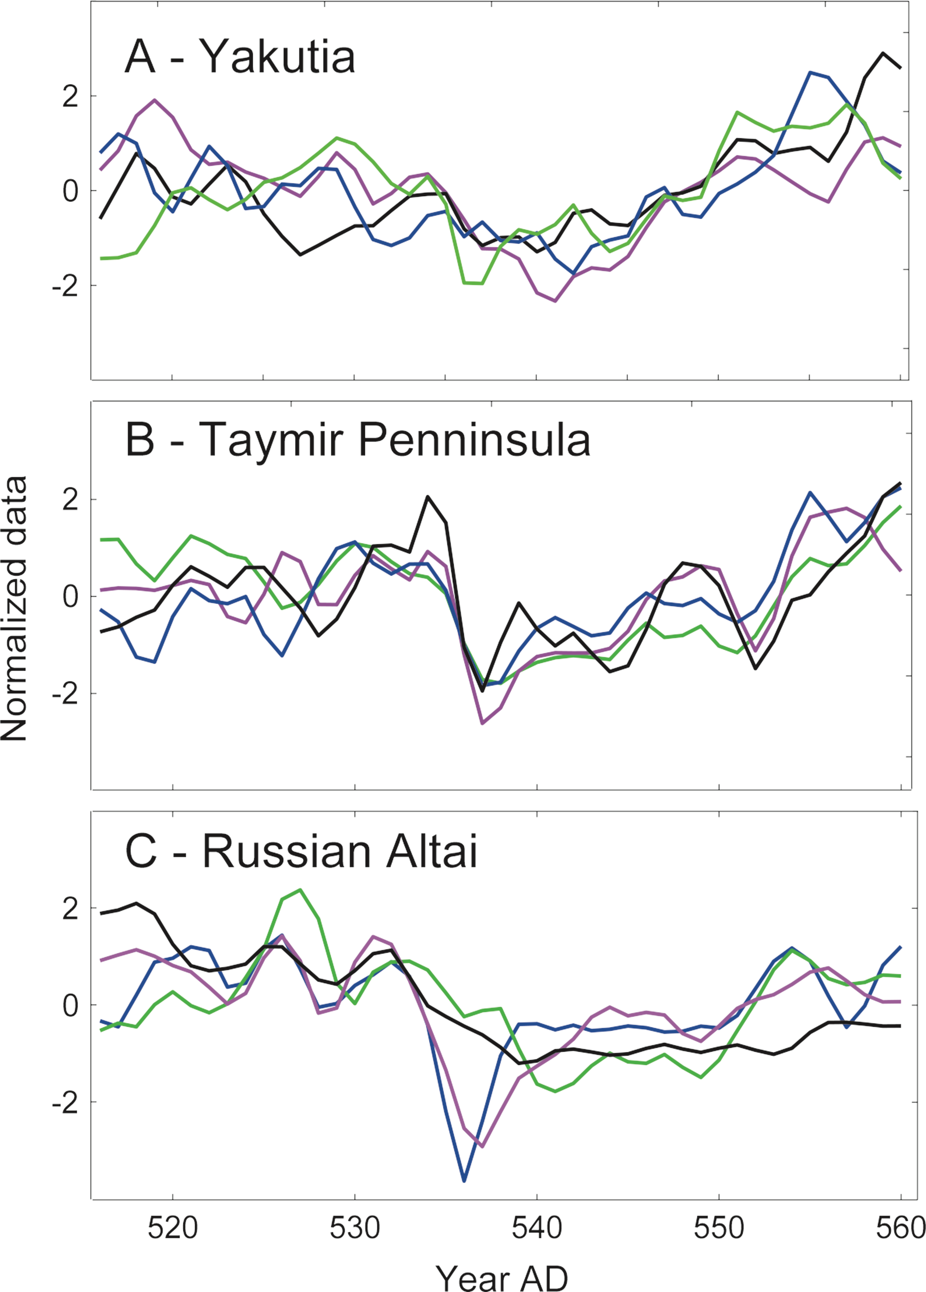
Notes:
Figure 2: Normalized by 3-year smoothed δ13C (green), δ18O (blue), tree-ring width index (black), and cell wall
thickness (pink) chronologies for the three study regions (A) Yakutia (YAK), (B) Taymir Penninsula (TAY), and (C)
Russian Altai (ALT).
Siberian trees: Eyewitnesses to the volcanic event of AD 536
Olga V. Churakova (Sidorova)1,2,3,4, M. Saurer2, R.T.W. Siegwolf2, M.V. Bryukhanova4,6, T. Boettger5, M.M. Naurzbaev4,
V.S. Myglan6, O.V. Naumova4,6, D.V. Ovchinnikov4, M. Stoffel1,7, E.A. Vaganov4,6 and M.K. Hughes8
AFFILIATIONS
1Dendrolab.ch, University of Bern, Switzerland
2Paul Scherrer Institute, Villigen, Switzerland
3Institute of Terrestrial Ecosystem, ETH Zürich,
Switzerland
4V.N. Sukachev Institute of Forest SB RAS, Krasnoyarsk,
Russia
5Helmholz Zentrum, Halle/Saale, Germany
6Siberian Federal University, Krasnoyarsk, Russia
7Institute for Environmental Sciences, University of
Geneva, Switzerland
8Laboratory of Tree-Ring Research, University of
Arizona, Tucson, USA
CONTACT
Olga Churakova (Sidorova): olga.churakova@geo.unibe.ch

