Slide 1
Figures – PAGES Magazine 22(1) 2014
Please cite the PAGES magazine article and, if available, the original reference when using a figure. See note section below the figures for details.

Slide 2
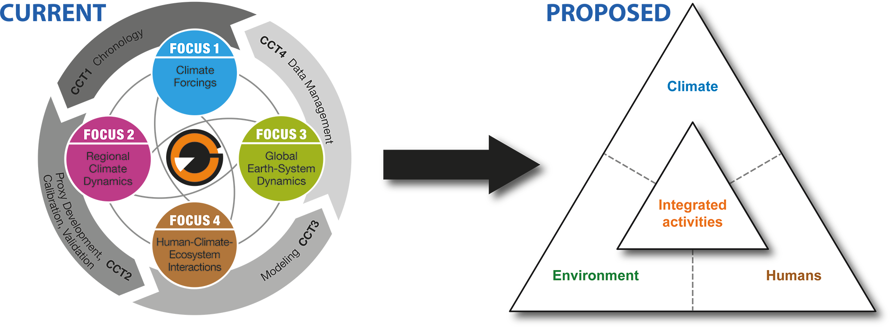
Notes:
PAGES restructured

Slide 3
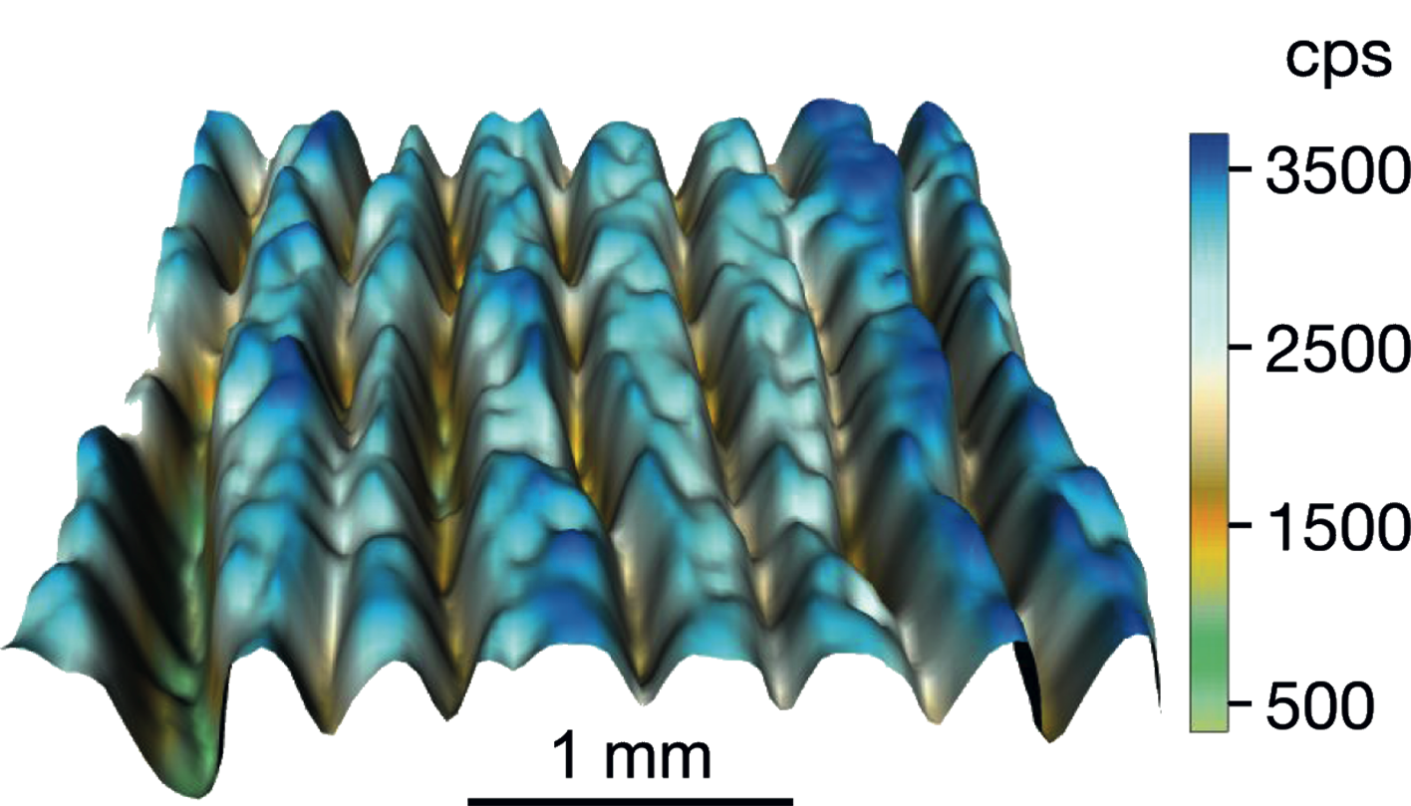
Notes:
Editorial: Maximizing the information yield from annually resolving natural archives
Bernd Zolitschka1 and Jennifer Pike2
Figure 1: Micro-XRF elemental grid scan of a varved sediment section from the Piánico paleolake (Italy) documenting a subannual geochemical profile for the element Ca (image courtesy of Peter Dulski).
AFFILIATIONS
1Institute of Geography, University of Bremen, Germany
2School of Earth and Ocean Sciences, Cardiff University, UK
CONTACT
Bernd Zolitschka: zoli@uni-bremen.de

Slide 4
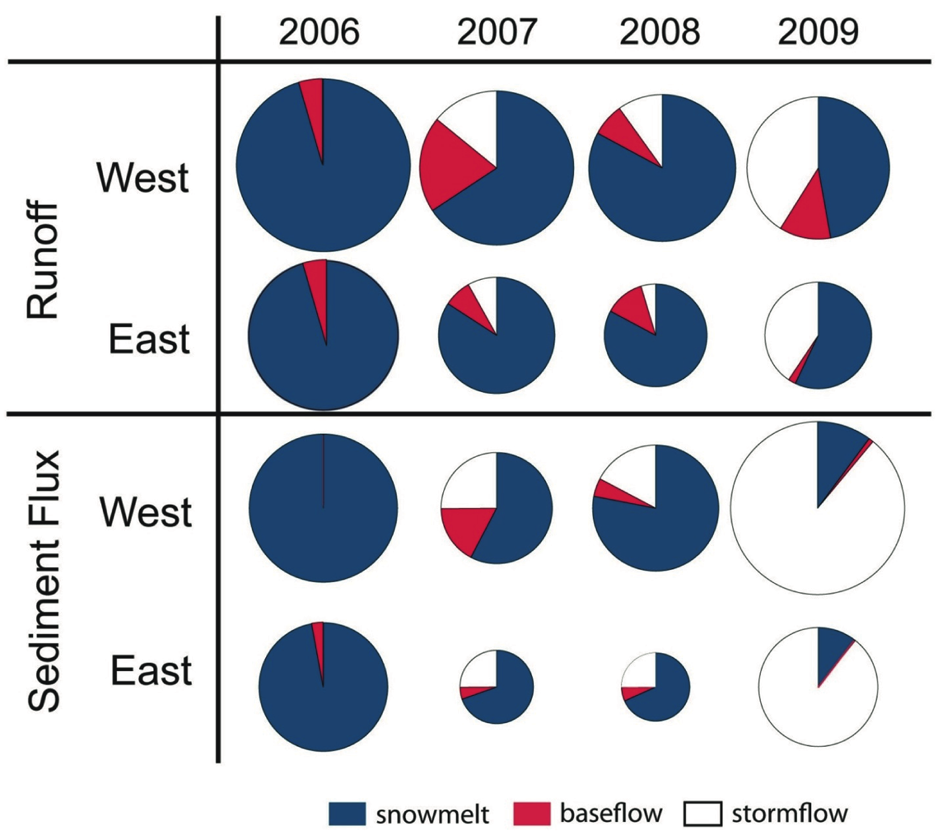
Notes:
Layers within layers: quantifying seasonal versus event processes in Arctic clastic varved sediments
Scott F. Lamoureux1 and Pierre Francus2
Figure 1: Four years of river discharge and suspended sediment flux at Cape Bounty Arctic Watershed
Observatory (CBAWO). Pie size is scaled to the magnitude of flux. Note the contrast between 2006 when
snowmelt dominated runoff and sediment transport, compared to 2009 when two major rainfall events were
responsible for 89% of sediment transport (after Lewis et al. 2012).
AFFILIATIONS
1Department of Geography, Queen’s University,
Kingston, Canada
2Institut National de la Recherche Scientifique, Centre
Eau Terre et Environnement, Québec, Canada
CONTACT
Scott F. Lamoureux: scott.lamoureux@queensu.ca

Slide 5
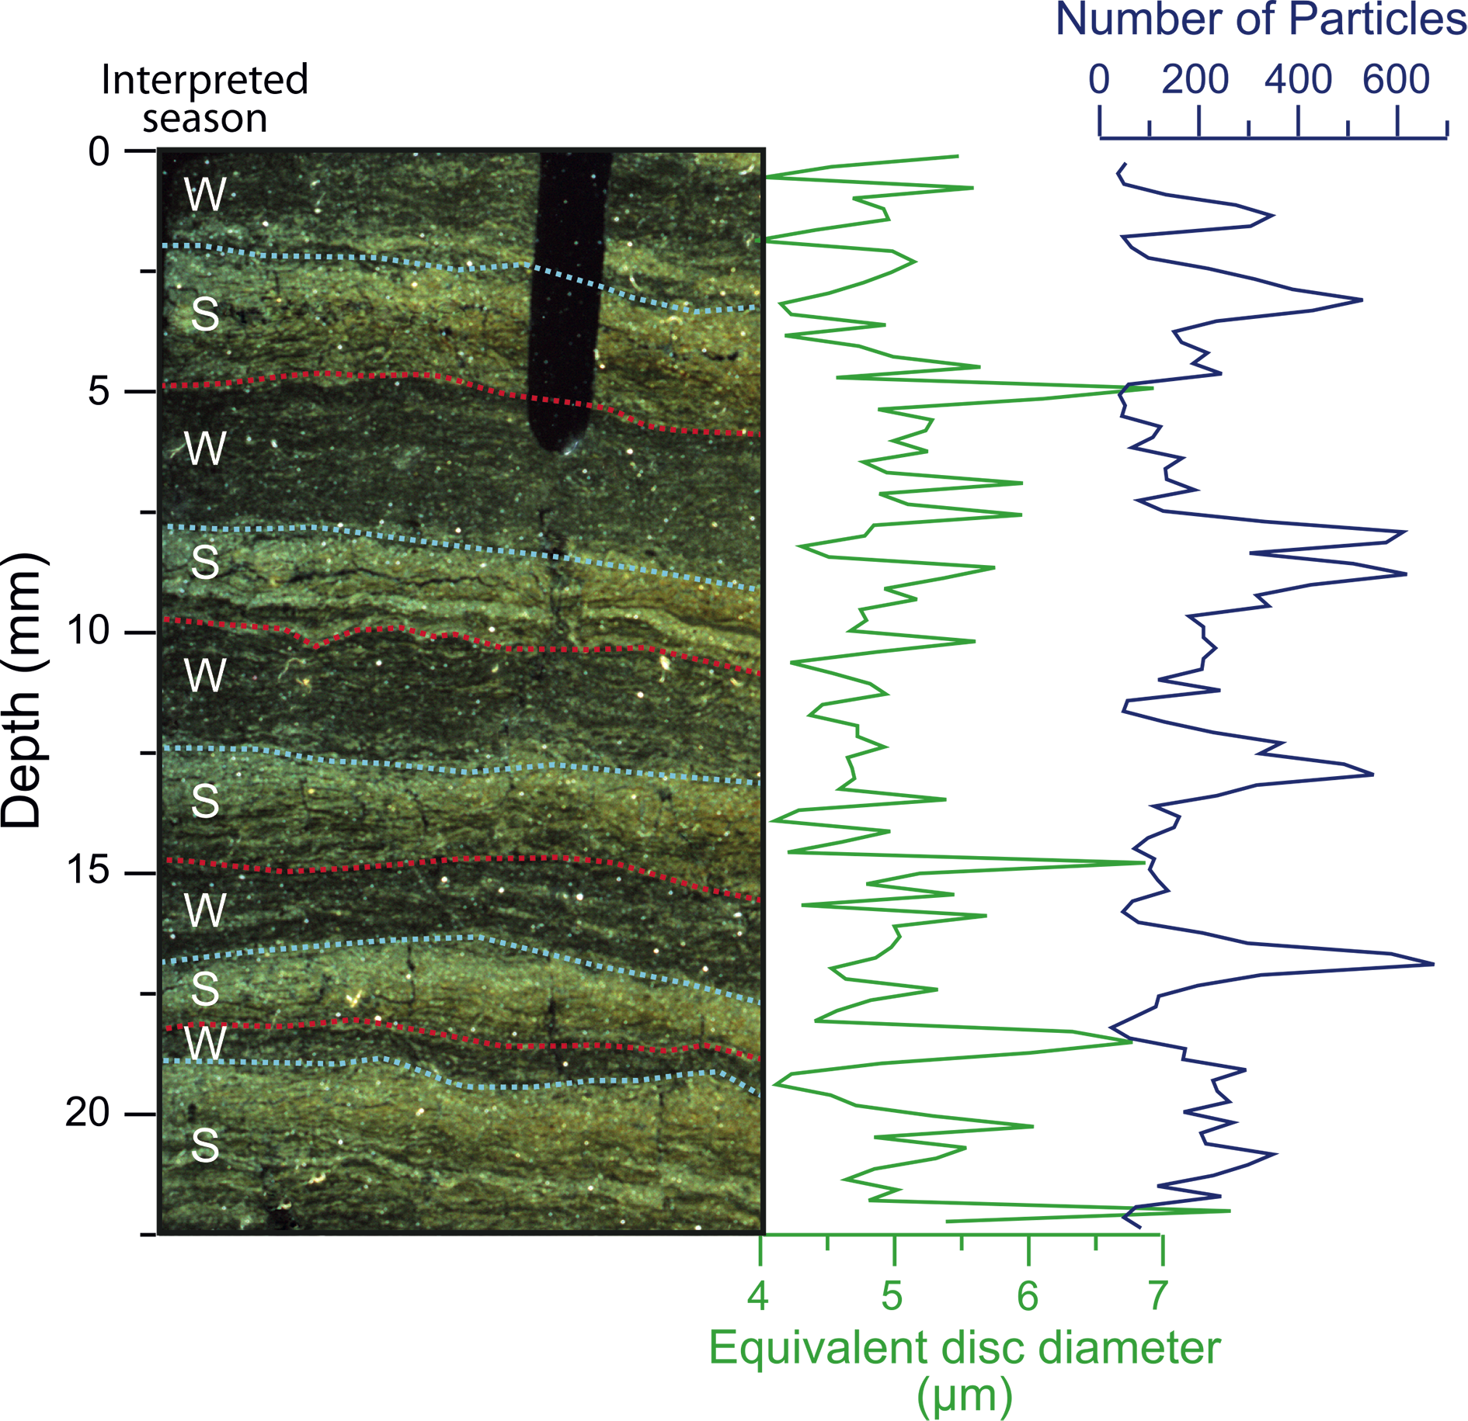
Notes:
Layers within layers: quantifying seasonal versus event processes in Arctic clastic varved sediments
Scott F. Lamoureux1 and Pierre Francus2
Figure 2: Results of an image analysis of particles in five varves from marine sediments in Saanich Inlet, British
Columbia. This image was obtained using a flatbed scanner under cross-polarized light while particle size
analysis was carried out at 220 μm intervals (102 measurements in total). Interpreted seasons are indicated
as winter (W) and summer (S) (Lewis et al. 2010). Blue dashed lines indicate the transition from underlying
terrigenous sediment to overlying biogenic sediment and red lines indicate the opposite transition.
AFFILIATIONS
1Department of Geography, Queen’s University,
Kingston, Canada
2Institut National de la Recherche Scientifique, Centre
Eau Terre et Environnement, Québec, Canada
CONTACT
Scott F. Lamoureux: scott.lamoureux@queensu.ca

Slide 6
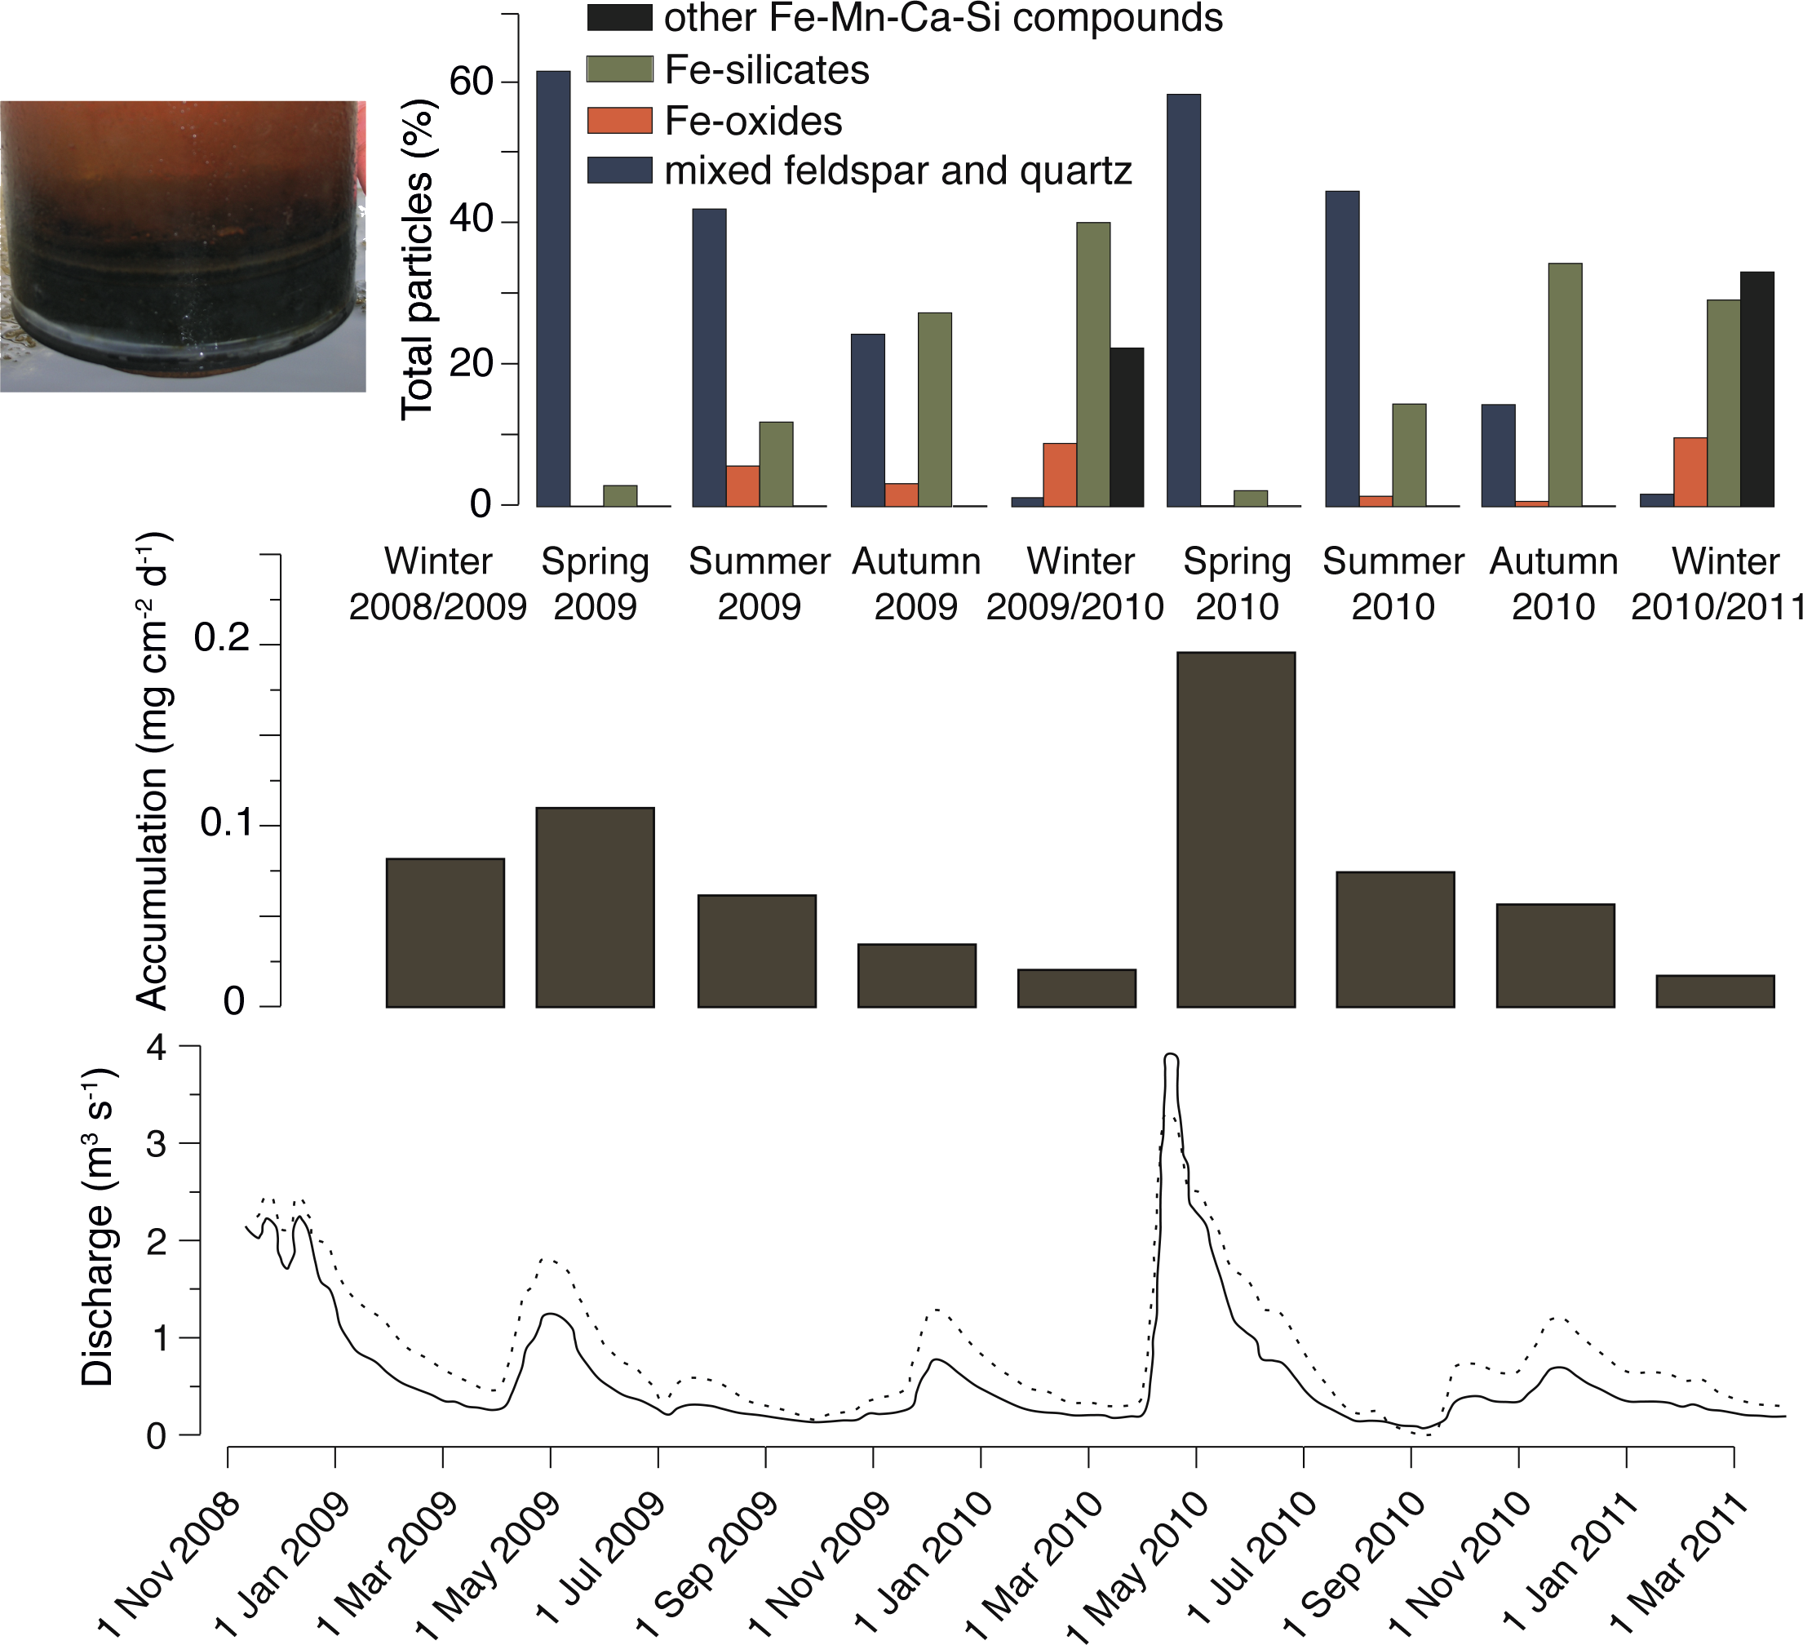
Notes:
Understanding varve formation processes from sediment trapping and limnological monitoring
Antti E.K. Ojala1, C. Bigler2 and J. Weckström3
Figure 1: Hydrological data, seasonal sediment accumulation, and seasonal sedimentation of different
components in Lake Nautajärvi (Finland) during the monitoring period between spring 2009 and winter
2010/2011 (Ojala et al. 2013). The photograph of the sediment collected in a plastic tube shows deposits of two
minerogenic spring laminae and uncompacted laminae of biogenic material deposited during summer, autumn
and winter.
AFFILIATIONS
1Geological Survey of Finland
2Department of Ecology and Environmental Science,
Umeå University, Sweden
3Department of Environmental Sciences, University of
Helsinki, Finland
CONTACT
Antti E.K. Ojala: antti.ojala@gtk.fi

Slide 7
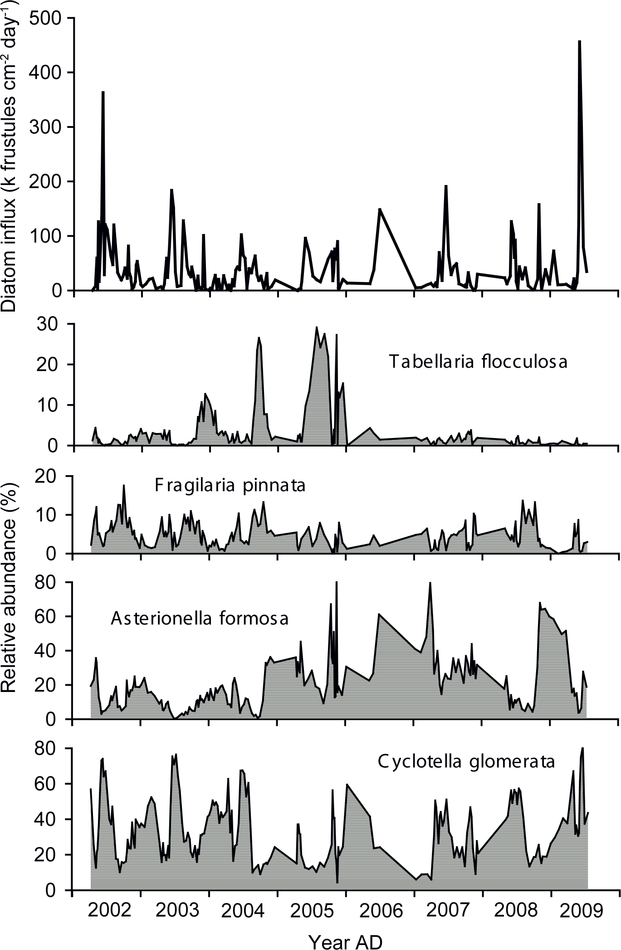
Notes:
Understanding varve formation processes from sediment trapping and limnological monitoring
Antti E.K. Ojala1, C. Bigler2 and J. Weckström3
Figure 2: Total diatom influx and relative abundance of major diatom taxa in Nylandssjön since 2001 based on
sediment trap data (Bigler et al. 2012).
AFFILIATIONS
1Geological Survey of Finland
2Department of Ecology and Environmental Science,
Umeå University, Sweden
3Department of Environmental Sciences, University of
Helsinki, Finland
CONTACT
Antti E.K. Ojala: antti.ojala@gtk.fi

Slide 8
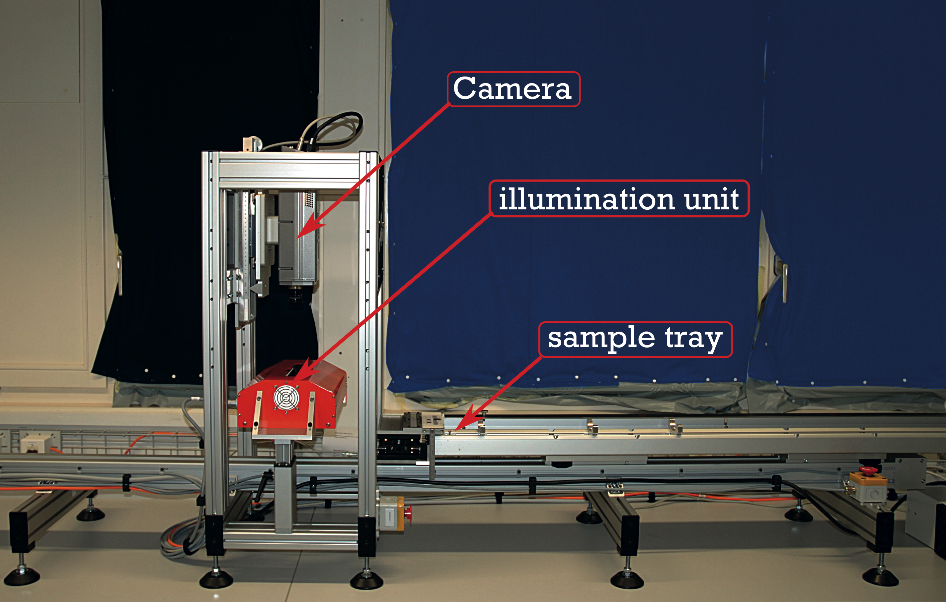
Notes:
Hyperspectral imaging: a novel, nondestructive method for investigating subannual sediment structures and composition
Martin Grosjean1, B. Amann1, C. Butz1, B. Rein2 and W. Tylmann3
Figure 1: Specim Ltd. hyperspectral core scanner at the Paleolimnology Lab, University of Bern.
AFFILIATIONS
1Oeschger Centre for Climate Change Research &
Institute of Geography, University of Bern, Switzerland
2GeoConsult Rein, Oppenheim, Germany
3Institute of Geography, University of Gdańsk, Poland
CONTACT
Martin Grosjean: martin.grosjean@oeschger.unibe.ch

Slide 9
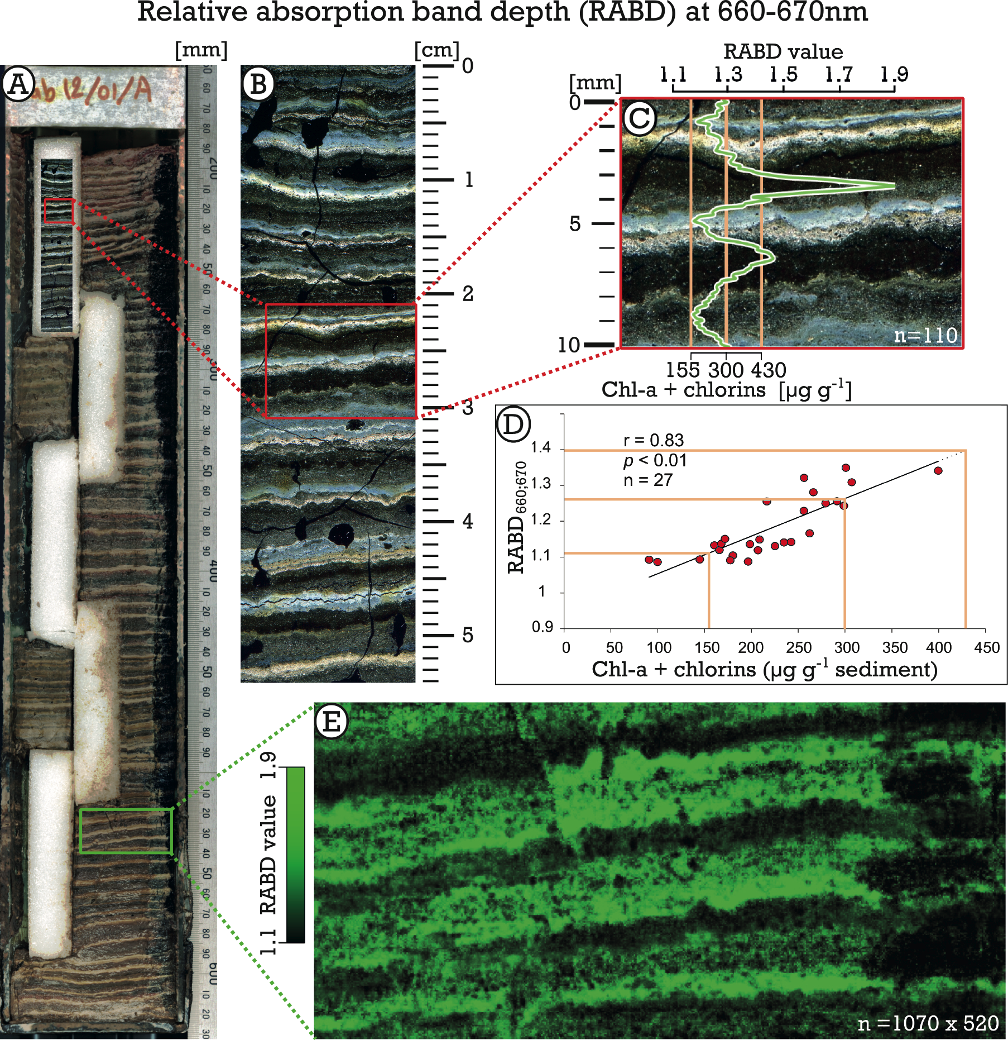
Notes:
Hyperspectral imaging: a novel, nondestructive method for investigating subannual sediment structures and composition
Martin Grosjean1, B. Amann1, C. Butz1, B. Rein2 and W. Tylmann3
Figure 2: Example of hyperspectral imaging of varves from Lake Żabińskie in Poland. (A) Near-infrared composite image of a sediment core; (B) close-up of a thin section
under cross-polarized light; (C) hyperspectral RABD660;670 time series along a cross section of two varves of wet sediment (green line, mean value of 29 pixels width); (D)
calibration of spectral imaging data with HPLC data for chl-a and chlorins; (E) map of the hyperspectral RABD660;670 index across three annual varves (light green color
indicates high chlorin concentration). The orange lines in (C) and (D) mark the range for which the calibration is valid.
AFFILIATIONS
1Oeschger Centre for Climate Change Research &
Institute of Geography, University of Bern, Switzerland
2GeoConsult Rein, Oppenheim, Germany
3Institute of Geography, University of Gdańsk, Poland
CONTACT
Martin Grosjean: martin.grosjean@oeschger.unibe.ch

Slide 10
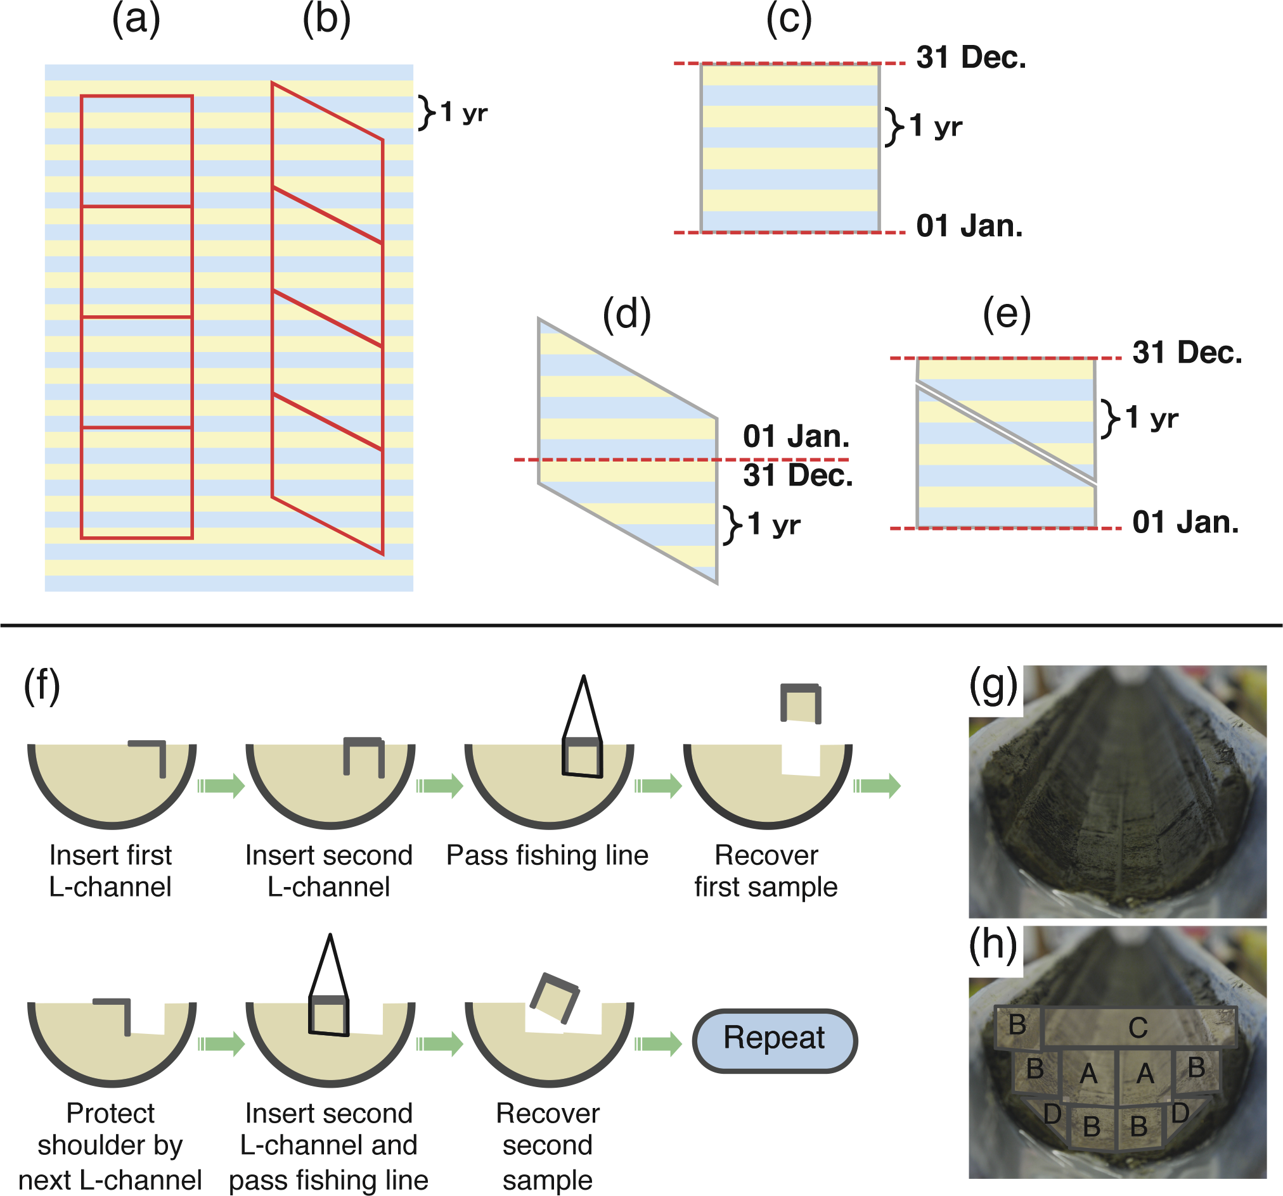
Notes:
High-precision sampling of laminated sediments: Strategies from Lake Suigetsu
Takeshi Nakagawa1 and Suigetsu 2006 Project Members2
Figure 1: Top. Parallel samples (a) may contain four blue and three yellow “seasonal” layers, or vice versa,
depending on sampling position, making the resulting samples incoherent. This effect is considerably reduced
in diagonal samples (b). If one could cut samples precisely between 1 January and 31 December, then we would
not have the “last seasonal layer” problem (c). Such ideal cutting is not possible in the real world. However,
diagonal cutting is almost equivalent to such ideal cutting. Theoretically (i.e. not in practice), it is possible to cut
a diagonal sample into two blocks precisely at the transition from one year to the next (d). By flipping the upper
and lower blocks of (d), we can obtain a sub-sample (e), which is very close to the ideal cutting (c) in terms of the
number of included seasonal layers. Bottom: (f) Procedure to recover multiple LL-channel samples (modified
after Nakagawa et al. 2012) and (g-h) an example of intense sub-sampling by double-L (LL) channels. A and B:
15x15 and 12x12 mm LL-channel samples. C: Slab samples for soft X-radiography. D: 12 mm single L-channel
samples. 84% of the entire core and 94% of the undisturbed part (i.e. excluding the outer 2 mm) of the core were
recovered.
AFFILIATIONS
1Department of Geography, University of Newcastle,
Newcastle upon Tyne, UK
2www.suigetsu.org
CONTACT
Takeshi Nakagawa: nakag@fc.ritsumei.ac.jp

Slide 11
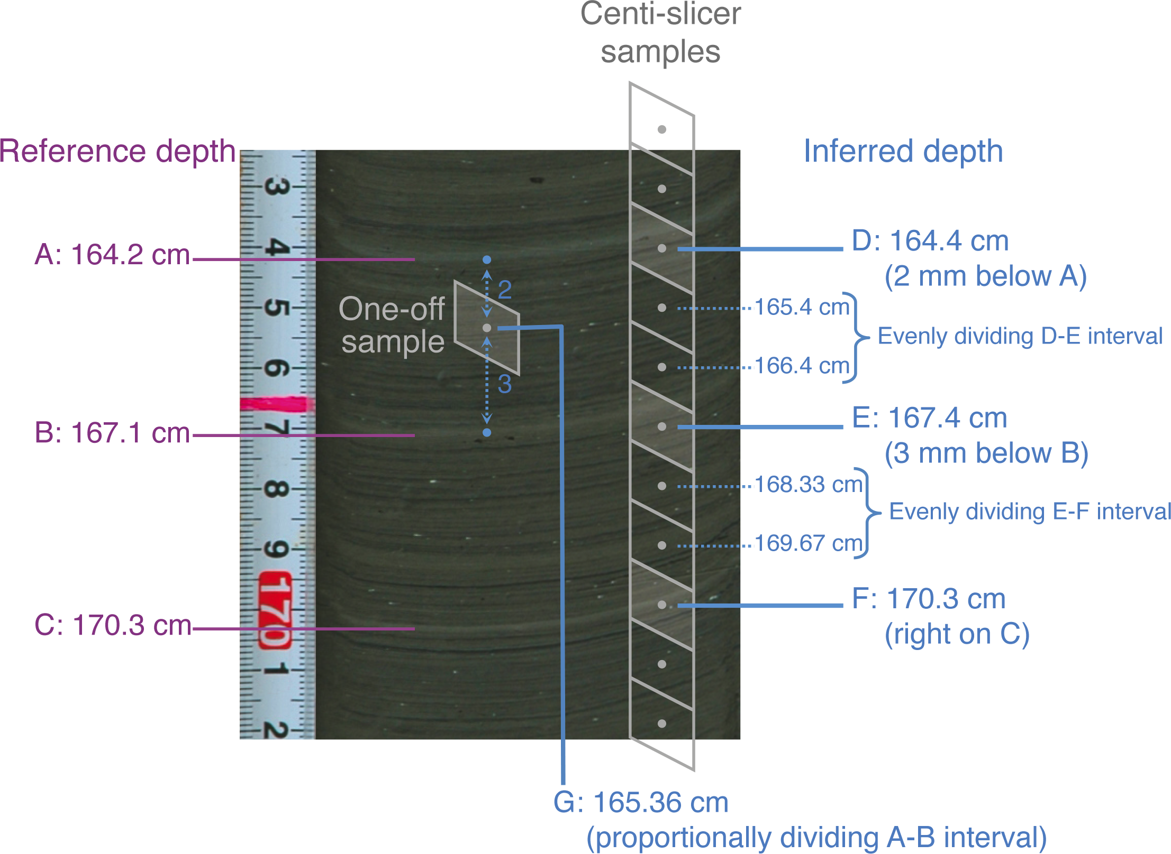
Notes:
High-precision sampling of laminated sediments: Strategies from Lake Suigetsu
Takeshi Nakagawa1 and Suigetsu 2006 Project Members2
Figure 2: (A-C) Marker layers with reference depth. (D-G) Depths measured relative to the marker layer. The sediment picture is artificially distorted for demonstration
purposes in order to enhance the impact of non-horizontal layers.
AFFILIATIONS
1Department of Geography, University of Newcastle,
Newcastle upon Tyne, UK
2www.suigetsu.org
CONTACT
Takeshi Nakagawa: nakag@fc.ritsumei.ac.jp

Slide 12
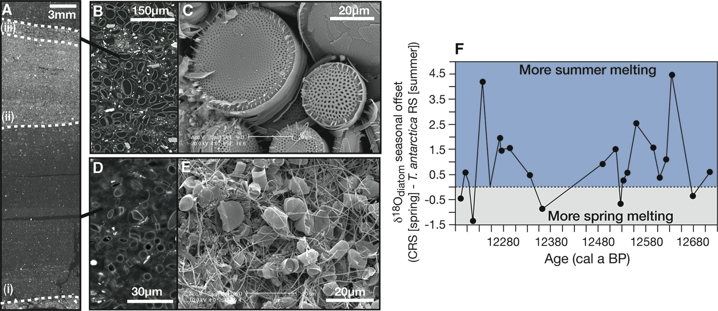
Notes:
Seasonal laminae in marine sediments: applications and potential
Alan E.S. Kemp
Figure 1: (A) Back-scattered electron imagery (BSEI) photomosaic of a polished thin section (PTS) of resin-embedded seasonally laminated sediments of deglacial age from
Palmer Deep, West Antarctic Peninsula. The core interval shows three seasonal flux laminae: (i) spring diatom lamina dominated by Hyalochaete Chaetoceros spp. resting
spores (CRS); (ii) summer terrigenous lamina; and (iii) late summer lamina characterized by high abundances of Thalassiosira antarctica resting spores. (B) BSEI of PTS and (C)
topographic SEM images of T. antarctica resting spore lamina (iii). (D) BSEI and (E) topographic SEM images of CRS lamina (i). (F) Seasonal offset between δ18Odiatom for CRS
(spring) and T. antarctica RS (summer) sampled from the same year (modified from Maddison 2006 and Swann et al. 2013).
AFFILIATION
National Oceanography Centre, University of Southampton,
UK
CONTACT
Alan E.S. Kemp: aesk@noc.soton.ac.uk

Slide 13
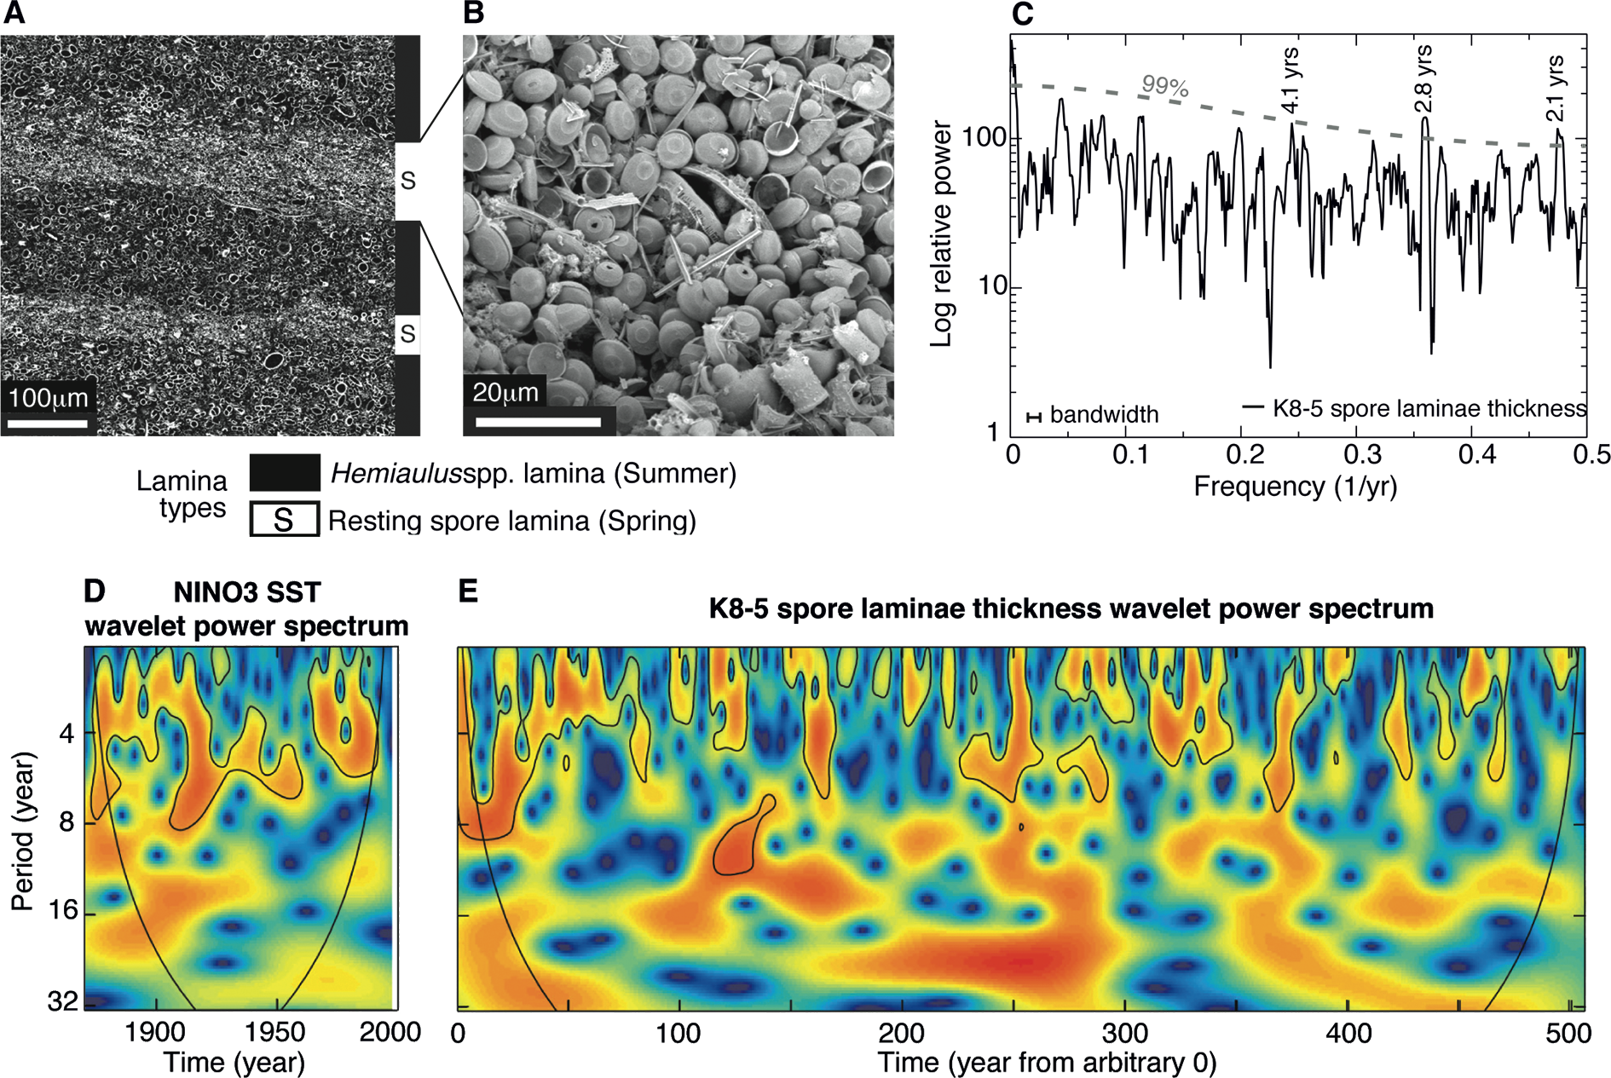
Notes:
Seasonal laminae in marine sediments: applications and potential
Alan E.S. Kemp
Figure 2: (A) Back-scattered electron imagery (BSEI) of seasonally laminated sediments of Cretaceous age from the Alpha Ridge of the Arctic Ocean. (B) Topographic SEM
image of spring Chaetoceros-type resting spore lamina. (C) Multi-taper method (MTM) power spectra of time series of resting spore lamina thickness from a 507-year interval
showing peaks significant at 99% confidence level in the quasi-biennial and typical ENSO low frequency band (4.1 years). (D) and (E) Wavelet power spectra (D) of the Niño3
SST index from 1871 to 1998 (Torrence and Compo 1998) resampled to annual resolution to mimic laminated data, and (E) a 507-year Alpha Ridge record from the late
Cretaceous. Late Cretaceous periodicities in the ENSO-band (broadly, 2-8 years) are non-stationary, that is to say, the dominant frequencies vary with time, and show a striking
resemblance to similar behavior in the modern ENSO time series. (Adapted from Figs 2-4 of Davies et al. 2011).
AFFILIATION
National Oceanography Centre, University of Southampton,
UK
CONTACT
Alan E.S. Kemp: aesk@noc.soton.ac.uk

Slide 14
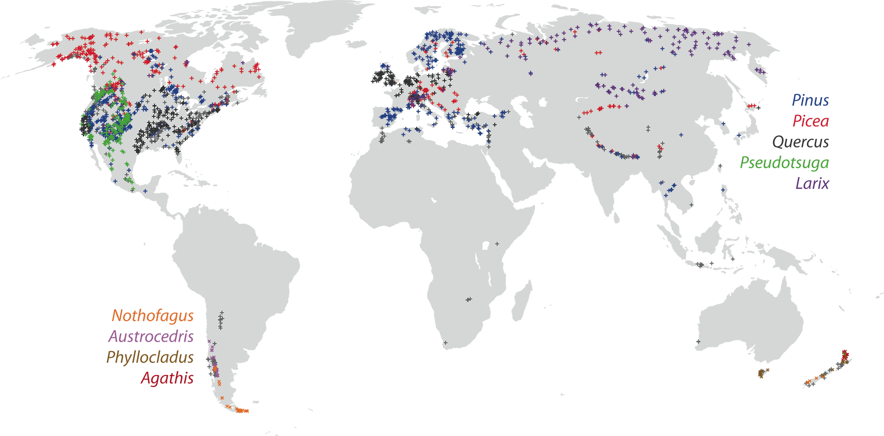
Notes:
The global network of tree-ring widths and its applications to paleoclimatology
Scott St. George
Figure 1: The global network of tree-ring width data held by the World Data Center for Paleoclimatology, NOAA (status 6 July 2012). Colored crosses mark the location of
ring-width records from the tree genera most commonly used. Records derived from genera other than those included in the legend are indicated by grey crosses.
AFFILIATION
Department of Geography, Environment and Society,
University of Minnesota, USA
CONTACT
Scott St. George: stgeorge@umn.edu

Slide 15
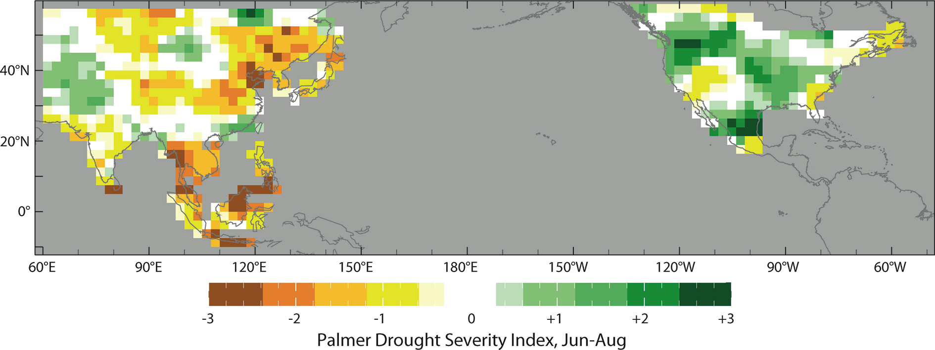
Notes:
The global network of tree-ring widths and its applications to paleoclimatology
Scott St. George
Figure 2: Drought severity in North America (Cook et al. 2004) and monsoon Asia (Cook et al. 2010) during the late Victorian Great Drought of 1876 to 1878 AD. Cook et
al. have used ring-widths and other tree-ring parameters to produce year-by-year maps of summer drought severity (as represented by the Palmer Drought Severity Index)
extending back to 1 BC in North America and 1300 AD in Asia
AFFILIATION
Department of Geography, Environment and Society,
University of Minnesota, USA
CONTACT
Scott St. George: stgeorge@umn.edu

Slide 16
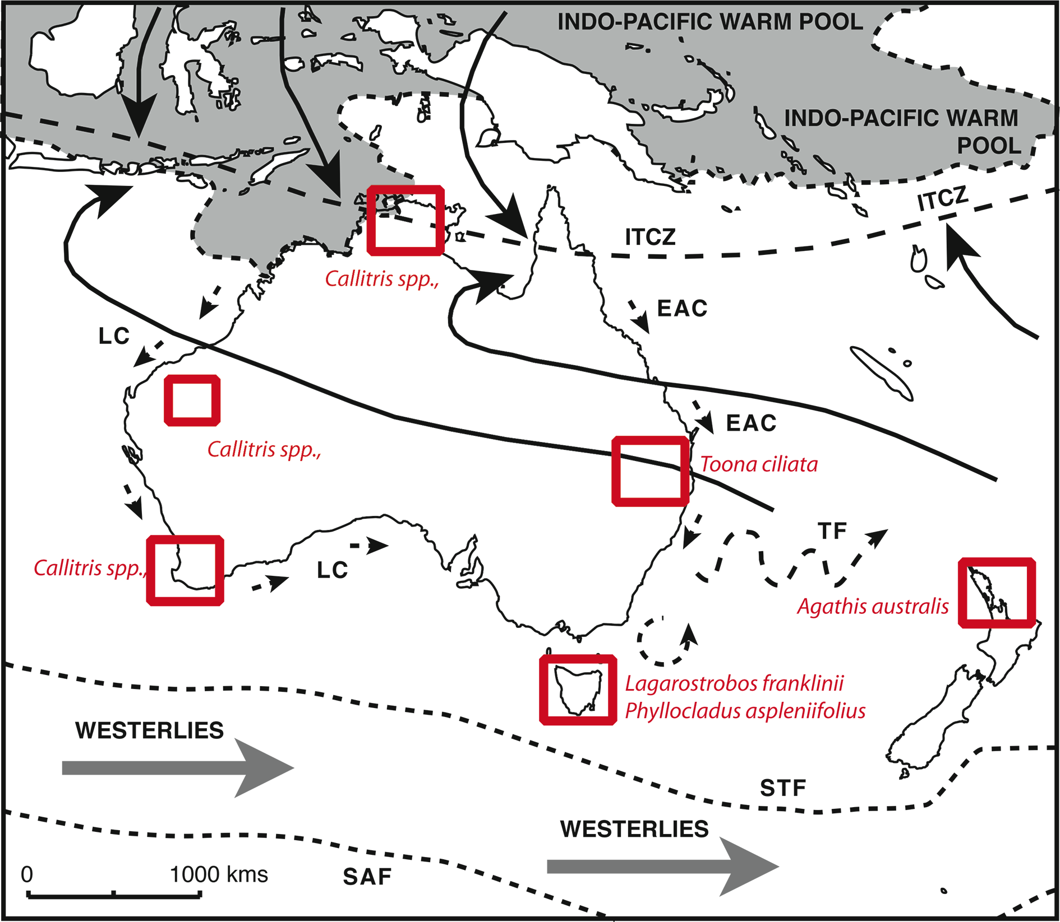
Notes:
The potential of tree rings in Terra Australis
Chris Turney1, J. Palmer1, K. Allen2, P. Baker2 and P. Grierson3
Figure 1: Location of Australasian tree-ring sites discussed in the text with major climatic and oceanographic
boundaries shown. ITCZ denotes Intertropical Convergence Zone, LC the Leeuwin Current, EAC the East
Australian Current, TF the Tasman Front, STF the Sub Tropical Front, and SAF the Subantarctic Front.
AFFILIATIONS
1Climate Change Research Centre, University of New
South Wales, Kensington, Australia
2Melbourne School of Land and Environment, University
of Melbourne, Richmond, Australia
3School of Plant Biology, The University of Western
Australia, Crawley, Australia
CONTACT
Chris Turney: c.turney@unsw.edu.au

Slide 17
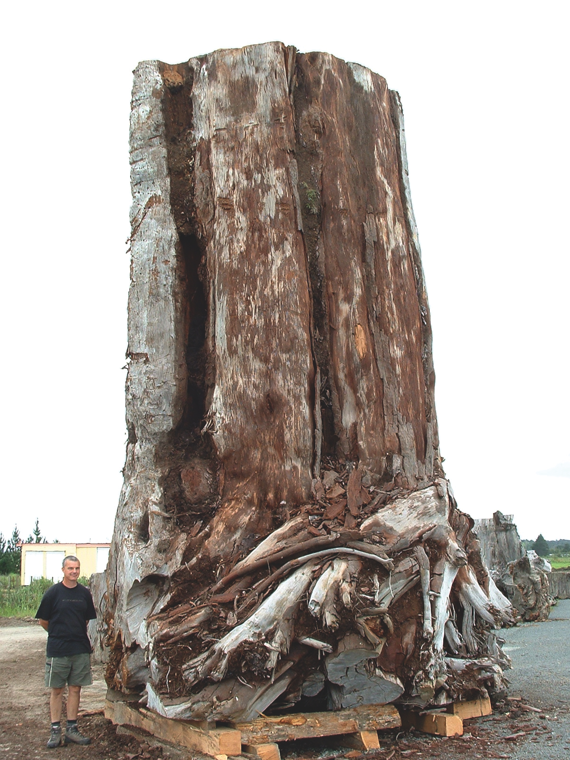
Notes:
The potential of tree rings in Terra Australis
Chris Turney1, J. Palmer1, K. Allen2, P. Baker2 and P. Grierson3
Figure 2: Ancient kauri tree (Agathis australis) prior to commercial processing in Northland, New Zealand
(Jonathan Palmer pictured for scale
AFFILIATIONS
1Climate Change Research Centre, University of New
South Wales, Kensington, Australia
2Melbourne School of Land and Environment, University
of Melbourne, Richmond, Australia
3School of Plant Biology, The University of Western
Australia, Crawley, Australia
CONTACT
Chris Turney: c.turney@unsw.edu.au

Slide 18
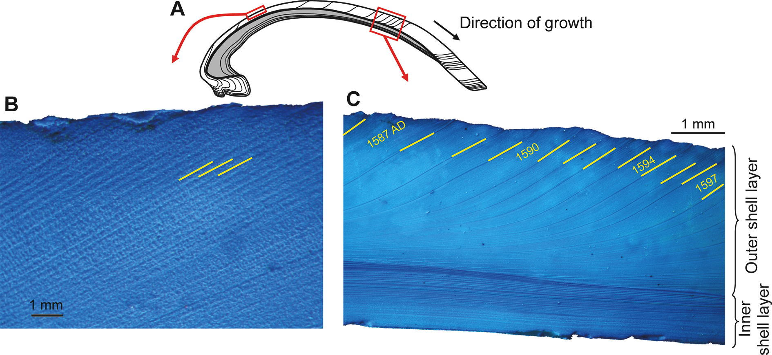
Notes:
Bivalve shells: ultra high-resolution paleoclimate archives
Bernd R. Schöne1 and Donna Surge2
Figure 1: Growth patterns in bivalve shells (example: Arctica islandica). (A) Schematic cross-section showing internal growth patterns in the outer (white) and inner (gray) shell
layers. Polished sections stained with Mutvei’s solution show daily (B) and annual (C) growth patterns in the outer shell layer. Growth lines (marked yellow in B and C) delimit
growth increments.
AFFILIATIONS
1Institute of Geosciences, University of Mainz, Germany
2Department of Geological Sciences, University of North
Carolina, Chapel Hill, USA
CONTACT
Bernd R. Schöne: schoeneb@uni-mainz.de

Slide 19
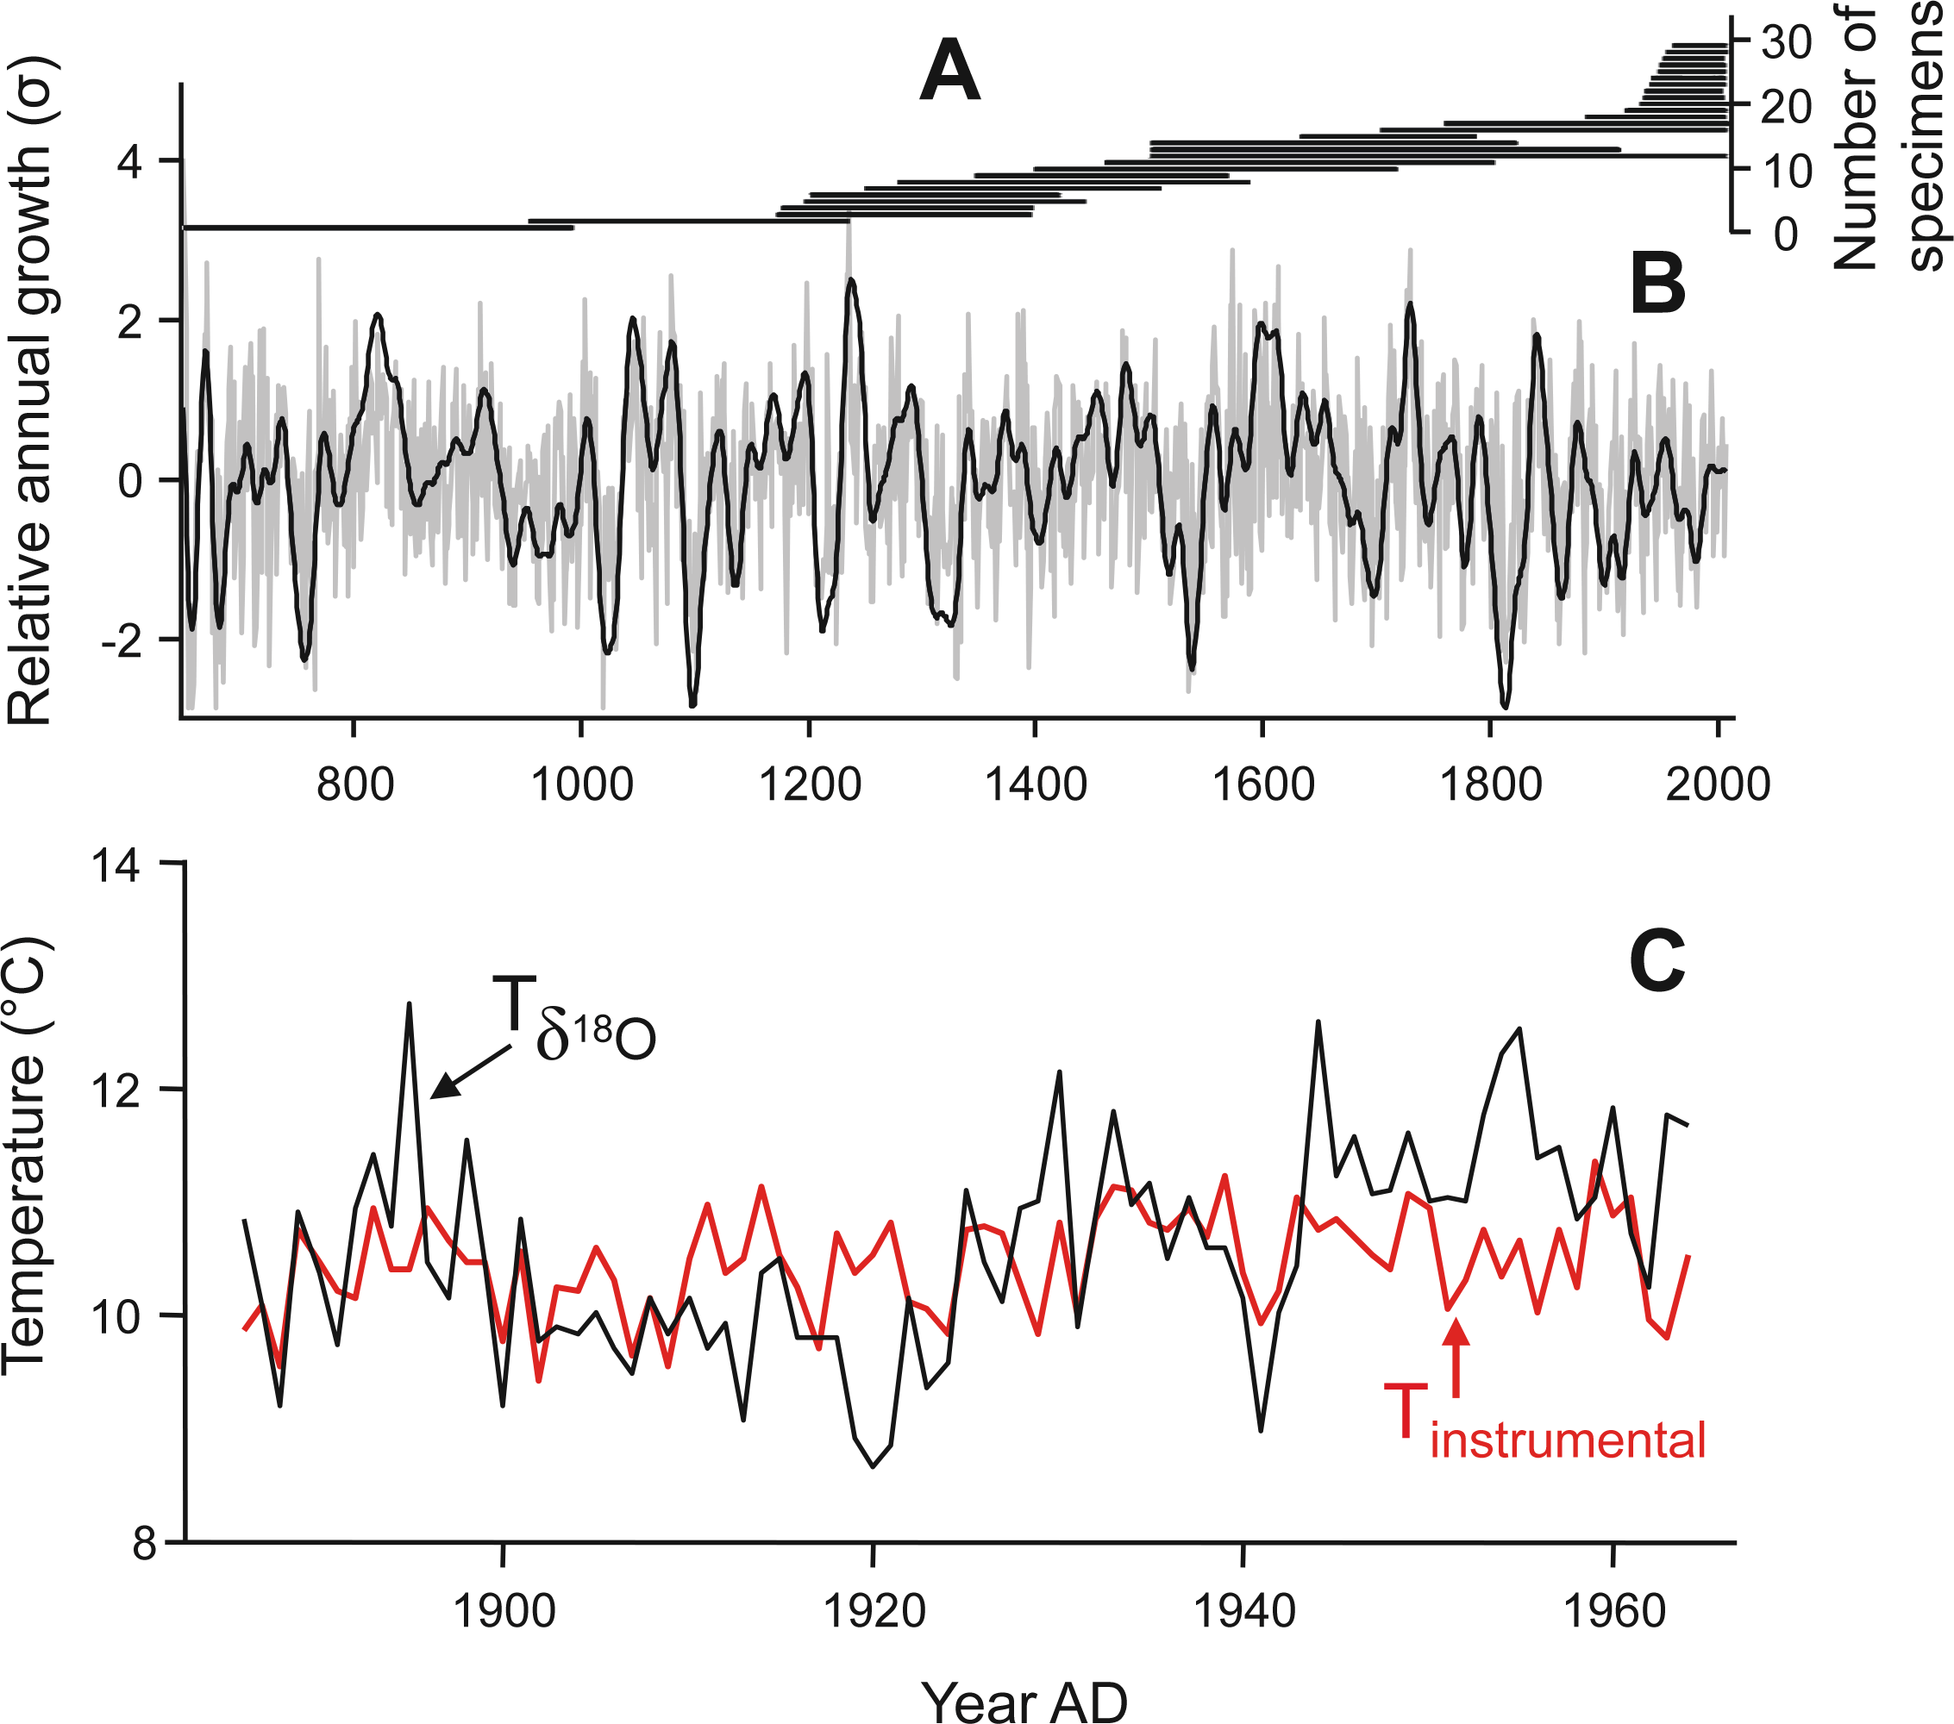
Notes:
Bivalve shells: ultra high-resolution paleoclimate archives
Bernd R. Schöne1 and Donna Surge2
Figure 2: A 1357-year master chronology of Arctica islandica from the North Icelandic shelf (data from Butler
et al. 2013). (A) Sample depth. Each horizontal line indicates the lifespan of one specimen. (B) Stacked record
of growth increment width-chronologies of the 30 specimens shown in (A). The black line represents the
30-year low-pass filtered annual growth data (gray). (C) Growth increment data can be combined with highresolution
geochemical analysis. The example from Schöne and Fiebig (2009) illustrates the annual temperature
evolution in the southern North Sea during the late 19th and the 20th century reconstructed from δ18Oshell values.
Instrumental sea surface temperatures are given for comparison.
AFFILIATIONS
1Institute of Geosciences, University of Mainz, Germany
2Department of Geological Sciences, University of North
Carolina, Chapel Hill, USA
CONTACT
Bernd R. Schöne: schoeneb@uni-mainz.de

Slide 20
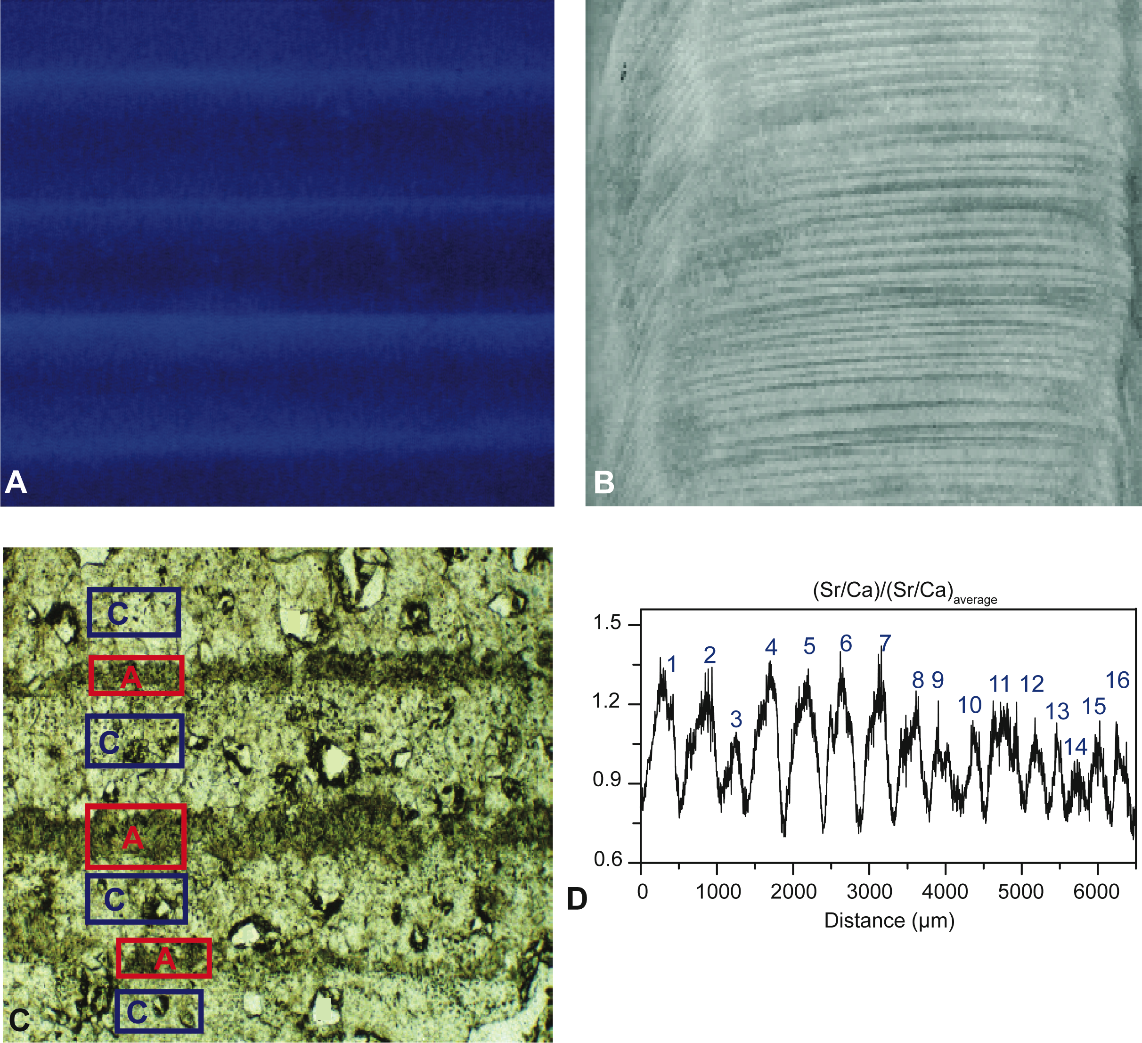
Notes:
Annually laminated speleothems in paleoclimate studies
Liangcheng Tan1, I.J. Orland2 and H. Cheng2,3
Figure 1: Four types of speleothem laminas. (A) Fluorescent laminas excited by UV light. (B) Visible laminas
observed under reflected-light microscopy. (C) Calcite (C) and aragonite (A) couplets, observed under
transmitted-light microscopy, and (D) geochemical laminas where the normalized Sr/Ca peaks were used to
define 16 years. Modified from Tan et al. (2006) and Johnson et al. (2006).
AFFILIATIONS
1Institute of Earth Environment, State Key Laboratory of
Loess and Quaternary Geology, Xi’an, China
2Department of Earth Sciences, University of Minnesota,
Minneapolis, USA
3Institute of Global Environmental Change, Xi’an Jiaotong
University, Xi’an, China
CONTACT
Liangcheng Tan: tanlch@ieecas.cn

Slide 21
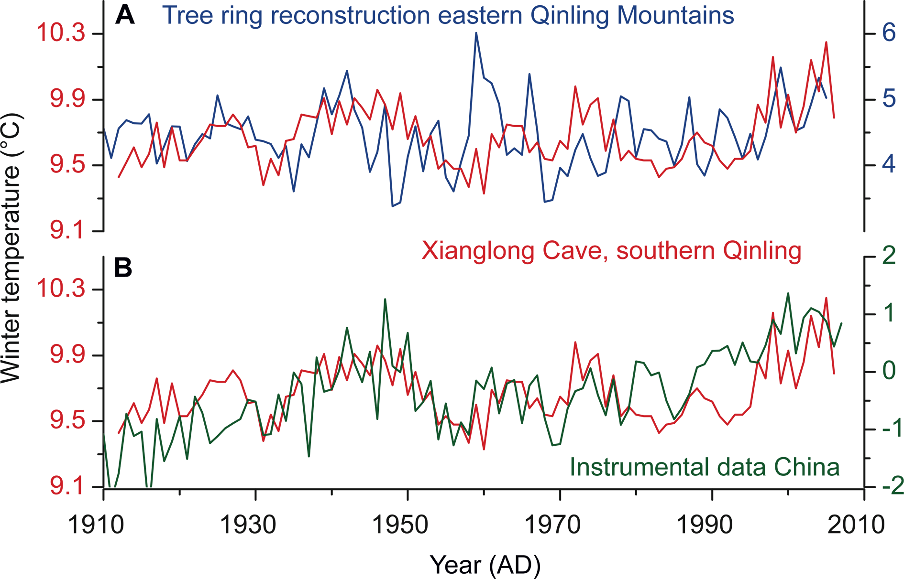
Notes:
Annually laminated speleothems in paleoclimate studies
Liangcheng Tan1, I.J. Orland2 and H. Cheng2,3
Figure 2: Comparison of temperature from September to May reconstructed by speleothem layer thickness from Xianglong Cave in southern Qinling Mountains, central
China (red lines) with (A) tree ring-based winter temperature reconstruction from nearby, and (B) surface winter temperature across China during the last hundred years.
Modified from Tan et al. 2013.
AFFILIATIONS
1Institute of Earth Environment, State Key Laboratory of
Loess and Quaternary Geology, Xi’an, China
2Department of Earth Sciences, University of Minnesota,
Minneapolis, USA
3Institute of Global Environmental Change, Xi’an Jiaotong
University, Xi’an, China
CONTACT
Liangcheng Tan: tanlch@ieecas.cn

Slide 22
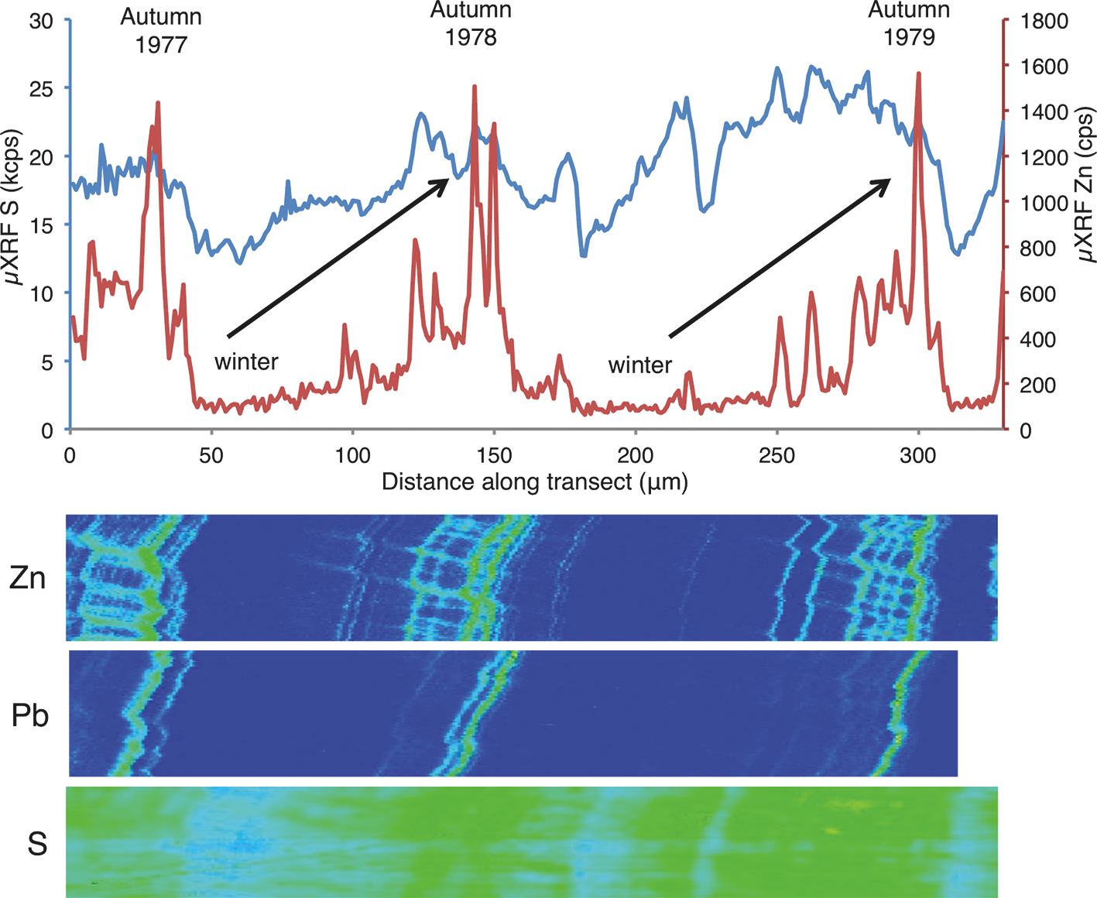
Notes:
Seasonality in speleothems
Ian J. Fairchild1, M. Bar-Matthews2, P. M. Wynn3 and I. J. Orland4
Figure 1: Three annual growth cycles in a speleothem from the Obir cave, Austrian Alps (Obi84) depicting
relative concentrations of lead (Pb), zinc (Zn) and sulfur (S; known to be in the form of sulfate by absorption
studies) mapped by micro-XRF synchrotron radiation. High-intensity banding (“greener”) represents transport
of organic-ligand-bound Pb and Zn during synoptic rainfall events. Highest intensity bands represent intense
autumnal rainfall and loss of organic molecules and associated metals from the soil zone during times of
vegetation dieback. Relative concentrations of S demonstrate independent verification of seasonality and timing
of the autumnal flush of Zn and Pb. Low winter S concentrations are a product of low cave chamber PCO2 and
high carbonate to sulfate ratios during speleothem growth. From Wynn et al. (2014) with permission.
AFFILIATIONS
1School of Geography, Earth and Environmental Sciences,
University of Birmingham, UK
2Geological Survey of Israel, Jerusalem, Israel
3Lancaster Environment Centre, Lancaster University, UK
4Department of Earth Sciences, University of Minnesota,
Minneapolis, USA
CONTACT
Ian J. Fairchild: i.j.fairchild@bham.ac.uk

Slide 23
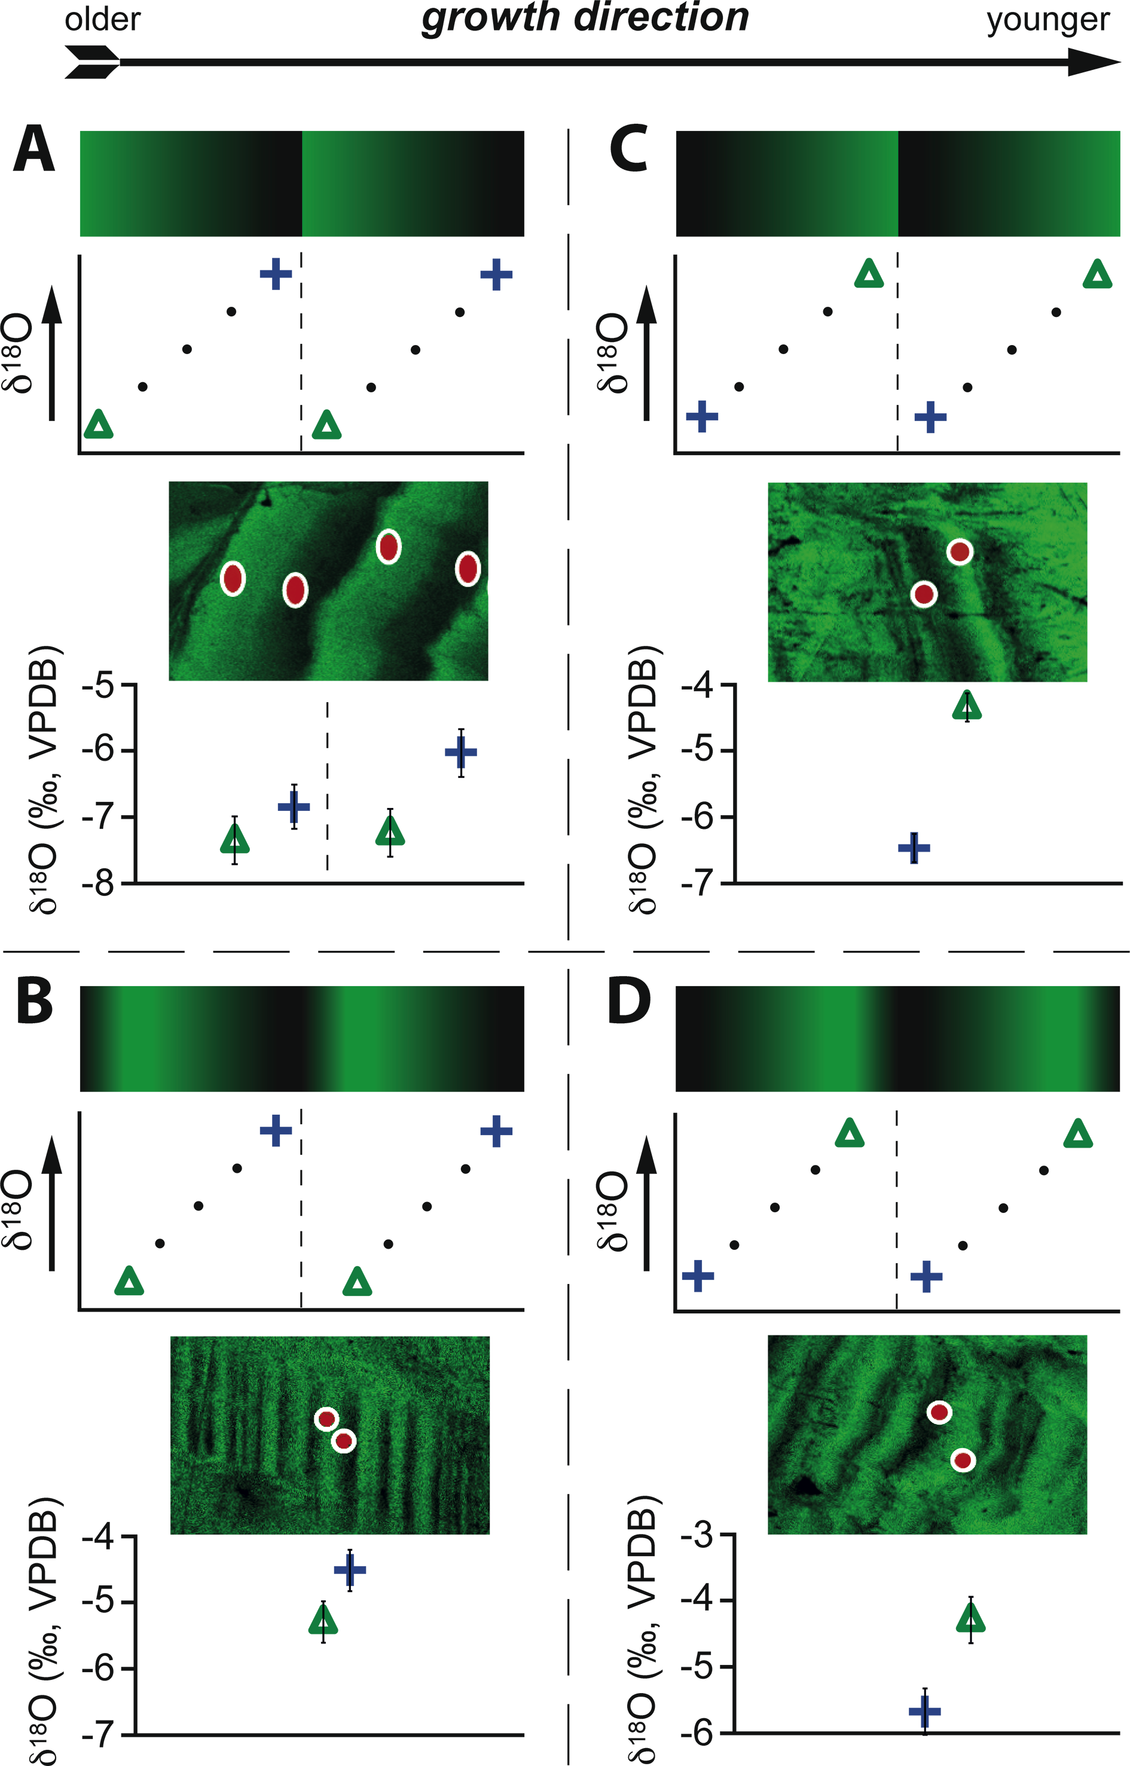
Notes:
Seasonality in speleothems
Ian J. Fairchild1, M. Bar-Matthews2, P. M. Wynn3 and I. J. Orland4
Figure 2: Examples of four patterns (A-D) of fluorescent banding and δ18O variability observed on annual
growth bands in a stalactite from Soreq Cave (Israel) that grew from 34 to 4 ka. A schematic of each pattern
is shown above an example from the speleothem. The spots analyzed for δ18O by ion microprobe are
marked by red dots, ~10 μm in diameter, on the image of fluorescent banding acquired by confocal laser
fluorescent microscopy. Green triangles and blue crosses mark δ18O values measured in areas of bright and
dark fluorescence, respectively; each with 2σ error bars. Note the range of δ18O analyses within single bands
varies from 0 to >2‰ (Figure adapted from Orland et al. 2012, which includes a climatic interpretation of these
patterns).
AFFILIATIONS
1School of Geography, Earth and Environmental Sciences,
University of Birmingham, UK
2Geological Survey of Israel, Jerusalem, Israel
3Lancaster Environment Centre, Lancaster University, UK
4Department of Earth Sciences, University of Minnesota,
Minneapolis, USA
CONTACT
Ian J. Fairchild: i.j.fairchild@bham.ac.uk

Slide 24
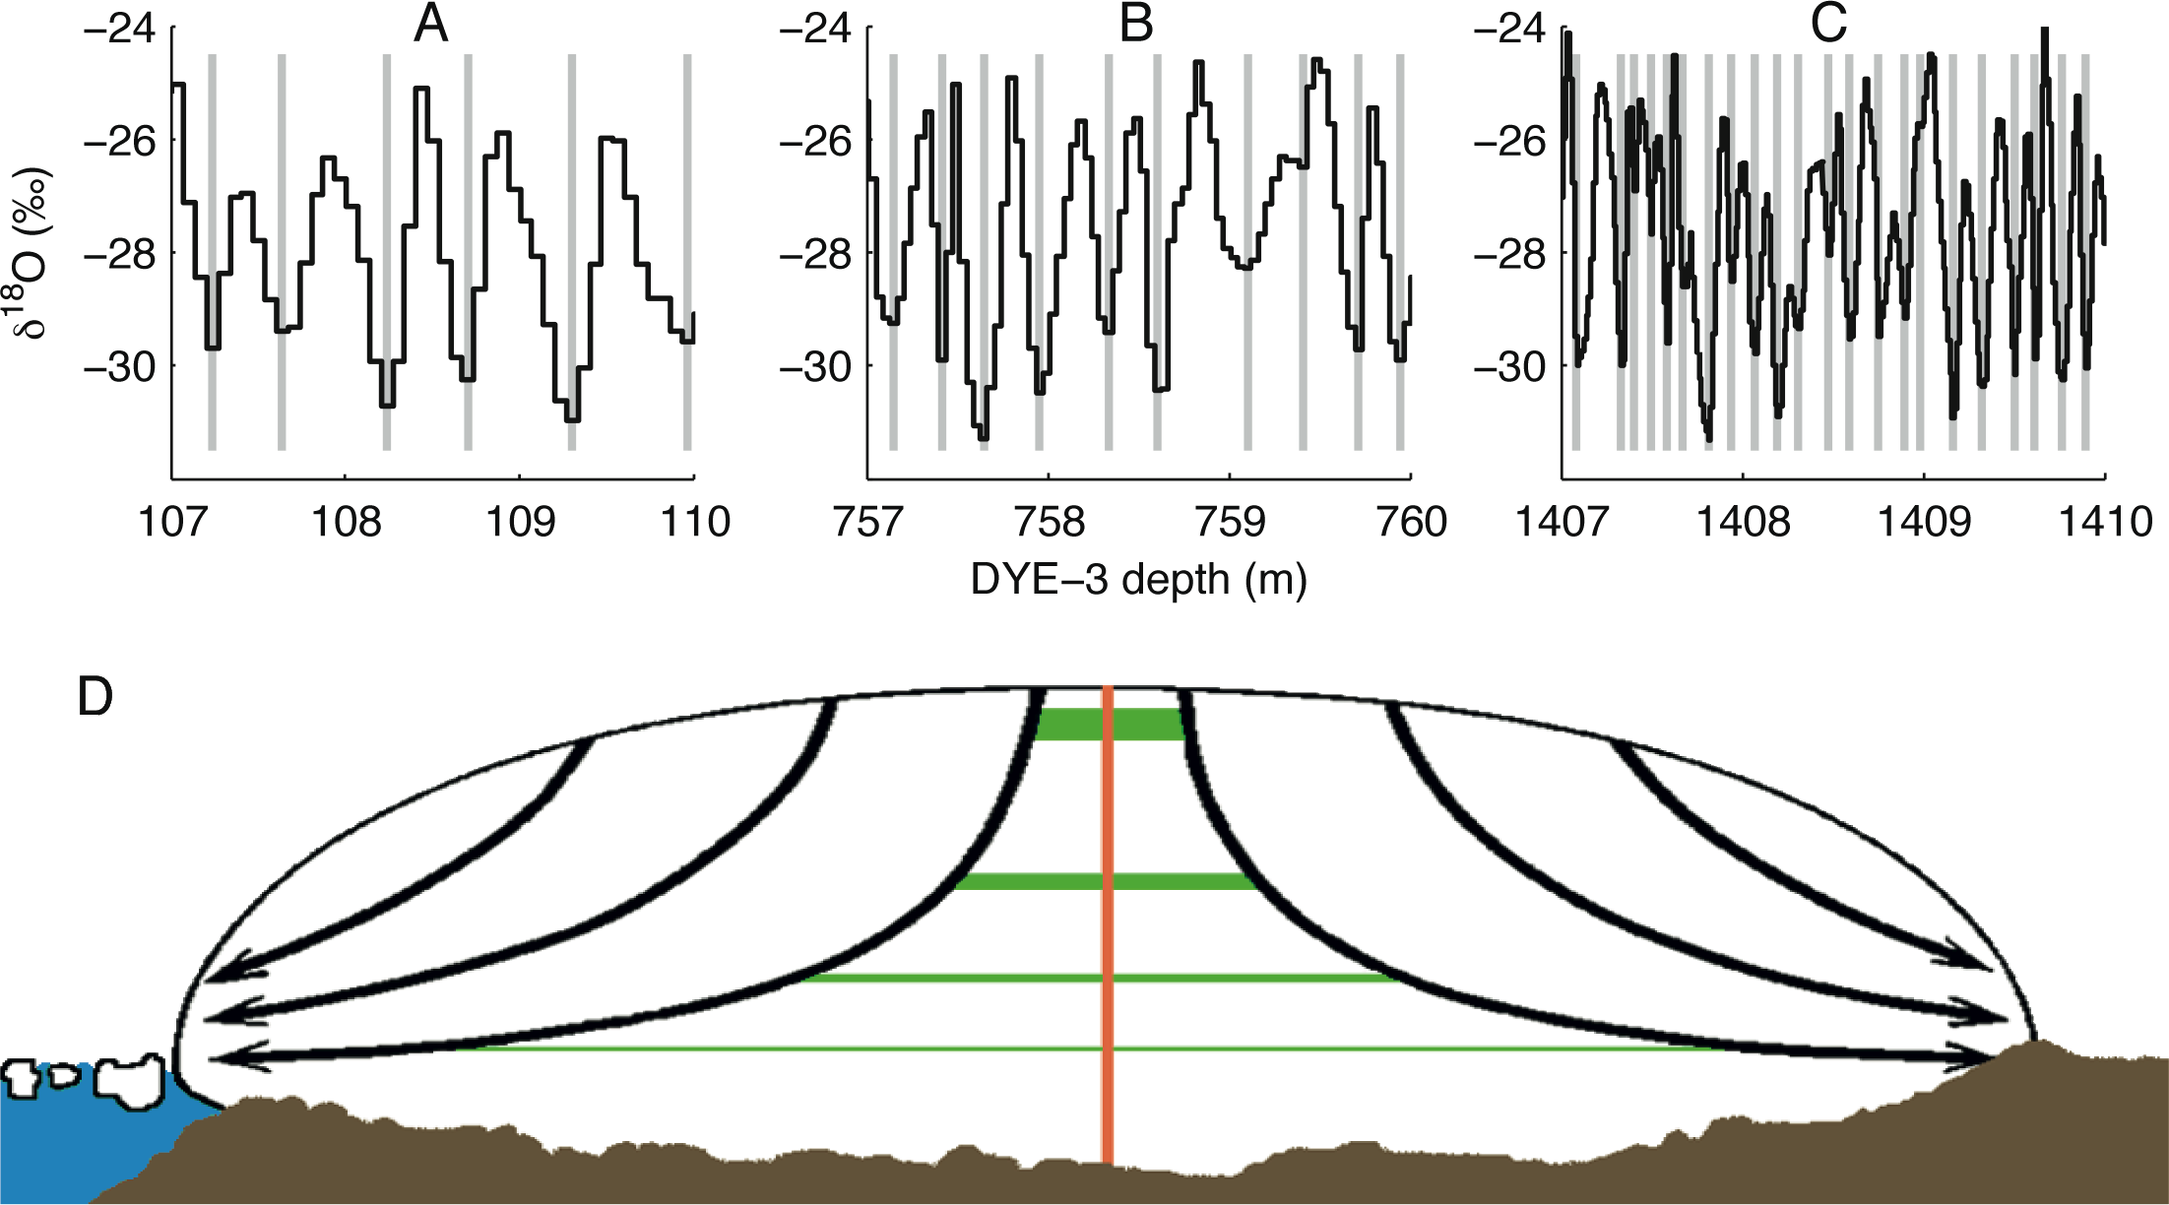
Notes:
State of the art of ice core annual layer dating
Sune O. Rasmussen, A. Svensson and M. Winstrup
Figure 1: Three 3-meter long sections (A-C) of annually resolved δ18O data from different depths of the 2,037 m
long South Greenland DYE-3 ice core. The ages are (A) 175-180, (B) 1845-1854, and (C) 4657-4678 years before
A.D. 2000, respectively. Gray bars show manually identified winter minima. (D) The ice flow leads to annual layer
thinning that together with diffusion ultimately leads to a loss of the annual signal with depth.
AFFILIATIONS
Centre for Ice and Climate, Niels Bohr Institute, University
of Copenhagen, Denmark
CONTACT
Sune O. Rasmussen: olander@gfy.ku.dk

Slide 25
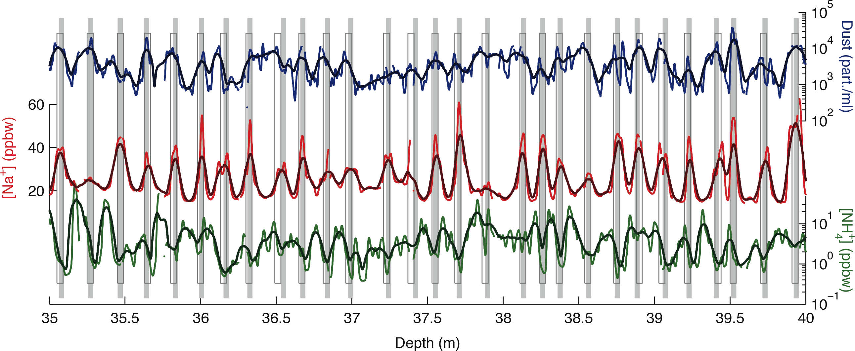
Notes:
State of the art of ice core annual layer dating
Sune O. Rasmussen, A. Svensson and M. Winstrup
Figure 2: Example of continuous flow analysis data (smoothed curves in bold) from a shallow ice core from the North East Greenland Ice Stream (NEGIS) site. Several different
impurities are measured, but here we show only the concentration of insoluble dust, Sodium ions, and Ammonium ions, chosen because the annual signal is expressed in
different ways in these three data series. Manually identified winter layers (grey solid bars) and automated dating results (open gray bars; for method see Winstrup et al. 2012)
agree in sections where the annual signal is clearly expressed in all three data series with a resolution sufficient to resolve even relatively thin layers.
AFFILIATIONS
Centre for Ice and Climate, Niels Bohr Institute, University
of Copenhagen, Denmark
CONTACT
Sune O. Rasmussen: olander@gfy.ku.dk

Slide 26
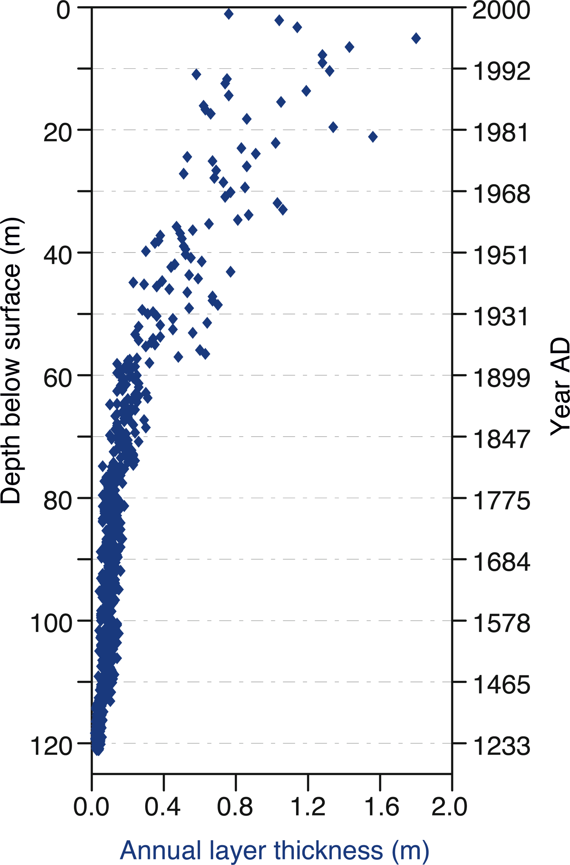
Notes:
Annually resolved climate signals in high-alpine ice cores
Margit Schwikowski, A. Eichler, T.M. Jenk and I. Mariani
Figure 1: Annual layer thickness for the Illimani ice
core from Bolivia as function of the depth below the
ice surface and the associated age of the ice.
AFFILIATIONS
Paul Scherrer Institut and Oeschger Centre for Climate
Change Research, University of Bern, Switzerland
CONTACT
Margit Schwikowski: margit.schwikowski@psi.ch

Slide 27
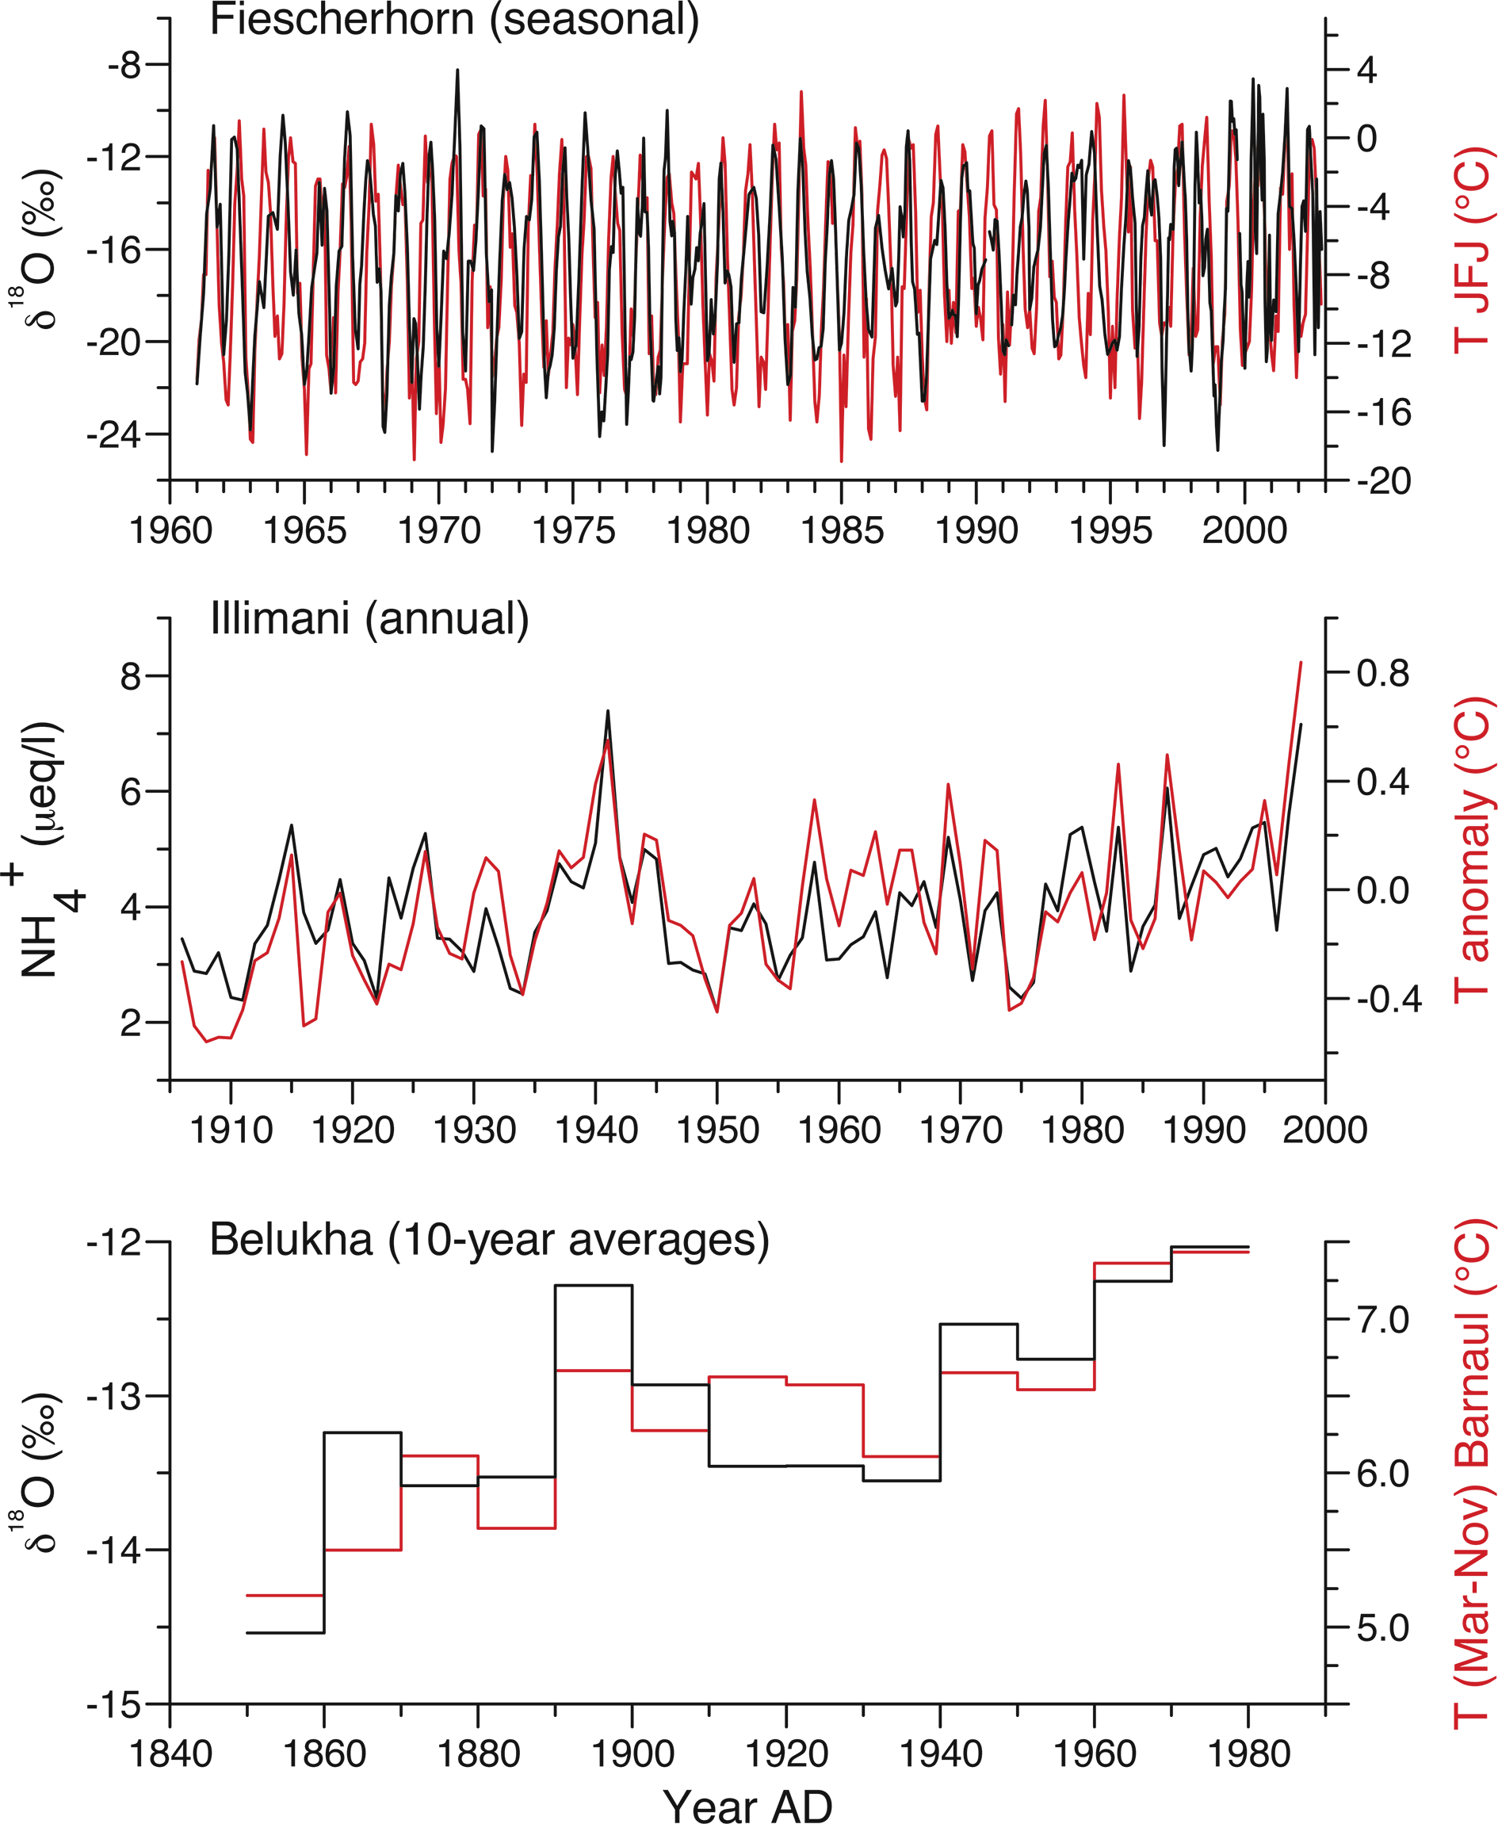
Notes:
Annually resolved climate signals in high-alpine ice cores
Margit Schwikowski, A. Eichler, T.M. Jenk and I. Mariani
Figure 2: Calibration of ice core data (black) with instrumental temperatures (red) at different resolution: (A) Fiescherhorn ice core δ18O and Jungfraujoch (JFJ) temperature
(seasonal values; Mariani et al. 2012), Switzerland (B) Illimani ice core NH+4 and HadCRUT3 (Amazon subset: 82-34°W, 12-20°S) temperature (annual values; Kellerhals et al.
2010), Bolivia, and (C) Belukha ice core δ18O and Barnaul (March-November) temperature (10-year averages; Eichler et al. 2009), Russia
AFFILIATIONS
Paul Scherrer Institut and Oeschger Centre for Climate
Change Research, University of Bern, Switzerland
CONTACT
Margit Schwikowski: margit.schwikowski@psi.ch

Slide 28
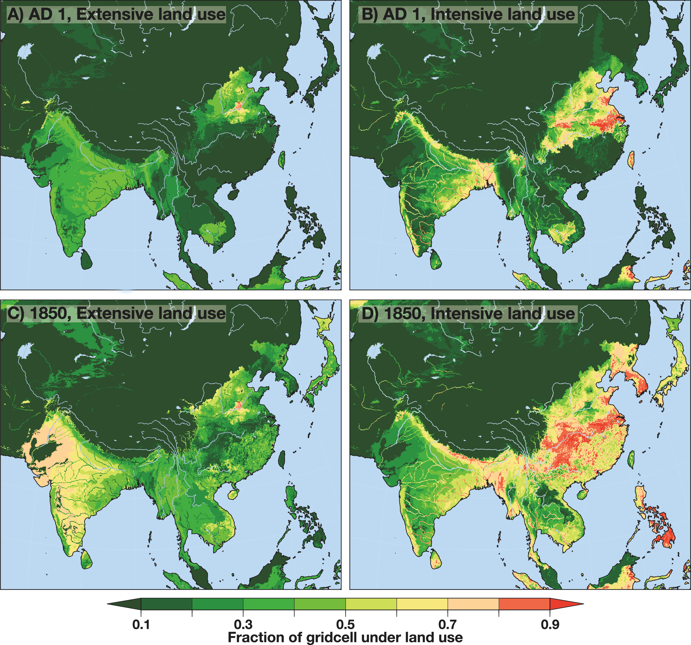
Notes:
PAGES’ Focus 4 Theme on Soils and Sediments: an Asian perspective
Thomas Hoffmann1, R. Wasson2 and A. Ziegler3
Figure 1: Amount of land employed for both extensive (A and C) and intensive (B and D) uses as at AD 1 (A and B), and then again in AD 1850 (C and D). The land use
patterns were extracted from the animation shown at http://grkapweb1.epfl.ch/pub/KK12_totallanduse.mov (Kaplan et al. 2011).
AFFILIATIONS
1Department of Geography, University of Bonn, Germany
2Asia Research Institute, National University of Singapore,
Singapore
3Geography Department, National University of
Singapore, Singapore
CONTACT
Thomas Hoffmann: thomas.hoffmann@uni-bonn.de

Slide 29
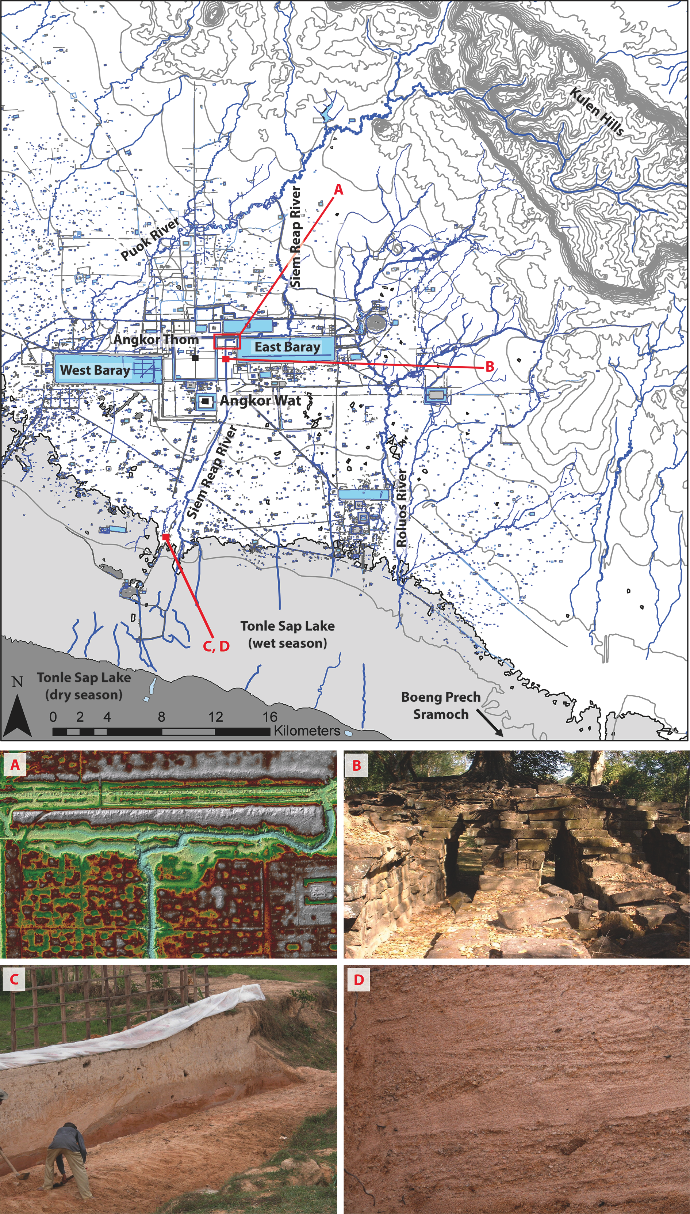
Notes:
Social upheaval in ancient Angkor resulting from fluvial response to land use and climate variability
Dan Penny
Figure 1: Archeological map of Greater Angkor, emphasizing the complexity of the water management network,
and the articulation of canals and rectilinear reservoirs with the natural fluvial network. Data from Evans et al.
(2007), Pottier (1999), Mekong River Commission, Japanese International Cooperation Agency. (A) False color
digital terrain model derived from a LiDAR point cloud. Erosion caused by uncontrolled water flow through the
canal network is clearly apparent as pale blue and green colors. Such water flow events triggered significant
vertical incision of the canal bed. Image courtesy of Khmer Archaeology LiDAR Consortium/Damian Evans. (B)
Spean Thma (lit. stone bridge), immediately east of the famous walled enclosure of Angkor Thom, once spanned
the Siem Reap canal. Destabilization of the canal network during the 14th century caused the canal to incise
several meters below the bridge, destroying its eastern half and leaving its western half, seen here, abandoned
on the dry canal bed. (C) Many of the ancient canals south of the city, presumably critical in linking the ports
at the edge of the lake to the markets in the central urban area, are now filled with several meters of sediment,
including coarse (28% by weight) to very-coarse (17%) cross-bedded sand and gravel (D), with the largest clasts
> -5 φ, > 32 mm in diameter. These deposits indicate an increase in the flux of sediment and other materials
from the canal network, and flows of sufficient energy to entrain them. Post-dating the 14th century, these events
broadly coincide with multi-decadal scale drought.
AFFILIATION
School of Geosciences, The University of Sydney,
Australia
CONTACT
Dan Penny: dan.penny@sydney.edu.au

Slide 30
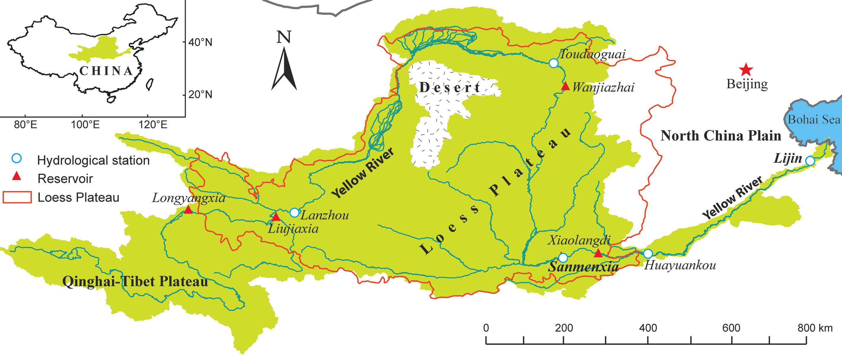
Notes:
Sediment load and carbon burial in the Yellow River during the Holocene
Lishan Ran and Xixi Lu
Figure 1: Location of the Yellow River basin with its middle reaches covered by the Loess Plateau that serves as the major sediment source.
AFFILIATIONS
Department of Geography, National University of
Singapore, Singapore
CONTACT
Lishan Ran: georl@nus.edu.sg

Slide 31
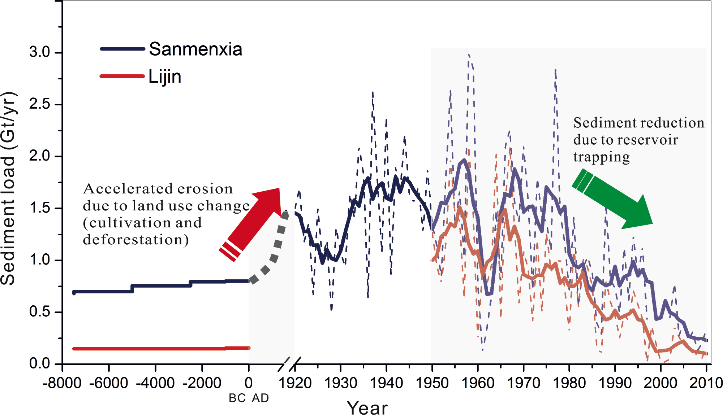
Notes:
Sediment load and carbon burial in the Yellow River during the Holocene
Lishan Ran and Xixi Lu
Figure 2: Changes in sediment load from the Yellow River basin during the Holocene as measured at Sanmenxia and Lijin stations (Fig. 1). Measurements at Sanmenxia are
referred to as the total sediment load from the Yellow River basin, those at Lijin monitor the discharge to the delta and the ocean. The “pristine” sediment load during the
early and middle Holocene was estimated from the sediment volume of deltaic and marine depositions and the sediments accumulated on the fluvial plains in the lower
Yellow River basin (Milliman et al. 1987; Shi et al. 2002; Wang et al. 2007).
AFFILIATIONS
Department of Geography, National University of
Singapore, Singapore
CONTACT
Lishan Ran: georl@nus.edu.sg

Slide 32
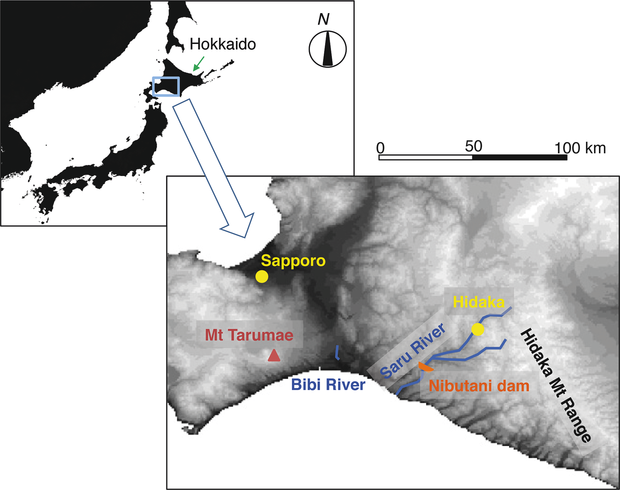
Notes:
Tectonic and volcanic forcing on fluvial systems: two case studies from Hokkaido, Japan
Thomas Parkner1 and Mio Kasai2
Figure 1: Location map of Hokkaido (inset) and the studied Saru and Bibi River.
1College of Geoscience, University of Tsukuba, Japan
2Graduate School of Agriculture, Hokkaido University,
Sapporo, Japan
CONTACT
Thomas Parkner: parkner.thomas.gb@u.tsukuba.ac.jp

Slide 33
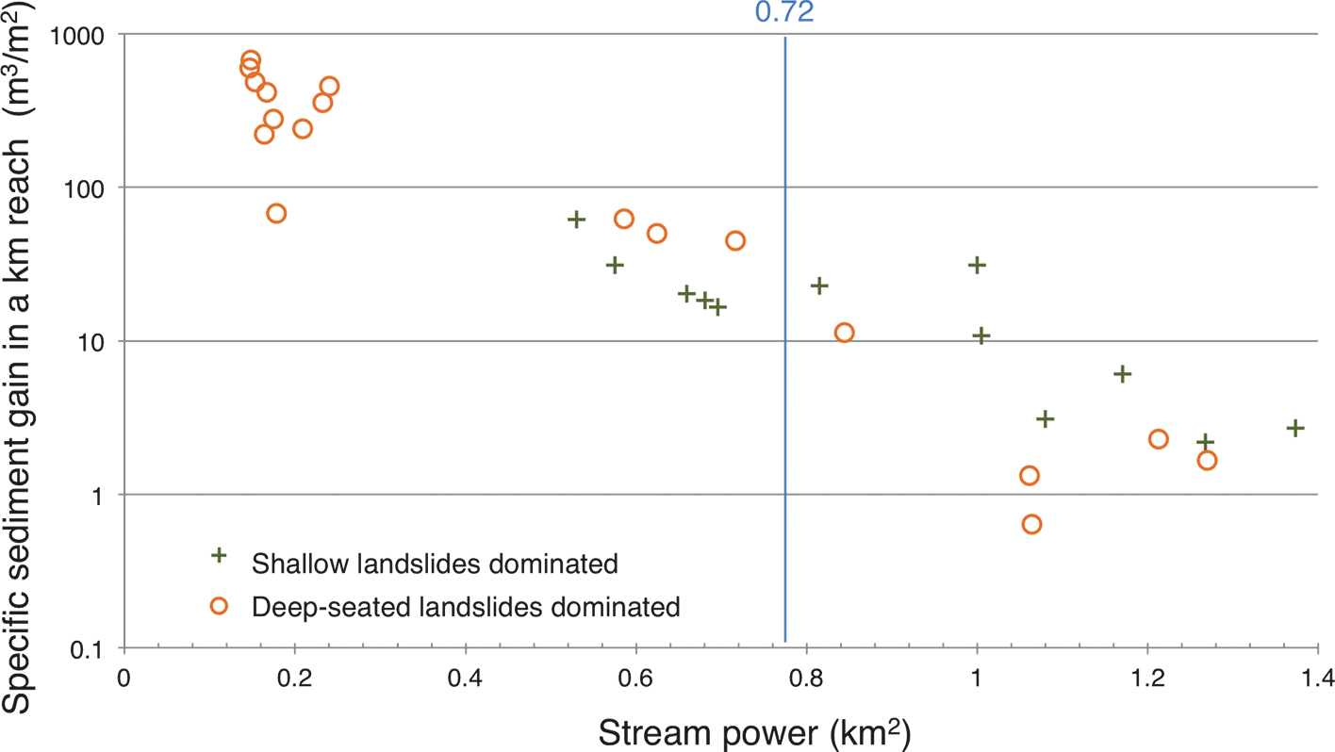
Notes:
Tectonic and volcanic forcing on fluvial systems: two case studies from Hokkaido, Japan
Thomas Parkner1 and Mio Kasai2
Figure 2: Relationship between stream power and specific sediment gain in a channel reach. Reaches were grouped according the dominant landslide type (i.e. deep-seated
vs. shallow landslides) in their tributary catchments.
1College of Geoscience, University of Tsukuba, Japan
2Graduate School of Agriculture, Hokkaido University,
Sapporo, Japan
CONTACT
Thomas Parkner: parkner.thomas.gb@u.tsukuba.ac.jp

Slide 34
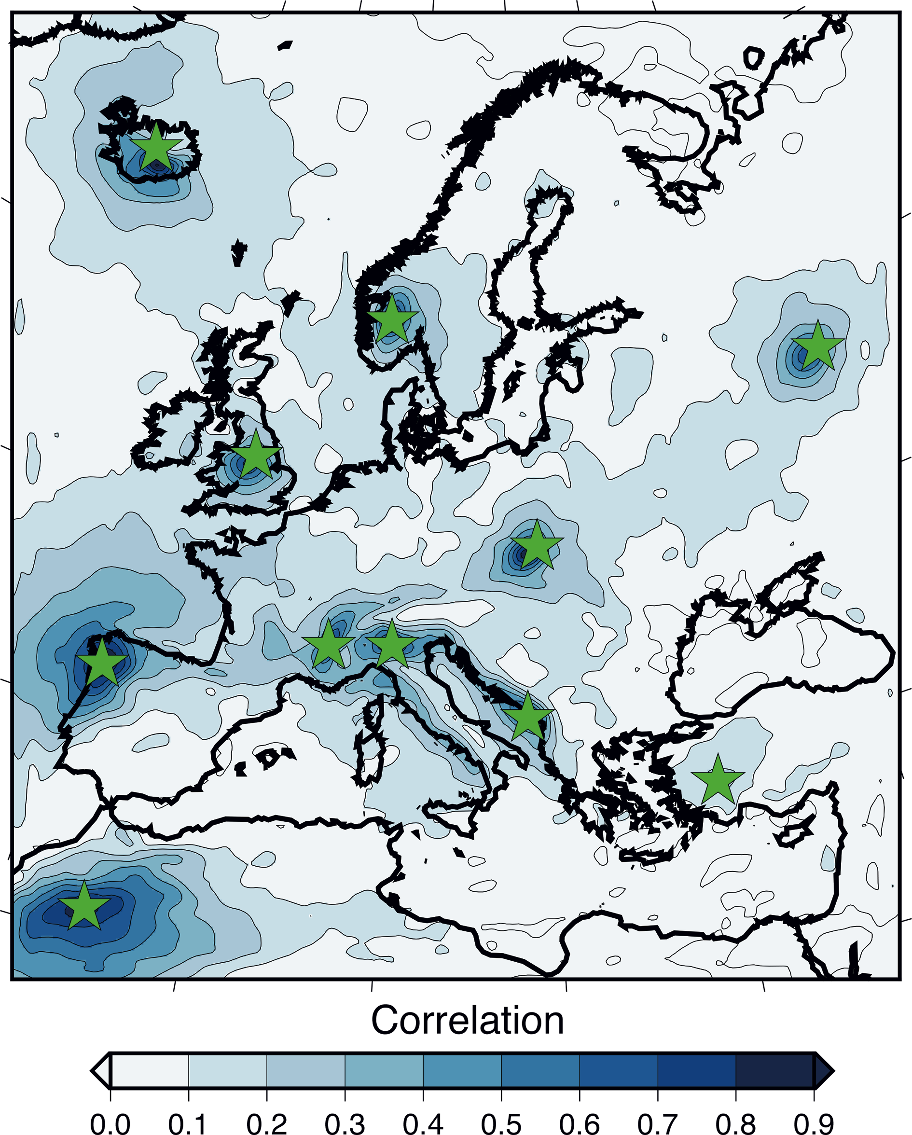
Notes:
Hydroclimatic reconstructions over Europe and the Mediterranean
Jürg Luterbacher1, J. Werner1, D. Fleitmann2, J.F. Gonzalez-Rouco3, D. McCarroll4, S. Wagner5, E. Zorita5, J. Gómez-
Navarro6, U. Büntgen7,8 and J. Esper9
Figure 1: Correlation map between summer precipitation reconstructed using the “analog method” based on
the pseudo-proxy locations (green stars) and the original regional climate model output. The reconstructed
period is 1-1999 AD (Gomez et al., unpublished data).
AFFILIATIONS
1Department of Geography, University of Giessen,
Germany
2Department of Archaeology, University of Reading, UK
3Institute of Geoscience, Complutense University,
Madrid, Spain
4Department of Geography, Swansea University, UK
5Institute of Coastal Research, Helmholtz-Zentrum
Geesthacht, Germany
6Climate and Environmental Physics and Oeschger
Centre for Climate Change Research, University of Bern,
Switzerland
7WSL, Birmensdorf, Switzerland
7Global Change Research Centre AS CR, Brno, Czech
Republic
9Department of Geography, University of Mainz, Germany
CONTACT
J. Luterbacher: Juerg.luterbacher@geogr.uni-giessen.de

Slide 35
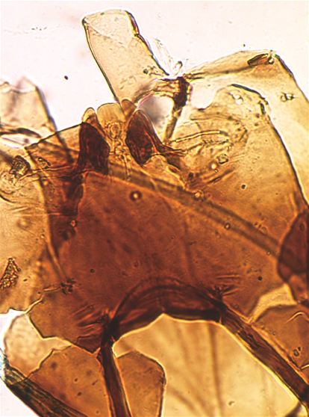
Notes:
12th International Workshop on Subfossil Chironomids
Peter Langdon1 and Steve Brooks2
Figure 1: Subfossil head capsule of Corynocera ambigua (image from Brooks et al. 2007). This taxon is relatively
easy to identify but its (paleo)ecology is not straightforward. It is seemingly a good cold indicator in the
Lateglacial and in northern regions but also appears to tolerate warm, eutrophic conditions in southern parts of
its range during the late Holocene. This illustrates the potential problems of using transfer functions, as raised by
Juggins (2013).
AFFILIATIONS
1Geography and Environment, University of Southampton,
UK
2Department of Life Sciences, Natural History Museum,
London, UK
CONTACT
Peter Langdon: P.G.Langdon@soton.ac.uk

Slide 36
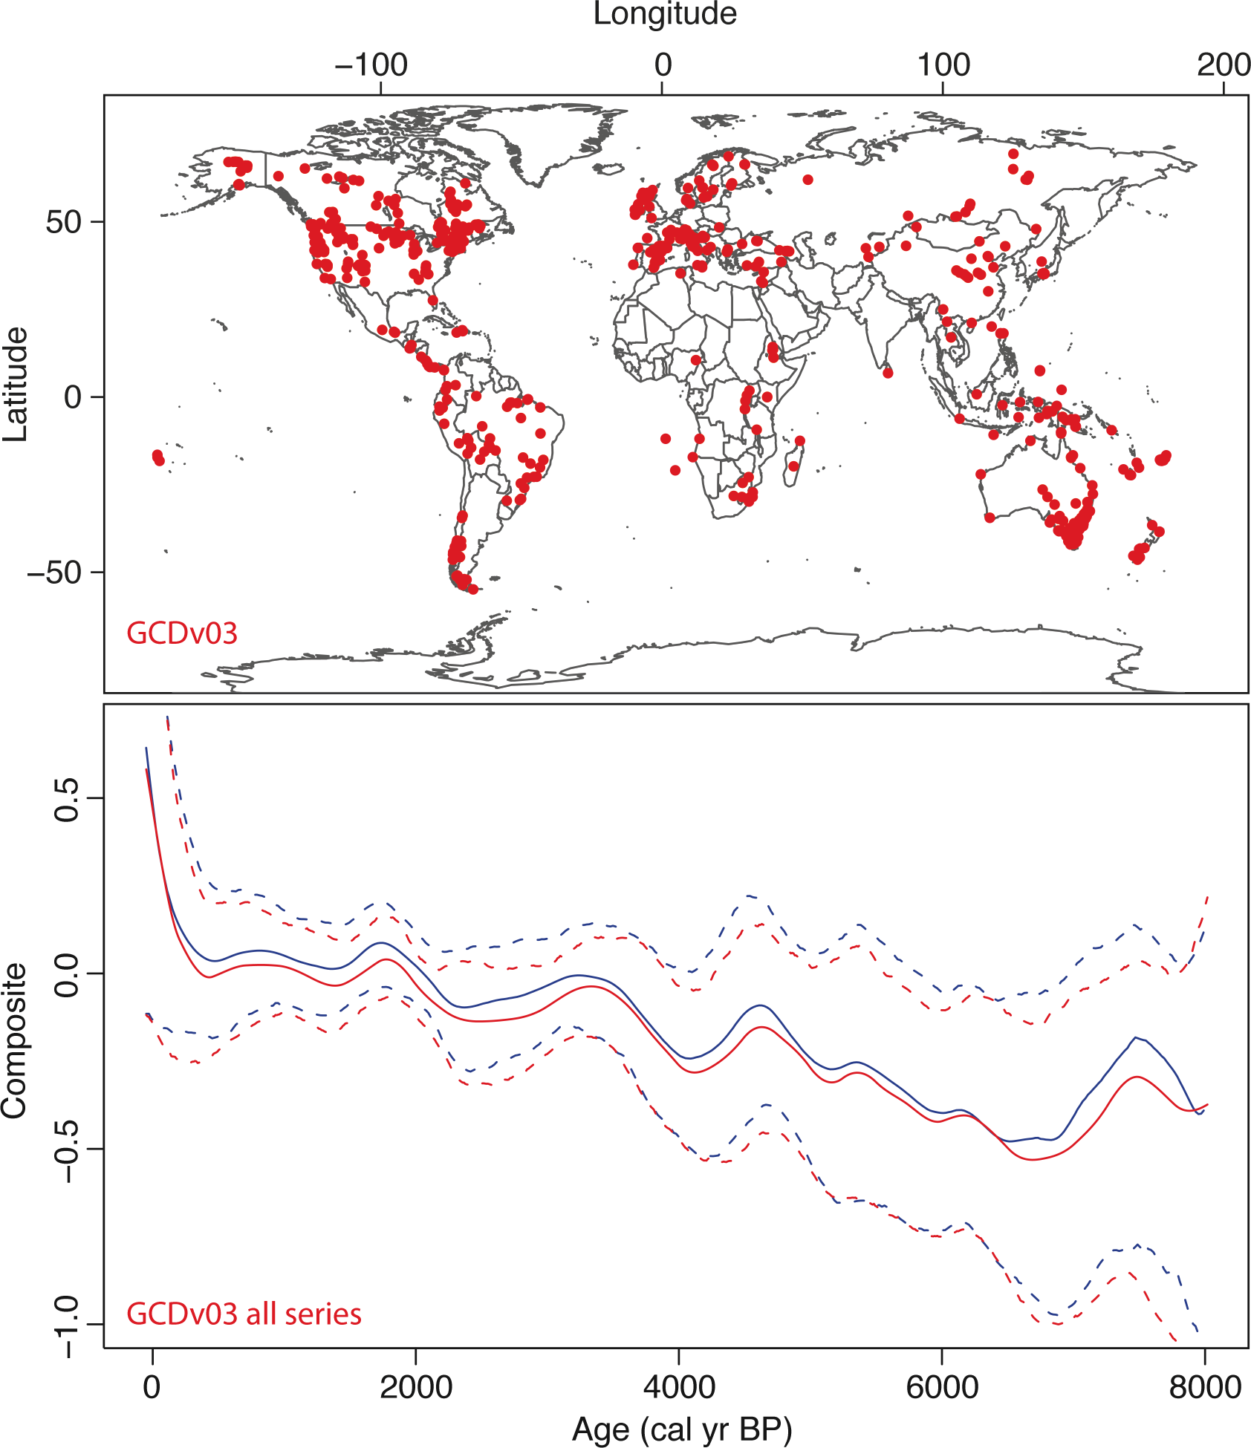
Notes:
Multi-Scale Analyses of Fire-Climate-Vegetation Interactions on Millennial Scales
Boris Vannière1, O. Blarquez2,3, J. Marlon4, A.-L. Daniau5 and M. Power6,7
Figure 1: Map of sites available in GCDv3 (top panel) and comparison of the Fortran (e.g. Marlon et al. 2013) and
paleofire R package compositing outputs for all GCDv03 charcoal sites (bottom panel). Composite curves (plain
line) and associated 95% confidence intervals are displayed in blue for the Fortran procedure and in red for the
paleofire R package. The results were obtained using the same arguments for both procedures. The results from
both approaches are highly correlated (r > 0.99) and significant (p << 0.001). The paleofire R-package offers
comparable results for charcoal series synthesis to former analyses based on the Fortran’s method. The 500
year smoothing window-width used in this analysis does not capture the most recent downturn known to have
occurred in global fire activity since the turn of the 20th century.
AFFILIATIONS
1Chrono-Environnement, CNRS, University of Franche-
Comté, Besançon, France
2Centre d'Étude de la Forêt, Université du Québec à
Montréal, Canada
3Forest Research Institute, Université du Québec en
Abitibi-Témiscamingue, Rouyn-Noranda, Canada
4Yale School of Forestry & Environmental Studies, Yale
University, New Haven, USA
5EPOC, CNRS, Université of Bordeaux, Talence, France
6Department of Geography, University of Utah, Salt Lake
City, USA
7Natural History Museum of Utah, University of Utah, Salt
Lake City, USA
CONTACT
Boris Vannière: boris.vanniere@univ-fcomte.fr

Slide 37
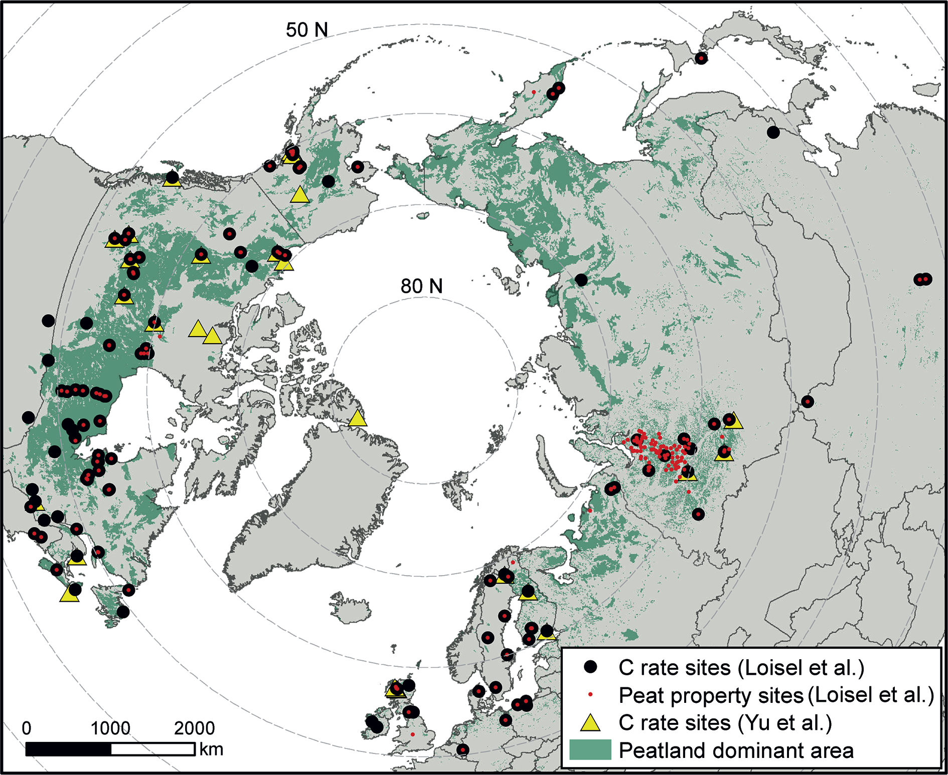
Notes:
Holocene circum-Arctic peatland carbon dynamics
Zicheng Yu and Julie Loisel
Figure 1: Map showing the locations of peatland sites for C accumulation and peat properties in the database (Loisel et al. in press). Also shown are C accumulation sites used in a previous synthesis (Yu et al. 2010) and the
distribution of northern peatlands (green area from Yu et al. 2010). Figure modified from Loisel et al. (in press).
AFFILIATIONS
Department of Earth and Environmental Sciences, Lehigh
University, Bethlehem, United States
CONTACT
Zicheng Yu : ziy2@lehigh.edu

Slide 38
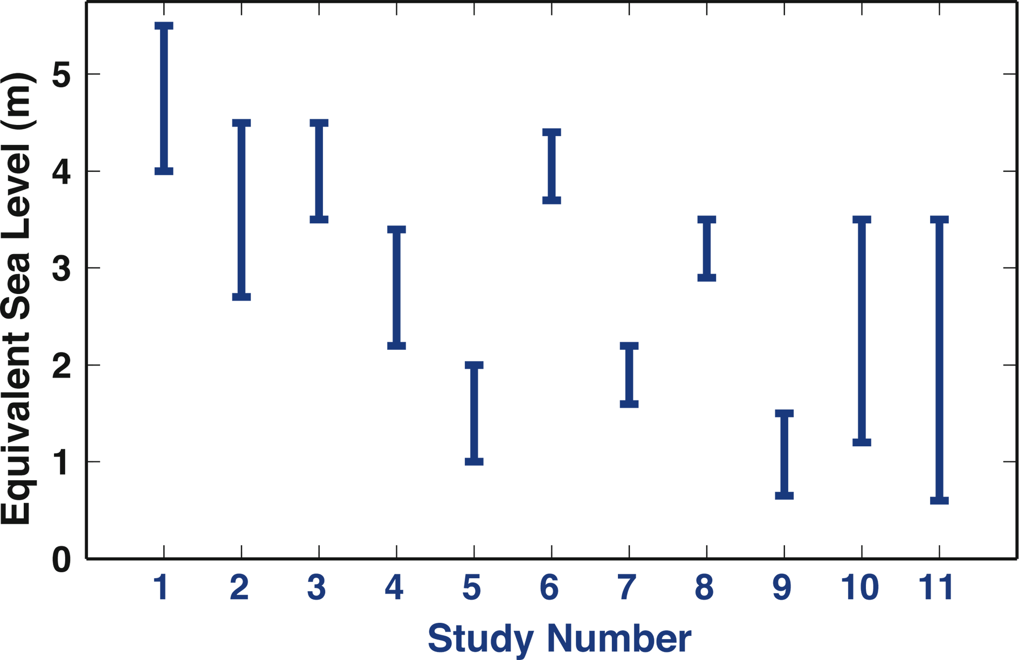
Notes:
Estimating rates and sources of sea level change during past warm periods
Glenn Milne1, A. Carlson2, A. Dutton3, A. Long4 and O. Rybak5,6
Figure 1: Estimates of the contribution of the Greenland ice sheet to global mean sea level during the Last
Interglacial. The studies numbered in publication order along the x-axis are: (1) Cuffey and Marshall (2000); (2)
Tarasov and Peltier (2003; most likely range shown); (3) L’homme et al. (2005; most likely range shown); (4) Otto-
Bliesner et al. (2006); (5) Oerlemans et al. (2006); (6) Robinson et al. (2011; most likely range shown); (7) Colville
et al. (2011); (8) Born and Nisancioglu (2012); (9) Quiquet et al. (2012); (10) Helsen et al. (2013); (11) Stone et al.
(2013). Only studies that provided a range of values are shown here.
AFFILIATIONS
1Department of Earth Sciences, University of Ottawa,
Canada
2College of Oceanic and Atmospheric Sciences, Oregon
State University, Corvallis, USA
3Department of Geological Sciences, University of
Florida, Gainsville, USA
4Department of Geography, Durham University, UK
5Department of Geography, Free University of Brussels,
Belgium
6Institute of Natural and Technical Systems of the Russian
Academy of Sciences, Sochi, Russia
CONTACT
Glenn Milne: gamilne@uottawa.ca

Slide 39
Notes:
CO MPARE 2013: Constraining tropical ocean cooling during the Last Glacial Maximum
David W. Lea1, M. Kienast2, T. de Garidel-Thoron3, M. Kageyama4, A. Paul5 and E. Bard3
Figure 1: (A) Distribution of newly available low latitude records (black dots) compared to the MARGO (2009) dataset (red dots) that have Mg/Ca (top panel) and UK37’
(lower panel) paleothermometry data. Note that sites are concentrated along oceanic margins. (B) Whisker plot comparison of low latitude UK37’ and Mg/Ca data compiled
in MARGO (2009). On average, Mg/Ca data indicates 3°C of tropical cooling vs. 2°C for UK37’.
AFFILIATIONS
1Department of Earth Science, University of California,
Santa Barbara, USA
2Department of Oceanography, Dalhousie University,
Halifax, Canada
3CEREGE, Aix-Marseille Université, Aix-en-Provence,
France
4LSCE/IP SL, Gif-sur-Yvette, France
5MARUM – Center for Marine Environmental Sciences,
University of Bremen, Germany
CONTACT
David Lea: lea@geol.ucsb.edu

Slide 40
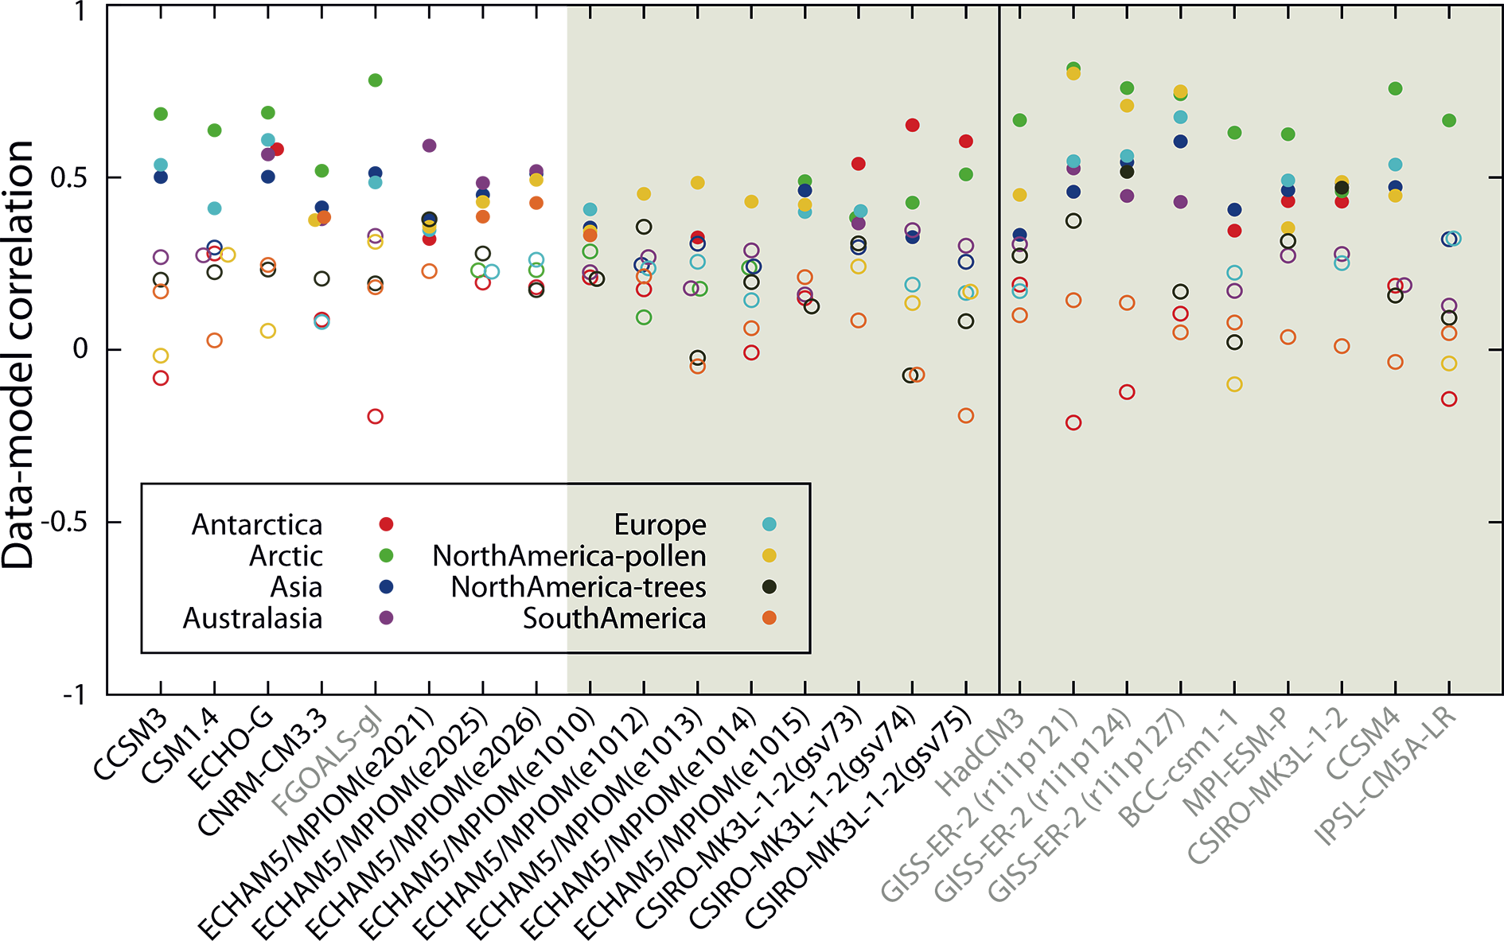
Notes:
Integrated analyses of reconstructions and multi-model simulations for the past two millennia
Johann H. Jungclaus1, H. Goosse2, E. García-Bustamante3,4, L. Fernández-Donado4 and J.F. González-Rouco4
Figure 1: Correlation values between PAGES2k reconstructions and PMIP 3 (grey) and pre-PMIP 3 (black)
simulations. Regions are depicted with colors. The full (empty) circles indicate a correlation value (not)
significantly different from zero (p<0.05). The gray shaded area highlights the simulations that included a
comparatively lower solar forcing variability scenario. Time series were 31-year low pass filtered and the full
period of overlap between simulations and reconstructions used. See Table 5.A.1 in Masson-Delmotte et al.
(2014) for details on model names and forcing.
AFFILIATIONS
1Max Planck Institute for Meteorology, Hamburg,
Germany
2Georges Lemaître Centre for Earth and Climate
Research, Université catholique de Louvain, Belgium
3Department of Physics, University of Murcia, Spain
4Institute of Geosciences, CSIC-UCM, Complutense
University of Madrid, Spain
CONTACT
Johan H. Jungclaus: johann.jungclaus@mpimet.mpg.de

Slide 41
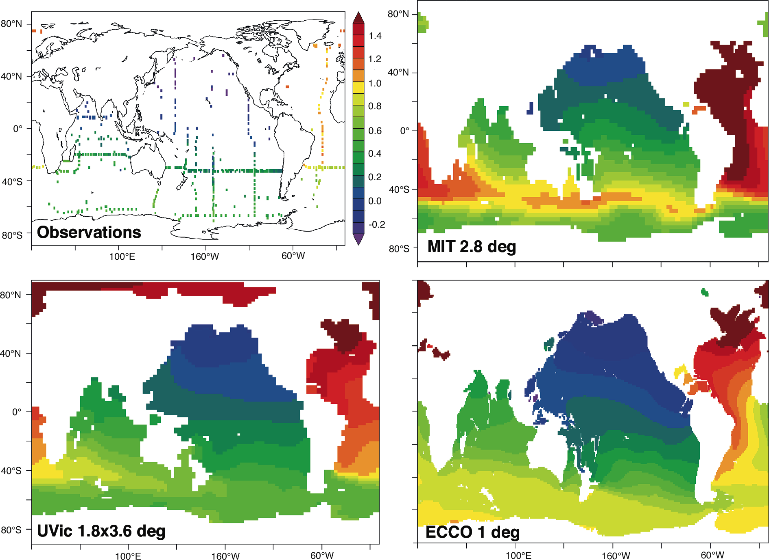
Notes:
PMIP Ocean - Understanding changes since the Last Glacial Maximum
Andreas Schmittner1, S.P. Harrison2, A.E. Carlson1, A.C. Mix1, M. Kageyama3 and Michal Kucera4
Figure 1: Comparison of deep (2 km) ocean δ13CDIC distributions in modern observations (top left) and three
different circulation models calculated using the same underlying biogeochemistry model (MOBI; Schmittner et
al. 2013) and transport tracer matrix method (Khatiwala et al. 2005). The model simulations do not account for
the anthropogenic rise in atmospheric δ13C. Note the effect of higher resolution (1°×1° MIT-ECCO lower right)
on the simulation of the western boundary current in the Atlantic compared with the coarser resolution models
(2.8°×2.8° MIT upper right and 1.8°×3.6° UVic lower left). PMIP 3 LGM simulations using this offline method of
calculating tracer distributions will be used in the future to predict isotope distributions for comparison with
paleo data from ocean sediments.
AFFILIATIONS
1College of Earth, Ocean, and Atmsopheric Sciences,
Oregon State University, Corvallis, USA
2Centre for Past Climate Change, University of Reading,
UK and Department of Biological Sciences, Macquarie
University, Sydney, Australia
3Laboratoire des Sciences du Climat et de l’Environnement/
IP SL, Gif-sur-Yvette, France
4Center for Marine Environmental Sciences, University of
Bremen, Germany
CONTACT
Andreas Schmittner: aschmitt@coas.oregonstate.edu

Slide 42
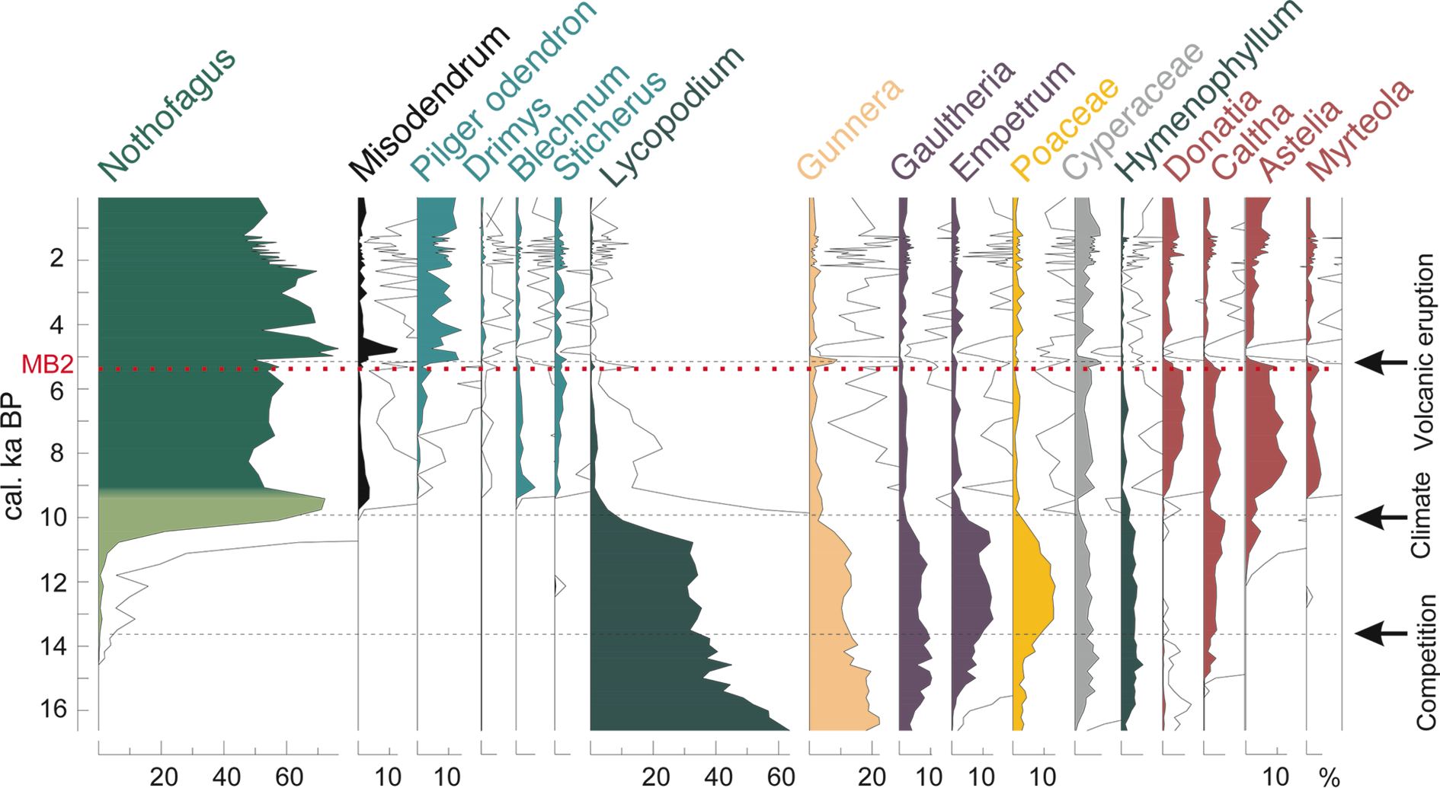
Notes:
Quaternary paleoecology: Reconstructing past environments
Sonia L. Fontana1 and Keith D. Bennett2
Figure 1: Pollen percentage diagram of selected taxa from Lake Ballena, indicating different processes that
have caused main vegetation changes since the LGM. MB2 indicates the position of the tephra layer from the
Mt Burney 2 eruption. Figure modified from Fontana and Bennett (2012).
AFFILIATIONS
1Department of Palynology and Climate Dynamics,
University of Göttingen, Germany
2School of Geography, Archaeology & Palaeoecology,
Queen's University Belfast, Northern Ireland, UK
CONTACT
Sonia L. Fontana: Sonia.Fontana@biologie.uni-goettingen.
de

Slide 43
Notes:
Long-term perspectives on ocean and climate dynamics – Three decades of ICP
Eva Calvo1, I. Cacho2, C. Pelejero1,3, J.O. Grimalt4, P.G. Mortyn5, R. Zahn3,5 and P. Ziveri5
Figure 1: “Castells”, Human Towers, a Catalan
tradition that accelerates your heartbeat. This
picture shows a performance of the “Castells of
Poble Sec” during the ICP11 ice breaker with
the participants’ help to support the tower. This
is an excellent example of team effort and the
importance of every single member to the success
of the project, in this case, the human tower. “Team
spirit, strength, balance, courage and common
sense”, the “castells” motto also defines the essence
of the ICP conferences and the paleoceanographic
community.
AFFILIATIONS
1Institute of Marine Sciences, CSIC, Barcelona, Spain
2Faculty of Geology, University of Barcelona, Spain
3Catalan Institution for Research and Advanced Studies,
Barcelona, Spain
4Institute of Environmental Assessment and Water
Research, CSIC, Barcelona, Spain
5Institute of Environmental Science and Technology,
Autonomous University of Barcelona, Spain
CONTACT
Eva Calvo: ecalvo@icm.csic.es

Slide 44
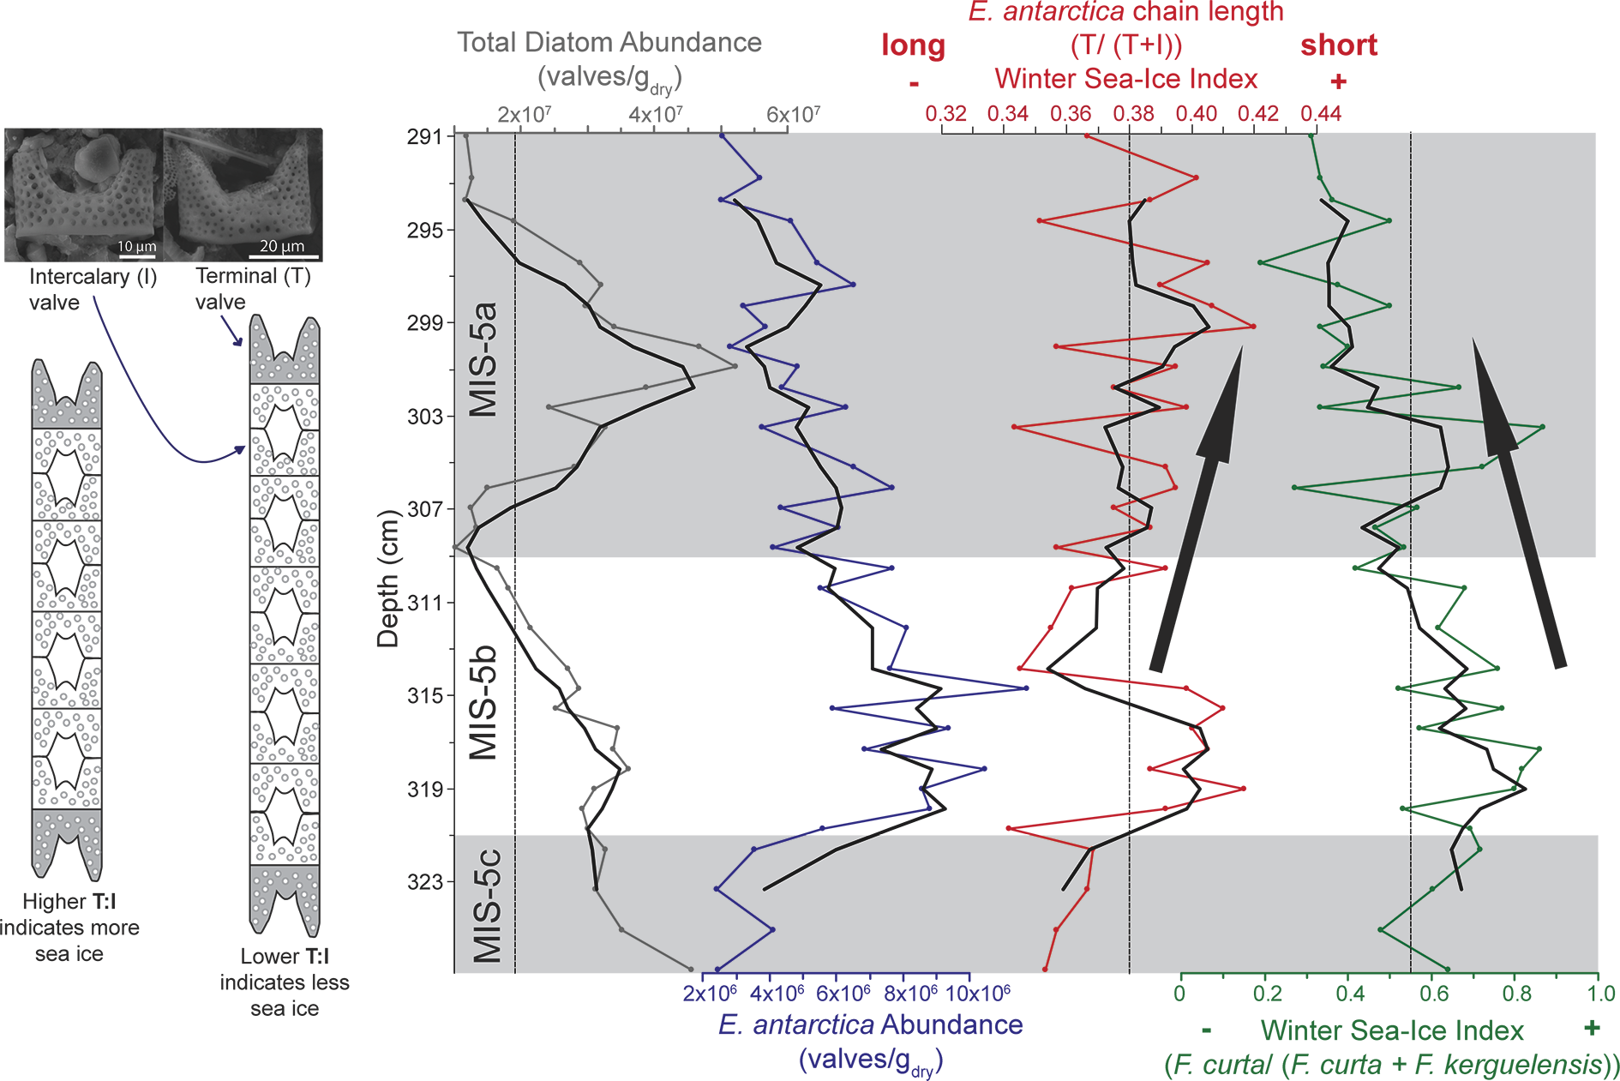
Notes:
4th Polar Marine Diatom Taxonomy and Ecology Workshop
Zuzia Stroynowski1, R. Minzoni2 and S.K. Shukla3
Figure 1: Morphometrics of horned diatom Eucampia antarctica as a proxy for sea-ice occurrence during
Marine Isotope Stage 5 at Drygalski Basin, Antarctica (M.A. Bárcena, personal communication). The ratio of
Terminal (T) and Intercalary (I) valves is calculated as a measure of chain length. Longer chains (i.e. lower T:I)
indicate higher light conditions and thinner/less sea-ice cover (Fryxell and Prasad 1990). The interpretation of
these results differs from a Fragilariopsis Index that compares sea-ice related species F. curta with open marine
species F. kerguelensis (after Denis et al. 2010), and suggests our understanding of these proxy indices needs
to be updated.
AFFILIATIONS
1Marine Geology Division, Portuguese Institute of Ocean
and Atmosphere, Portugal
2Department of Earth Science, Rice University, Houston,
USA
3Department of Marine Sciences, Goa University, India
CONTACT
Zuzia Stroynowski: zuzia.stroynowski@ipma.pt

Slide 45
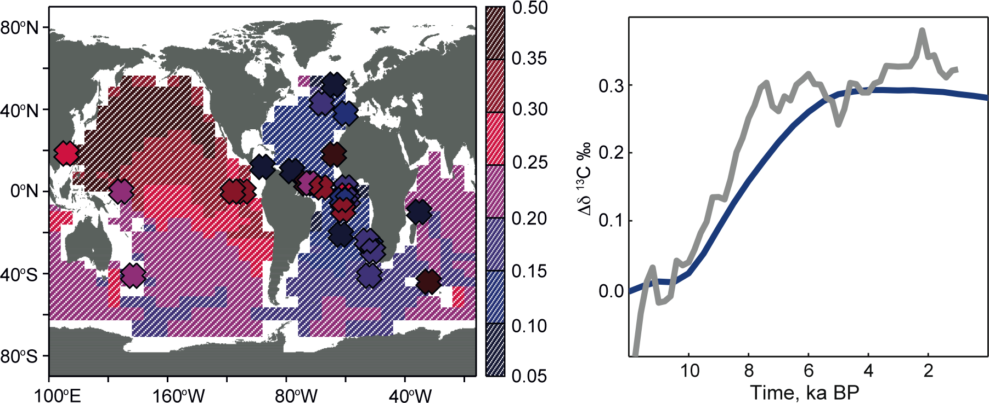
Notes:
Isotopes of carbon, water and geotracers in paleoclimate research
Fortunat Joos1, B. Otto-Bliesner2 and E. Brady2
Figure 1: Spatio-temporal evolution of δ13C in the deep ocean (> 3000 m) as reconstructed from ocean sediment data (symbols) and simulated with an Earth System Model
of Intermediate Complexity. The map shows the total change over the Holocene; the right panel shows the evolution from the stacked proxy data (grey) and the globallyaveraged
model results (blue).
AFFILIATIONS
1Oeschger Centre for Climate Change Research and
Physics Institute, University of Bern, Switzerland
2National Center for Atmospheric Research (NCAR),
Boulder, USA
CONTACT
Fortunat Joos: joos@climate.unibe.ch

Slide 46
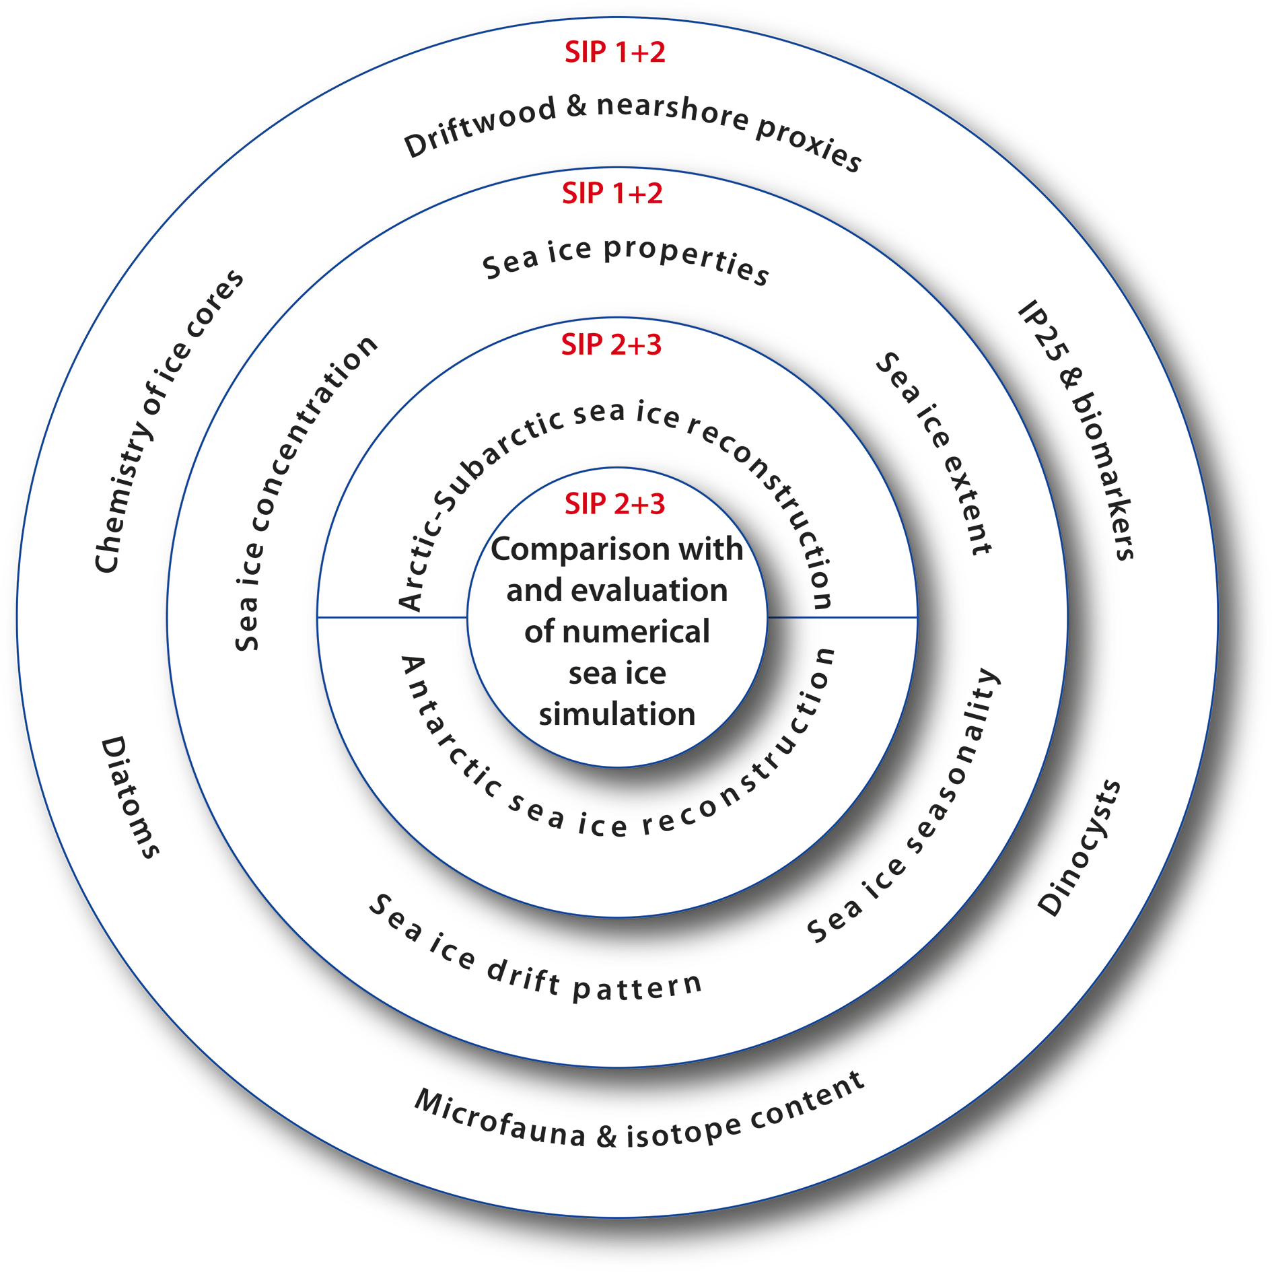
Notes:
Reconstructing past sea ice
Eric W. Wolff1, R. Gersonde2 and A. de Vernal3
Figure 1: : Through its three workshops, SIP has considered all the issues (of sampling, measurement, process
understanding, reporting and statistics) which intervene between measurements of different proxies and the
production of sea ice reconstructions that are suitable for comparison with modern data and models.
AFFILIATIONS
1Department of Earth Sciences, University of Cambridge,
UK
2Alfred-Wegener-Institute Helmholtz Centre for Polar and
Marine Research, Bremerhaven, Germany
3GEOTOP, Université du Québec à Montréal, Canada
CONTACT
Eric W. Wolff: ew428@cam.ac.uk

Slide 47
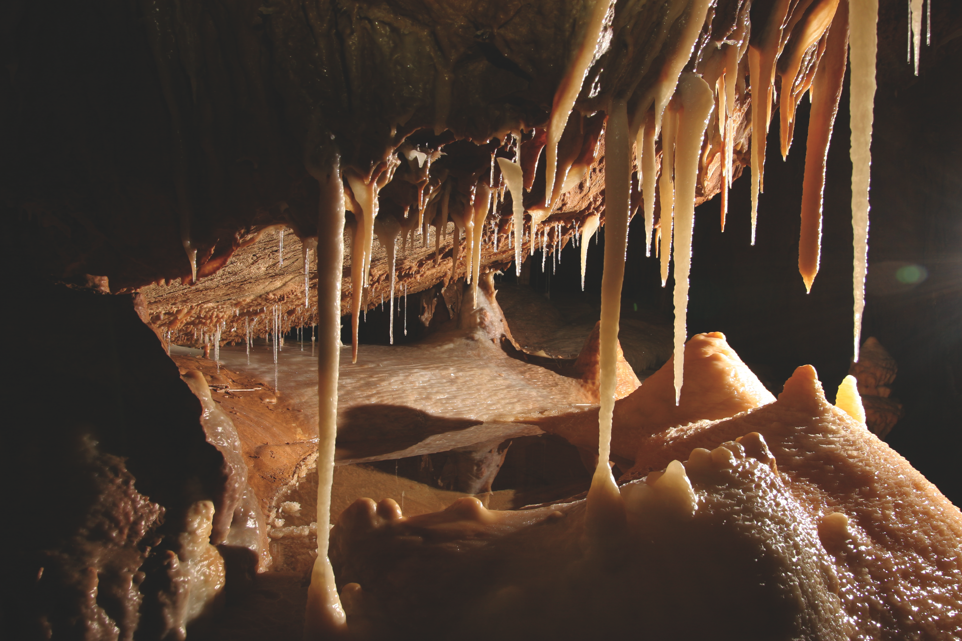
Notes:
1st Summer School on Speleothem Science
Michael Deininger1,2, S. Winterhalder2,3, M. Boyd4,5, K. Braun6,7, Y. Burstyn6,7, L. Comas-Bru8 and A.D. Häuselmann9
Figure 1: Finding a suitable stalagmite for paleoclimate studies is still one of the most challenging parts of
speleothem science. The picture is showing a cave chamber of the Herbstlabyrinth, Germany, which was visited
during the S4 field trip. Photo by Simon Mischel.
AFFILIATIONS
1Heidelberg Academy of Science, Heidelberg, Germany
2Institute of Environmental Physics, Ruprecht Karls
University, Heidelberg, Germany
3Institute for Geosciences, Johannes Gutenberg
University, Mainz, Germany
4Department of Physical Geography and Quaternary
Geology, Stockholm University, Sweden
5Bolin Centre for Climate Research, Stockholm, Sweden
6Geological Survey of Israel, Jerusalem, Israel
7Fredy and Nadine Herrmann Institute of Earth Sciences,
Hebrew University of Jerusalem, Israel
8UCD School of Geological Sciences, University College
Dublin, Ireland
9Institute of Geological Sciences and Oeschger Centre
for Climate Change Research, University of Bern,
Switzerland
CONTACT
Michael Deininger: michael.deininger@iup.uni-heidelberg.
de

Slide 48
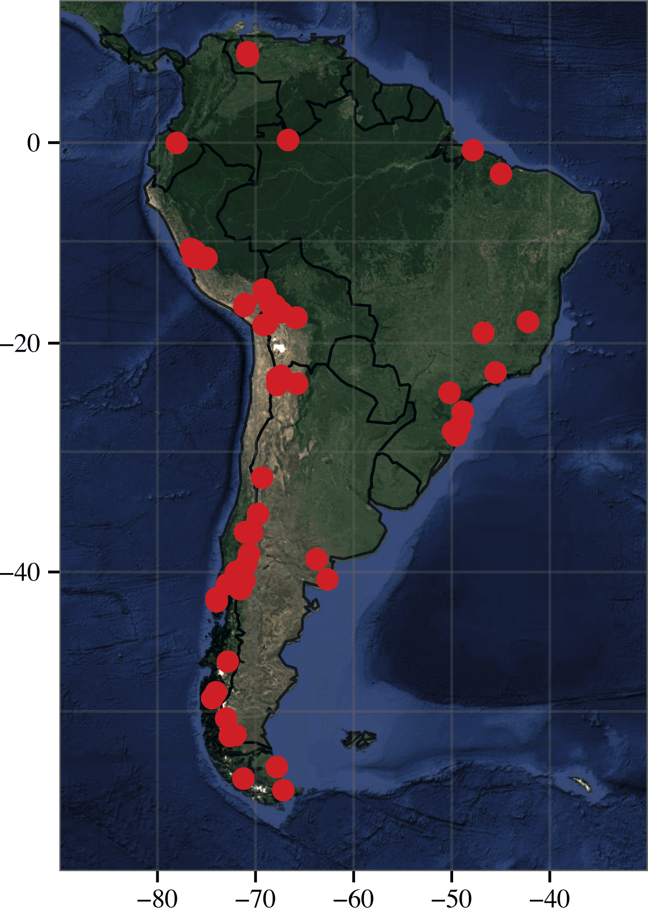
Notes:
1st Workshop on Paleoecological Databases in South America
Claudio Latorre1,2, P.I. Moreno2,3 and E.C. Grimm4
Figure 1: Current South American paleoecological sites in Neotoma. The vast majority of these are part of the
constituent Latin American Pollen database. Future collaborations could add much needed faunal data as well as
other databases (for figure source code see http://pastebin.com/fgQSVTKb; image credit: Simon Goring
AFFILIATIONS
1Department of Ecology, Pontifical Catholic University of
Chile, Santiago, Chile
2Institute of Ecology and Biodiversity, University of Chile,
Santiago, Chile
3Department of Ecological Sciences, University of Chile,
Santiago, Chile
4Illinois State Museum, Springfield, USA
CONTACT
Claudio Latorre: clatorre@bio.puc.cl

Slide 49
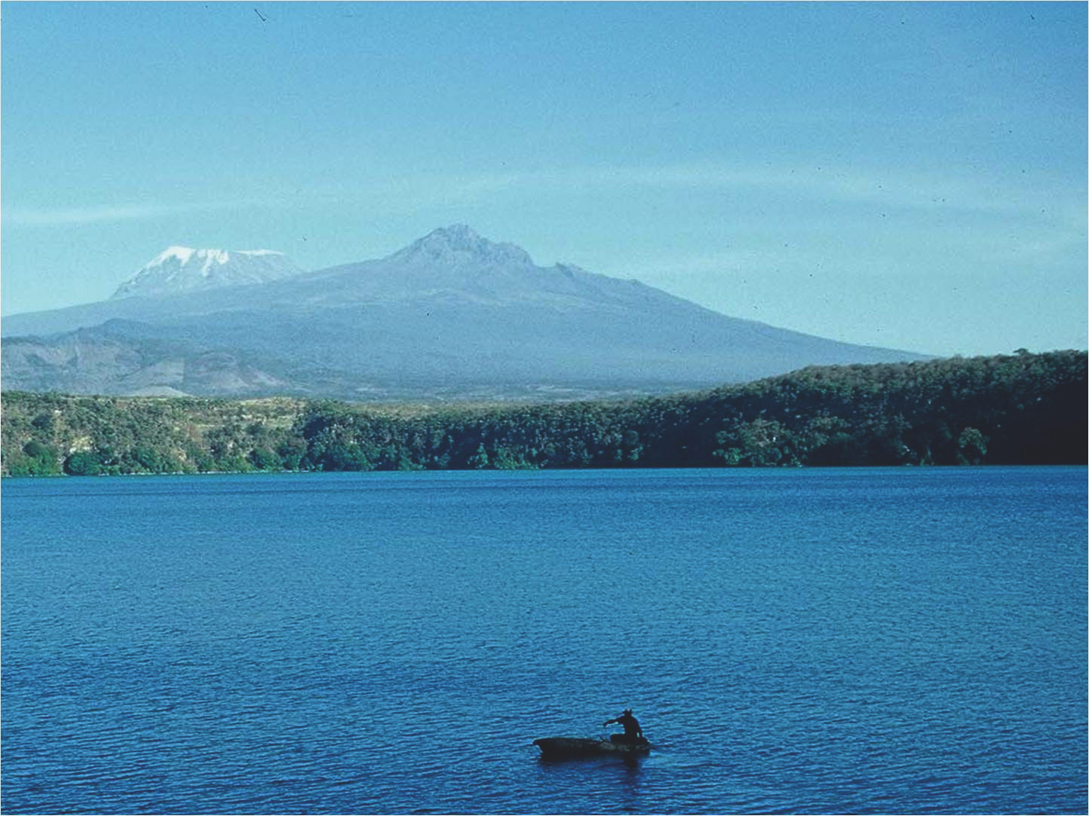
Notes:
Eastern African Quaternary Climate change and variability
Christine A. Ogola
Figure 1: Lake Chala southeast of Mt Kilimanjaro. Sediments from this lake are one of the longest archives of
climate change in the region, reaching back at least 25,000 years (Moernaut et al. 2010)
AFFILIATIONS
Archaeology Section, National Museums of Kenya,
Nairobi, Kenya
CONTACT
Christine A. Ogola: cogola@gmail.com

Slide 50
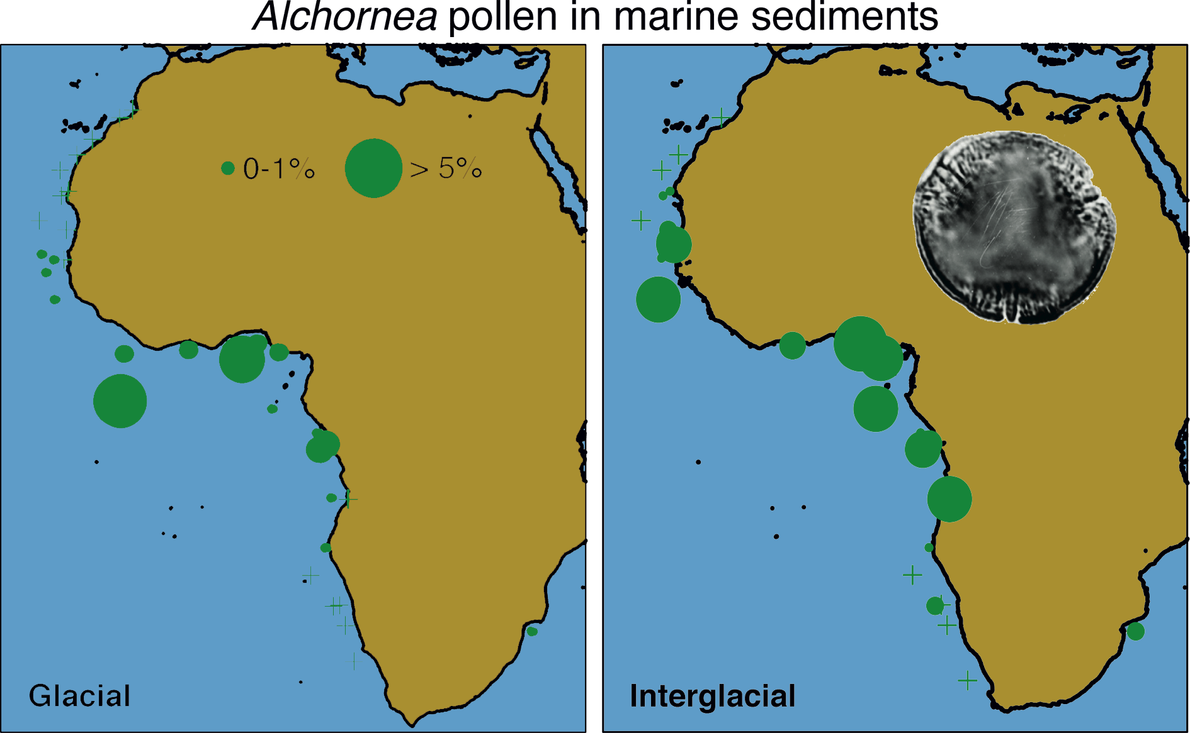
Notes:
African climate-vegetation interaction since the last glacial period
Ilham Bouimetarhan1, L. Dupont1, C. Itambi2 and J.-B.W. Stuut1,3
Figure 1: Alchornea pollen distribution (% of total pollen) in the marine sediment along the African coast
illustrates orbital scale vegetation changes. The maps show that during the Last Glacial Maximum, (LGM, left)
outside the equatorial region only, very little Alchornea pollen are found. This suggests a reduction of the tropical
rain forest area compared with the mid-Holocene (right). Figure modified from Jolly et al. (1998), Elenga et al.
(2000) and Dupont (2011).
AFFILIATIONS
1Center for Marine Environmental Sciences (MARUM),
University of Bremen, Germany
2Department of Geosciences, University of Bremen,
Germany
3Royal Netherlands Institute for Sea Research (NIOZ), Den
Burg, The Netherlands
CONTACT
Ilham Bouimetarhan: bouimetarhan@uni-bremen.de

Slide 51
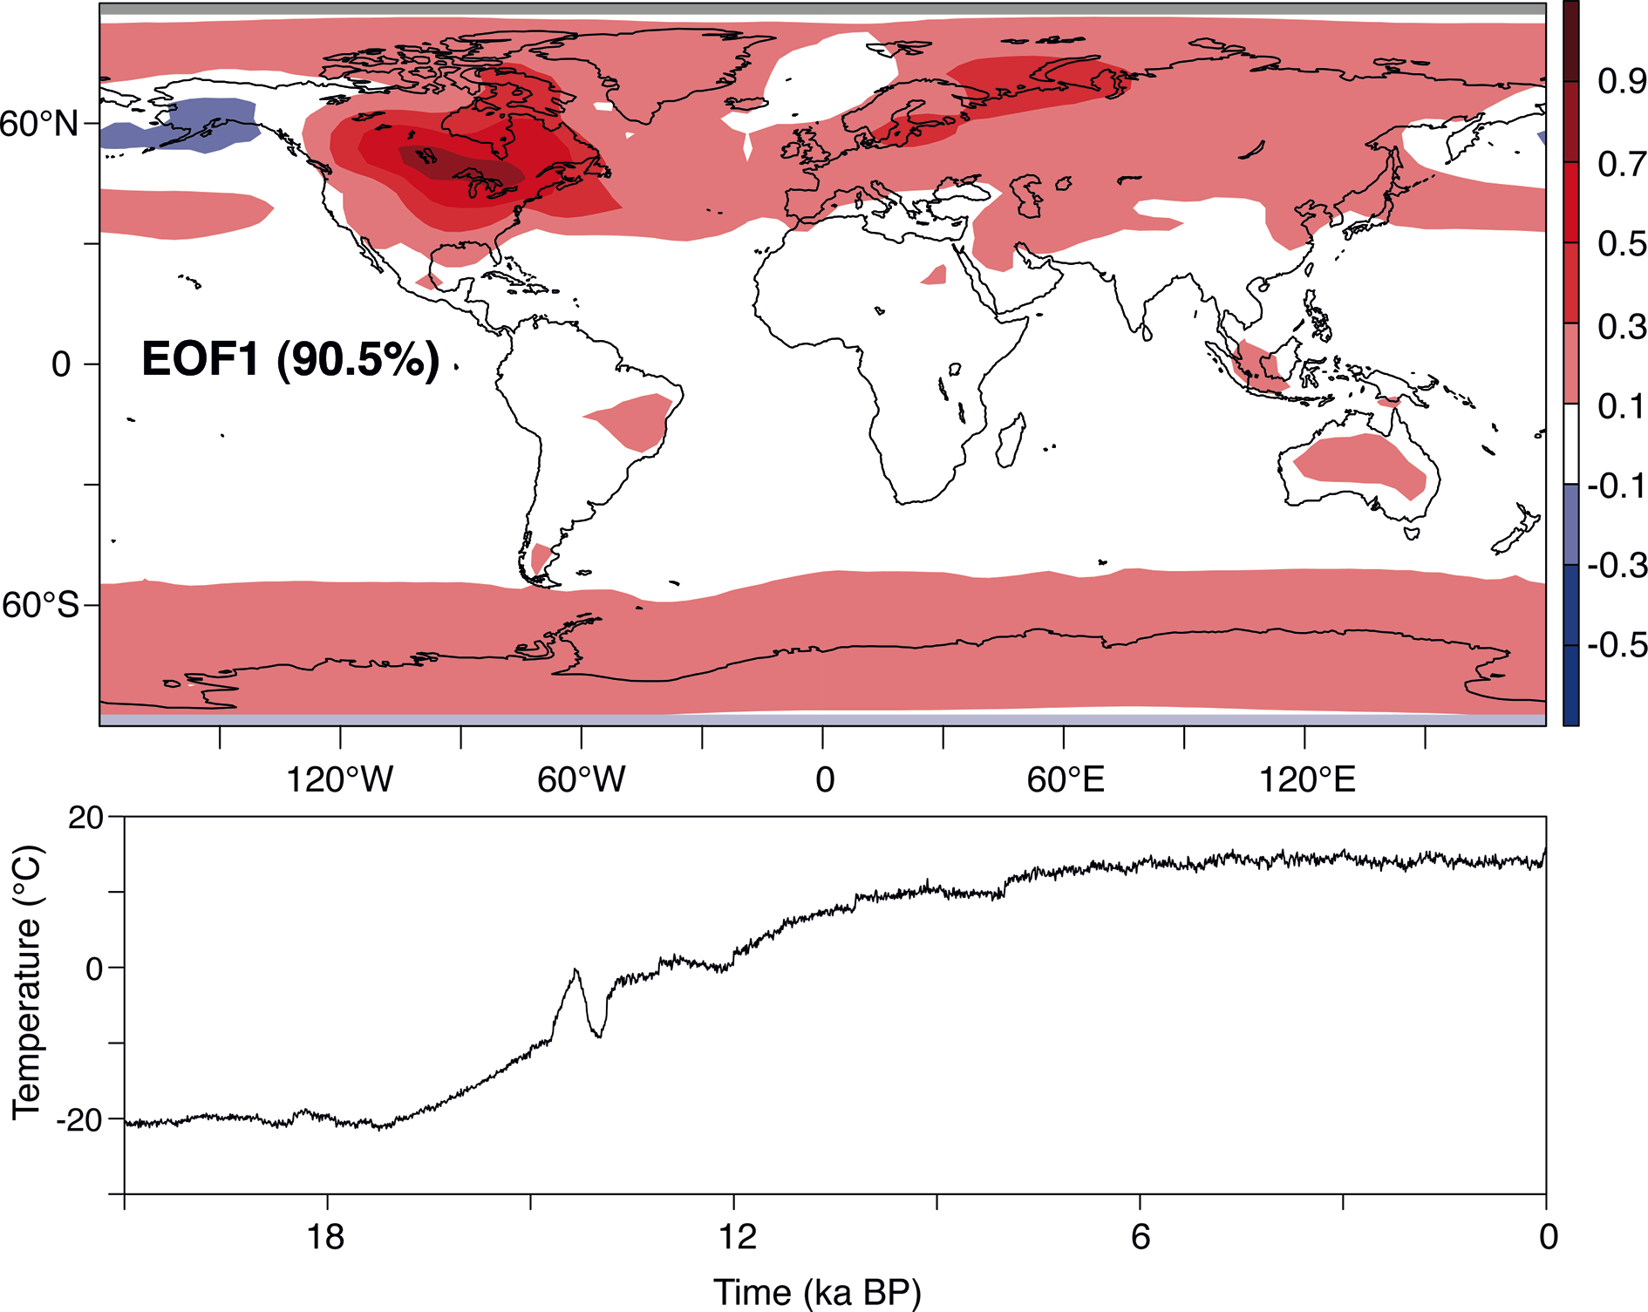
Notes:
SynTraCE-21 Workshop
James M. Russell1, B. Otto-Bliesner2 and Z. Liu3
Figure 1: The first empirical orthogonal function of global temperature change from 21 ka BP to the present,
simulated by CCSM 3. Nearly the entire planet warmed, with warming focused over the high latitudes, and North
America and Northern Europe in particular, with both gradual and abrupt temperature changes occurring during
the past 21 ka BP.
AFFILIATIONS
1Department of Geological Sciences, Brown University,
Providence, USA
2National Center for Atmospheric Research, Boulder, USA
3Center for Climatic Research, University of Wisconsin,
Madison, USA
CONTACT
James M. Russell: James_Russell@Brown.edu

