Slide 1
Figures – PAGES Magazine 22(2) 2014
Please cite the PAGES magazine article and, if available, the original reference when using a figure. See note section below the figures for details.

Slide 2
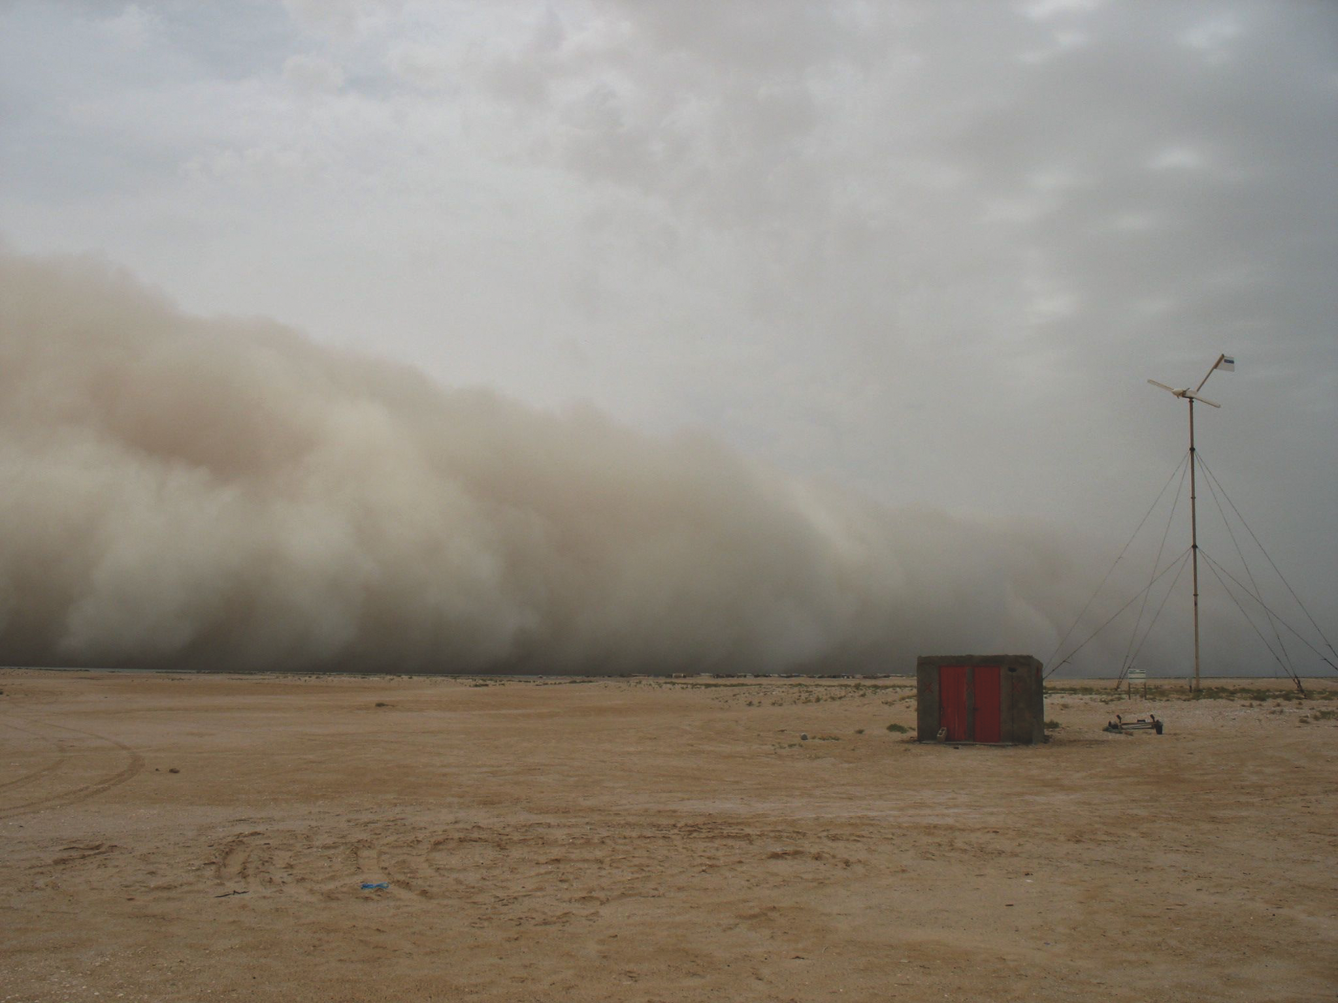
Notes:
Present and past mineral dust variations – a cross-disciplinary challenge for research
Ute Merkel1, D.-D. Rousseau2,3, J.-B. W. Stuut1,4 and G. Winckler3,5
Figure 1: Dust storm in Iwik, Mauritania (photo by Jutta Leyrer).
AFFILIATIONS
1MARUM - Center for Marine Environmental Sciences and Faculty of Geosciences, University of Bremen, Germany
2Laboratoire de Météorologie Dynamique & CERES-ERTI, CNRS - Ecole Normale Supérieure, Paris, France
3Lamont-Doherty Earth Observatory, Columbia University, Palisades, USA
4NIOZ Royal Netherlands Institute for Sea Research, Texel, The Netherlands
5Department of Earth and Environmental Sciences, Columbia University, New York, USA
CONTACT
Ute Merkel: umerkel@marum.de

Slide 3
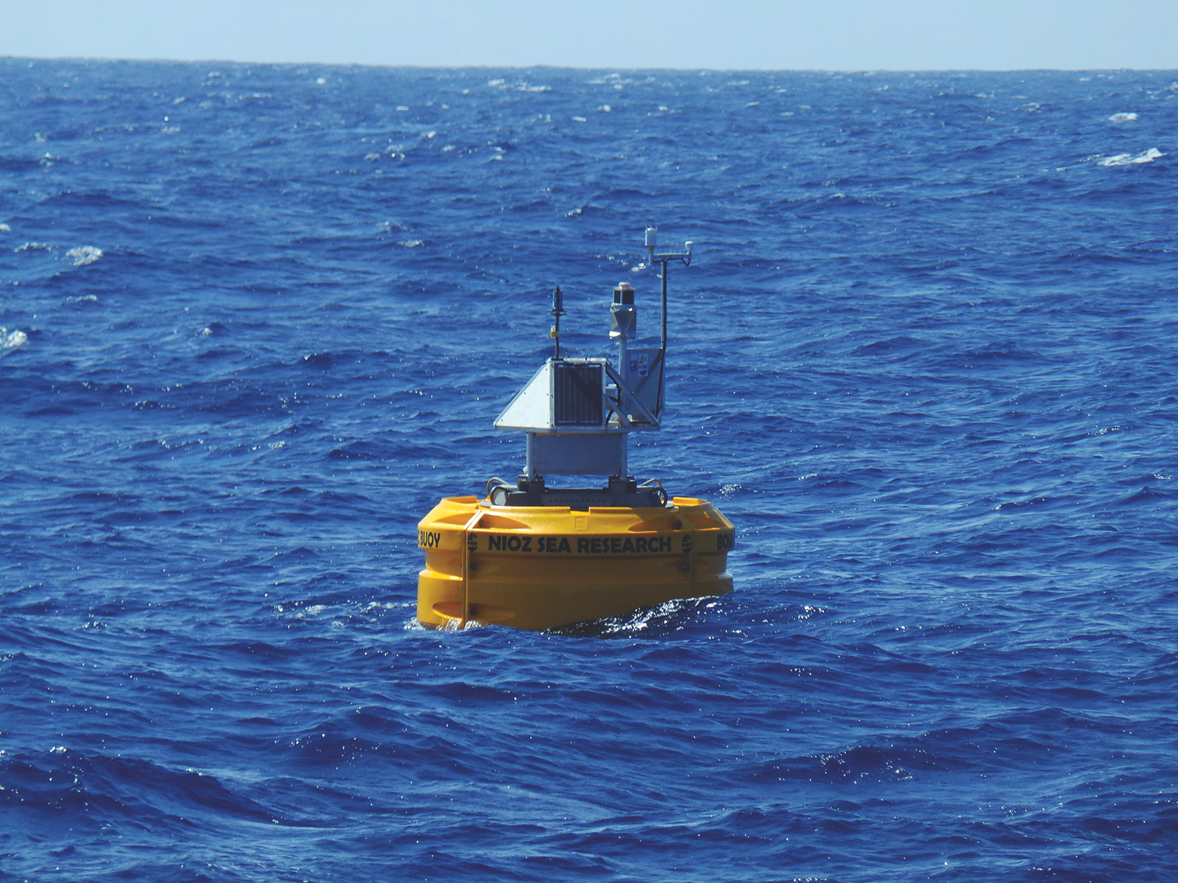
Notes:
Present and past mineral dust variations – a cross-disciplinary challenge for research
Ute Merkel1, D.-D. Rousseau2,3, J.-B. W. Stuut1,4 and G. Winckler3,5
Figure 1: Dust storm in Iwik, Mauritania (photo by Jutta Leyrer).
AFFILIATIONS
1MARUM - Center for Marine Environmental Sciences and Faculty of Geosciences, University of Bremen, Germany
2Laboratoire de Météorologie Dynamique & CERES-ERTI, CNRS - Ecole Normale Supérieure, Paris, France
3Lamont-Doherty Earth Observatory, Columbia University, Palisades, USA
4NIOZ Royal Netherlands Institute for Sea Research, Texel, The Netherlands
5Department of Earth and Environmental Sciences, Columbia University, New York, USA
CONTACT
Ute Merkel: umerkel@marum.de

Slide 4
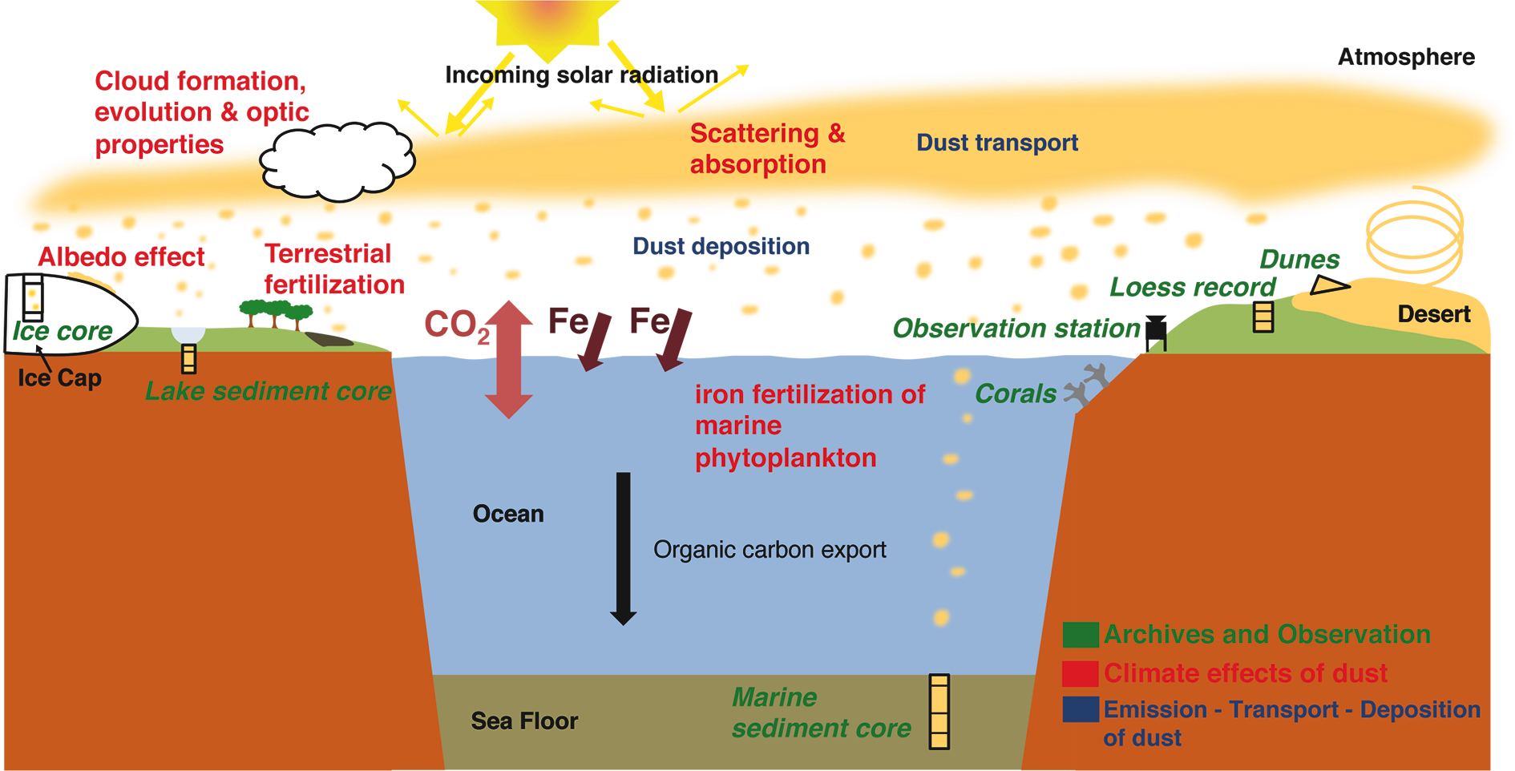
Notes:
DICE: Dust impact on climate and environment
Gisela Winckler1,2 and Natalie Mahowald3
Figure 1: Schematic showing the interactions between mineral aerosols and climate.
Visit the DICE working group webpage at: www.pages-igbp.org/workinggroups/dice
AFFILIATIONS
1Lamont-Doherty Earth Observatory, Columbia University, Palisades, USA
2Department of Earth and Environmental Sciences, Columbia University, New York, USA
3Department of Earth and Atmospheric Sciences, Cornell University, Ithaca, USA
CONTACT
Gisela Winckler: winckler@ldeo.columbia.edu

Slide 5
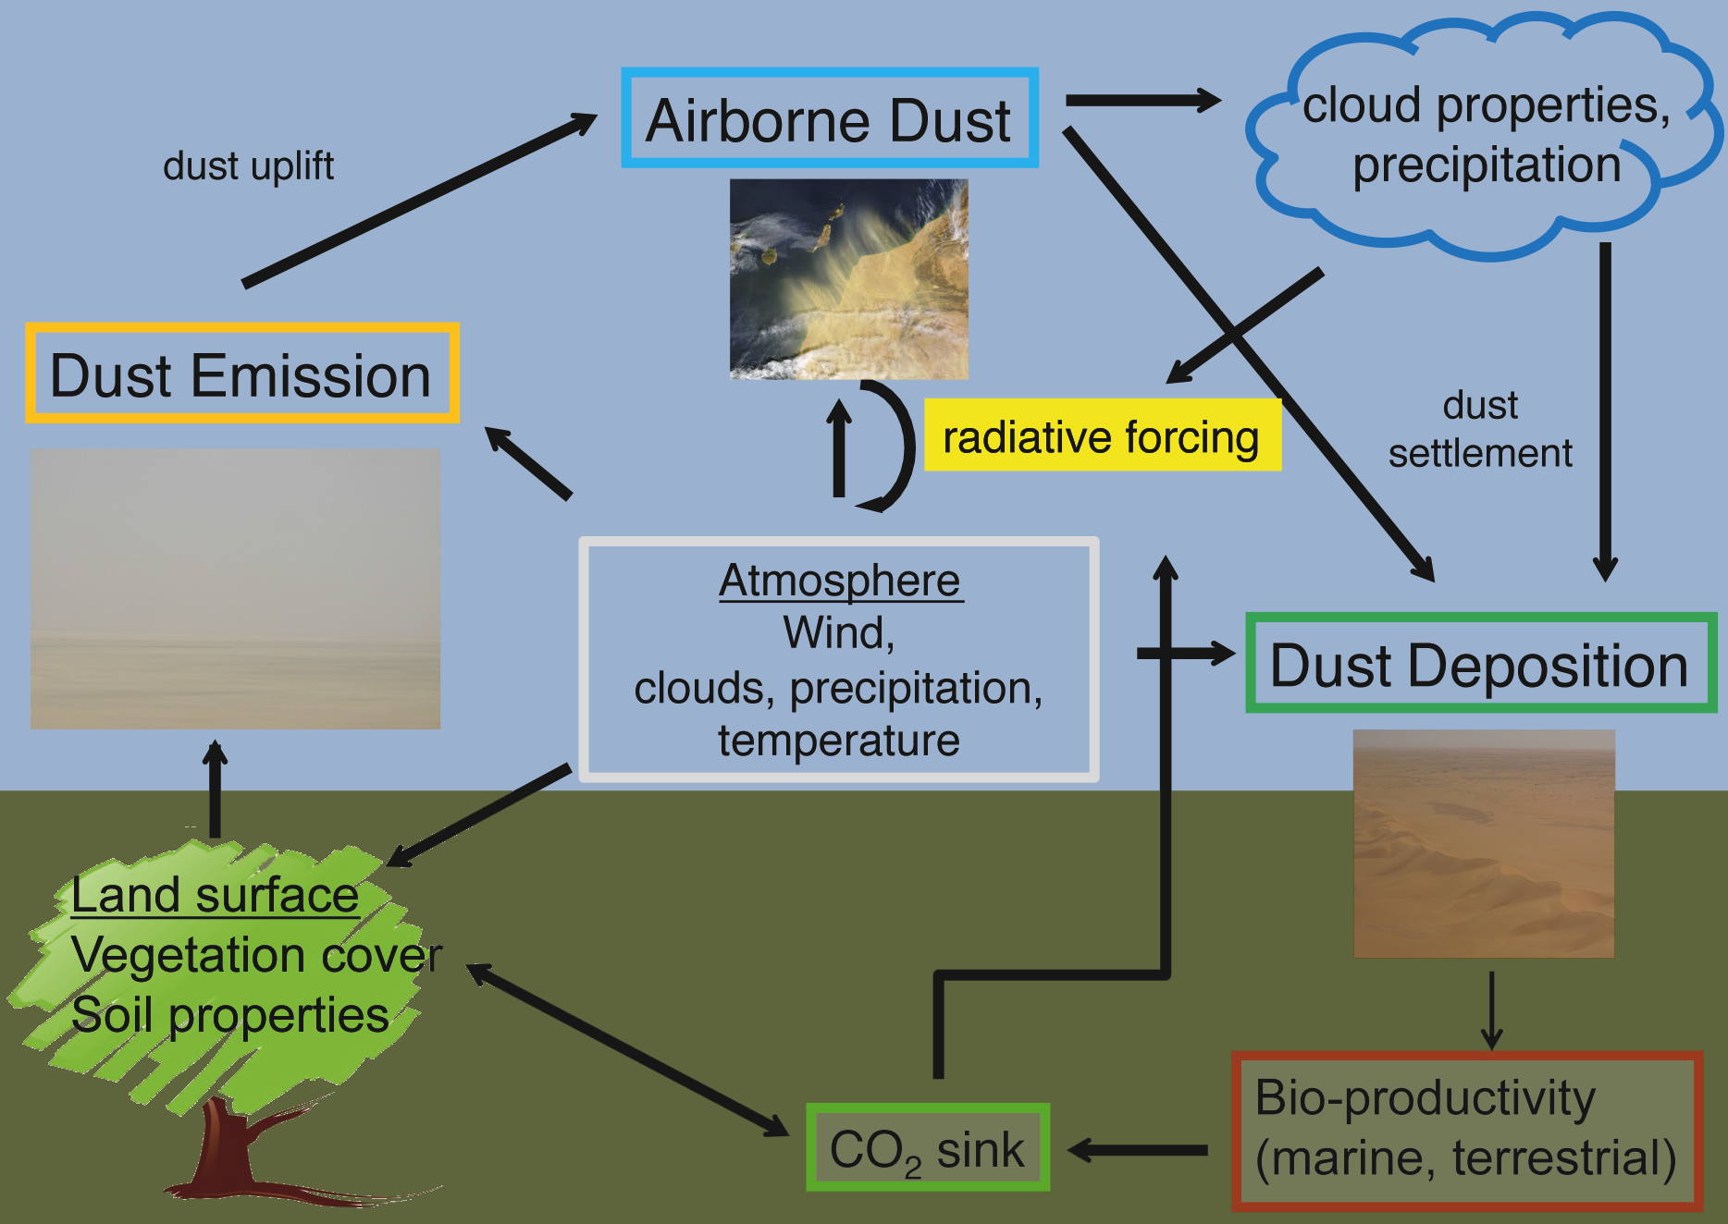
Notes:
Mineral dust: Meteorological controls and climate impacts
Kerstin Schepanski1, U. Merkel2 and I. Tegen1
Figure 1: The atmospheric dust cycle and related feedback mechanisms.
AFFILIATIONS
1Leibniz Institute for Tropospheric Research, Leipzig, Germany
2MARUM, Bremen, Germany
CONTACT
Kerstin Schepanski: schepanski@tropos.de

Slide 6
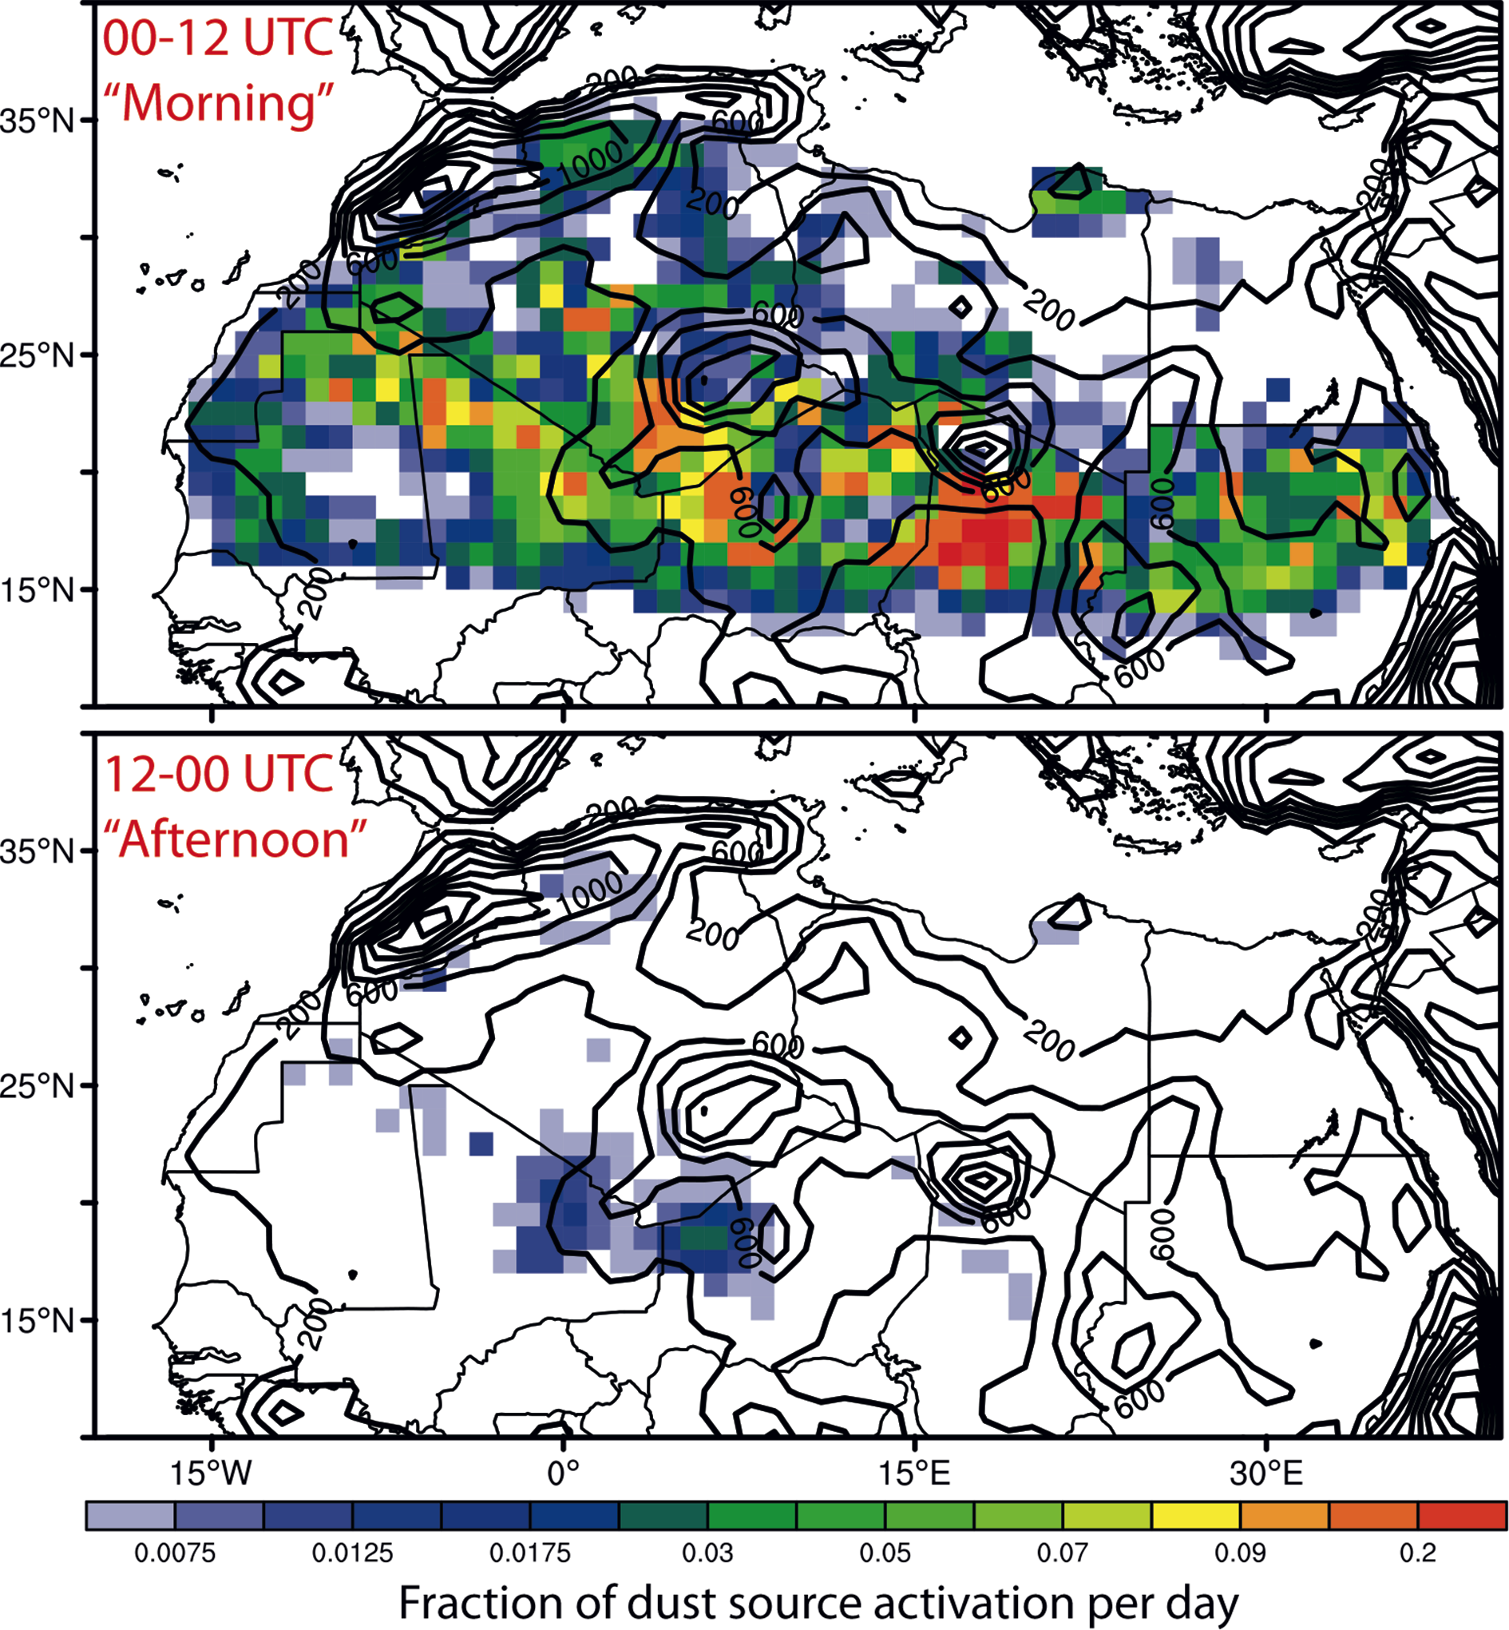
Notes:
Mineral dust: Meteorological controls and climate impacts
Kerstin Schepanski1, U. Merkel2 and I. Tegen1
Figure 2: Diurnal variability of dust source activations over North Africa inferred from MSG-SEVIRI IRdust imagery for 2006-2010 following Schepanski et al. (2009). Figures shows the occurrence frequency of dust source activations in the first (top panel) and second (bottom panel) half of the day. Orography is given by contour lines.
AFFILIATIONS
1Leibniz Institute for Tropospheric Research, Leipzig, Germany
2MARUM, Bremen, Germany
CONTACT
Kerstin Schepanski: schepanski@tropos.de

Slide 7
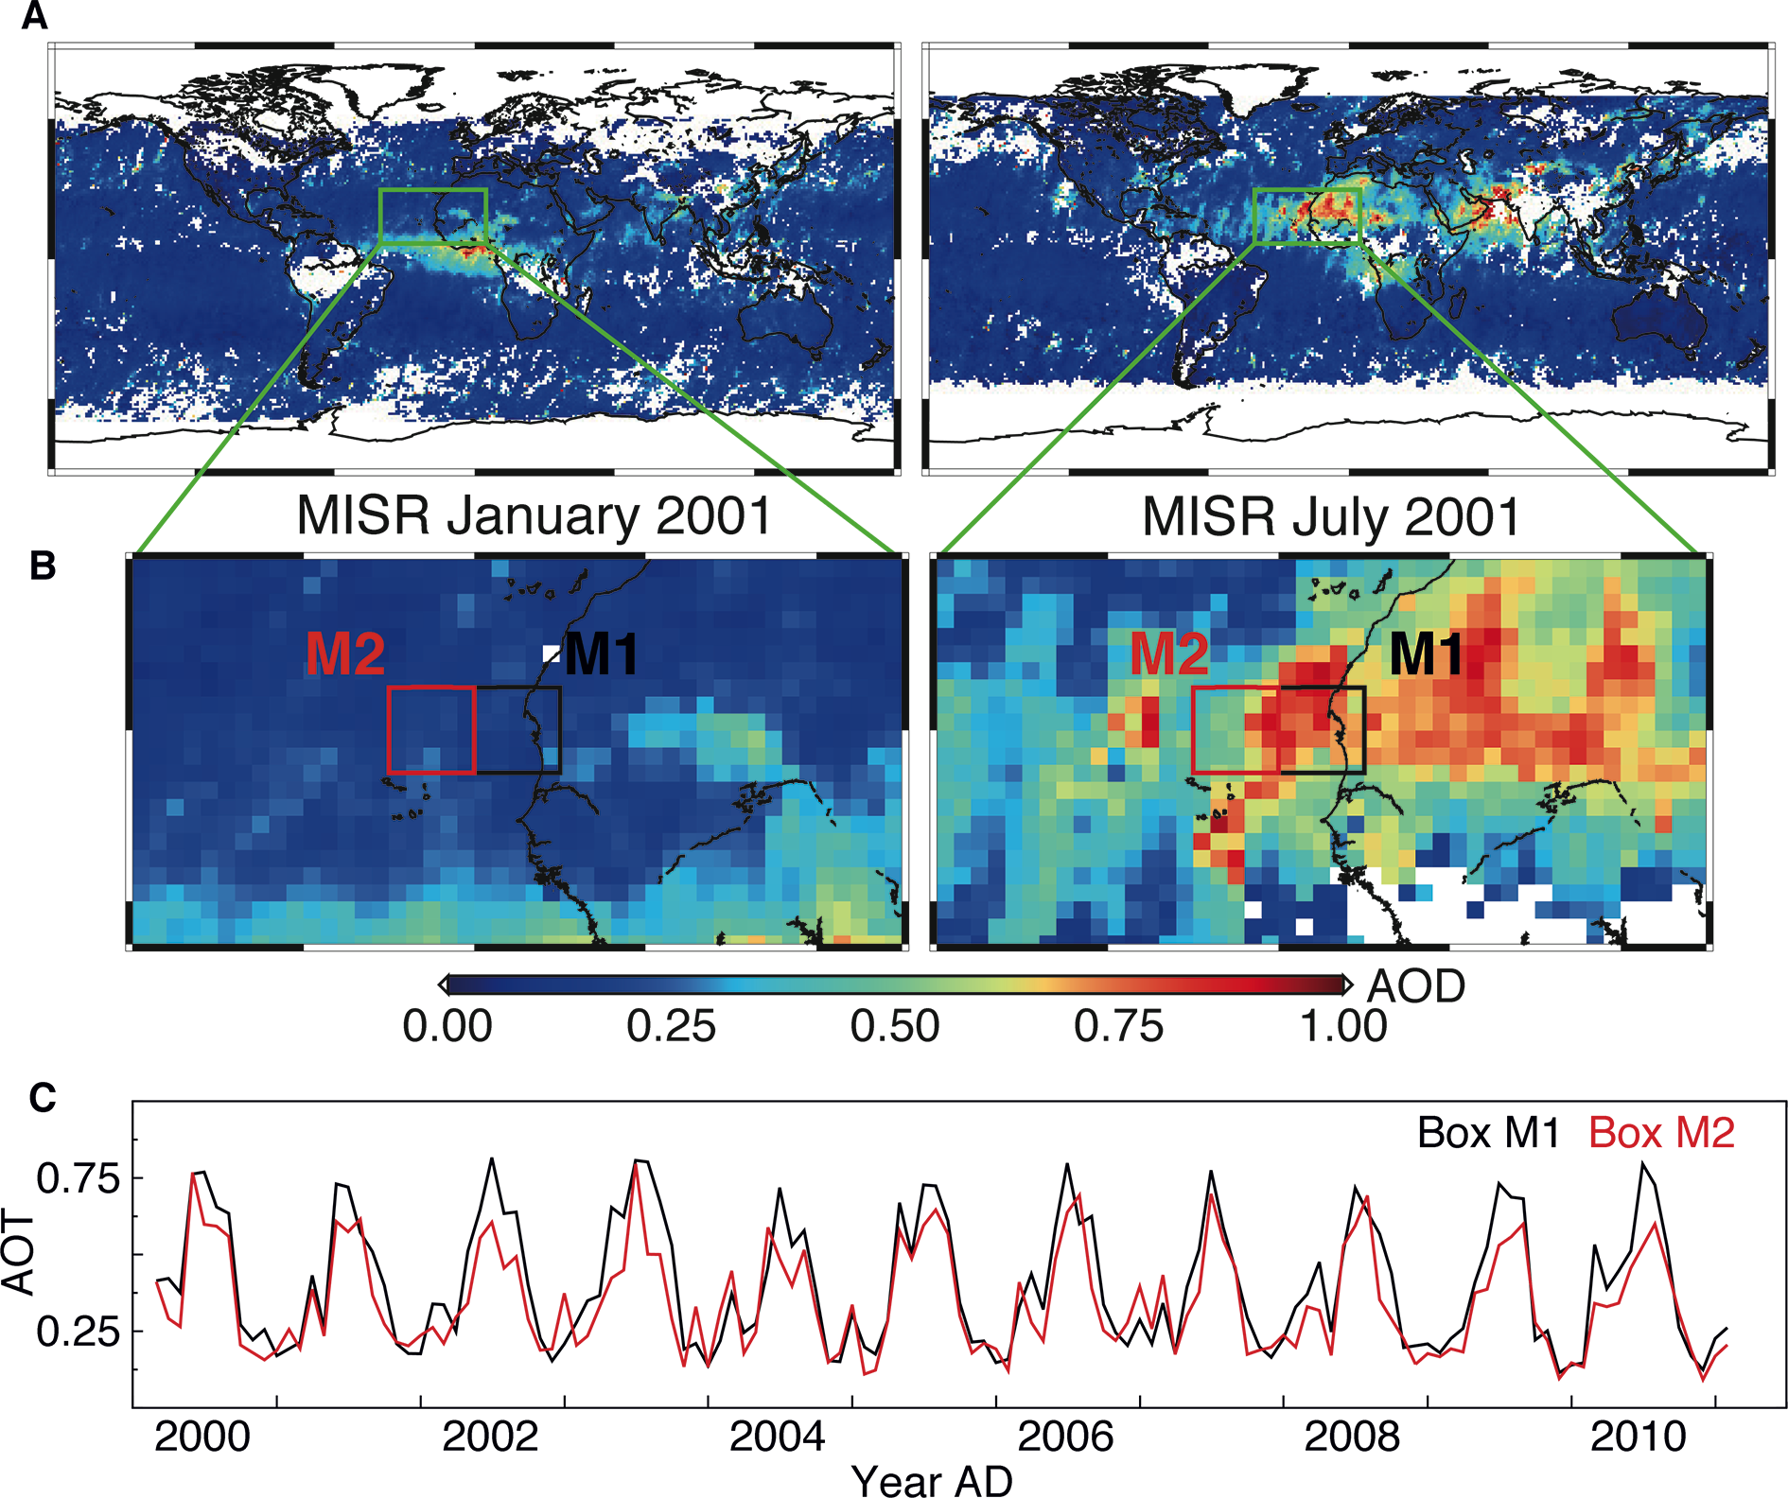
Notes:
Dust deposition rates derived from optical satellite observations
Luca Lelli, W. von Hoyningen-Huene, M. Vountas, M. Jäger and J.P. Burrows
Figure 1: Monthly averages of Aerosol Optical Thickness (AOT; dimensionless) retrieved from MISRsatellite data for the determination of dust sedimentation rate. Maps of AOTfor January and July 2001 on a global scale (A) and zoomed in to the example region around Cape Blanc (B), where sediment traps are deployed across West Africa and the Atlantic Ocean. The time series in (C) portrays the AOTsignal extracted for the adjacent boxes M1 and M2. The oscillations of both curves indicate that dust activity is more frequent in summer than in winter. Dust deposition is reflected by the difference between the red and black curves during the respective months.
AFFILIATIONS
Institute of Environmental Physics and Remote Sensing (IUP), University of Bremen, Germany
CONTACT
Luca Lelli: luca@iup.physik.uni-bremen.de

Slide 8
Notes:
Dust deposition rates derived from optical satellite observations
Luca Lelli, W. von Hoyningen-Huene, M. Vountas, M. Jäger and J.P. Burrows
Figure 2: Time series of AOTchanges between boxes M1 and M2 (see Fig.1), derived from satellite retrievals from SeaWiFS (black curve) and MISR(blue curve) instruments. The curves can be considered as approximations for the rate of dust deposition at the site of Cape Blanc.
AFFILIATIONS
Institute of Environmental Physics and Remote Sensing (IUP), University of Bremen, Germany
CONTACT
Luca Lelli: luca@iup.physik.uni-bremen.de

Slide 9
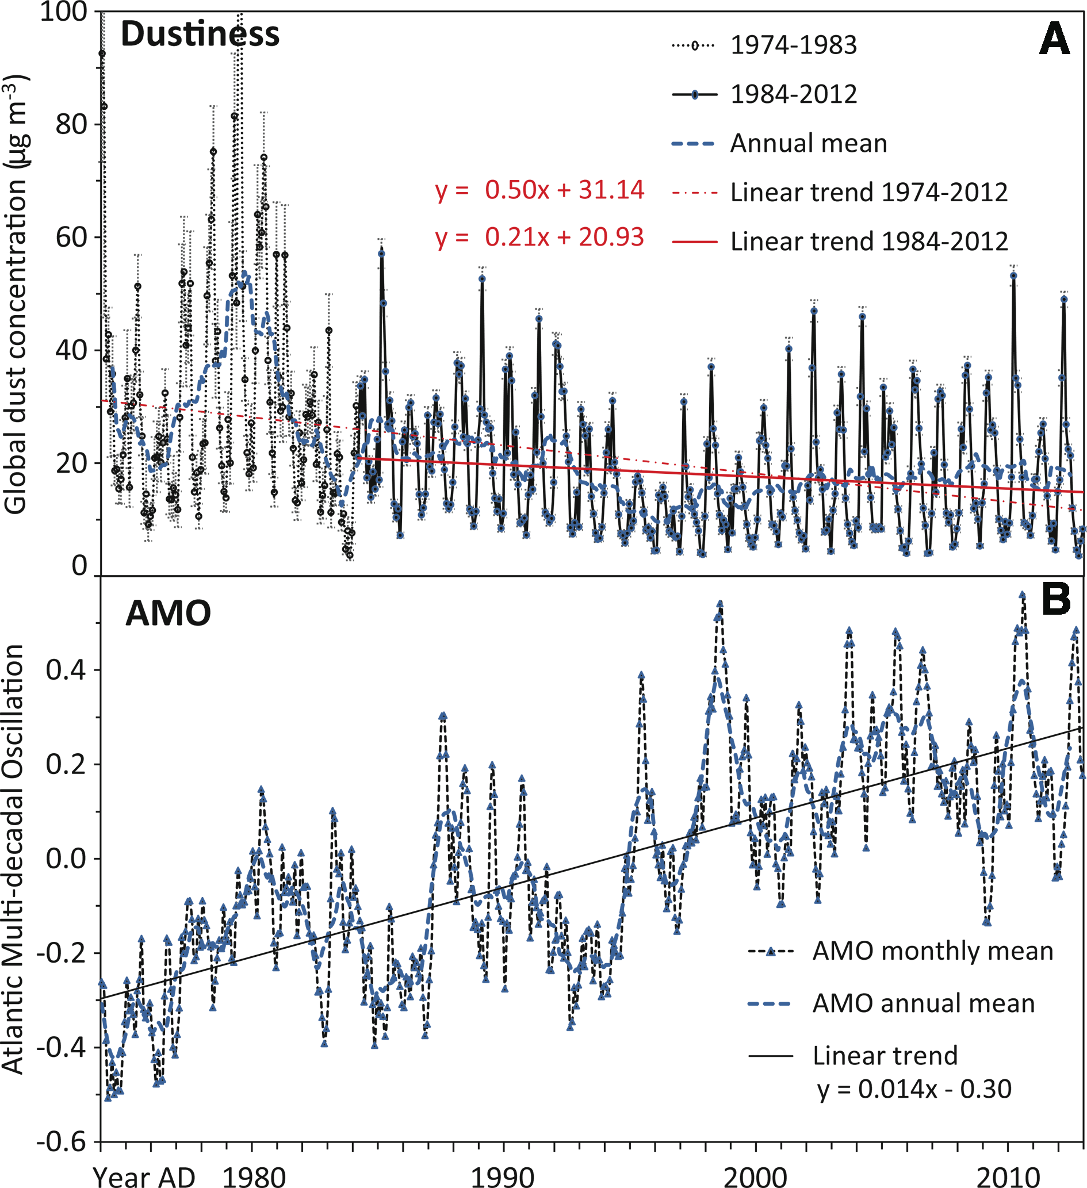
Notes:
Including dust dynamics in paleoclimate modeling
Yaping Shao
Figure 1: (A) Time series of global monthly-mean dust concentration, and the corresponding 95% confidence interval (in error bars), for the period 1974-2012, together with the yearly running mean and the linear trends. The trend for the full is shown by the dashed red line, for the period 1984-2012 by the solid red line. (B) Time series of the AMO index as monthly and yearly running mean, and showing the linear trend.
AFFILIATIONS
Institute for Geophysics and Meteorology, University of Cologne, Germany
CONTACT
Yaping Shao: yshao@uni-koeln.de

Slide 10
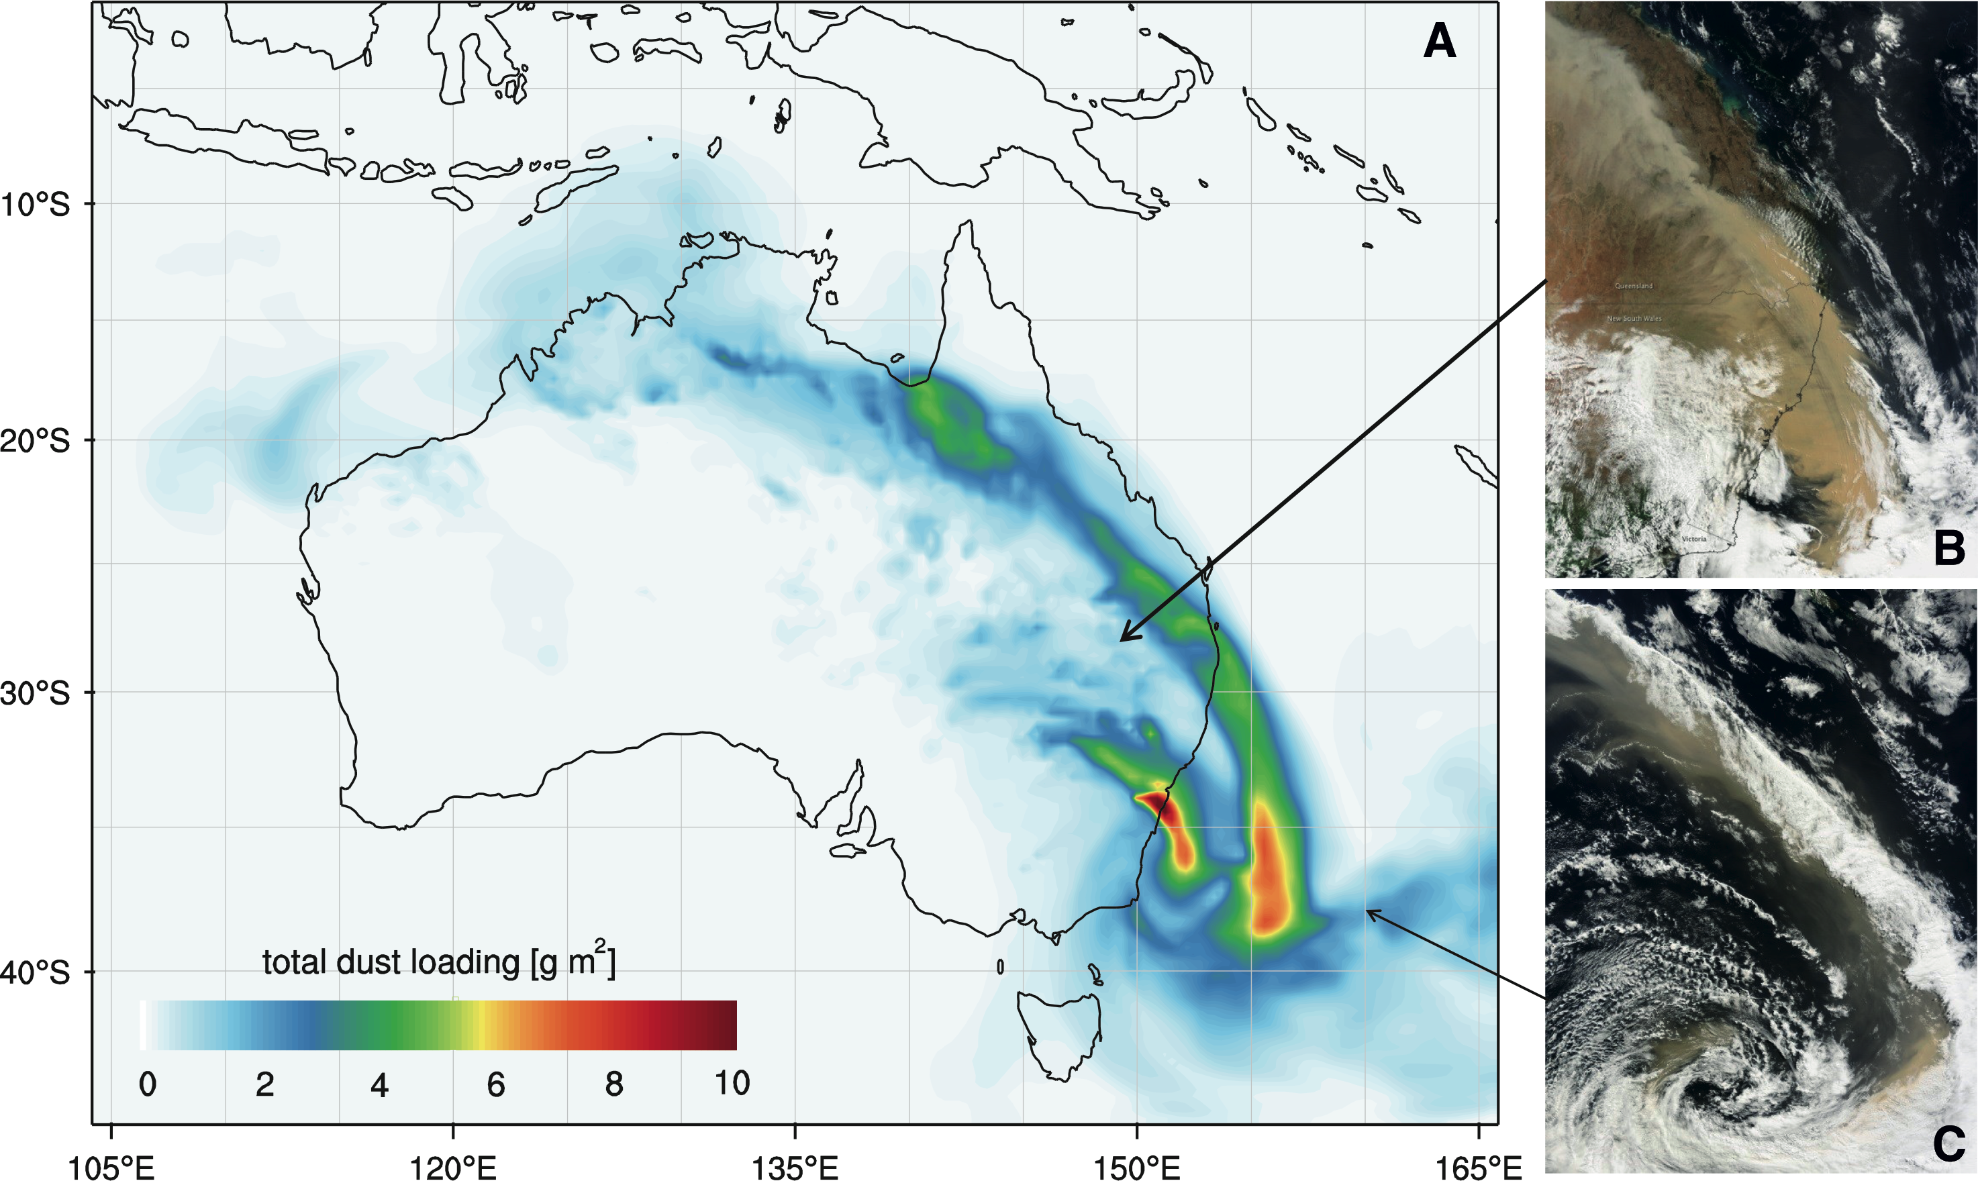
Notes:
Including dust dynamics in paleoclimate modeling
Yaping Shao
Figure 2: (A) Simulated dust load for the Australian dust event on 23 September 2009, using the WRF-CHEM/D model with a spatial resolution of 40 km. Australian dust is transported across the continent along two major routes: the southeast route along which dust is transported to the southern Pacific Ocean and the northwest route to the Indian Ocean. (B) MODIS satellite image from the morning of 23 September 2009. (C) As (B), but from 24 September 2009. The satellite images confirm the good performance of the model.
AFFILIATIONS
Institute for Geophysics and Meteorology, University of Cologne, Germany
CONTACT
Yaping Shao: yshao@uni-koeln.de

Slide 11
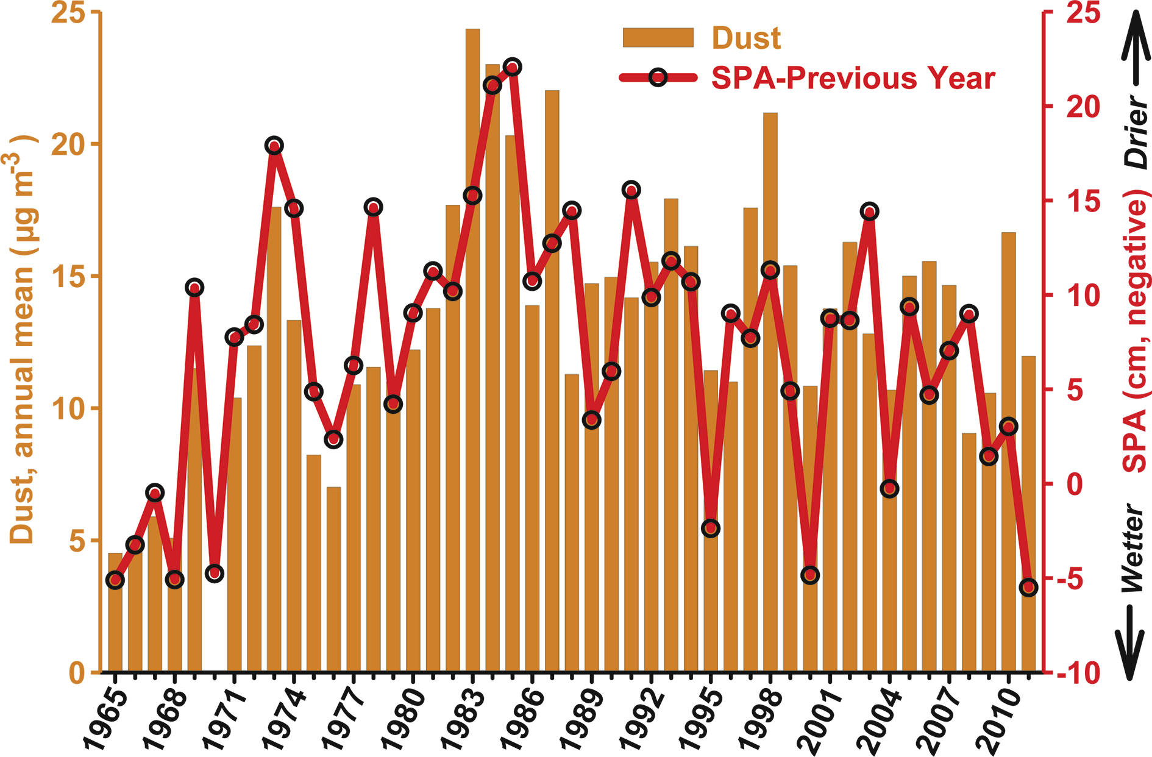
Notes:
Characterizing the temporal and spatial variability of African dust over the Atlantic
Joseph M. Prospero
Figure 1: Barbados annual mean dust concentrations and Sahel June-October Precipitation Anomalies (SPA) from 1965-2011. To more easily compare dust concentrations with rainfall metrics, the SPA values are plotted as the arithmetic negative. SPA data are taken from www.jisao.washington.edu/data_sets/sahel/ with anomalies calculated from data over the period 1950 to 2011.
AFFILIATIONS
1Rosenstiel School of Marine and Atmospheric Science, University of Miami, USA
CONTACT
Joseph M. Prospero: jprospero@rsmas.miami.edu

Slide 12
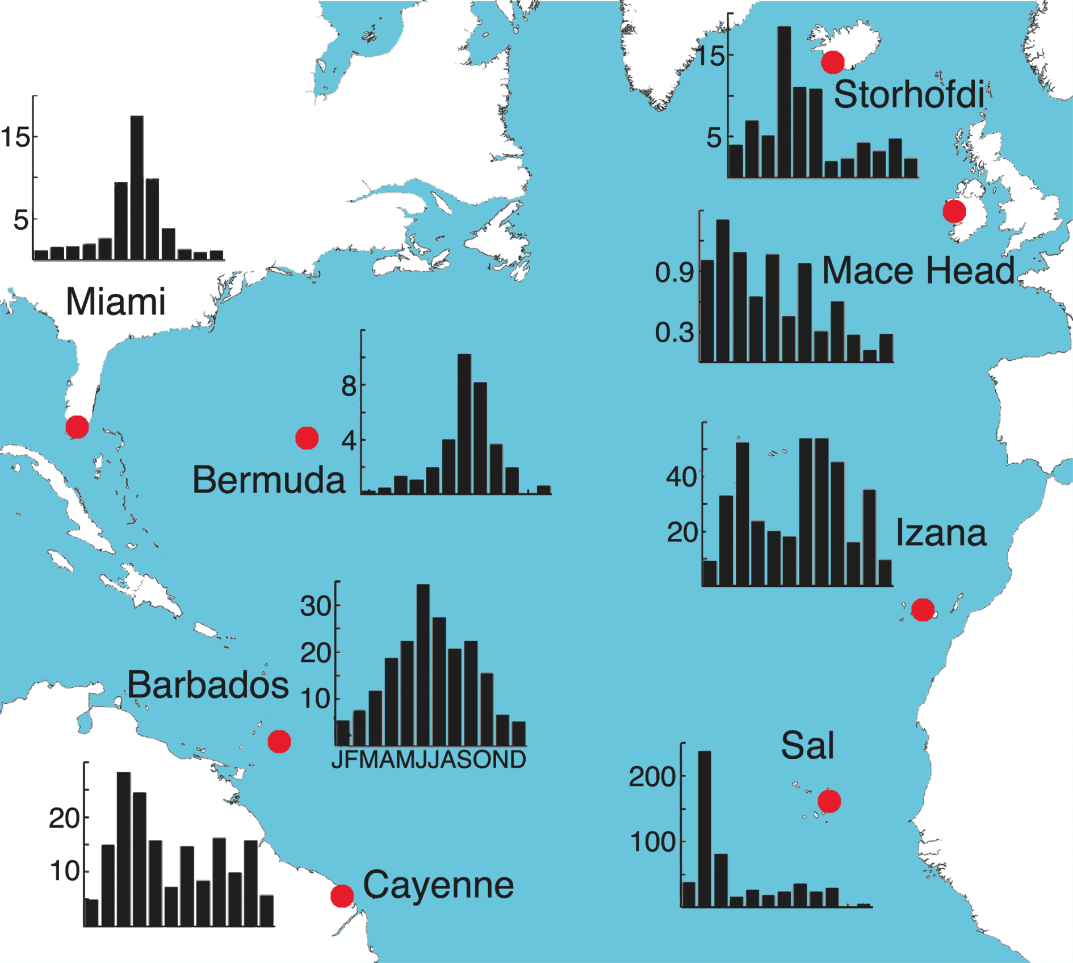
Notes:
Characterizing the temporal and spatial variability of African dust over the Atlantic
Joseph M. Prospero
Figure 2: The annual cycles of monthly mean dust concentrations at University of Miami network sites in the North Atlantic. The means at each site are based on multi-year data but they are not necessarily measured concurrently. Note the difference in the ordinate scales in each inset figure. Figure adapted from Prospero et al. (2012).
AFFILIATIONS
1Rosenstiel School of Marine and Atmospheric Science, University of Miami, USA
CONTACT
Joseph M. Prospero: jprospero@rsmas.miami.edu

Slide 13
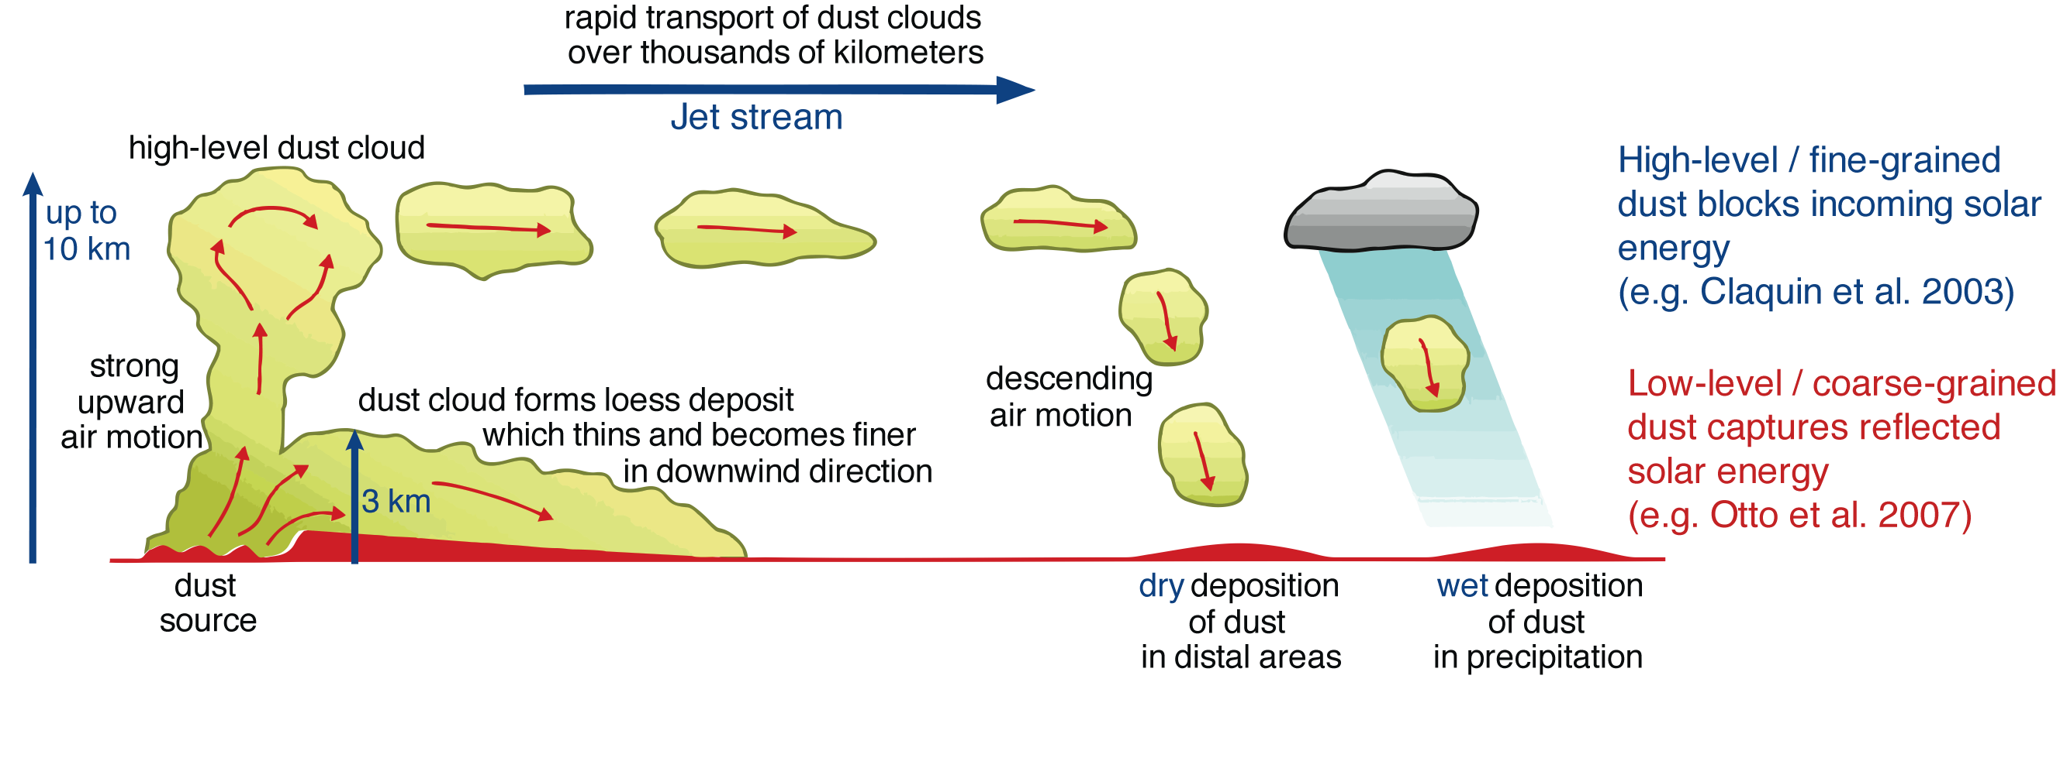
Notes:
The significance of particle size of long-range transported mineral dust
Jan-Berend W. Stuut1,2 and Maarten A. Prins3
Figure 1: Schematic diagram showing different dust-transport mechanisms in the high- and low-level atmosphere (redrawn from Pye and Zhou 1989).
AFFILIATIONS
1NIOZ - Royal Netherlands Institute for Sea Research, Den Burg, the Netherlands
2MARUM - Center for Marine Environmental Sciences, Bremen University, Germany
3Earth Sciences, Vrije Universiteit Amsterdam, the Netherlands
CONTACT
Jan-Berend Stuut: Jan-Berend.Stuut@nioz.nl

Slide 14
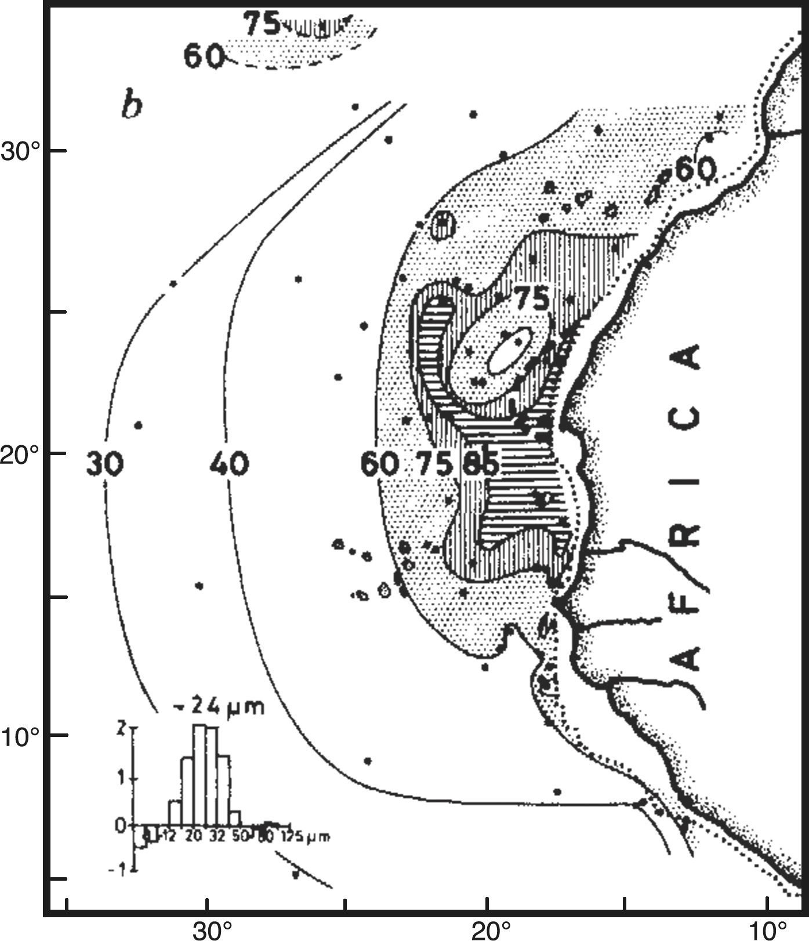
Notes:
The significance of particle size of long-range transported mineral dust
Jan-Berend W. Stuut1,2 and Maarten A. Prins3
Figure 2: Map of the subtropical northeastern Atlantic, showing the decrease in both particle size and dust flux as measured in surface sediments by Sarnthein et al. (1981).
AFFILIATIONS
1NIOZ - Royal Netherlands Institute for Sea Research, Den Burg, the Netherlands
2MARUM - Center for Marine Environmental Sciences, Bremen University, Germany
3Earth Sciences, Vrije Universiteit Amsterdam, the Netherlands
CONTACT
Jan-Berend Stuut: Jan-Berend.Stuut@nioz.nl

Slide 15
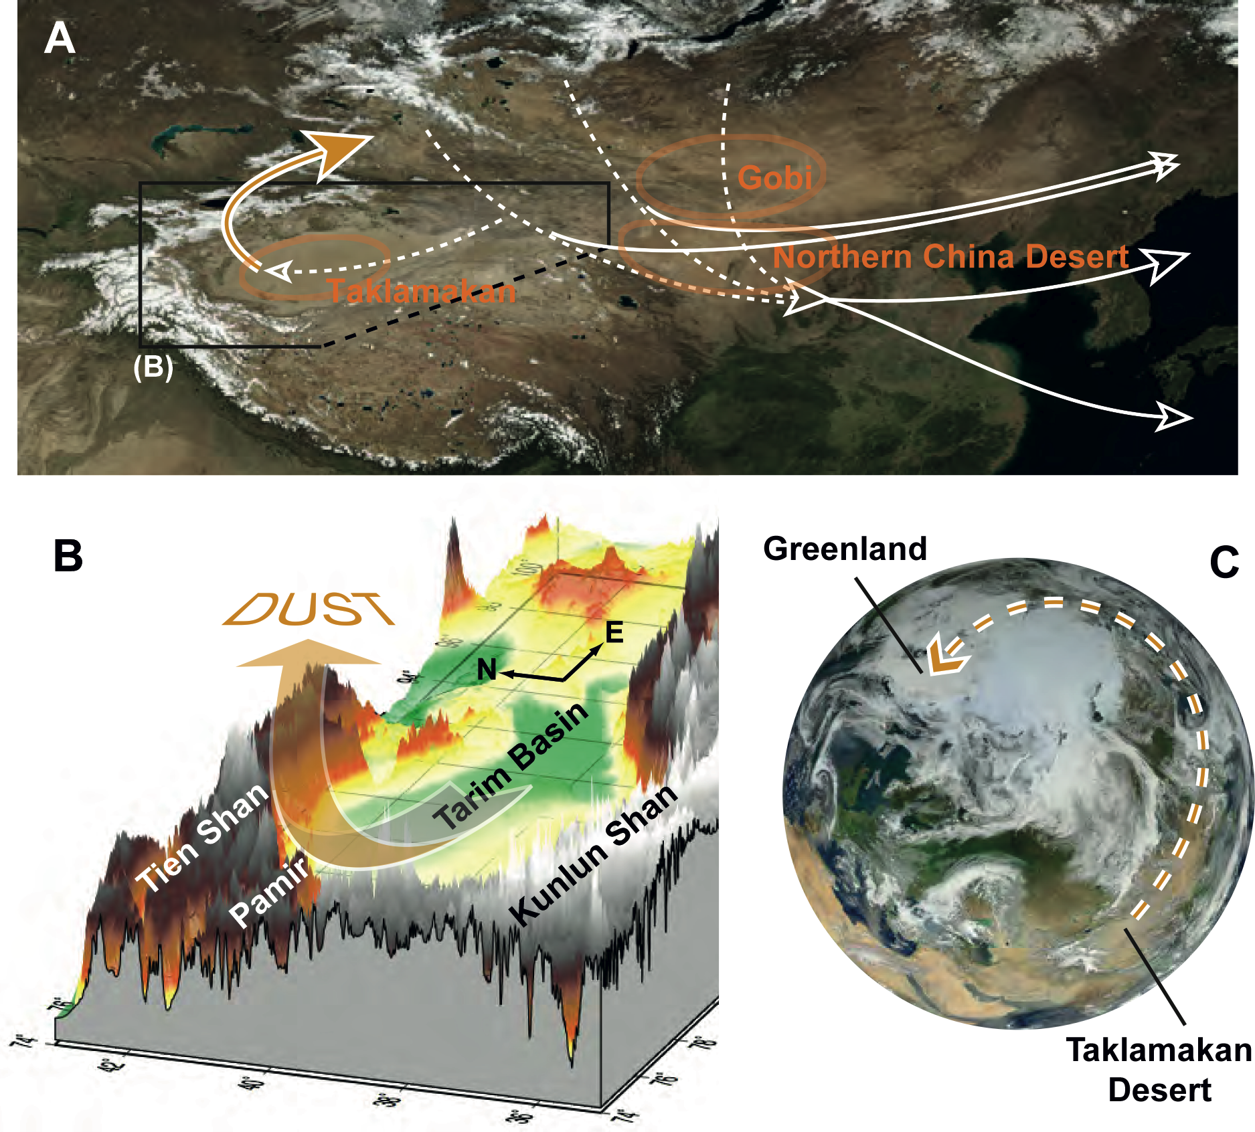
Notes:
A 10,000 km dust highway between the Taklamakan Desert and Greenland
Aloys J-M Bory
Figure 1: (A) April view of Eastern Asia (Terra MODIS sensor). Locations of the main deserts. Taklamakan and Northern China deserts are indicated together with the main winds (dotted lines) and dust transport pathways (solid lines) in the spring (adapted from Sun et al. 2001). (B) 3D-topographic modeling (NASA SRTM30 data) of the Tarim Basin and surrounding mountain chains (5x vertical exaggeration) and schematic illustration the dust’s typical pathway in the spring. (C) Full disk of the Earth from space, showing both the Taklamakan desert of Western China and the Greenland ice sheet (background images in (A) and (C) courtesy of NASA).
AFFILIATIONS
Laboratoire d’Océanologie et Géosciences, University of Lille-1, France and Lamont-Doherty Earth Observatory of Columbia University, New York, USA
CONTACT
Aloys J-M Bory: Aloys.Bory@univ-lille1.fr

Slide 16
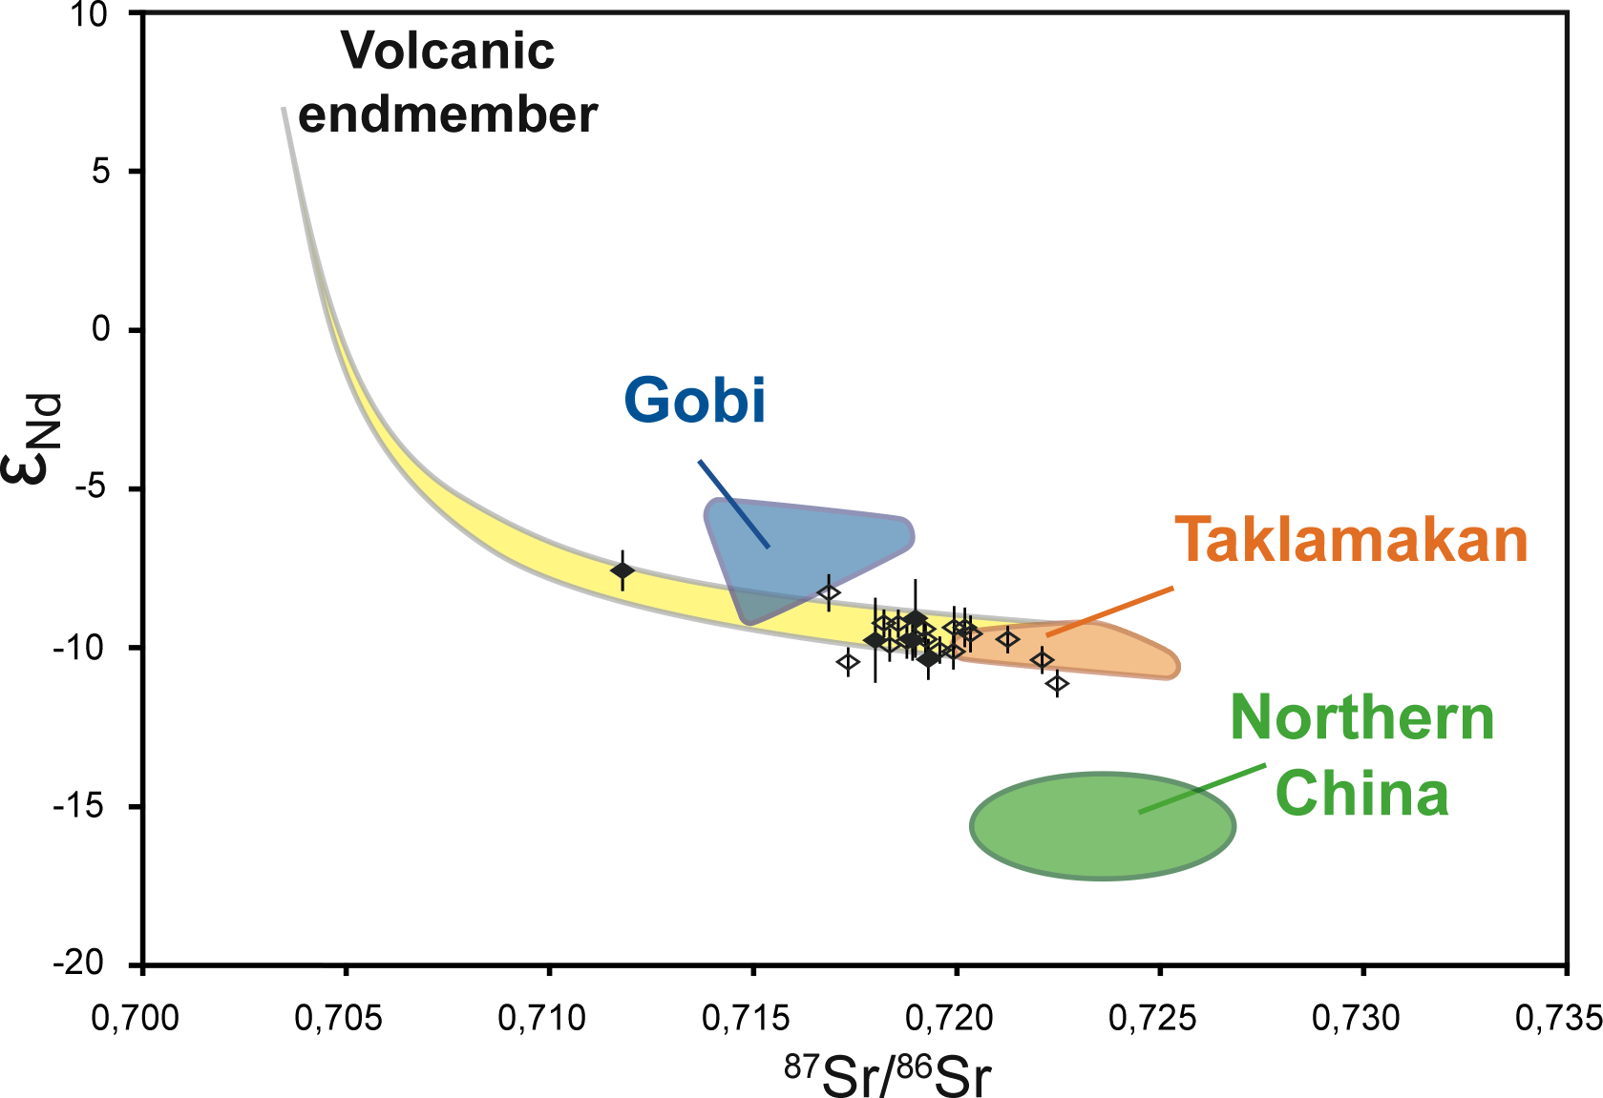
Notes:
A 10,000 km dust highway between the Taklamakan Desert and Greenland
Aloys J-M Bory
Figure 2: εNd versus 87Sr/86Sr signature of Greenland dust extracted from late glacial sections of the GISP2 (closed diamonds) and GRIP (open diamonds) ice core records (Biscaye et al. 1997; Svensson et al. 2000) and of potential source area samples from China and Mongolia (Bory et al. 2003b). The isotopic mixing domain between the Taklamakan desert and a circum-Pacific volcanic end-member is also shown.
AFFILIATIONS
Laboratoire d’Océanologie et Géosciences, University of Lille-1, France and Lamont-Doherty Earth Observatory of Columbia University, New York, USA
CONTACT
Aloys J-M Bory: Aloys.Bory@univ-lille1.fr

Slide 17
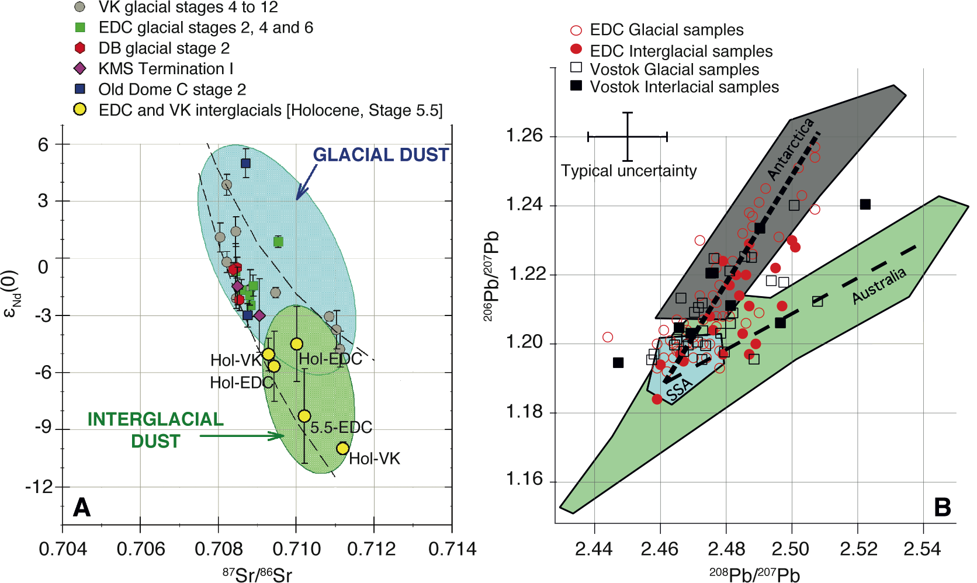
Notes:
The enigma of dust provenance: where else does Antarctic dust come from?
Paul Vallelonga
Figure 1: Strontium and Neodymium isotopes (A) and Lead isotopes (B) demonstrate changes in isotopic signature from glacial to interglacial periods. The identification of dust sources other than those of Southern South America is limited by measurement precision and the overlapping signatures of potential secondary dust source areas. Panel A modified from Delmonte et al. (2007). VK: Vostok; EDC: Epica Dome C; DB: Dome B; KMS: Komsomolskaya.
AFFILIATIONS
Centre for Ice and Climate, University of Copenhagen, Denmark
CONTACT
Paul Vallelonga: ptravis@nbi.ku.dk

Slide 18
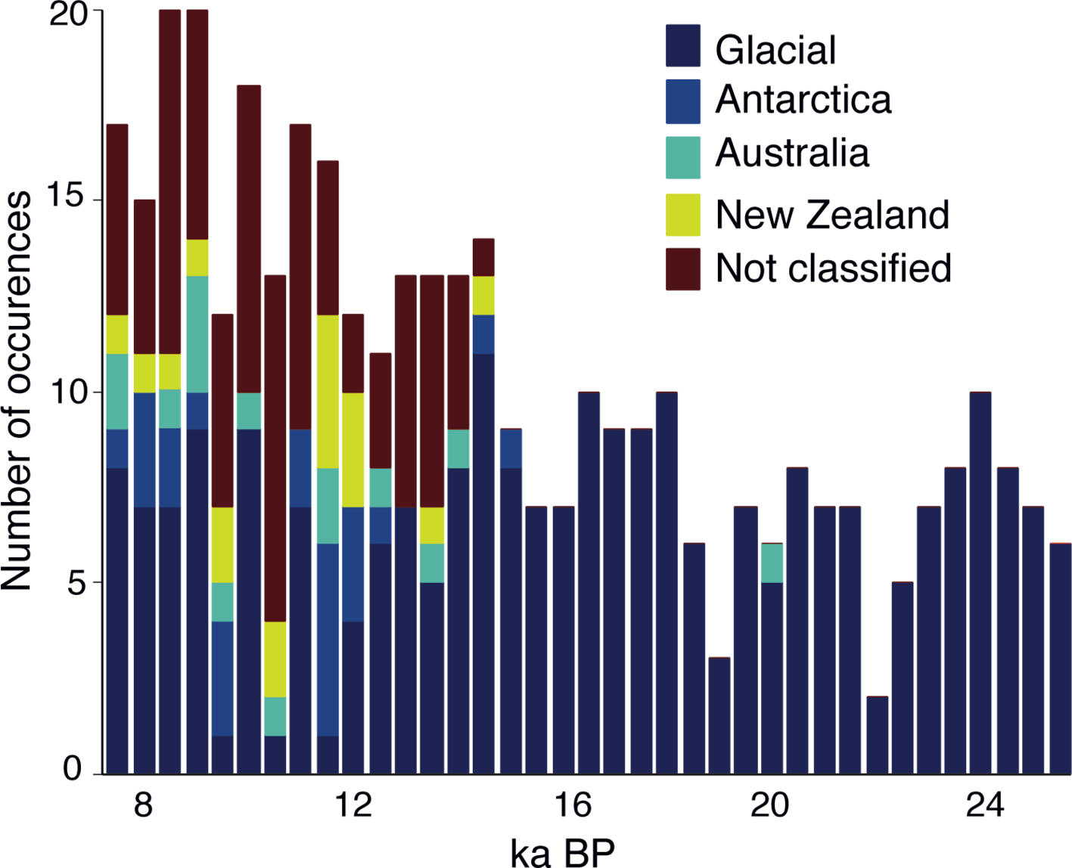
Notes:
The enigma of dust provenance: where else does Antarctic dust come from?
Paul Vallelonga
Figure 2: Histogram of REE patterns found in the EPICA Dronning Maud Land ice core over the last deglaciation, clearly demonstrating the appearance of non-glacial dust types after ~15 ka BP. REE patterns were statistically attributed to dust from Antarctica, Australia and New Zealand. Modified after Wegner et al. (2012).
AFFILIATIONS
Centre for Ice and Climate, University of Copenhagen, Denmark
CONTACT
Paul Vallelonga: ptravis@nbi.ku.dk

Slide 19
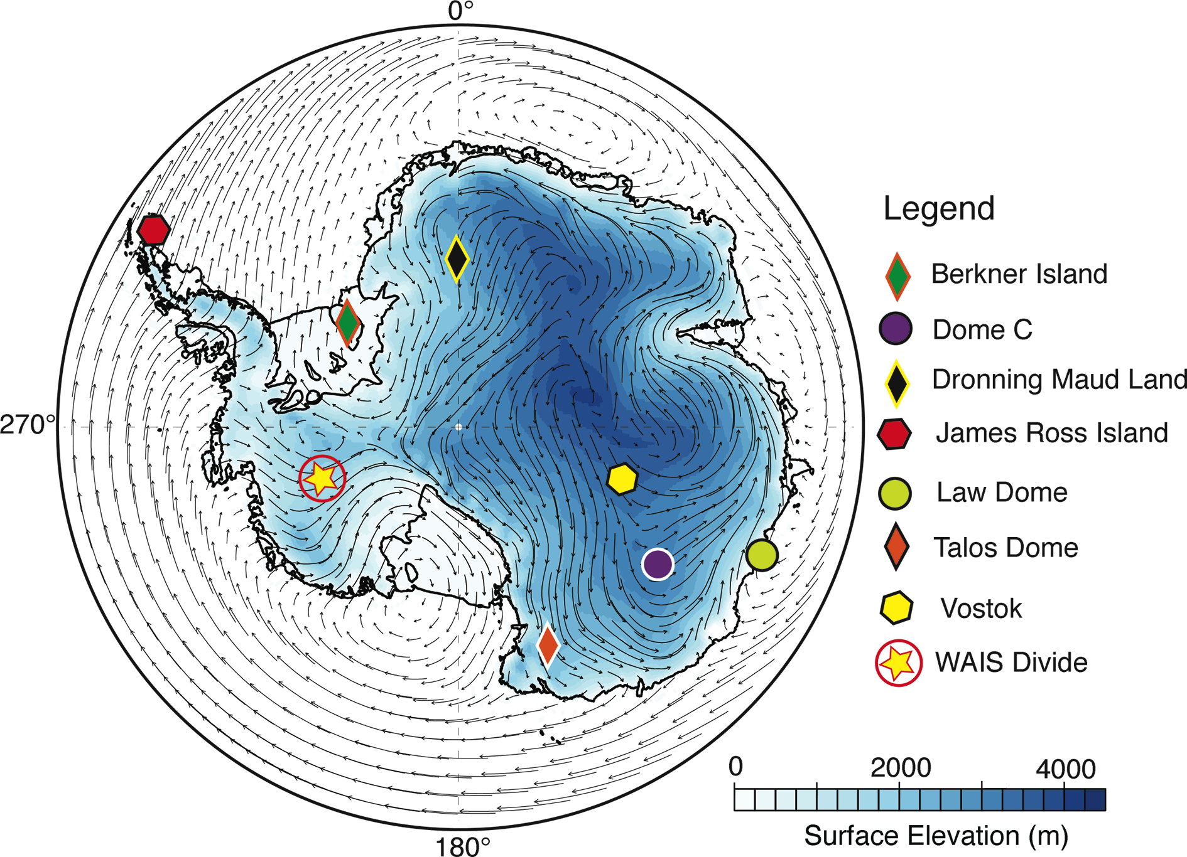
Notes:
Evidence that local dust sources supply low-elevation Antarctic regions
Bess G. Koffman1,2 and Karl J. Kreutz1
Figure 1: Surface elevation map of Antarctica showing sites discussed in the text and annual average winds at 700 hPa (ERA-Interim climate reanalysis). Image obtained using Climate Reanalyzer (http://cci-reanalyzer.org).
AFFILIATIONS
1School of Earth and Climate Sciences and the Climate Change Institute, University of Maine, Orono, USA
2Lamont-Doherty Earth Observatory of Columbia University, Palisades, USA
CONTACT
Bess G. Koffman: bkoffman@ldeo.columbia.edu

Slide 20
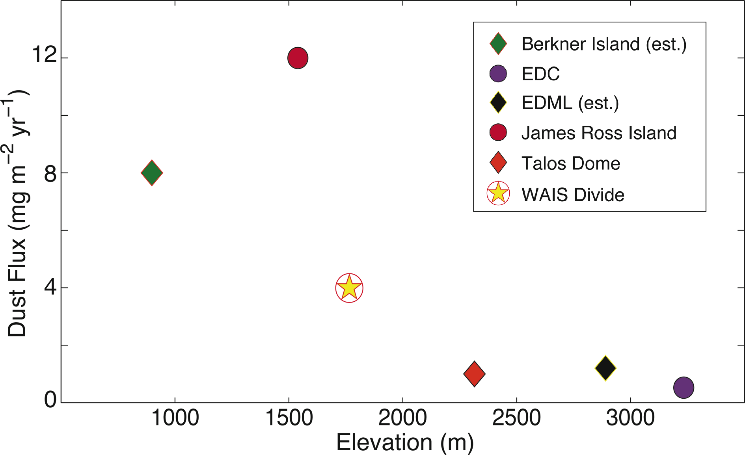
Notes:
Evidence that local dust sources supply low-elevation Antarctic regions
Bess G. Koffman1,2 and Karl J. Kreutz1
Figure 2: Dust flux versus elevation for: Berkner Island (Bory et al. 2010), EPICA Dome C(EDC; Lambert et al. 2012), EPICA Dronning Maud Land (EDML; Fischer et al. 2007), James Ross Island (McConnell et al. 2007), Talos Dome (Albani et al. 2012) and WAIS Divide (Koffman et al. 2014). Flux values for EDML and Berkner Island are estimated based on published flux ratios to other sites and available particle size information.
AFFILIATIONS
1School of Earth and Climate Sciences and the Climate Change Institute, University of Maine, Orono, USA
2Lamont-Doherty Earth Observatory of Columbia University, Palisades, USA
CONTACT
Bess G. Koffman: bkoffman@ldeo.columbia.edu

Slide 21
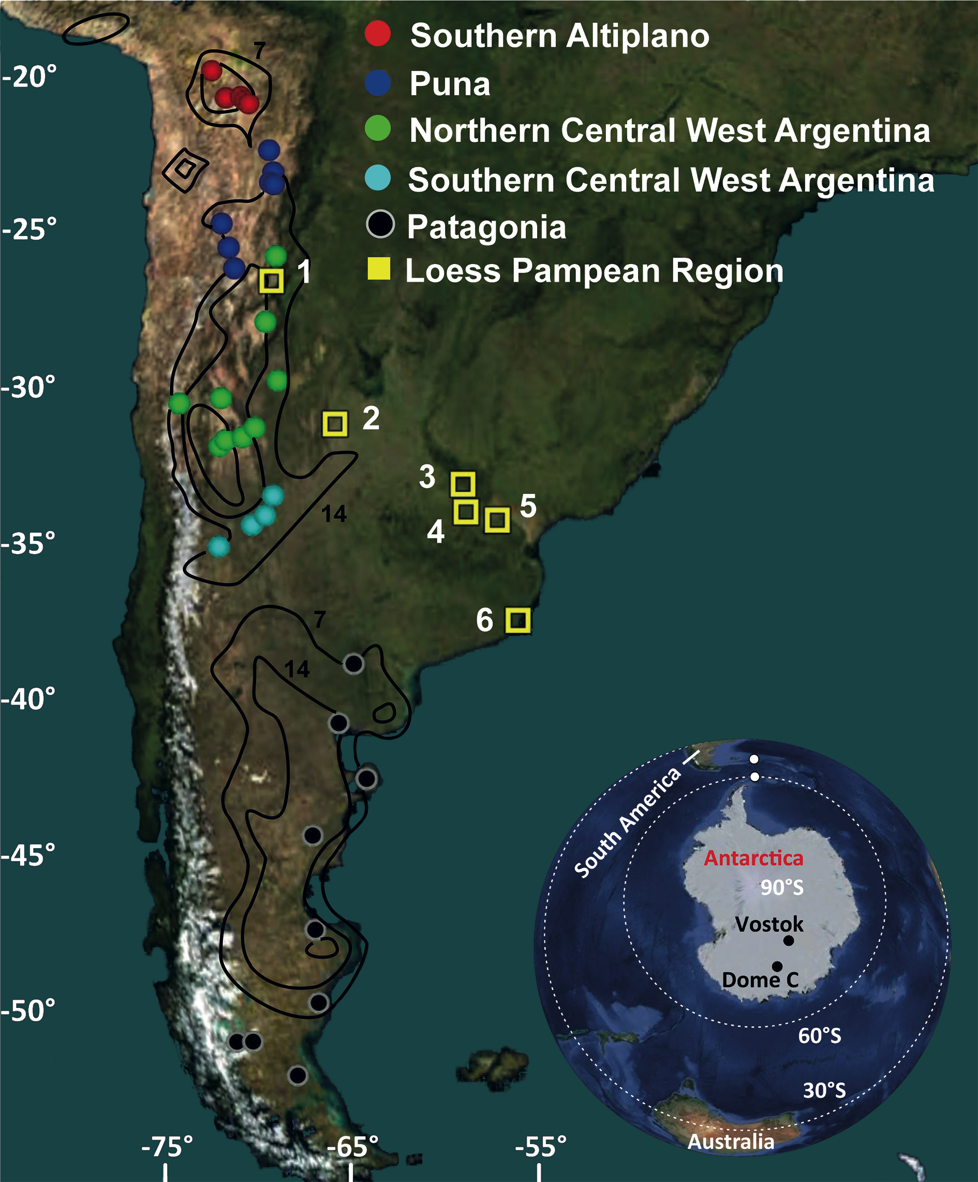
Notes:
South American dust signature in geological archives of the Southern Hemisphere
Stefania Gili and Diego M. Gaiero
Figure 1: Location of the main present-day dust sources in southern South America (black lines show the number of days with dust activity during a year; adapted from Prospero et al. 2002). Color dots indicate the position of collected surface sediments used to define the rare earth elements signature regions as shown in Figure 2. Yellow squares show the position of proximal aeolian (loess) records across the Pampas (Smith et al. 2003; Gallet et al. 1998). Inset: Distal aeolian records. Scotia Sea (white dots; Diekmann et al. 2000), and Vostock and Epica Dome C(black dots; EPICA community members 2006).
AFFILIATIONS
Center for Earth Science Research, National University of Cordoba, Argentina
CONTACT
Stefania Gili: sgili@efn.uncor.edu

Slide 22
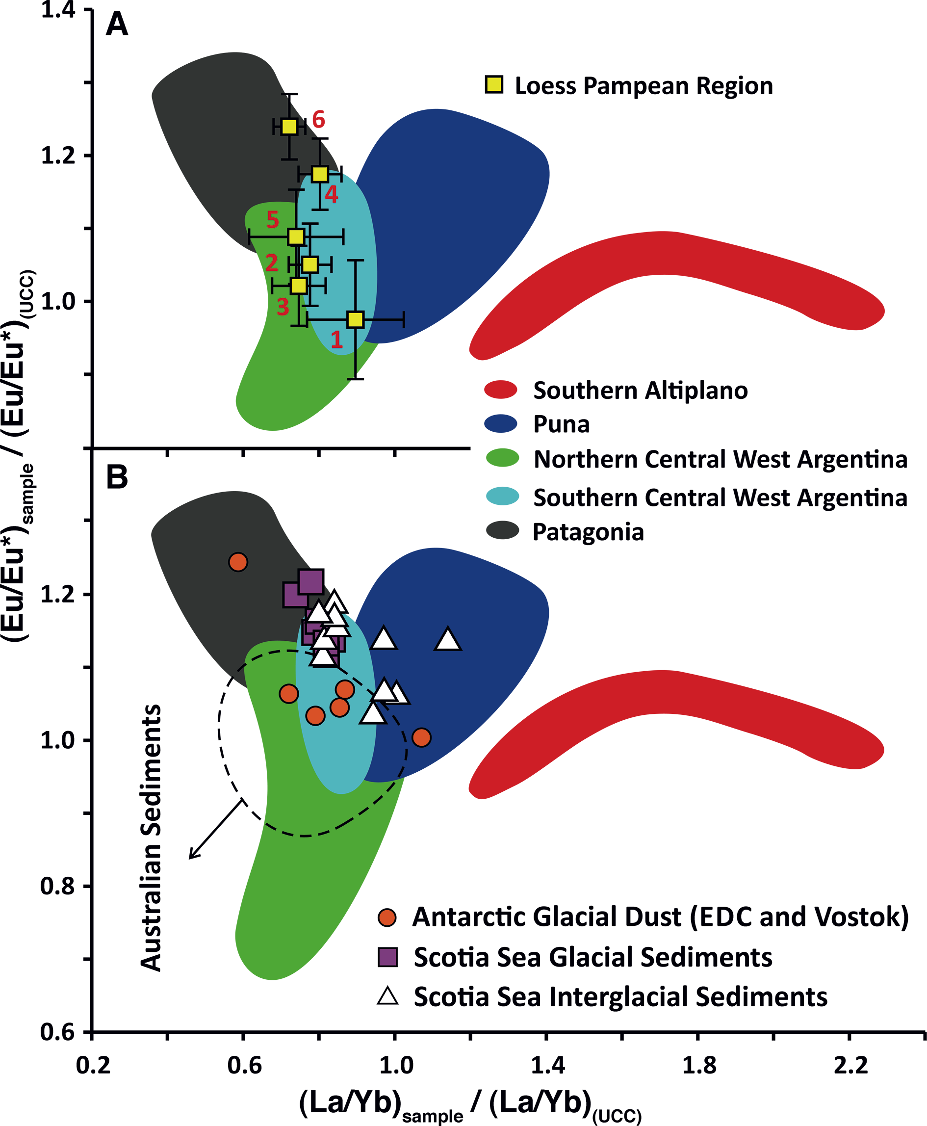
Notes:
South American dust signature in geological archives of the Southern Hemisphere
Stefania Gili and Diego M. Gaiero
Figure 2: (A) Colored areas represent the rare earth elements (REEs) signature of the main potential dust sources in southern South America as inferred from surface sediments (Fig. 1). The yellow squares show the chemical composition of Pampean loess sequences (1, 2, 3, 5 and 6 from Smith et al. 2003; 4 from Gallet et al. 1998). (B) Comparison with distal geological records: sediments from the Scotia Sea and dust from East Antarctica (Basile et al. 1997; Diekmann et al. 2000). Autstralian sediments data from Gingele et al. 2007.
AFFILIATIONS
Center for Earth Science Research, National University of Cordoba, Argentina
CONTACT
Stefania Gili: sgili@efn.uncor.edu

Slide 23
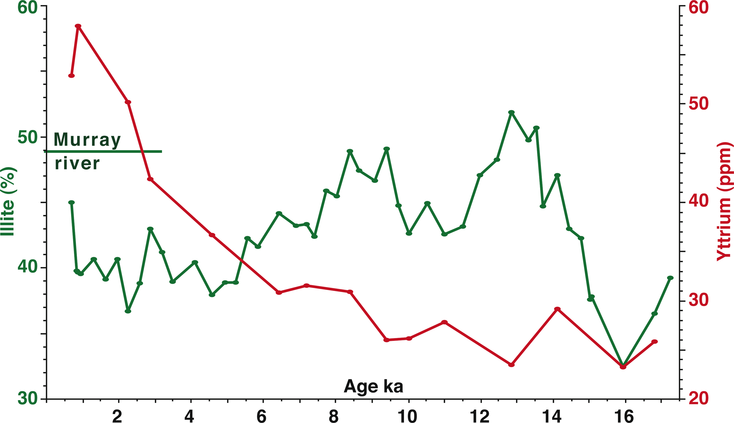
Notes:
Fingerprinting aeolian dust in marine sediment: examples from Australia
Patrick De Deckker
Figure 1: Illite and yttrium concentrations in sediment core MD03-2611 offshore Kangaroo Island for the last 17 ka. The horizontal line shows the illite percentage at the mouth of the Murray River today. The two illite peaks around 14-12 ka and 10-8 ka represent significant water discharge from the eastern highlands of SE Australia. The yttrium increase shows a change to predominantly aeolian sediment supply after 6 ka.
AFFILIATIONS
Research School of Earth Sciences, The Australian National University, Canberra, Australia
CONTACT
Patrick De Deckker: patrick.dedeckker@anu.edu.au

Slide 24
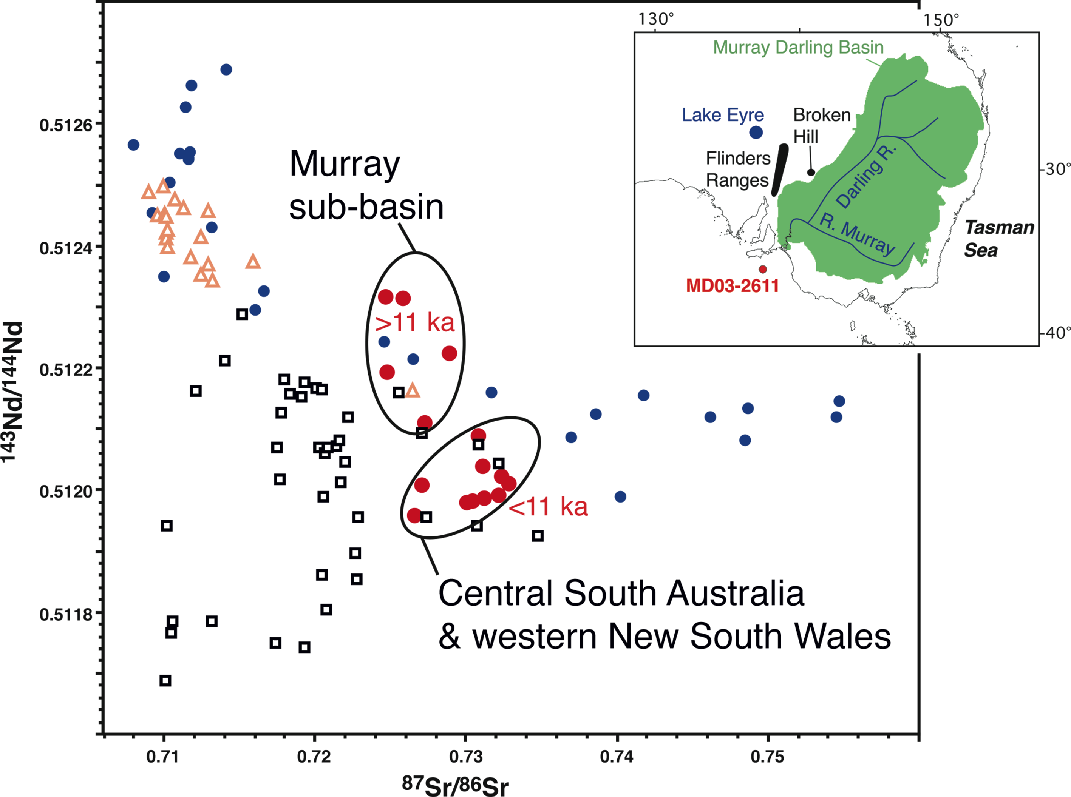
Notes:
Fingerprinting aeolian dust in marine sediment: examples from Australia
Patrick De Deckker
Figure 2: Plot of Sr and Nd isotopes for sediment core MD03-2611 (red dots) and from regolith samples in eastern and central Australia that are considered potential sources of airborne dust. Blue dots represent tributaries of the River Murray and Darling River. The Nd isotopic ratios above 0.51255 pertain to Darling River tributaries that share similarities with samples from the Lake Eyre region (orange triangles). Black squares represent samples from west and east of the Flinders Ranges and from western New South Wales near Broken Hill. The samples aged >11 ka BP come from the Murray sub-basin and would have been transported to the core site by water (thus being river borne), whereas the younger samples come from central South Australia and western New South Wales, and are considered to have been airborne, being from outside the Murray Darling Basin.
AFFILIATIONS
Research School of Earth Sciences, The Australian National University, Canberra, Australia
CONTACT
Patrick De Deckker: patrick.dedeckker@anu.edu.au

Slide 25
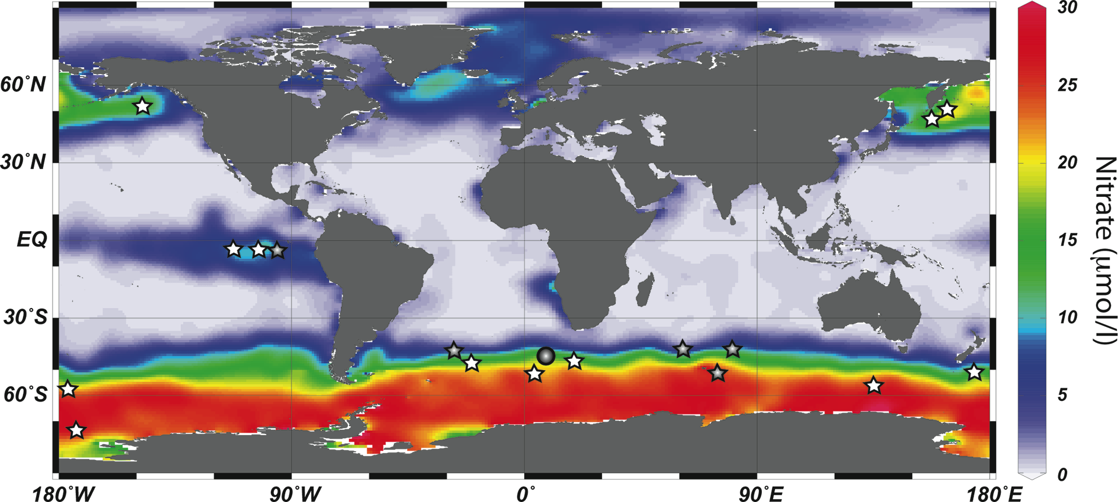
Notes:
Iron fertilization in the glacial ocean
Alfredo Martínez-García1 and Gisela Winckler2
Figure 1: World ocean surface nitrate concentrations from the World Ocean Atlas (Garcia et al. 2010) indicating the three high-nutrient, low-chlorophyll (HNLC) areas (Southern Ocean, equatorial Pacific, Subarctic North Pacific). The gray circle marks the location of ODP Site 1090 and the stars mark locations where iron fertilization experiments (white stars) and iron enrichment experiments (gray stars) have been performed (Blain et al. 2007; Boyd et al. 2007; Smetacek et al. 2012).
AFFILIATIONS
1Geological Institute, ETH Zurich, Switzerland
2Lamont-Doherty Earth Observatory, Columbia University, Palisades, USA and Department of Earth and Environmental Sciences, Columbia University, New York, USA
CONTACT
Alfredo Martínez-García: alfredo.martinez-garcia@erdw. ethz.ch

Slide 26
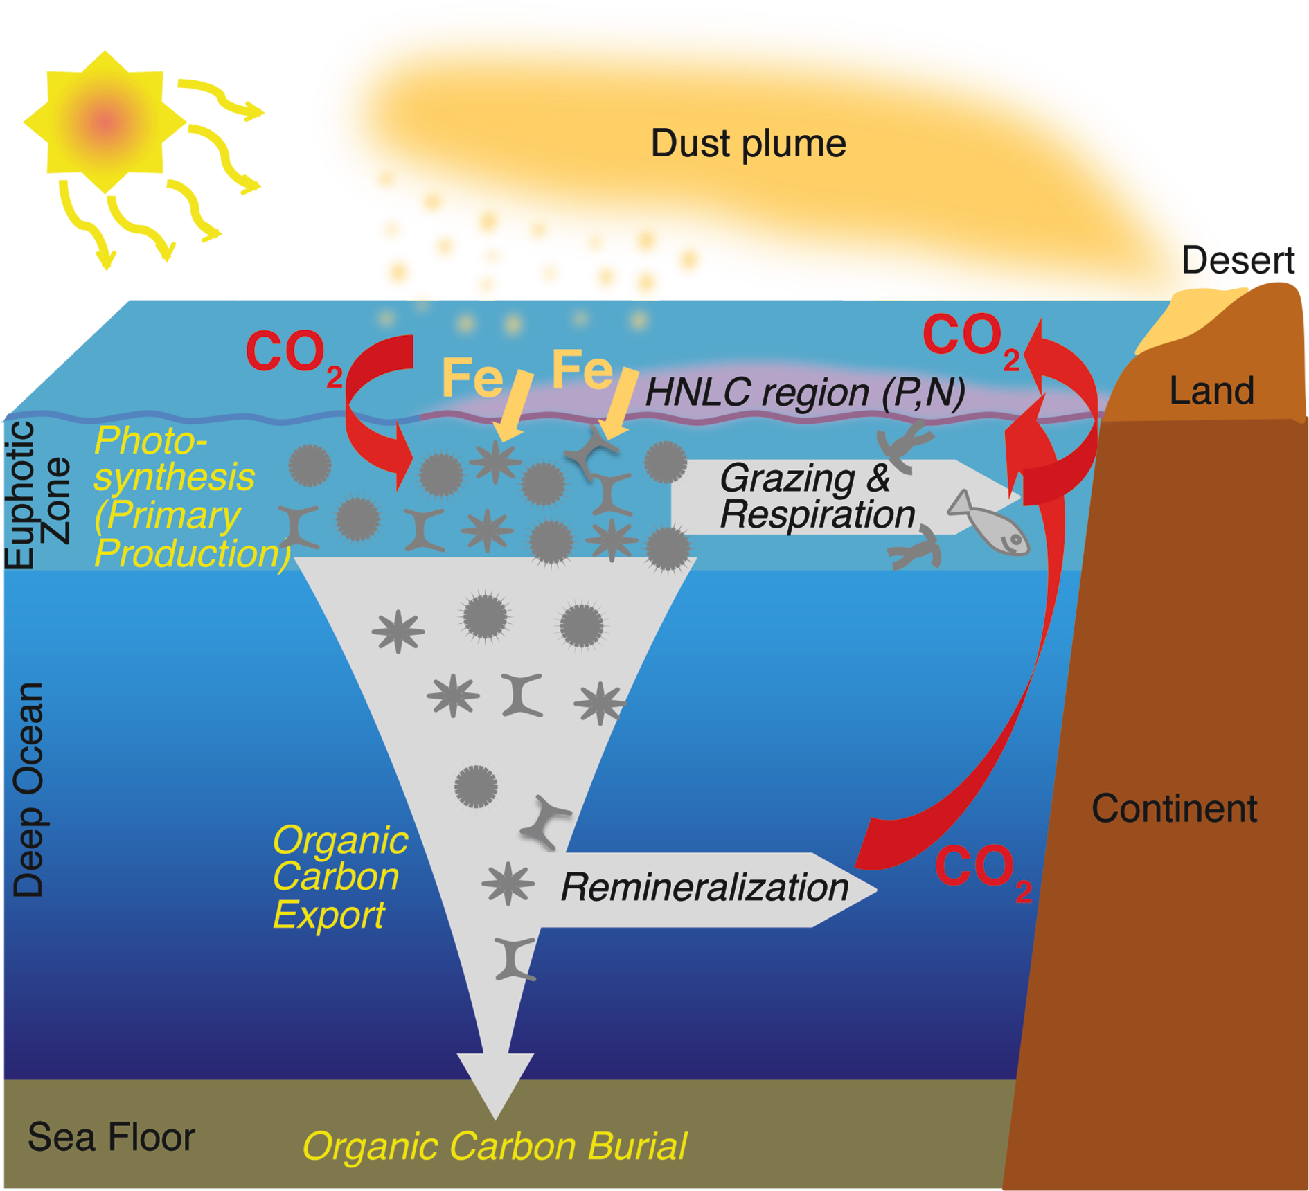
Notes:
Iron fertilization in the glacial ocean
Alfredo Martínez-García1 and Gisela Winckler2
Figure 2: Schematic representation of the iron fertilization process.
AFFILIATIONS
1Geological Institute, ETH Zurich, Switzerland
2Lamont-Doherty Earth Observatory, Columbia University, Palisades, USA and Department of Earth and Environmental Sciences, Columbia University, New York, USA
CONTACT
Alfredo Martínez-García: alfredo.martinez-garcia@erdw. ethz.ch

Slide 27
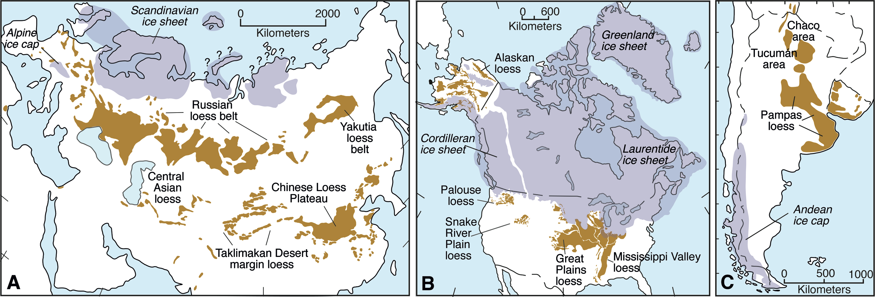
Notes:
Loess as a Quaternary paleoenvironmental indicator
Daniel R. Muhs1, M.A. Prins2 and B. Machalett3
Figure 1: Distribution of loess in (A) Eurasia, (B) North America and (C) South America. Redrawn from Muhs (2013) and Muhs et al. (2014), and sources therein.
AFFILIATIONS
1US Geological Survey, Denver, USA
2Faculty of Earth and Life Sciences, VU University Amsterdam, the Netherlands
3Institute of Geography, Humboldt-Universität zu Berlin, Germany and Department of Natural and Applied Sciences, Bentley University, Waltham, USA
CONTACT
Daniel R. Muhs: dmuhs@usgs.gov

Slide 28
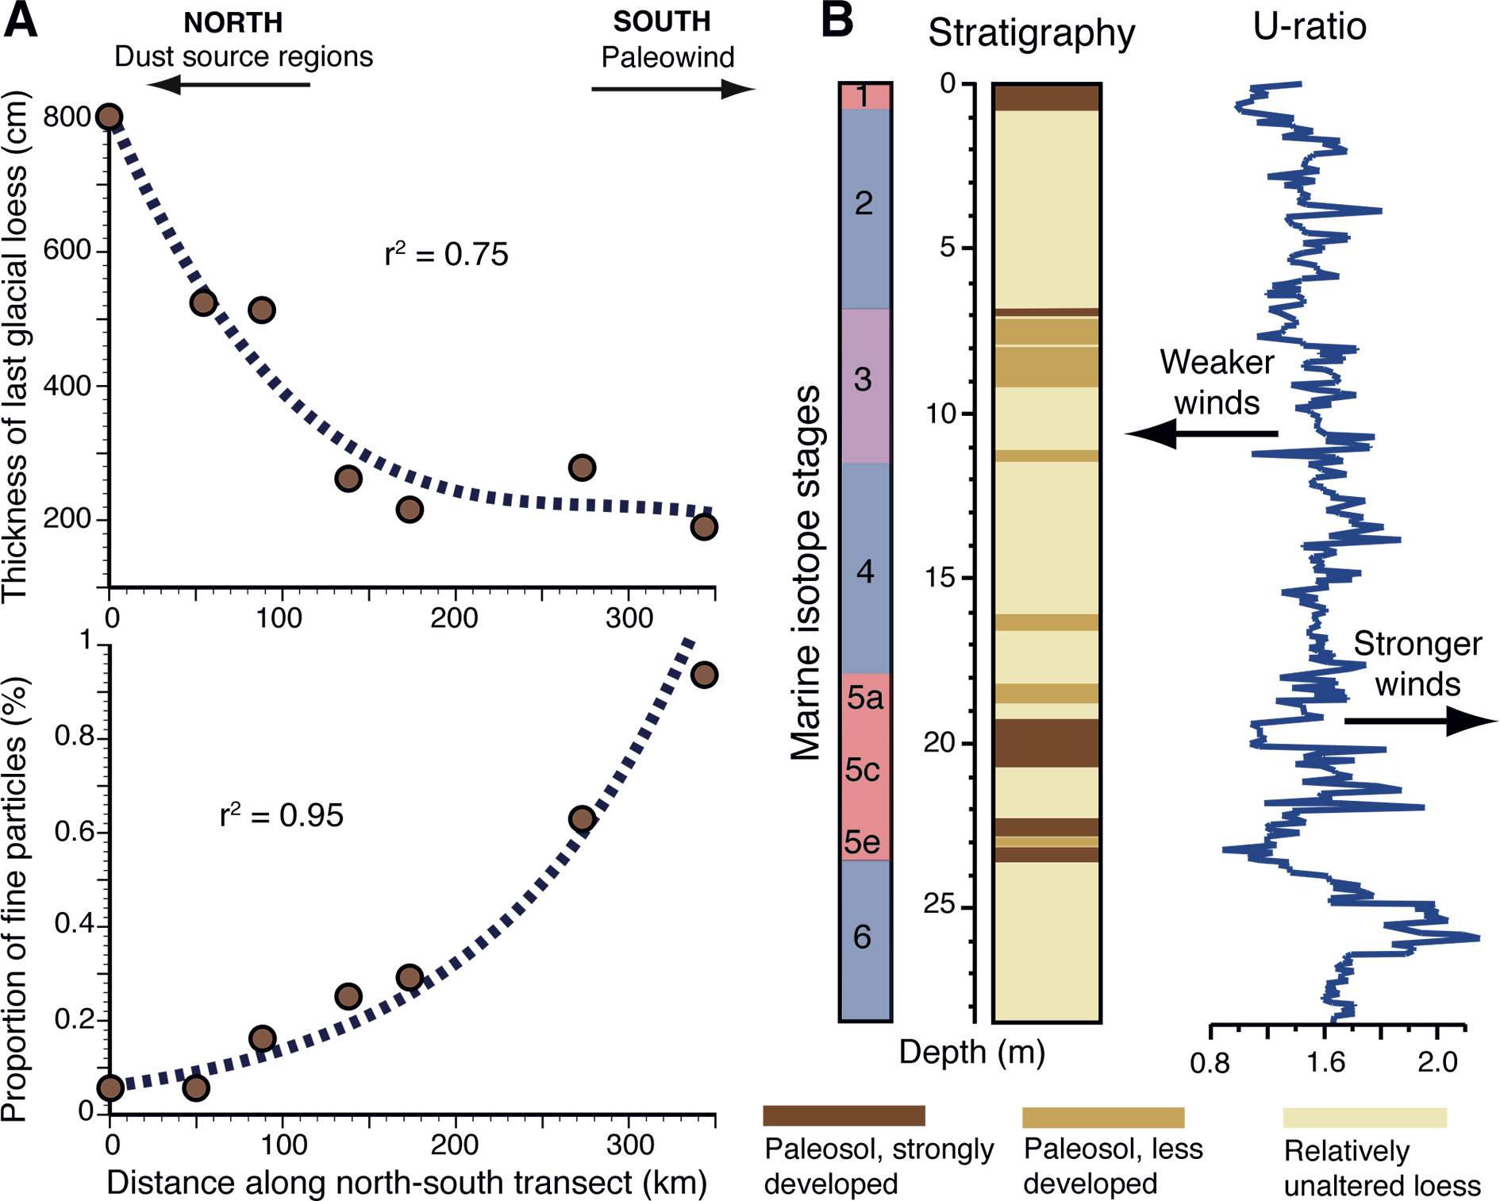
Notes:
Loess as a Quaternary paleoenvironmental indicator
Daniel R. Muhs1, M.A. Prins2 and B. Machalett3
Figure 2: (A) Trends in thickness (upper plot) and abundance of fine silt particles (modal size of ~22 μm; lower plot) shown as a function of distance along a north-south transect in the Loess Plateau region of China, for last-glacial-aged loess (unit L1-1 in the Chinese loess stratigraphic system). Redrawn from data in Prins and Vriend (2007). (B) Stratigraphy of loess deposited during the past two glacial periods and ratio of coarse-plus-medium silt to fine silt (the "U-ratio") at a thick loess section at Remisowka, Kazakhstan. Note that while loess sedimentation occurs at a greatly diminished rate during interglacial or interstadial periods, allowing soil formation, it does not cease completely. Redrawn from data in Machalett et al. (2008).
AFFILIATIONS
1US Geological Survey, Denver, USA
2Faculty of Earth and Life Sciences, VU University Amsterdam, the Netherlands
3Institute of Geography, Humboldt-Universität zu Berlin, Germany and Department of Natural and Applied Sciences, Bentley University, Waltham, USA
CONTACT
Daniel R. Muhs: dmuhs@usgs.gov

Slide 29
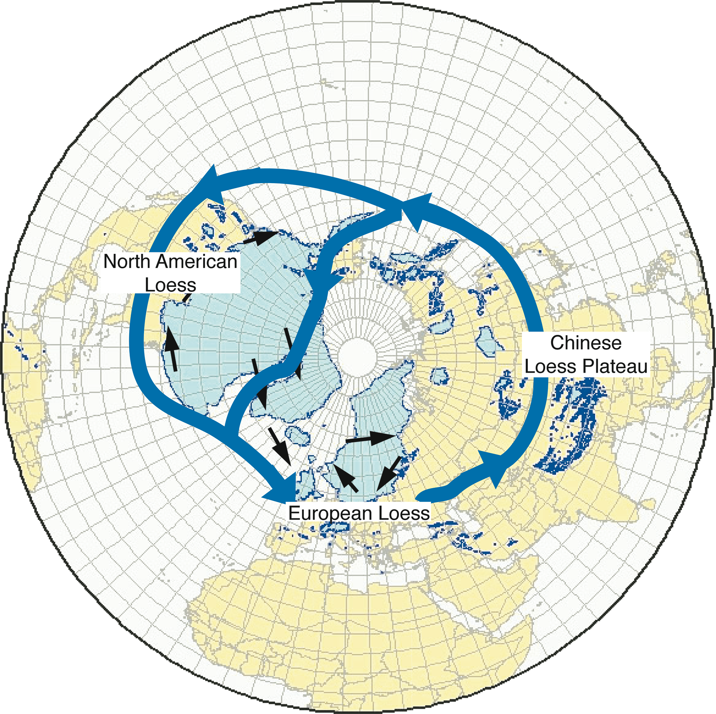
Notes:
Abrupt climate changes recorded in loess sequences
Denis-Didier Rousseau1,2 and Adriana Sima1
Figure 1: The Northern Hemisphere ice-sheets (in light blue) and glaciers (dark blue dots) at the Last Glacial Maximum (map compiled by Jürgen Ehlers, available at www.qpg.geog.cam.ac.uk/lgmextent.html), the schematic location of the polar jet stream (blue arrows), wind patterns (black arrows) generated by the presence of the ice sheets (Kutzbach 1987), and (labeled) the loess regions discussed in the text.
AFFILIATIONS
1Laboratoire de Météorologie Dynamique & CERES-ERTI, CNRS - Ecole Normale Supérieure, Paris, France
2Lamont-Doherty Earth Observatory of Columbia University, Palisades, USA
CONTACT
Denis-Didier Rousseau: denis.rousseau@lmd.ens.fr

Slide 30
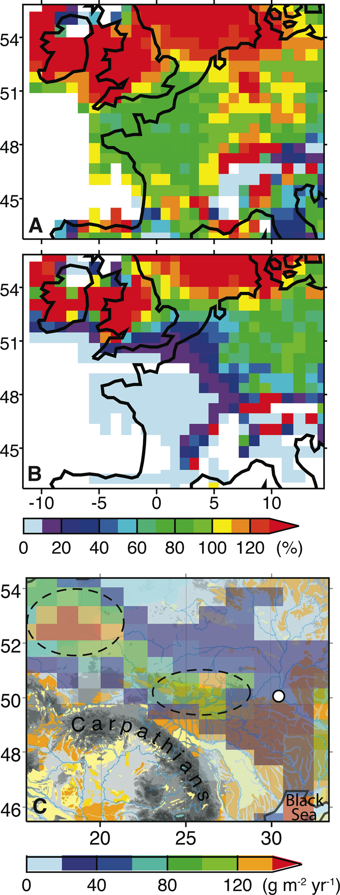
Notes:
Abrupt climate changes recorded in loess sequences
Denis-Didier Rousseau1,2 and Adriana Sima1
Figure 2: (A) Simulated dust emission fluxes for Western Europe for a “Greenland interstadial” (GIS) are relatively close to those for a “Greenland stadial” (GS) when the GIS and GS fluxes are computed without taking the vegetation effect into account (GIS/GS flux ratio between 70-130%); (B) the flux ratio GIS/GS strongly decreases when the vegetation effect of inhibiting eolian erosion is taken into account (modified from Sima et al. 2009). (C) Simulated dust emission fluxes for Eastern Europe for a GIS, superimposed on a topographic map; the most active spots (indicated with dotted lines) have probably been important sources for some Eastern European loess deposits (in yellow, in background), such as those around Stayky (white dot) in NW Ukraine (modified from Sima et al. 2013).
AFFILIATIONS
1Laboratoire de Météorologie Dynamique & CERES-ERTI, CNRS - Ecole Normale Supérieure, Paris, France
2Lamont-Doherty Earth Observatory of Columbia University, Palisades, USA
CONTACT
Denis-Didier Rousseau: denis.rousseau@lmd.ens.fr

Slide 31
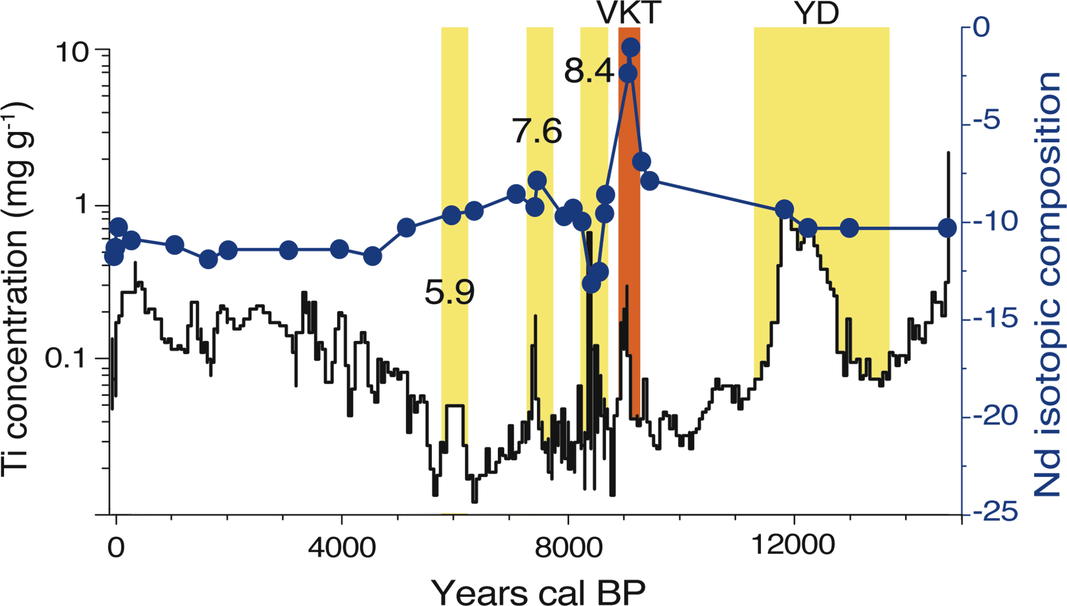
Notes:
Extracting paleodust information from peat geochemistry
François De Vleeschouwer1,2, M. Ferrat3, H. McGowan4, H. Vanneste1,2 and D. Weiss3
Figure 1: Ti concentration and Nd isotopic composition (εNd) in a bog profile in Switzerland. The Younger Dryas (YD) is characterized by an increase in local dust input, reflected by high Ti concentrations. Early Holocene Vasset-Kilian eruptions (VKT) in the French Massif Central result in high εNd. Saharan dust input is identified by negative εNd around 8.4 ka. The progressive desertification of the Sahara during the Holocene decreases εNd progressively from 7.5 to 3.5 ka cal BP, when local erosion becomes dominant. The two dust peaks (yellow bars) at 5.9 and 7.6 ka remain unexplained. Modified from Le Roux et al. 2012.
AFFILIATIONS
1EcoLab (Laboratory for Functional Ecology and Environment), Université de Toulouse, INP, UPS, ENSAT, Castanet Tolosan, France
2EcoLab, CNRS, Castanet Tolosan, France
3Department of Earth Sciences and Engineering, Imperial College London, London, UK.
4Climate Research Group, The University of Queensland, Brisbane, Australia
CONTACT
François De Vleeschouwer: francois.devleeschouwer@ ensat.fr

Slide 32
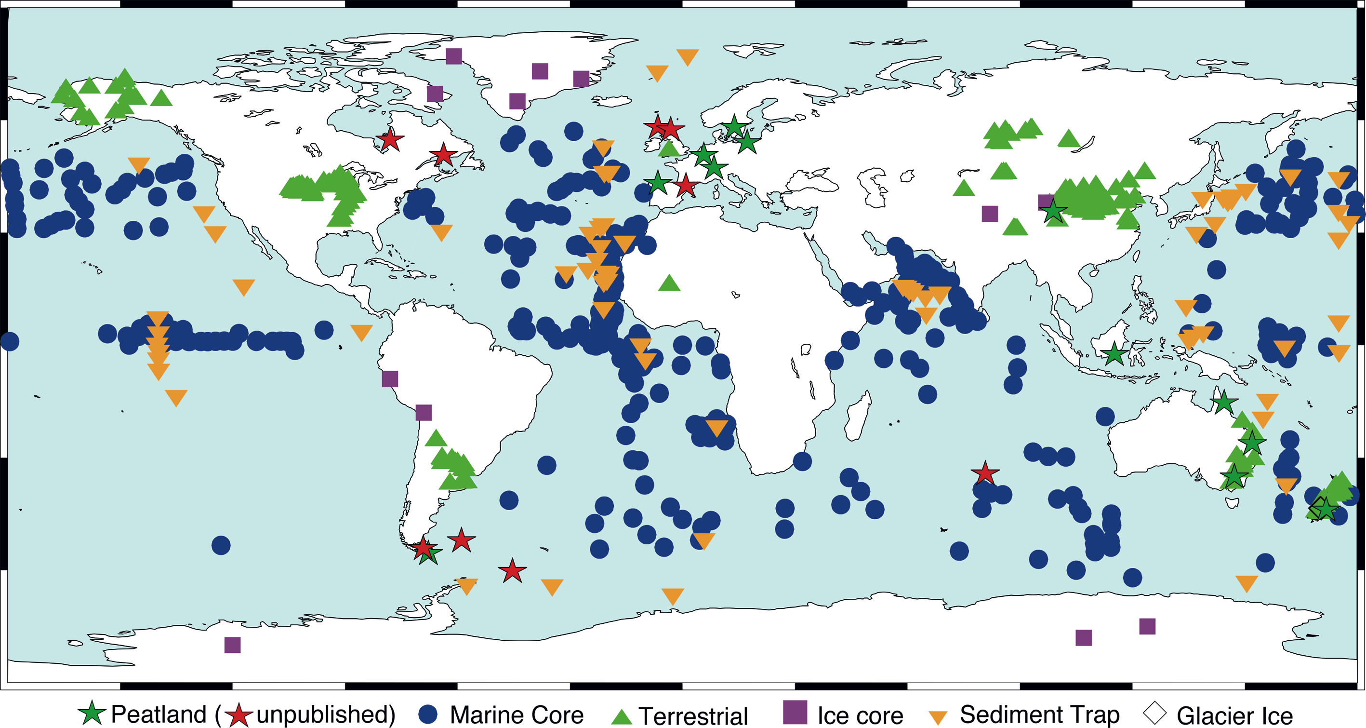
Notes:
Extracting paleodust information from peat geochemistry
François De Vleeschouwer1,2, M. Ferrat3, H. McGowan4, H. Vanneste1,2 and D. Weiss3
Figure 2: World coverage of dust records in peat, including already published peatland records (green stars) and ongoing works (red stars). Map drawn from Kohfeld and Tegen (2007), Mahowald et al. (2006) and Kohfeld and Harrison (2001).
AFFILIATIONS
1EcoLab (Laboratory for Functional Ecology and Environment), Université de Toulouse, INP, UPS, ENSAT, Castanet Tolosan, France
2EcoLab, CNRS, Castanet Tolosan, France
3Department of Earth Sciences and Engineering, Imperial College London, London, UK.
4Climate Research Group, The University of Queensland, Brisbane, Australia
CONTACT
François De Vleeschouwer: francois.devleeschouwer@ ensat.fr

Slide 33
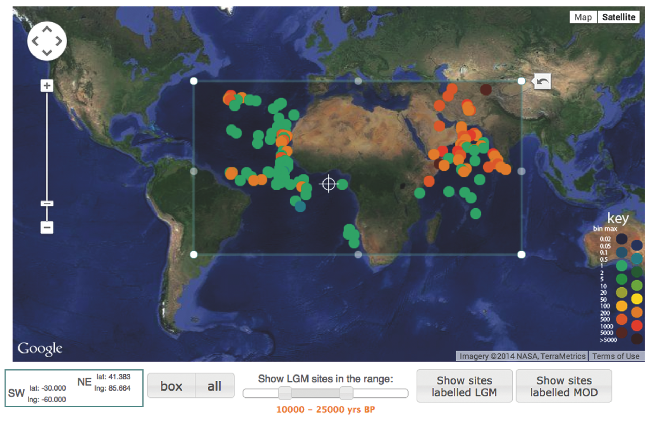
Notes:
DIRTMAP: development of a web-based dust archive
Barbara A. Maher and David T. Leedal
Figure 1: Detail from DIRTMAP4 website showing map and querying controls.
AFFILIATIONS
Centre for Environmental Magnetism & Palaeomagnetism, Lancaster University, UK
CONTACT
Barbara A. Maher: b.maher@lancaster.ac.uk

Slide 34
Notes:
Share your geoscience resources in EarthCube's Paleogeoscience Catalog
David Anderson, K. Horlick and R. Lingo
AFFILIATIONS
World Data Center for Paleoclimatology, NOAA's National Climatic Data Center, Boulder, USA
CONTACT
Kaleb Horlick: kaleb.horlick@noaa.gov

Slide 35
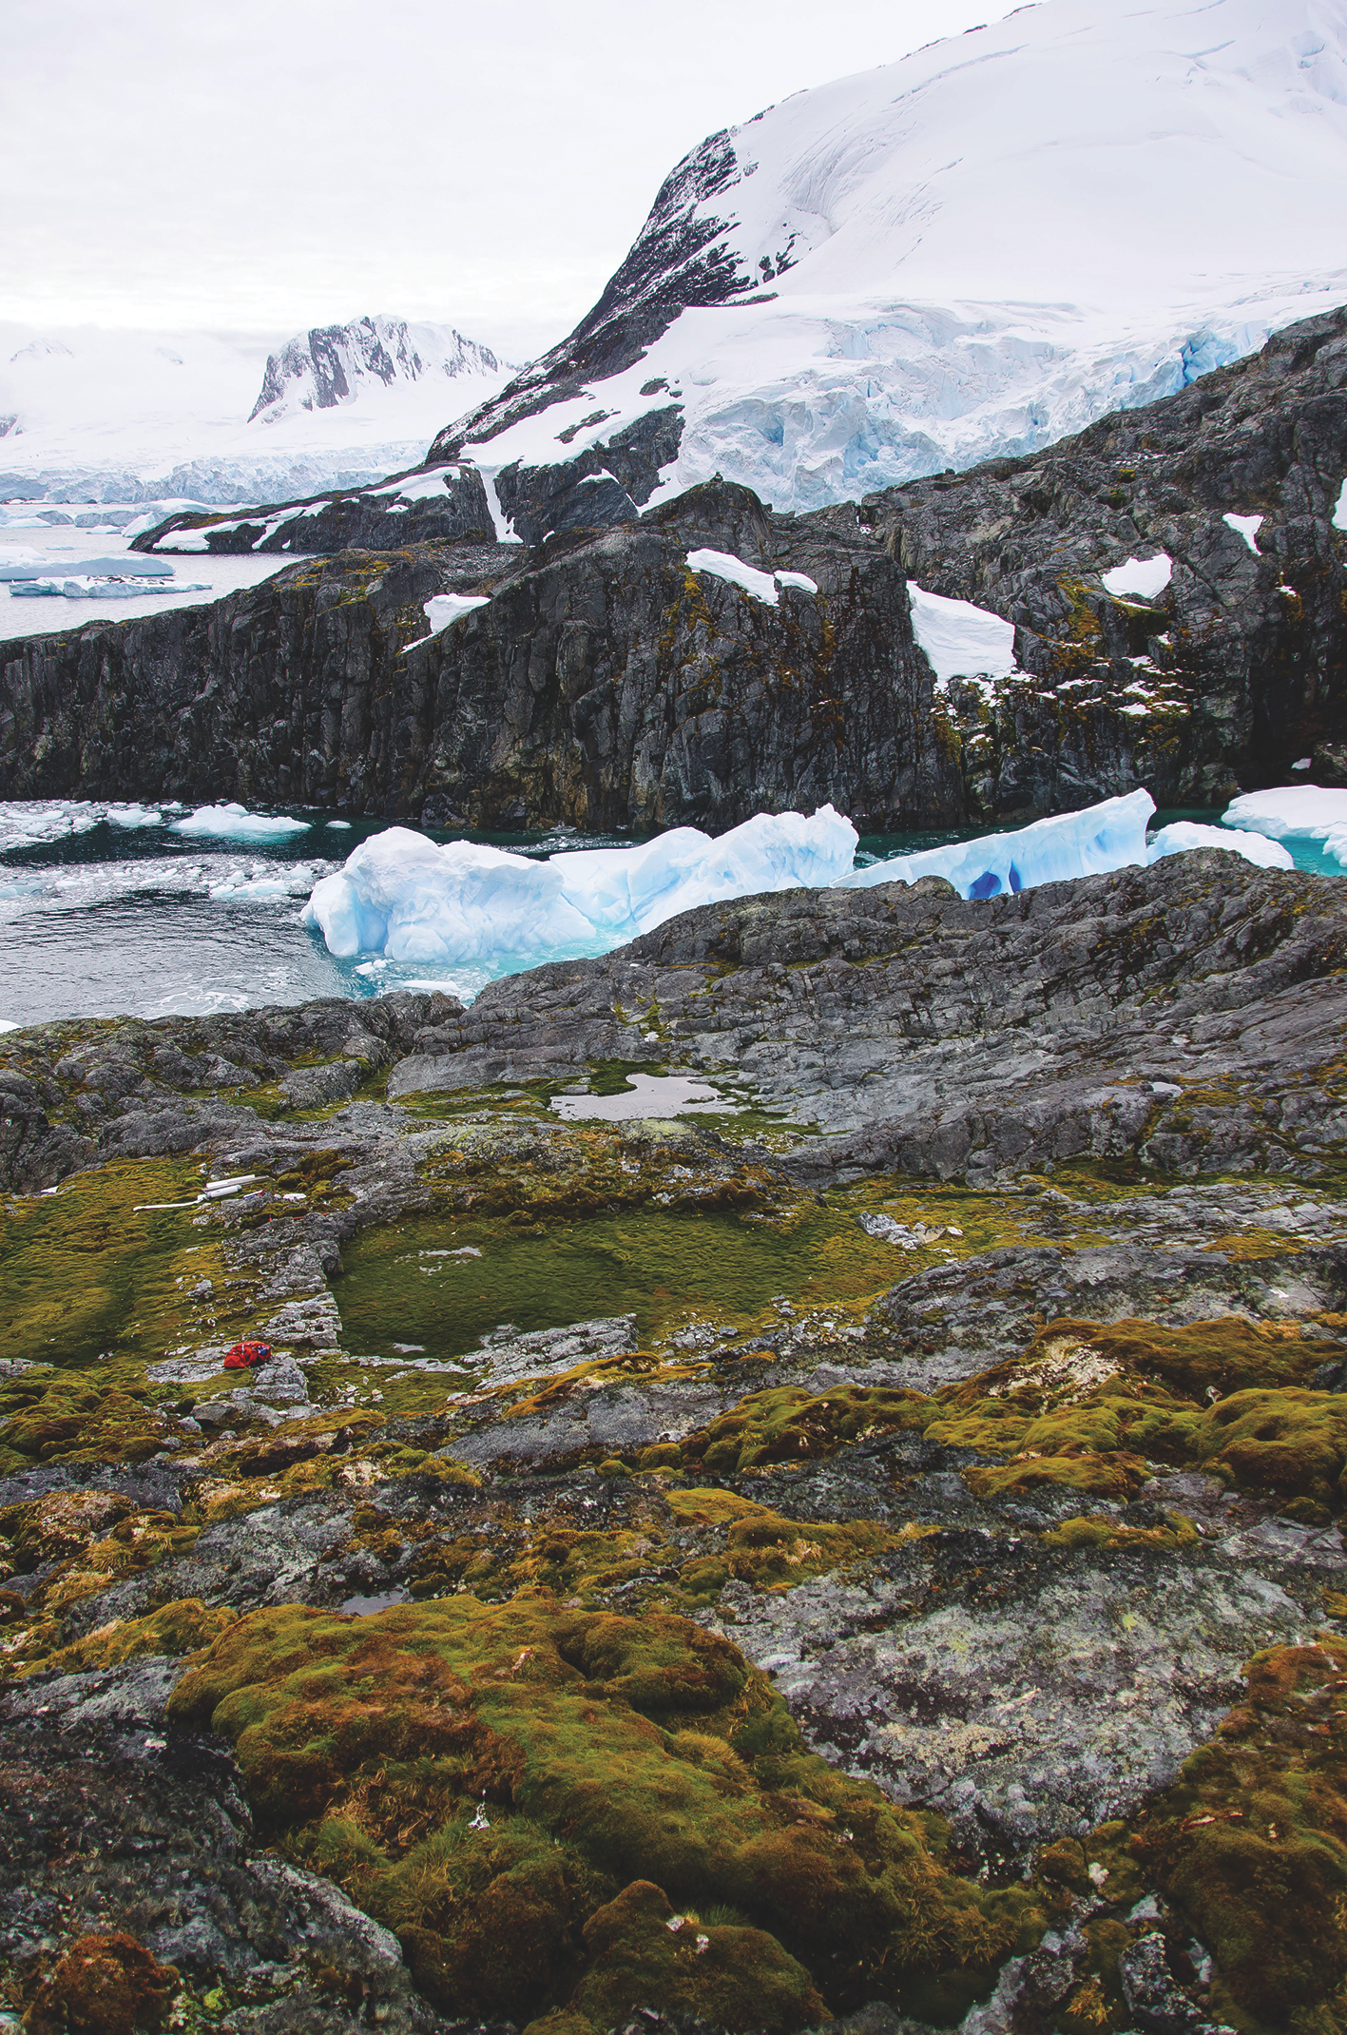
Notes:
Carbon in Peat on EArth through Time (C-PEAT)
Zicheng Yu1, D. Charman2, D.W. Beilman3, V. Brovkin4 and D.J. Large5
Figure 1: Peat-accumulating systems in Antarctica. Two waterlogged “peatlands” (center left) and aerobic moss peatbanks (foreground) at Rasmussen Hut on mainland Antarctic Peninsula around 65°S (photo by Zicheng Yu, February 2014).
AFFILIATIONS
1Department of Earth and Environmental Sciences, Lehigh University, Bethlehem, USA
2School of Geography, University of Exeter, UK
3Department of Geography, University of Hawaii at Manoa, Honolulu, USA
4Max Planck Institute for Meteorology, Hamburg, Germany
5Department of Chemical and Environmental Engineering, University of Nottingham, UK
CONTACT
Zicheng Yu: ziy2@lehigh.edu

Slide 36
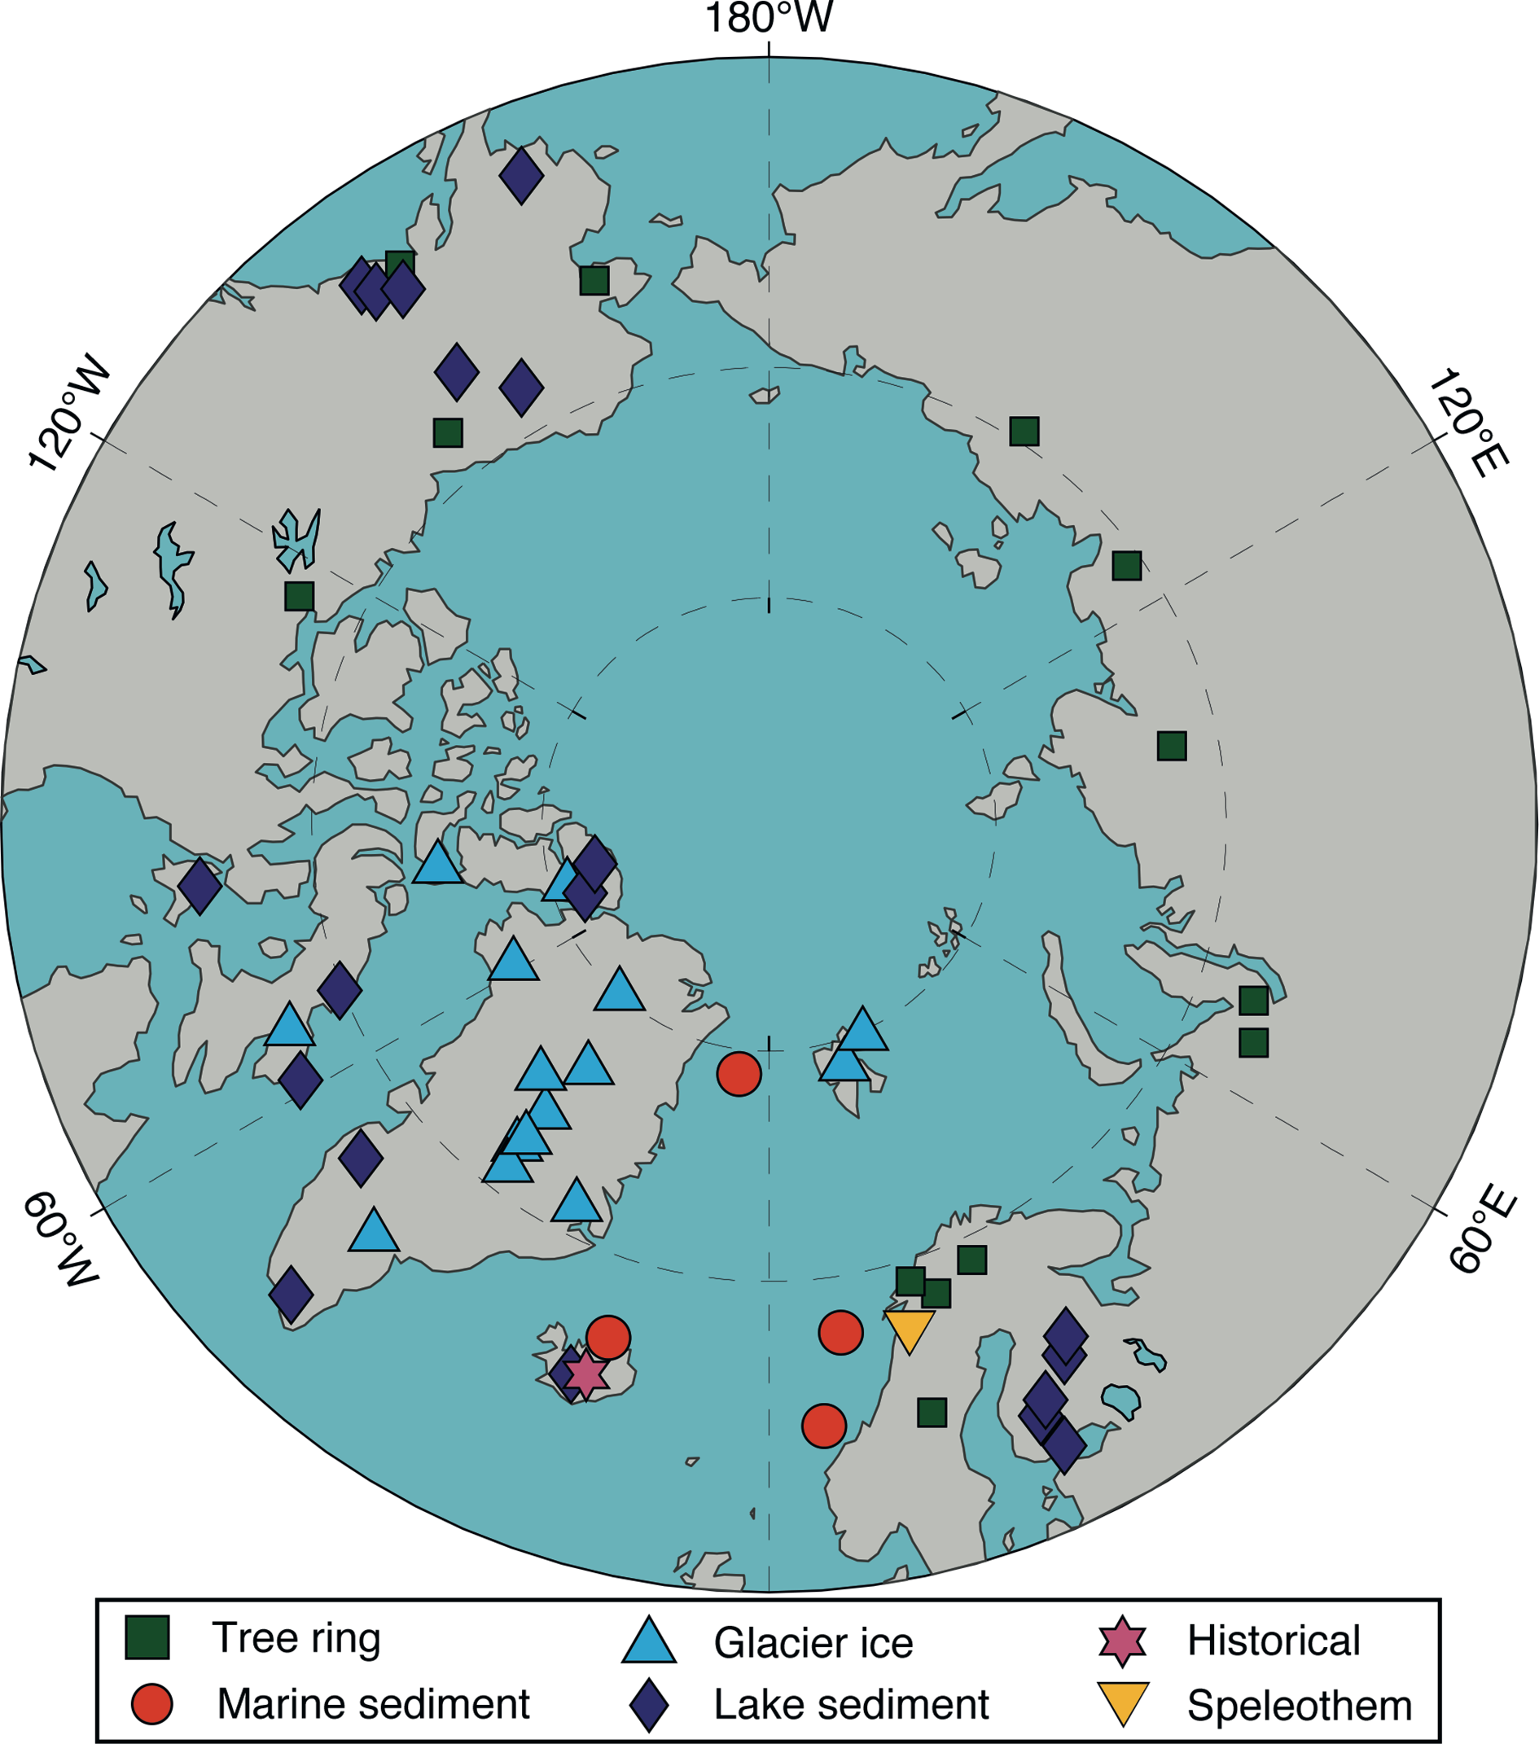
Notes:
The quest for temperature and hydroclimate records
Anne Hormes1 and Jostein Bakke2
Figure 1: Map of the Arctic showing the location and type of temperature proxy records in the PAGES Arctic2k database. Modified from McKay and Kaufman (2014).
AFFILIATIONS
1Department of Earth Sciences, University of Gothenburg, Sweden
2Department of Earth Science and Bjerknes Centre for Climate Research, University of Bergen, Norway
CONTACT
Anne Hormes: anne.hormes@gvc.gu.se

Slide 37
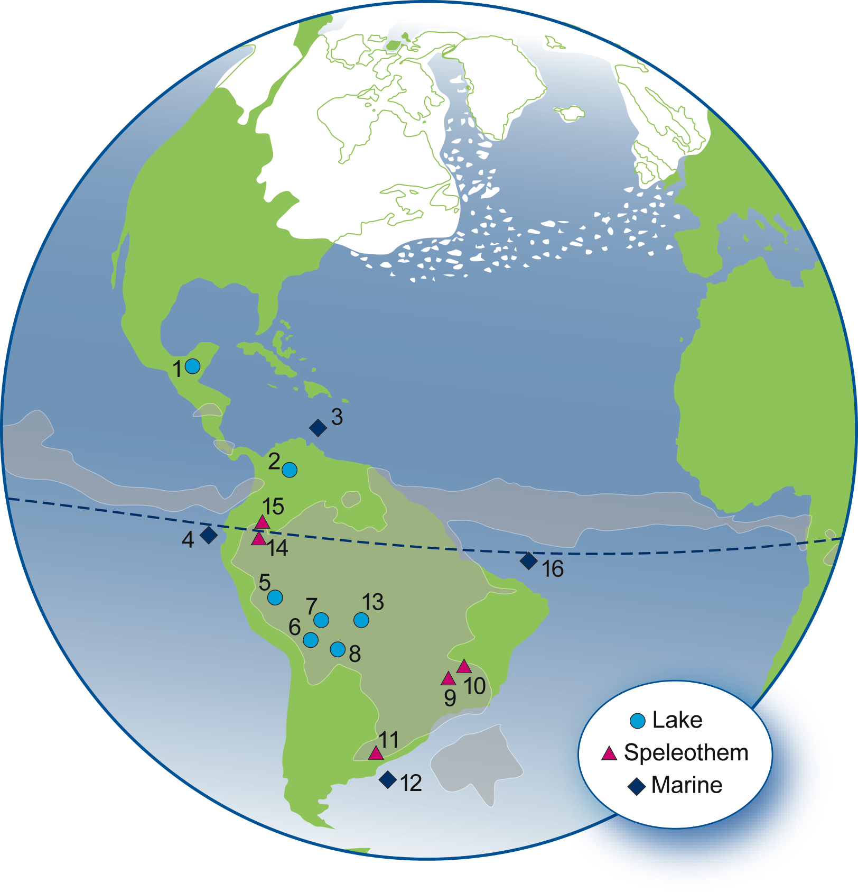
Notes:
Millennial-scale climate variability in the American tropics and subtropics
Dunia H. Urrego1,2, J.P. Bernal3, C.M. Chiessi4, F.W. Cruz5, M.F. Sanchez-Goñi2, M. Power6, H. Hooghiemstra7 and LaACERparticipants8
Figure 1: Sampling sites and schematic representation of a Heinrich event. White spots depict iceberg discharge in the Ruddiman belt (Ruddiman 2001). Gray areas represent the boreal-winter configuration of the ITCZ and the SASM based on average January rainfall measured between 1998-2009 (NASA TRMM). Locations of records mentioned in the text are numbered as follows: 1. Peten-Itza (Correa-Metrio et al. 2012; Escobar et al. 2012), 2. Fúquene (Bogotá et al. 2011; Groot et al. 2011; Hooghiemstra 1984), 3. Cariaco (González and Dupont 2009; Peterson et al. 2000), 4. M772-059 (Mollier-Vogel et al. 2013), 5. Junin (Hansen et al. 1994), 6. Titicaca (Baker et al. 2001; Fritz et al. 2010; Paduano et al. 2003), 7. Consuelo (Urrego et al. 2010), 8. La Gaiba (Whitney et al. 2011), 9. Lapa Sem Fim, and 10. Paixão (Strikis et al., pers. comm.), 11. Botuverá (Cruz et al. 2005), 12. GeoB6211–2 (Chiessi et al. 2008, 2009), 13. Chaplin (Mayle et al. 2000), 14. Cueva del Diamante (Cheng et al. 2013), 15. Santiago (Mosblech et al. 2012), 16. GeoB3104-1 (Arz et al. 1998).
AFFILIATIONS
1Geography, College of Life and Environmental Sciences, University of Exeter, UK
2Ecole Pratique des Hautes Etudes, University of Bordeaux, France
3Centro de Geociencias, Universidad Nacional Autónoma de México, Mexico
4Escola de Artes, Ciências e Humanidades, Universidade de São Paulo, Brazil
5Instituto de Geociências, Universidade de São Paulo, Brazil
6Natural History Museum of Utah, Department of Geography, University of Utah, USA
7Institute for Biodiversity and Ecosystem Dynamics, University of Amsterdam, The Netherlands
8http://ephe-paleoclimat.com/acer/LaACER.htm
CONTACT
Dunia H. Urrego: D.Urrego@exeter.ac.uk

Slide 38
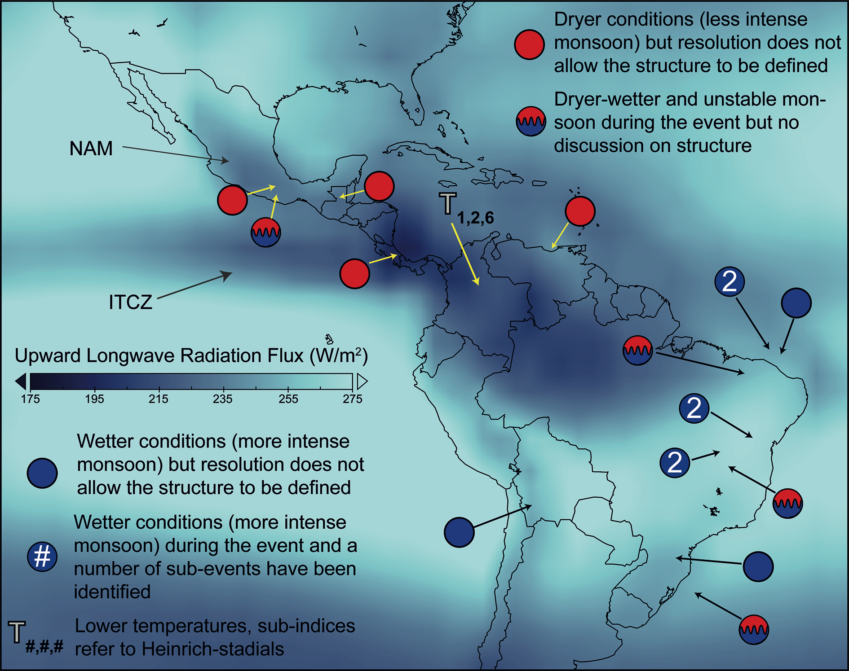
Notes:
Millennial-scale climate variability in the American tropics and subtropics
Dunia H. Urrego1,2, J.P. Bernal3, C.M. Chiessi4, F.W. Cruz5, M.F. Sanchez-Goñi2, M. Power6, H. Hooghiemstra7 and LaACERparticipants8
Figure 2: Average outgoing long-wave radiation for the period 1950-2008 (May-November) for the American tropics and subtropics as an indicator for convective activity (NCEP Reanalysis) showing the average position of the ITCZ and the NAM. Circles indicate the structure and signature of millennial-scale North Atlantic cooling stadials at different sites.
AFFILIATIONS
1Geography, College of Life and Environmental Sciences, University of Exeter, UK
2Ecole Pratique des Hautes Etudes, University of Bordeaux, France
3Centro de Geociencias, Universidad Nacional Autónoma de México, Mexico
4Escola de Artes, Ciências e Humanidades, Universidade de São Paulo, Brazil
5Instituto de Geociências, Universidade de São Paulo, Brazil
6Natural History Museum of Utah, Department of Geography, University of Utah, USA
7Institute for Biodiversity and Ecosystem Dynamics, University of Amsterdam, The Netherlands
8http://ephe-paleoclimat.com/acer/LaACER.htm
CONTACT
Dunia H. Urrego: D.Urrego@exeter.ac.uk

Slide 39
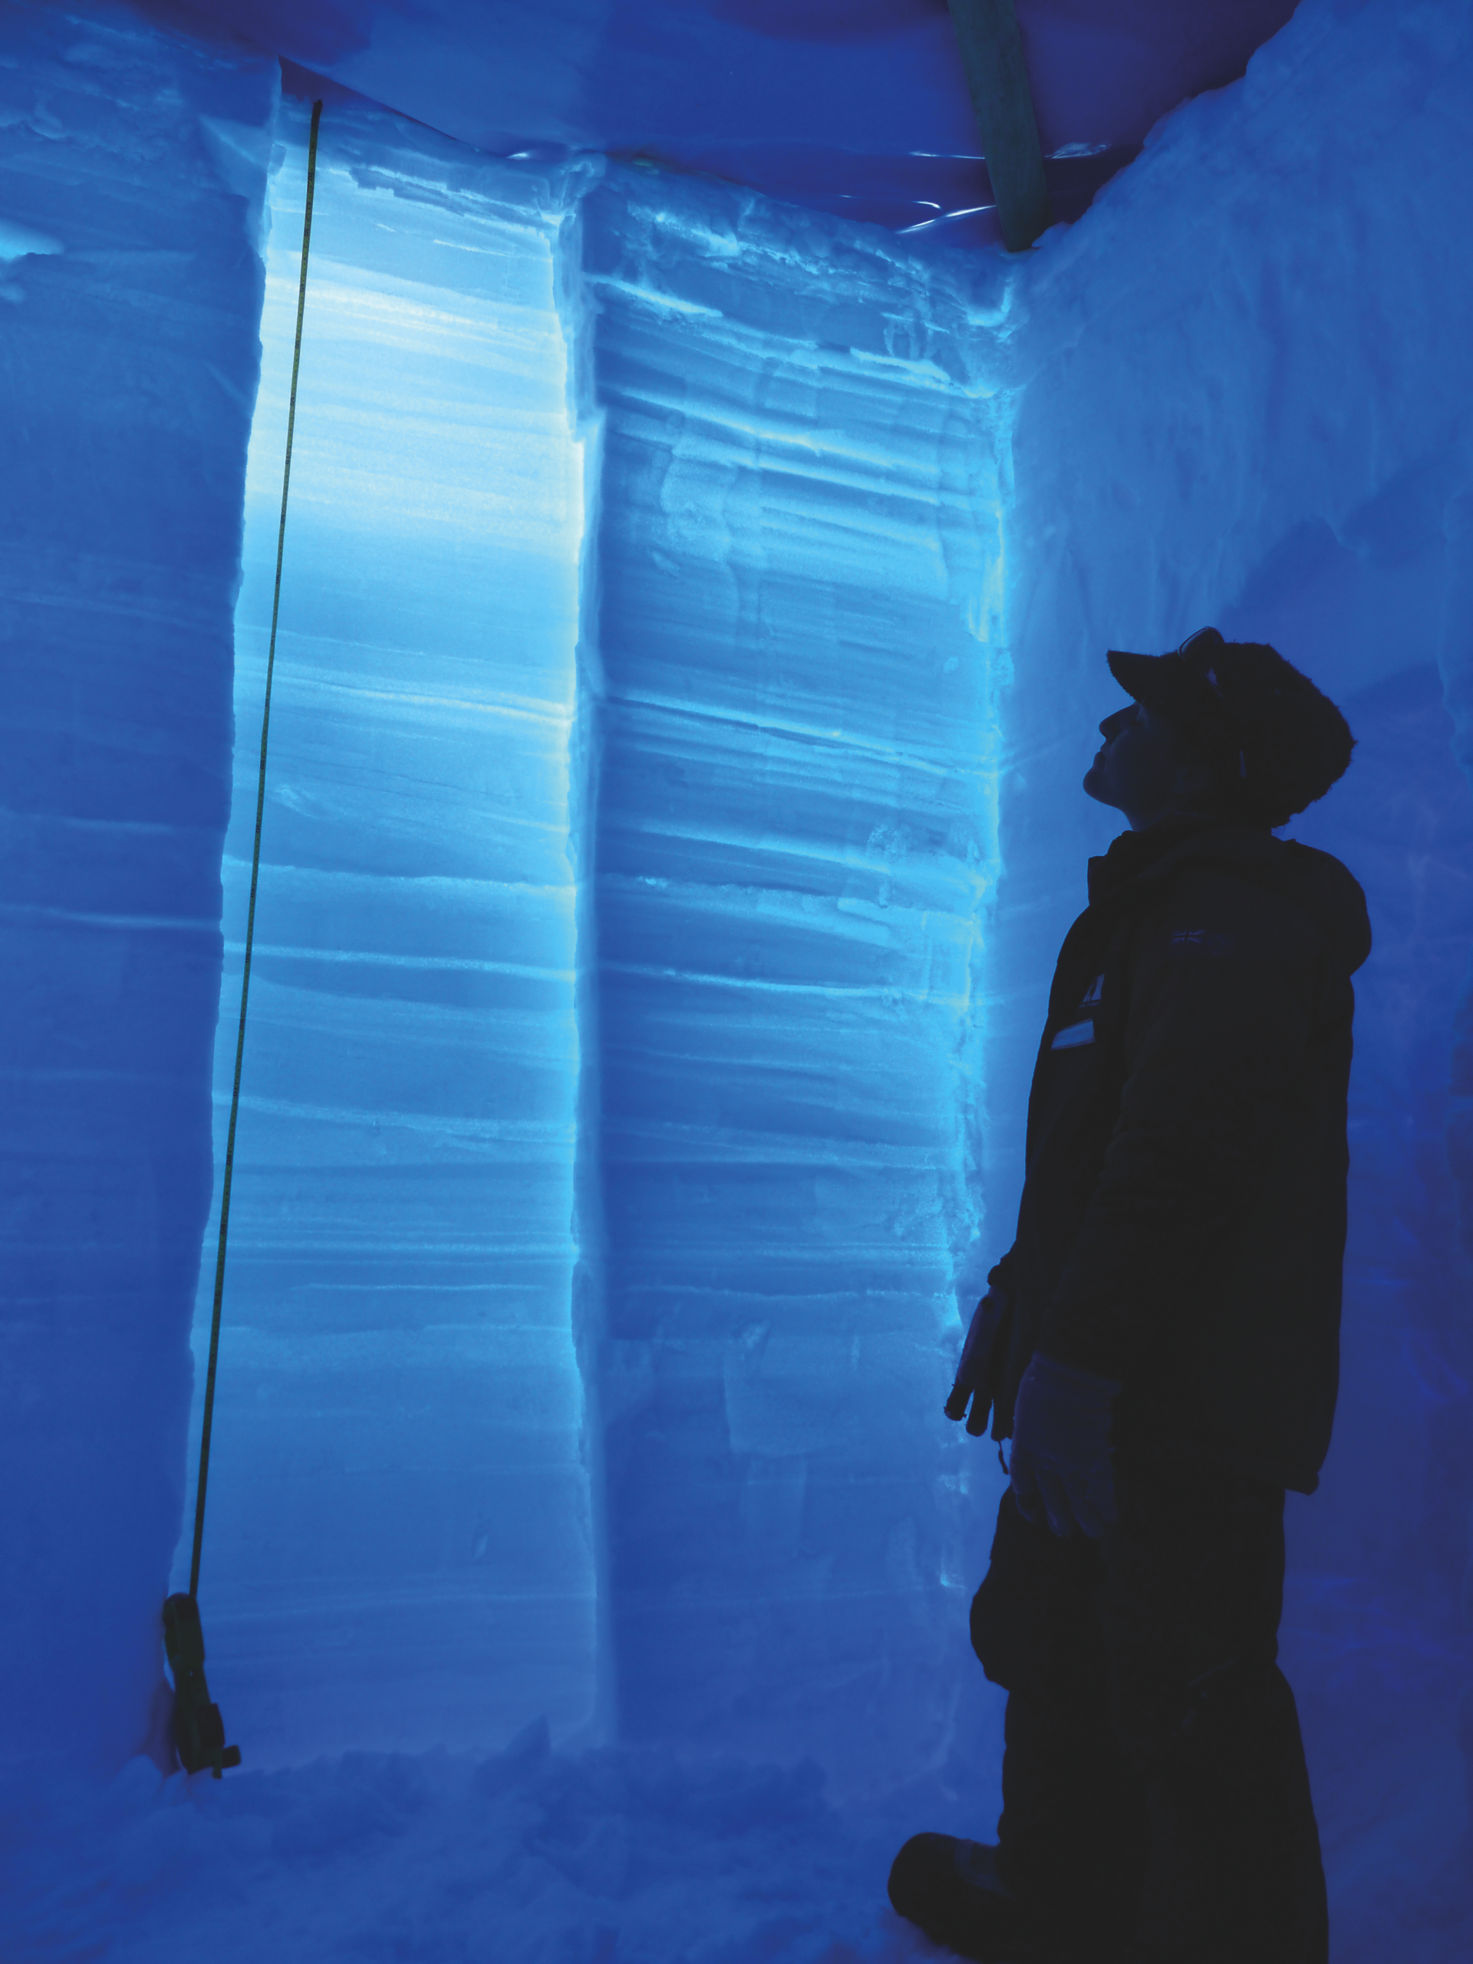
Notes:
Ice Core Young Scientists
Pascal Bohleber1, M. Cavitte2, B. Koffman3, B. Markle4, P. Pavlova5, M. Winstrup4 and H. Winton6
Figure 1: Lana Cohen (Victoria University of Wellington, New Zealand) examining storm layers in a snow pit on Roosevelt Island, Antarctica, 2010. Photo by Bradley Markle.
Website: www.pages-igbp.org/icys
LinkedIn: www.linkedin.com/groups?home= &gid=5053409&trk=anet_ug_hm Facebook: https://www.facebook.com/ groups/751731074891138/?fref=ts
AFFILIATIONS
1Climate Change Institute, University of Maine, USA 2Institute for Geophysics, University of Texas of Austin, USA 3Lamont-Doherty Earth Observatory of Columbia University, Palisades, USA 4Earth & Space Sciences, University of Washington, Seattle, USA 5Paul Scherrer Institut, Villigen, Switzerland 6John de Laeter Centre for Mass Spectrometry, Curtin University, Bentley, Australia
CONTACT
Holly Winton: icecoreys@gmail.com

Slide 40
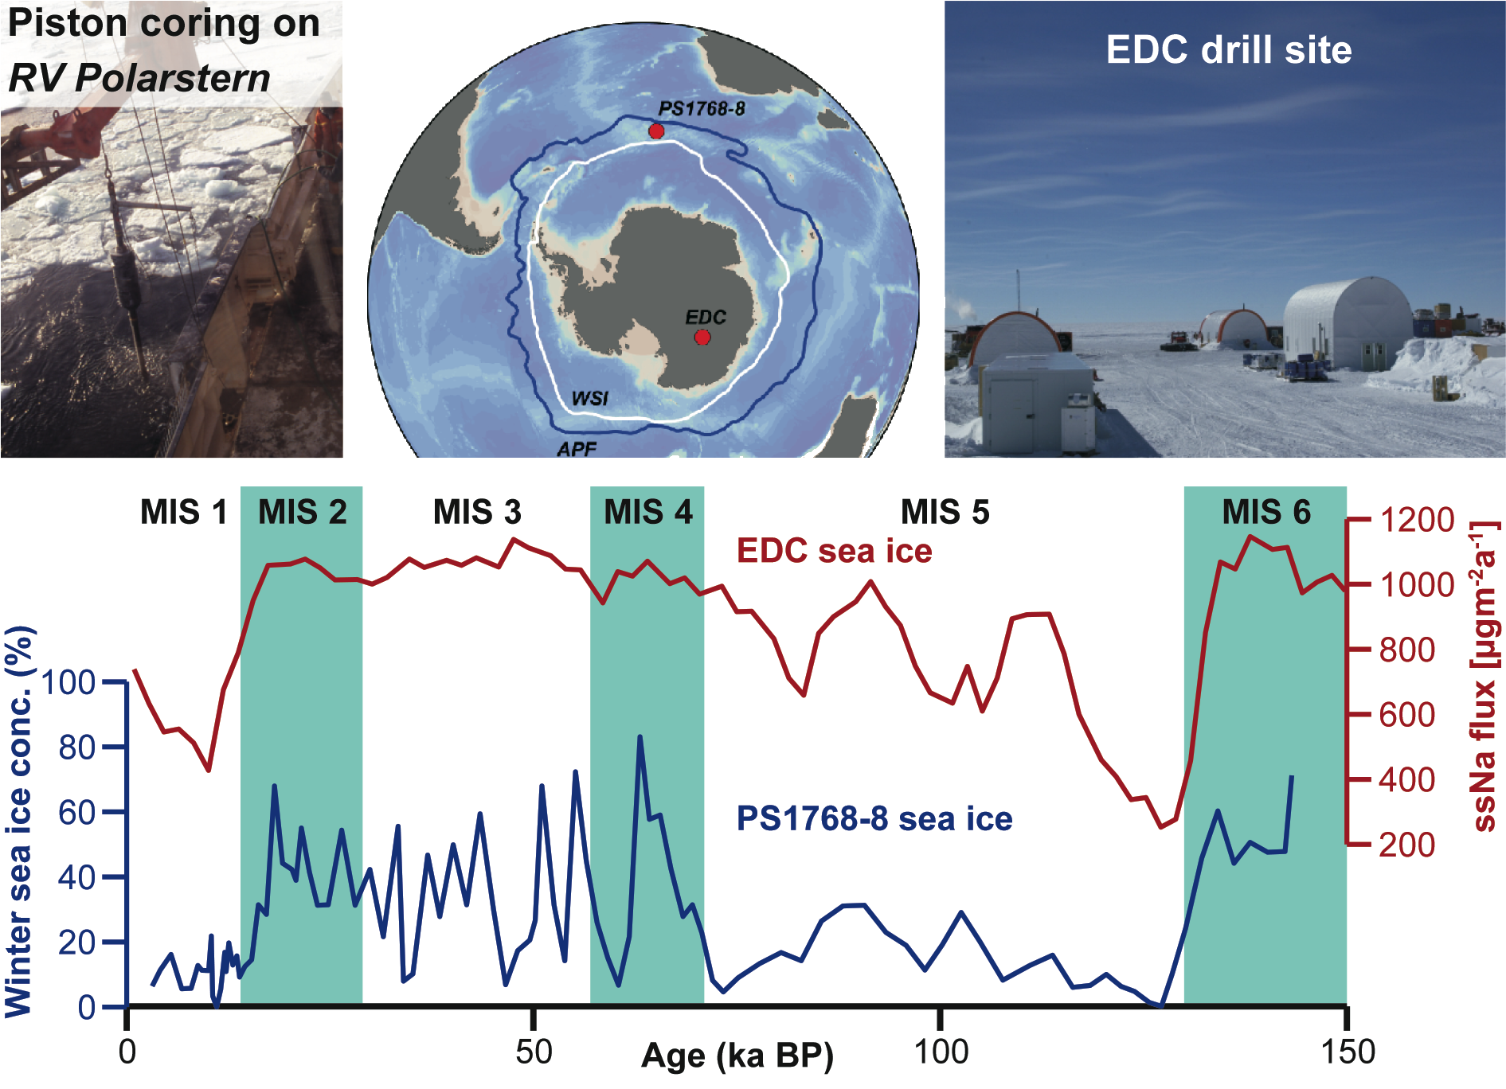
Notes:
Past sea ice reconstruction - proxy data and modeling
Rainer Gersonde1, A. de Vernal2 and E. W. Wolff3
Figure 1: Comparison of marine (PS1768-8) and ice core (EDC) records documenting Antarctic sea ice variability during the last climate cycle. In the middle top panel, the location of the EDCand the marine core are presented relative to the modern average winter sea ice extent (WSI, at 40% concentration) and the Antarctic Polar Front (APF). The records show concurring sea ice minima during the Marine Isotope Stages (MIS) 5 and 1, and similar sea ice retreat during the glacial/interglacial transitions. The marine record displays strong variability during MIS 2-4, while the ice core record shows a more stable signal. Data from Esper and Gersonde 2014 and Wolff et al. 2006.
AFFILIATIONS
1Alfred-Wegener-Institute Helmholtz Centre for Polar and Marine Research, Bremerhaven, Germany
2GEOTOP, Université du Québec à Montréal, Canada
3Department of Earth Sciences, University of Cambridge, UK
CONTACT
Rainer Gersonde: Rainer.Gersonde@awi.de

Slide 41
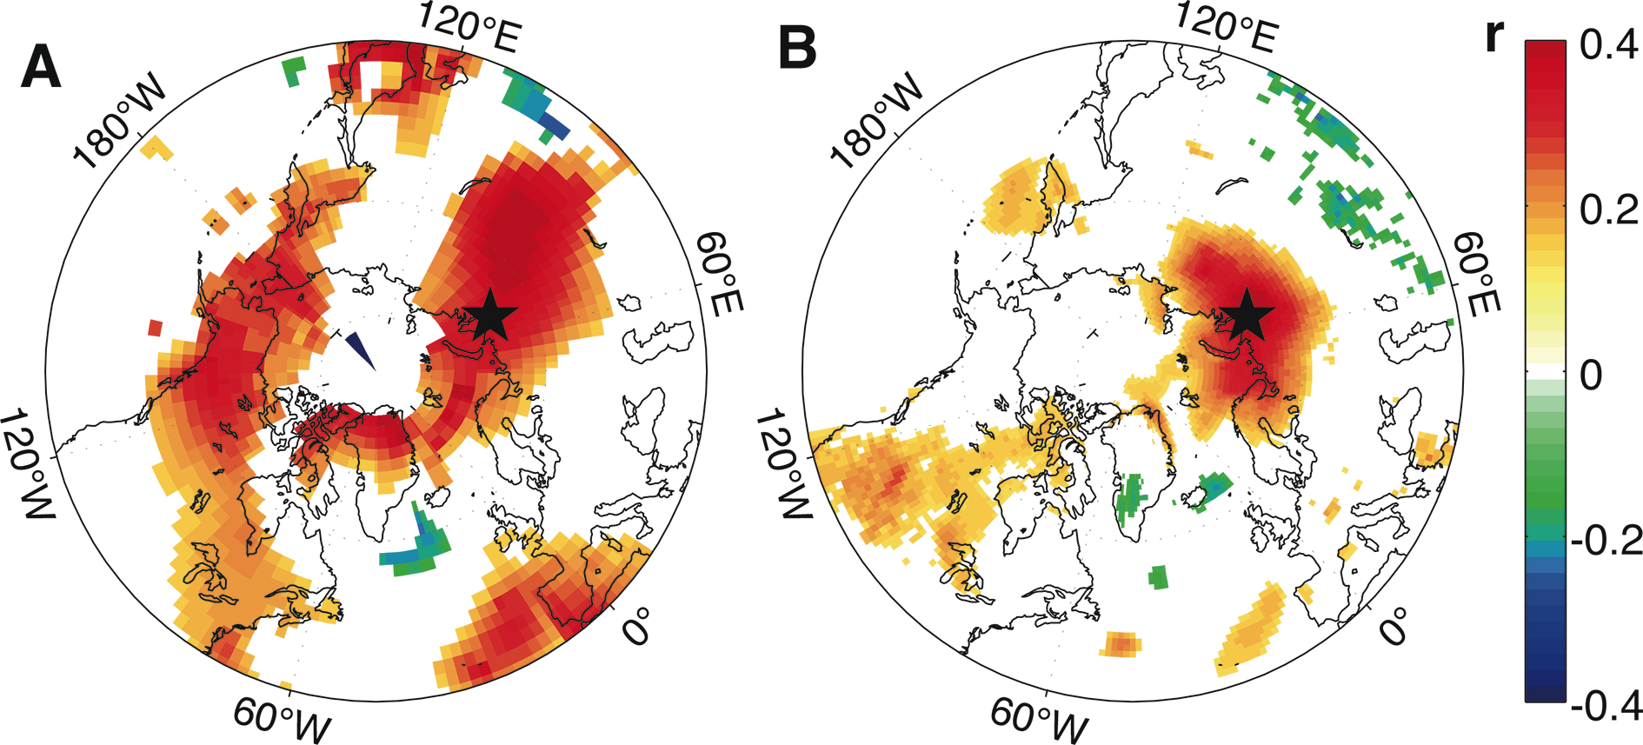
Notes:
PAGES2k: Advances in climate field reconstructions
Kevin J Anchukaitis1 and Nicholas McKay2
Woods Hole, United States, 15-16 April 2014
Figure 1: Correlation between March-August mean temperatures and (A) simulated pseudoproxy and (B) actual tree-ring chronologies from the Yamal Peninsula (Briffa et al. 2008; McKay and Kaufman 2014). The pseudoproxy series was created using simulated temperatures from the last millennium NCARCCSM4 simulation with additional Gaussian noise to mimic the signal-to-noise ratio of the actual chronology. Correlations for the pseudoproxy series are with the corresponding CCSM4 mean surface temperature field, while the actual Yamal chronology is correlated against the GISTEMP (Hansen et al. 2010) combined land-sea temperature field. The star indicates the location of the chronology.
AFFILIATIONS
1Department of Geology and Geophysics, Woods Hole Oceanographic Institution, Woods Hole, USA
2School of Earth Sciences and Environmental Sustainability, Northern Arizona University, Flagstaff, USA
CONTACT
Kevin Anchukaitis: kja@whoi.edu

Slide 42
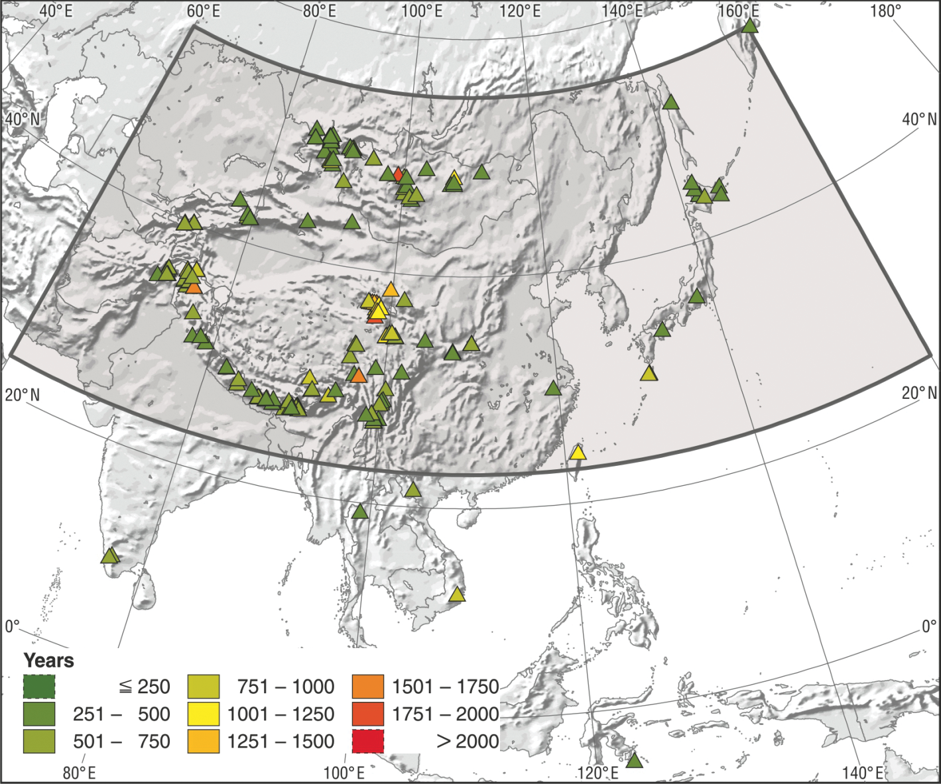
Notes:
Understanding and reconstructing the Asian climate of the last 2000 years
Quansheng Ge1, Z. Hao1, X. Shao1, H. Borgaonkar2, J. Luterbacher3, T. Nakatsuka4, M. Sano4, O. Solomina5 and L. Zhou6
3rd Asia2k workshop, Beijing, China, 26-27 May 2014
Figure 1: Phase I database of the Asia 2k group as published in the PAGES 2k Consortium paper (2013). A major task for the group is to add many of the available non-tree ring records to the database.
AFFILIATIONS
1Institute of Geographic Sciences and Natural Resources Research, Chinese Academy of Sciences, China;
2Indian Institute of Tropical Meteorology, Pune, India
3Department of Geography, Justus-Liebig-University Giessen, Germany
4Research Institute of Humanity and Nature, Kyoto, Japan
5Institute of Geography, Russian Academy of Sciences, Moscow, Russia
6Department of Geography, Peking University, Beijing, China
CONTACT
Zhixin Hao: haozx@igsnrr.ac.cn

Slide 43
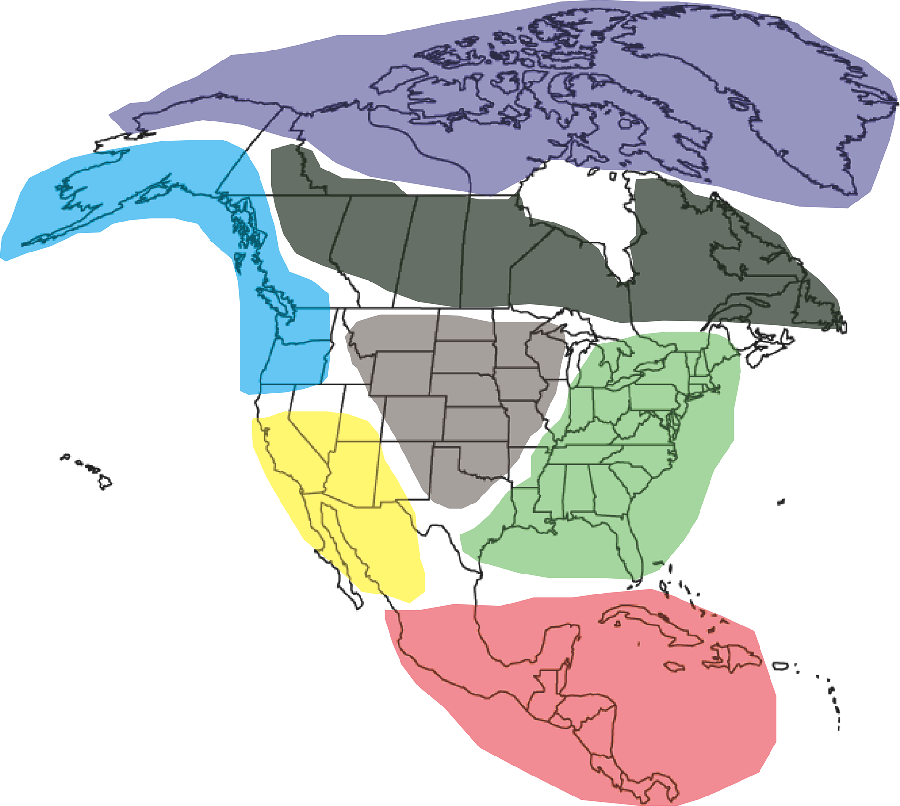
Notes:
A novel multiproxy approach: The PAGESNorth America 2k working group
Nicholas McKay
Fort Collins, USA, 23-26 June 2014
Figure 1: Preliminary delineation of sub-continental regions for multiproxy, pollen, and borehole temperature reconstructions. Regions will likely be adjusted to accommodate natural breaks in proxy data coverage.
AFFILIATIONS
School of Earth Sciences and Environmental Sustainability, Northern Arizona University, Flagstaff, USA
CONTACT
Nicholas McKay: Nicholas.McKay@nau.edu

Slide 44
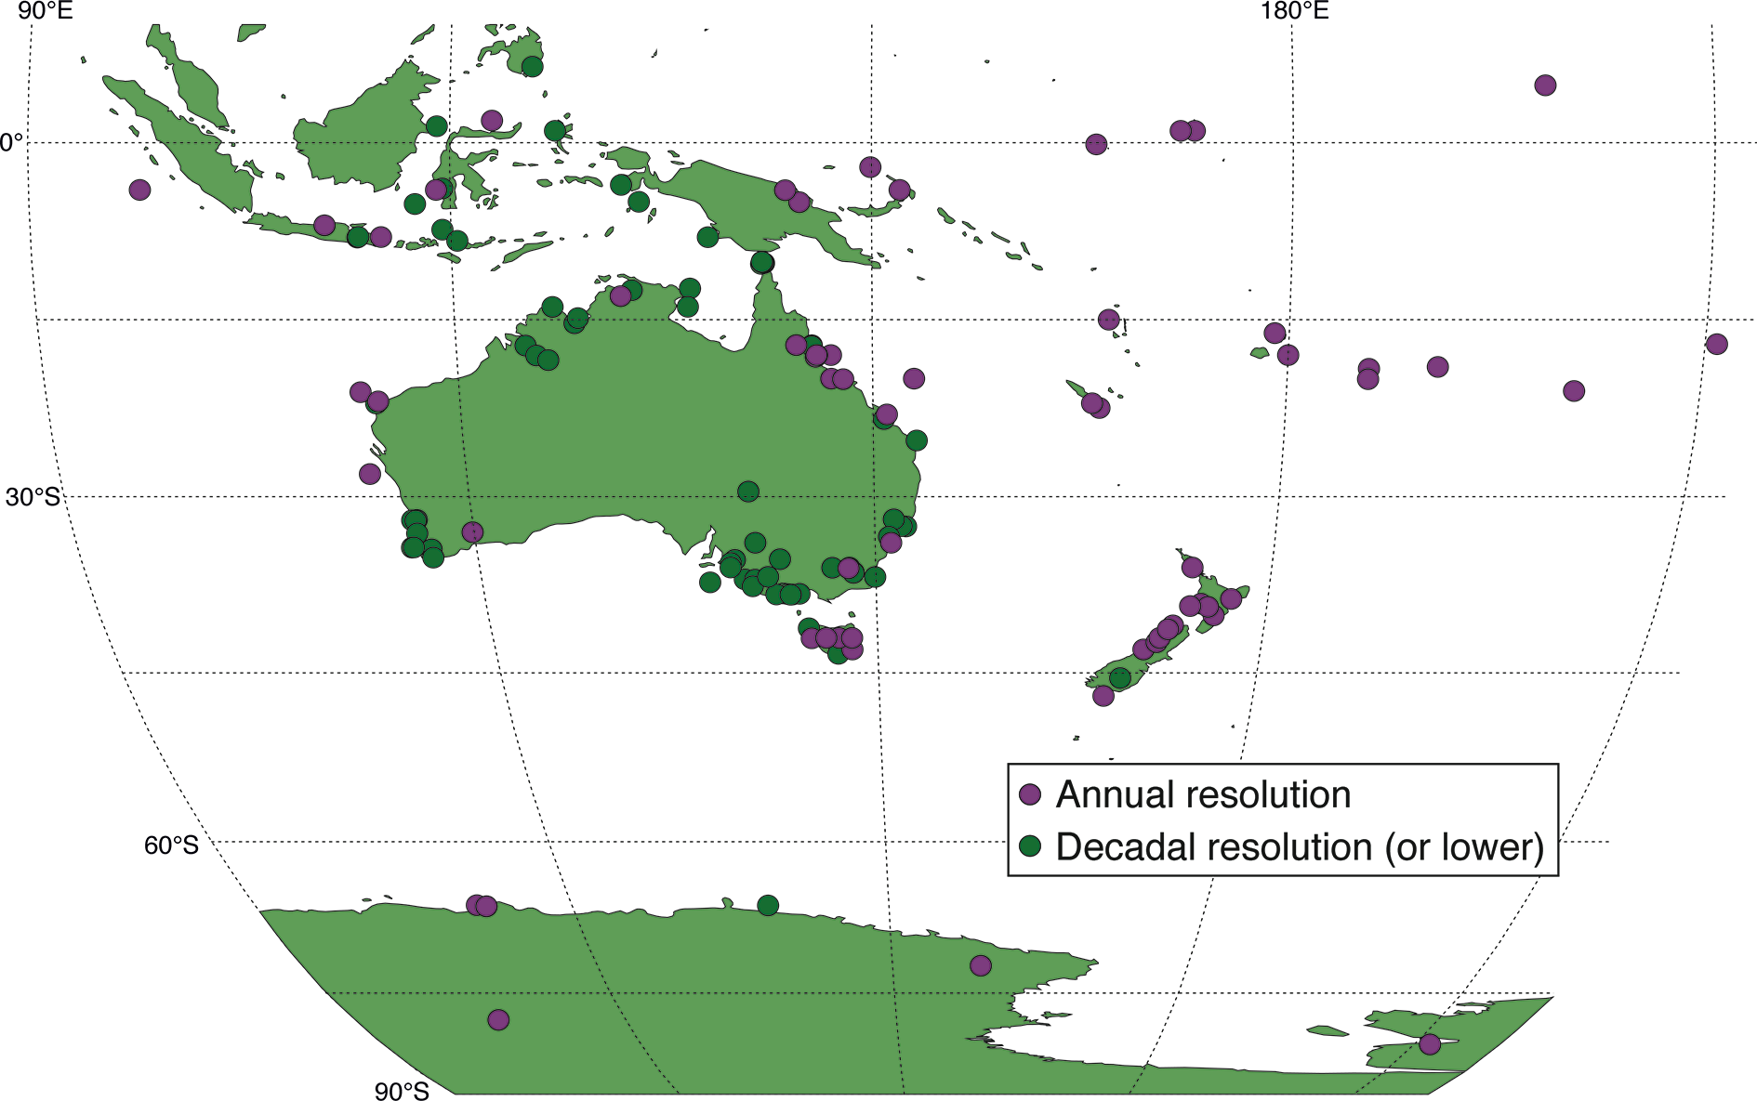
Notes:
Australasia’s climate variability: clues drawn from paleoclimate and model data over the last 2000 years
Joëlle Gergis1, P. Hope2, N. Abram3 and B. Henley1
3rd Aus2k workshop - 26-27 June 2014, Melbourne, Australia
Figure 1: Locations of annually resolved and lower resolution paleoclimate archives in the Australasian region.
A longer version of this workshop report is available online at www.pages-igbp.org/calendar/2014/127-pages/1198-accsp-aus2k-wshop
AFFILIATIONS
1School of Earth Sciences, University of Melbourne, Australia
2Australian Bureau of Meteorology, Melbourne, Australia
3Research School of Earth Sciences, Australian National University, Canberra, Australia
CONTACT
Joëlle Gergis: jgergis@unimelb.edu.au

Slide 45
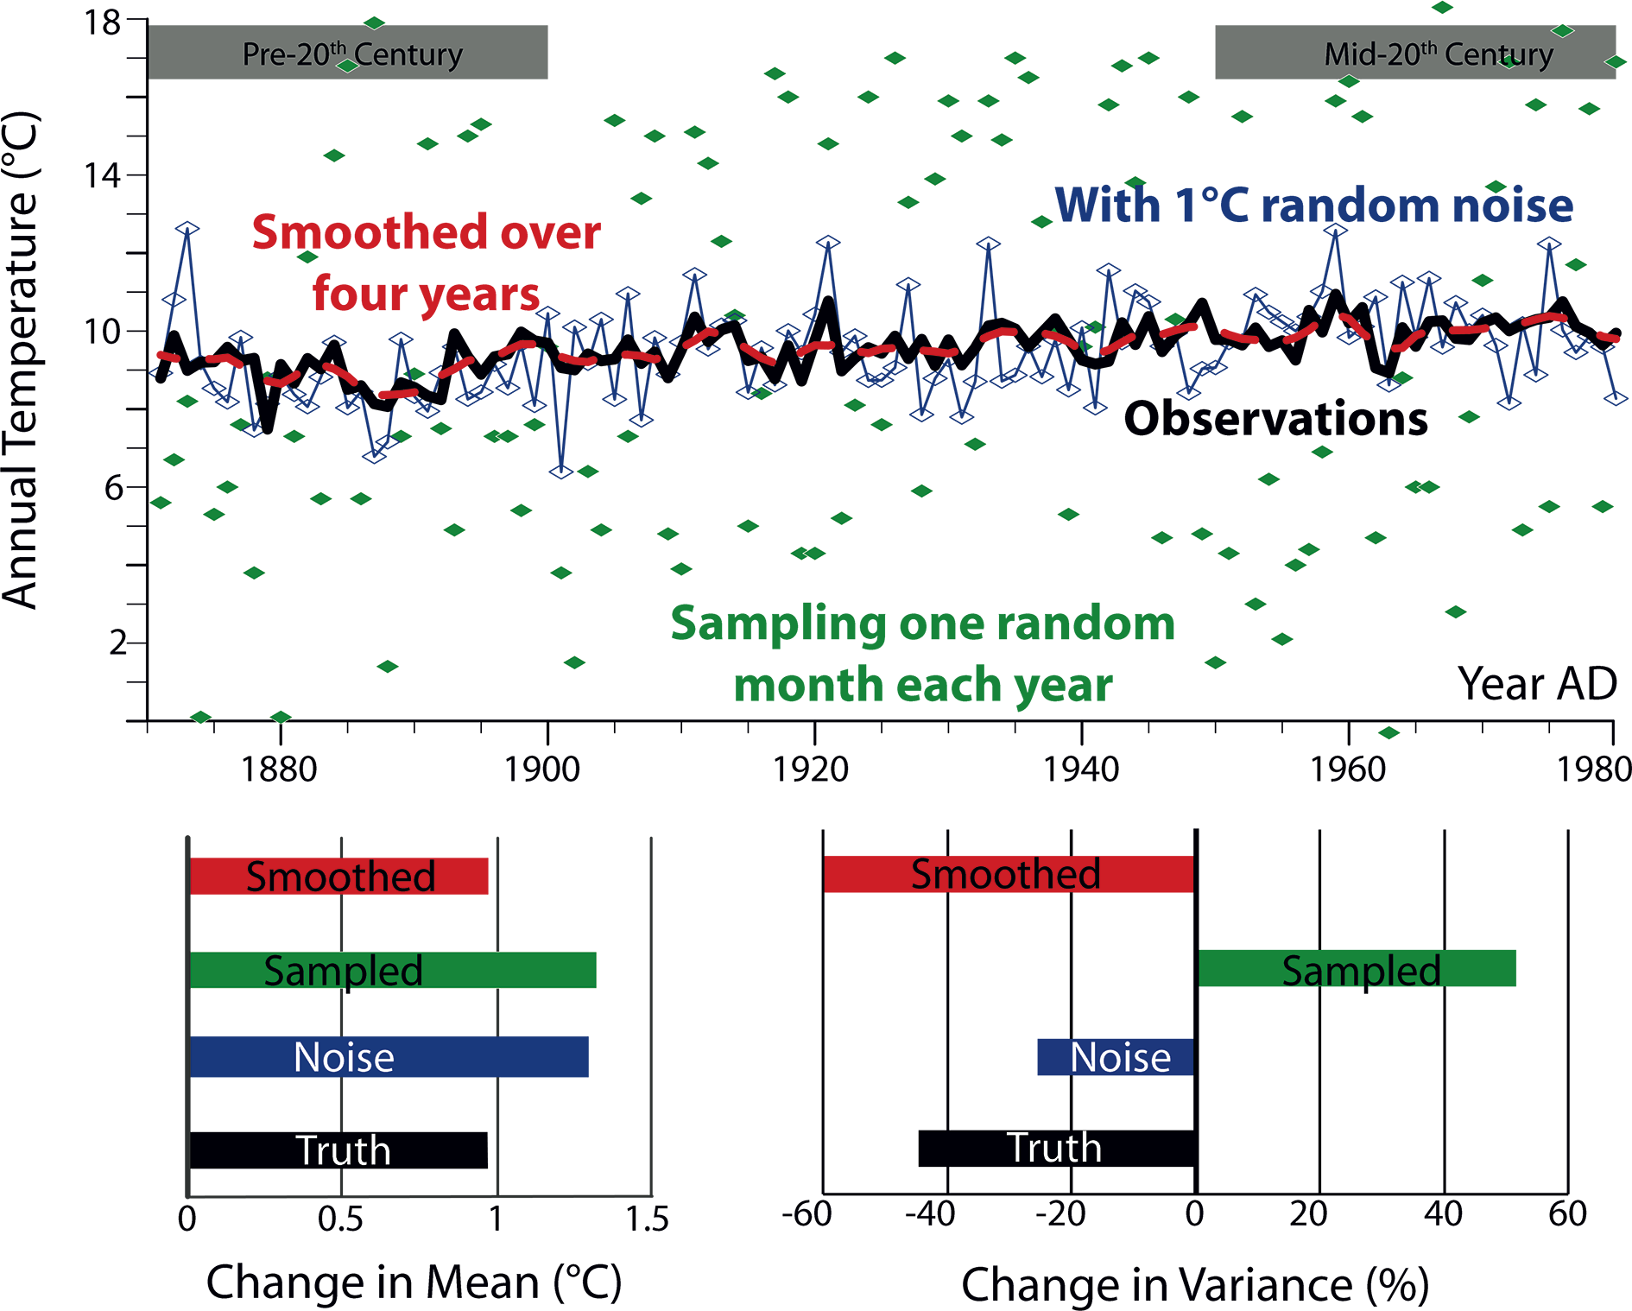
Notes:
Paleovariability: Data Model Comparisons
Chris Brierley1 and Kira Rehfeld2
London, UK, 12-14 March 2014
Figure 1: Annual temperatures measured at Kew Gardens, London (Peterson and Vose 1997) as an example of the three potential factors’ impacting climate variability. Neither adding random noise (e.g. instrumental error), nor smoothing (e.g. bioturbation), nor snapshot-type sampling (e.g. individual organisms that only live for a single random month) substantially alters the roughly 1°Cof warming; however, the normalized estimates of variability differ in both magnitude and even sign.
AFFILIATIONS
1University College London, UK
2Alfred Wegener Institute, Helmholtz Centre for Polar and Marine Research, Potsdam, Germany
CONTACT
Chris Brierley: c.brierley@ucl.ac.uk

Slide 46
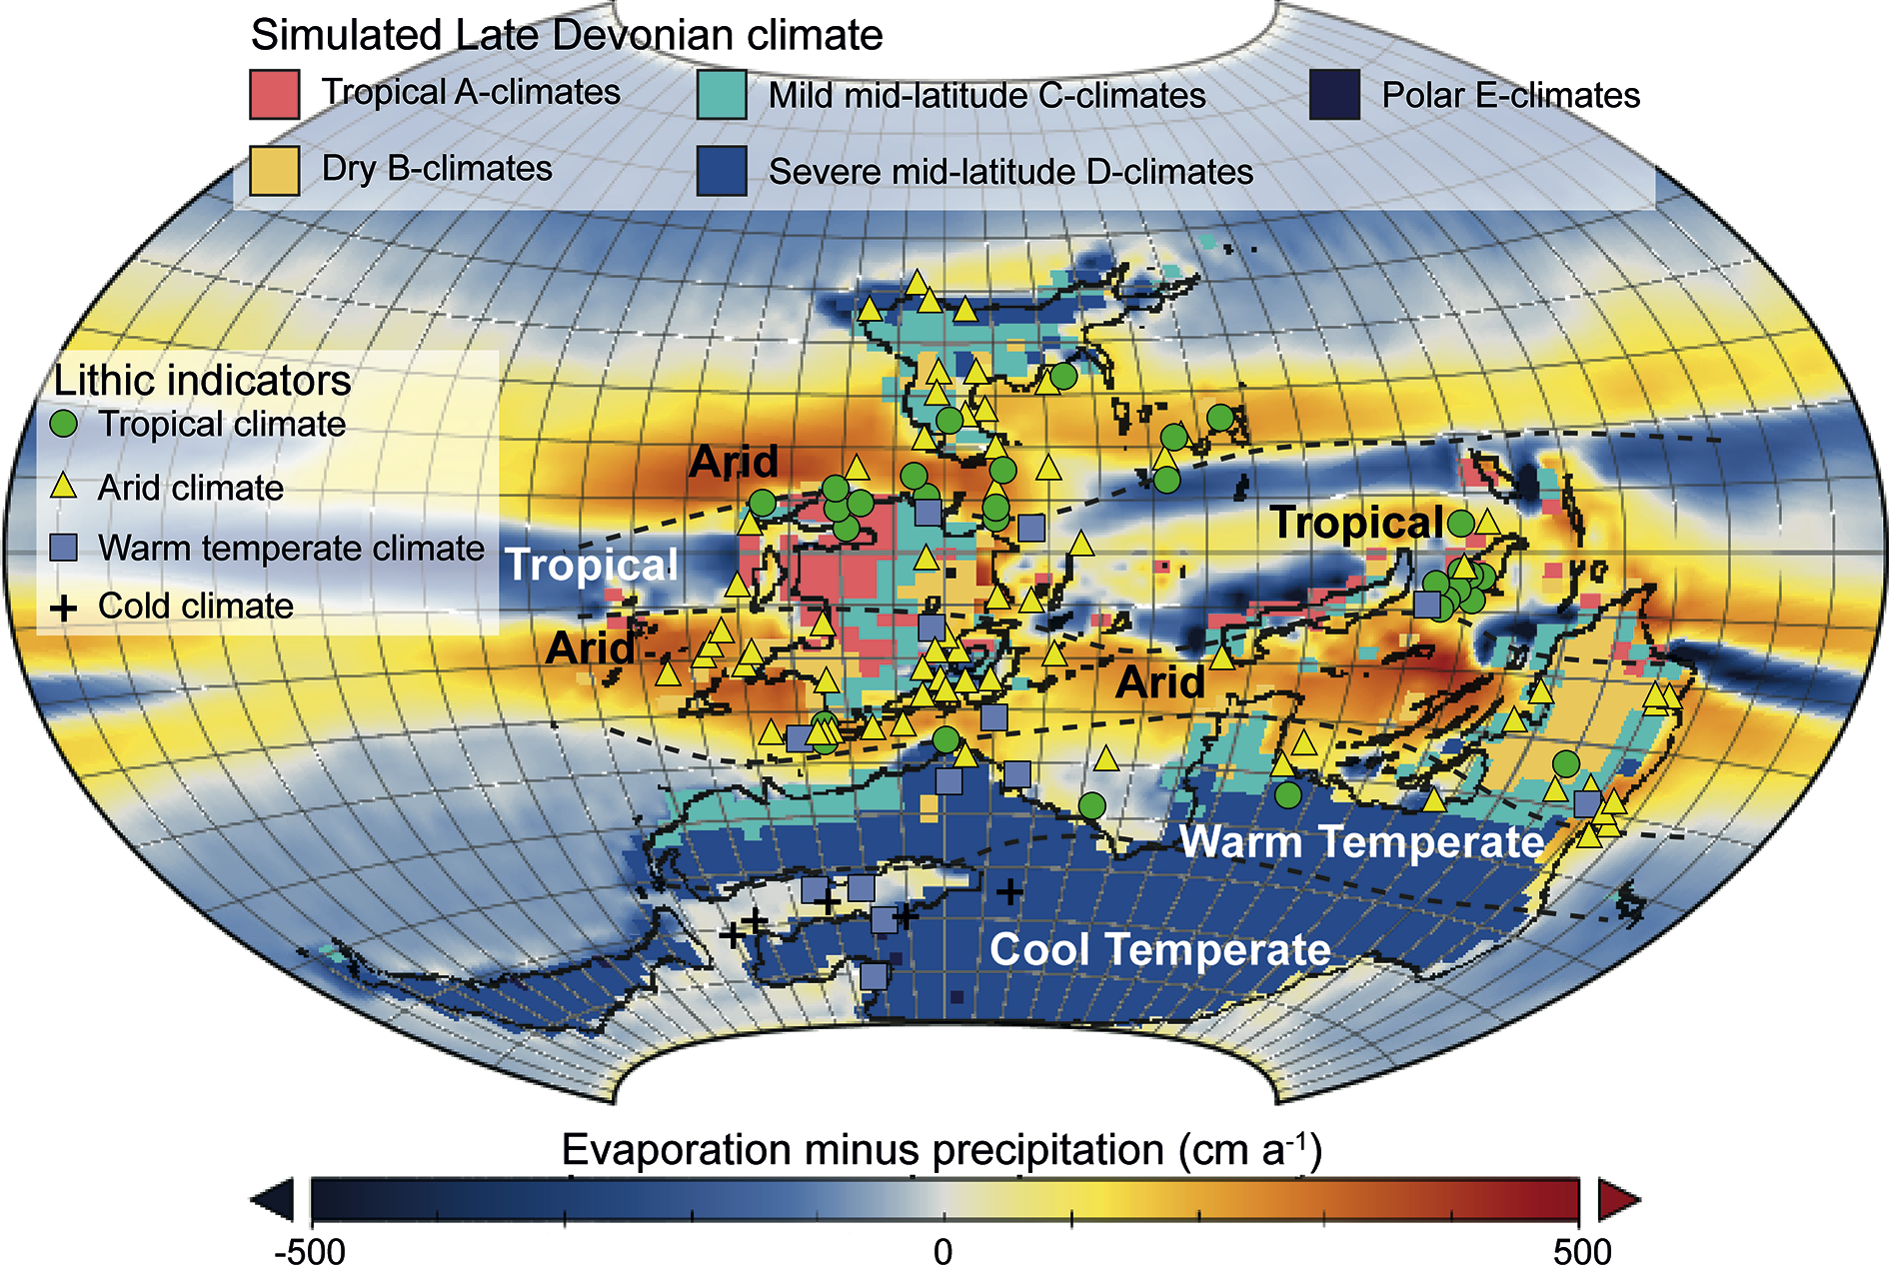
Notes:
Third general meeting of PMIP3
Michel Crucifix1, E. Zorita2 and J.-Y. Peterschmitt3
Namur, Belgium, 25-30 May 2014
Figure 1: Data-Model comparison for a "median orbit" Late Devonian simulation. The HadSM3 slab model simulated climate types and evaporation minus precipitation data are compared to lithic indicators of paleoclimate (PALEOMAP project; Scotese and Barrett 1990). Modified from De Vleeschouwer et al. 2014.
AFFILIATIONS
1Georges Lemaître Centre for Earth and Climate Research, Université catholique de Louvain, Louvain-la- Neuve, Belgium
2Institute for Coastal Research, Helmholz-Zentrum, Geesthacht, Germany
3Laboratoire des Sciences du Climat et de l'Environnement, Institut Pierre et Simon Laplace, Gif-sur- Yvette, France
CONTACT
Michel Crucifix: michel.crucifix@uclouvain.be

Slide 47
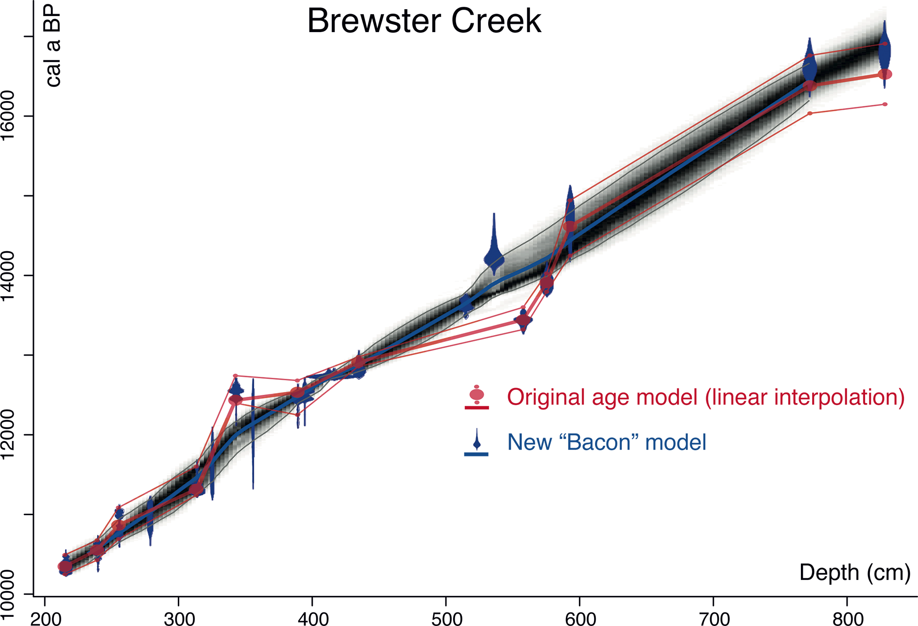
Notes:
Age models, chronologies, and databases workshop
Eric C. Grimm1, M. Blaauw2, C.E. Buck3 and J.W. Williams4
Belfast, UK, 13-16 January 2014
Figure 1: New Bayesian age model for the Brewster Creek (USA) site produced by the Bacon program (Blaauw and Christen 2011) overlaid with the published classical model (Curry et al 2007). The original model is based on the IntCal04 calibration curve, linear interpolation, and ad hoc rejection of reversed dates; while the Bacon model is based on the IntCal13 curve and can accommodate reversed dates. The gray-scale shading represents the relative probability within the 95% higher posterior density region (or Bayesian confidence interval). The thick red line is the linear interpolation between the median probabilities of the calibrated ages in the original model; the thin red lines connect the 95% confidence limits of the calibrated ages but are not a valid statistical representation of the confidence limits of the interpolated ages.
AFFILIATIONS
1Illinois State Museum, Springfield, USA
2School of Geography, Archaeology and Palaeoecology, Queen’s University Belfast, Northern Ireland, UK
3School of Mathematics and Statistics, University of Sheffield, UK
4Department of Geography, University of Wisconsin- Madison, USA
CONTACT
Eric C. Grimm: grimm@museum.state.il.us

Slide 48
Notes:
“Paleoecological data analysis with R” course for Latin American researchers
Julieta Massaferro1, L. Pérez2, M.E. de Porras3, L. Pérez Becoña4, M. Tonello5 and S. Juggins6
San Carlos de Bariloche, Argentina, 31 March- 6 April 2014
Figure 1: (A) Non-metric multidimensional scaling (NMDS) of a set of pollen samples from modern rodent middens collected along a climatic and vegetation gradient in the Atacama Desert (21°S). The numbers represent the altitudes the samples were taken at. (B) A two-way ordered bubble plot of freshwater ostracods along an altitudinal gradient in Central America. Altitude increases from left to right in the plot, with lowlands <500 and highlands from 500-2000 m a.s.l Size of dots represents species richness. (C) Canonical Correspondence Analysis of diatom data (1960-2009 AD) in a sediment core from Río de la Plata (red), climate indexes (PDO and ENSO), and anomalies in the discharges of the Paraná and Uruguay river discharges (blue arrows).
AFFILIATIONS
1Programa de estudios aplicados a la conservación de la Biodiversidad (CENAC/APN), Bariloche, Argentina
2Instituto de Geología, Universidad Nacional Autónoma de México, México
3Center for Advanced Research in Arid Zones, La Serena, Chile
4Institute of Ecology and Environmental Sciences, University of the Republic, Montevideo, Uruguay
5Institute for Marine and Coastal Research, National University of Mar del Plata, Argentina
6School of Geography, Politics and Sociology, Newcastle University, UK
CONTACT
Julieta Massaferro: julimassaferro@hotmail.com

Slide 49
Notes:
Towards a more accurate quantification of human-environment interactions in the past
Gert Verstraeten
Leuven, Belgium, 3-7 February 2014
Figure 1: One of the themes discussed during the workshop is the quantification of historic soil erosion and sedimentation following human disturbance. The time-differentiated sediment budget for the Dijle catchment shows the changing importance of colluvial and alluvial storage as well as sediment yield through time. Not only the absolute increase in human-induced land cover change, but also its spatial patterns explain the observed changes in the sediment record. The entire system behaves non-linearly and is characterized by tipping points, which change the coupling relationship between hillslopes, river channels and floodplains. Adapted from Verstraeten (2012).
AFFILIATIONS
Department of Earth and Environmental Sciences & Center for Archaeological Sciences, University of Leuven, Belgium
CONTACT
Gert Verstraeten: gert.verstraeten@ees.kuleuven.be

Slide 50
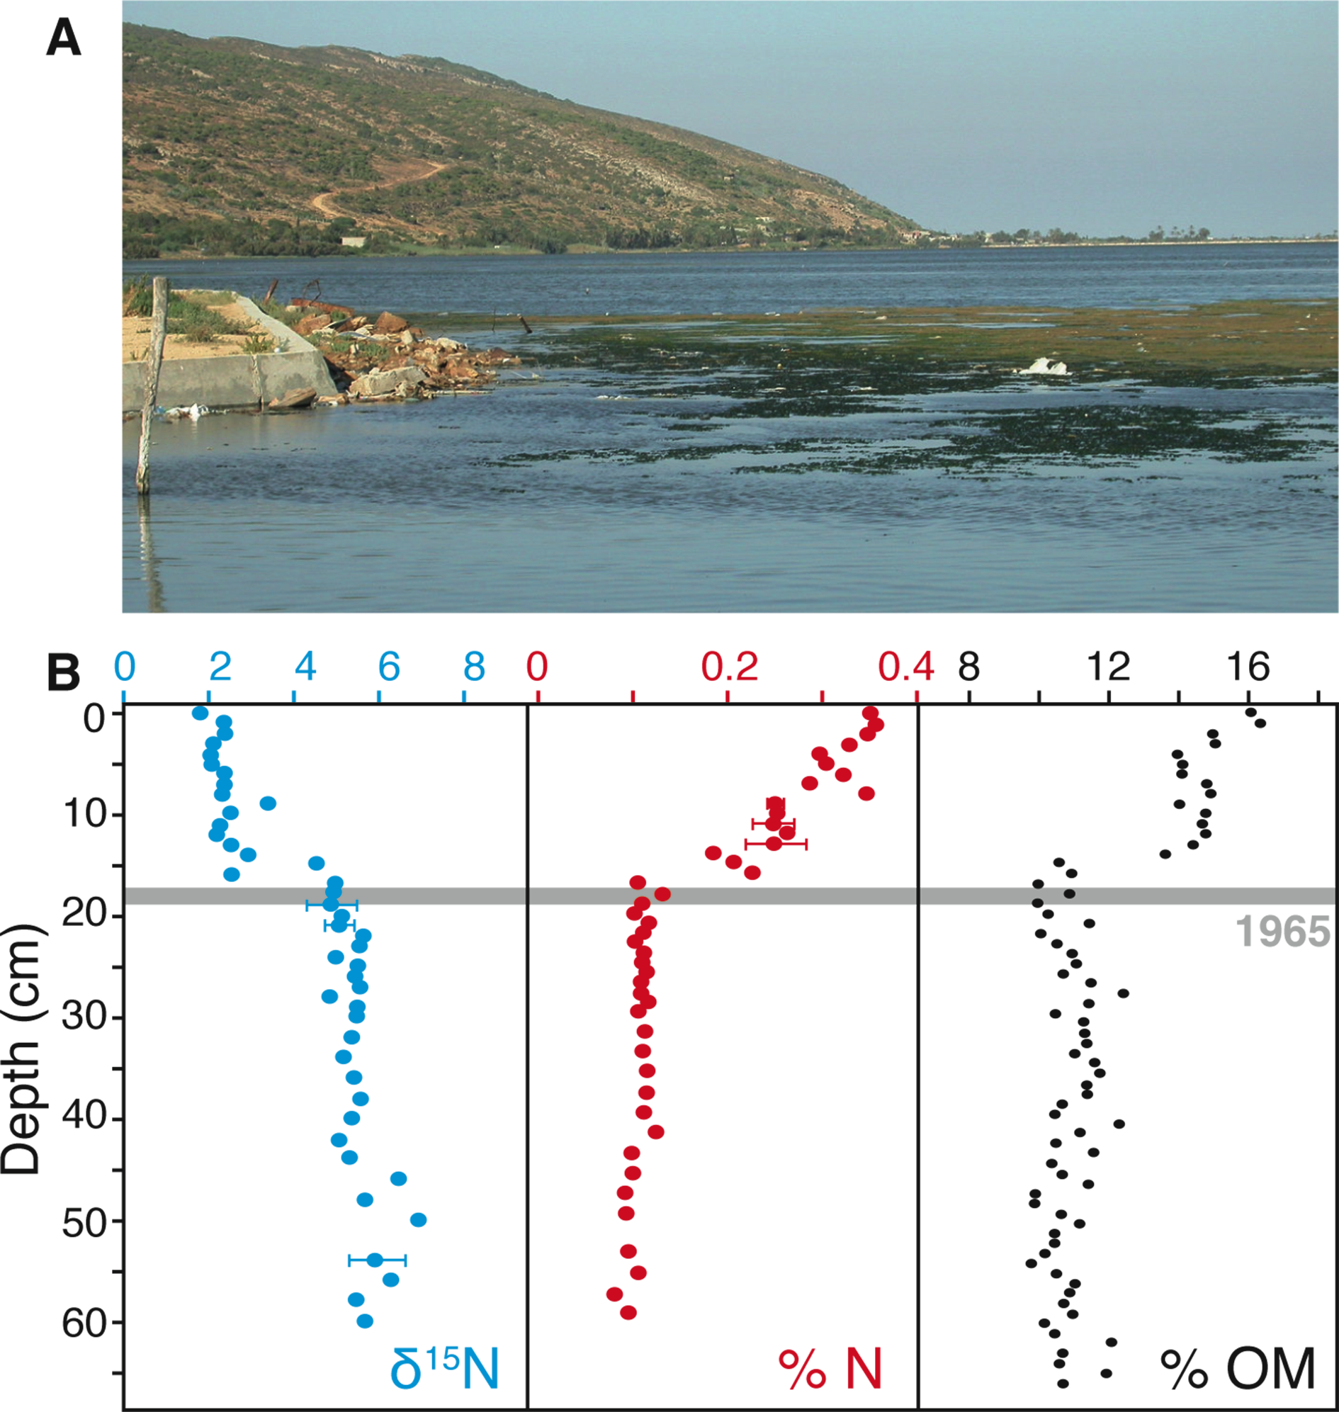
Notes:
Ramsar Wetlands: Understanding Change in Ecological Character
Peter Gell1, O. Burge2 and R. Flower3
Queenscliff, Australia, 6-8 November 2013
Figure 1: (A) Recent eutrophication of the coastal lagoon of Ghar El Melh (Tunisia) is currently manifested by development of green filamentous algal mats and excessive growth of Ulva rigida. (B) Sedimentary profiles for δ15N, percentage nitrogen and percentage organic matter in a dated sediment core from this lagoon indicate marked environmental changes occurred during the 1960s following the introduction of agro-chemical methods and artificial fertilizers (from Oczkowski et al. 2011).
AFFILIATIONS
1Collaborative Research Network, Federation University Australia, Ballarat, Australia;
2School of Biological Sciences, University of Canterbury, New Zealand
3Environmental Change Research Centre, University College London, UK
CONTACT
Peter Gell: p.gell@federation.edu.au

Slide 51
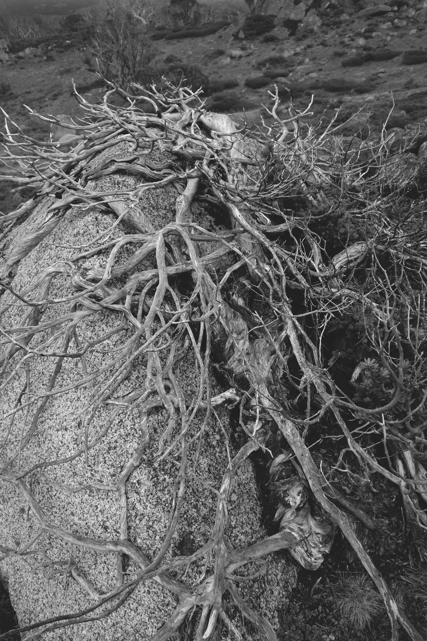
Notes:
Dendrochronology heats up Down Under
Patrick J. Baker
9th International Conference on Dendrochronology - Melbourne, Australia,13-17 January 2014
Figure 1: Fire-killed Podocarpus lawrencei from the Snowy Mountains of New South Wales, Australia. A new multi-century tree-ring chronology from Podocarpus lawrencei presented by Matt Brookhouse (ANU) and colleagues is the first of its kind from the southeastern Australian mainland.
AFFILIATIONS
Department of Forest and Ecosystem Science, University of Melbourne, Australia
CONTACT
Patrick J. Baker: patrick.baker@unimelb.edu.au

Slide 52
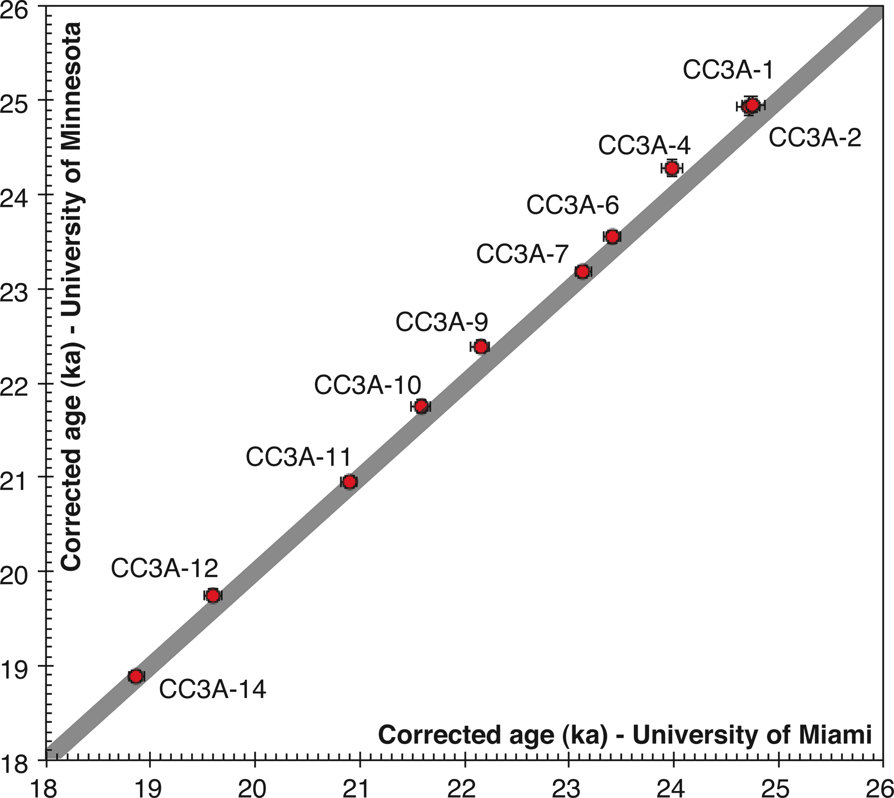
Notes:
Cast, cut, sample and analyze: A practical approach to processing speleothems for paleoclimate reconstruction
Ali Pourmand
Miami, USA, 12-14 May 2014
Figure 1: Comparison between U-Th ages determined at the University of Minnesota and the University of Miami on a speleothem from Cathedral Cave, Utah (Modified from Pourmand et al. 2014).
AFFILIATIONS
Department of Marine Geosciences, Rosenstiel School of Marine and Atmospheric Science, The University of Miami, USA
CONTACT
Ali Pourmand: apourmand@rsmas.miami.edu

Slide 53
Notes:
Mediterranean Holocene climate and human societies
Karin Holmgren1, M.-A. Sicre2, A. Gogou3, E. Xoplaki4 and J. Luterbacher4
Messinia, Greece, 23-25 April 2014
Figure 1: Having the workshop in Greece – a country rich in archeology, history and social dynamics – inspired the participants in their creative discussions on climate, environment, people and their societies. Photo: Poseidon Temple in Cape Sounion, Attica Peninsula (by Nikolas Lambrou).
AFFILIATIONS
1Navarino Environmental Observatory (NEO) and Bolin Centre for Climate Research, Stockholm University, Sweden
2LOCEAN, Sorbonne University, Paris, France
3Institute of Oceanography, Hellenic Centre for Marine Research, Anavyssos, Greece
4Department of Geography, Justus-Liebig University Giessen, Germany
CONTACT
Karin Holmgren: Karin.holmgren@natgeo.su.se

Slide 54
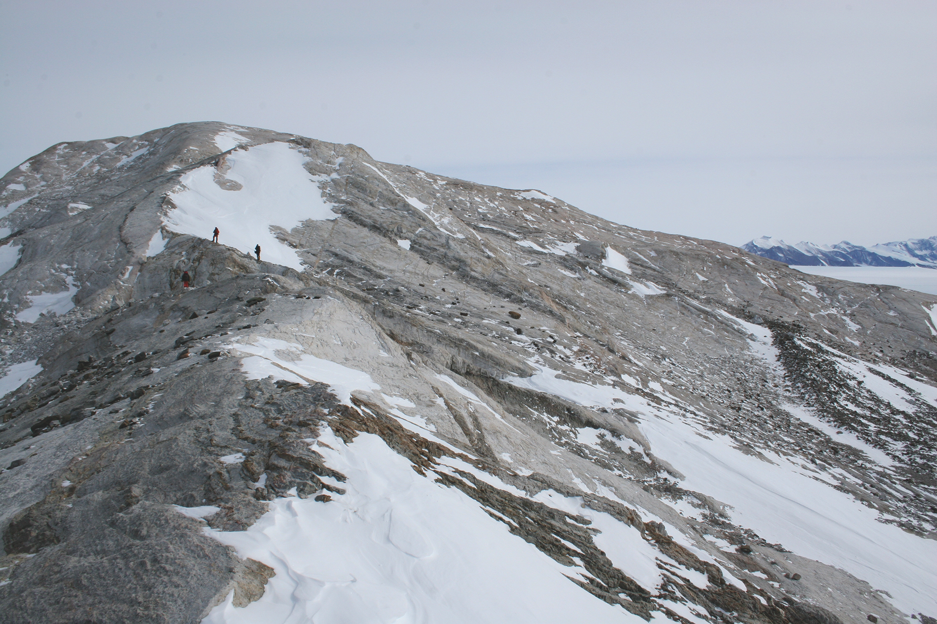
Notes:
Modeling and data perspectives on reconstructing Late Pleistocene ice sheets
Pippa L. Whitehouse1 and Lev Tarasov2
Grenoble, France, 22-24 May 2014
Figure 1: Erratics scattered on the bedrock surface of a nunatak in the Ellsworth Mountains, Antarctica. Cosmogenic exposure ages on such erratics can determine the timing of ice-sheet thinning. Photo: M. Bentley.
AFFILIATIONS
1Department of Geography, Durham University, UK
2Department of Physics and Physical Oceanography, Memorial University of Newfoundland, St John's, Canada
CONTACT
Pippa L. Whitehouse: pippa.whitehouse@durham.ac.uk

Slide 55
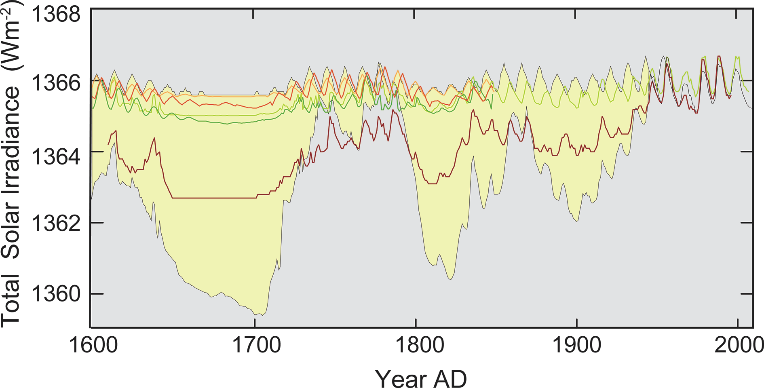
Notes:
Constraining Holocene solar forcing by “detection and attribution”
Jürg Beer
2nd Solar Forcing Workshop, Davos, Switzerland, 20-23 May 2014
Figure 1: Seven reconstructions of total solar irradiance for the past 400 years (for details see Schmidt et al. 2012).
AFFILIATIONS
Eawag, Swiss Federal Institute of Aquatic Science and Technology, Dübendorf, Switzerland
CONTACT
Jürg Beer: beer@eawag.ch

